Slide 1
Platform Driver

Slide 2
Platform Driver
A Driver model interface to the platform bus
Used to integrate peripherals on many SOC processors
The platform devices are the devices that are directly
connected to the CPU, without any kind of bus.
Platform devices is not a char device ,block device and
network device

Slide 3
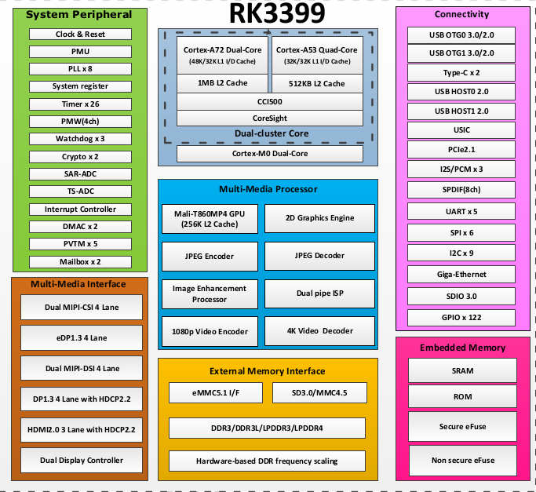
Platform Driver

Slide 4
Platform Driver Model
linux/platform_device.h
Other driver
Platform bus
Platform device
Platform driver
pseudo-bus
bus
device
driver
Kobject/kset/ktype

Slide 5
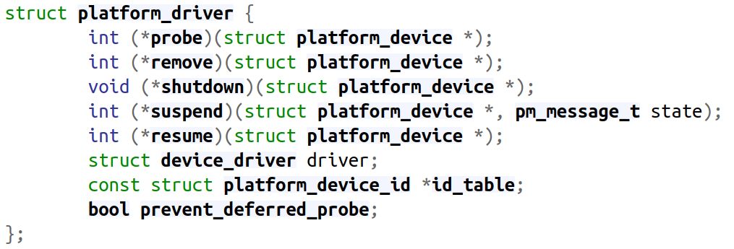
Platform Drivers Model
https://elixir.bootlin.com/linux/latest/source/include/linux/platform_device.h#L209

Slide 6
Platform Driver Register
Kernel API
Register a driver for platform-level devices
int platform_driver_register(struct platform_driver *drv);
Unregister an array of platform drivers
void platform_unregister_drivers(struct platform_driver * const *drivers,
unsigned int count);

Slide 7
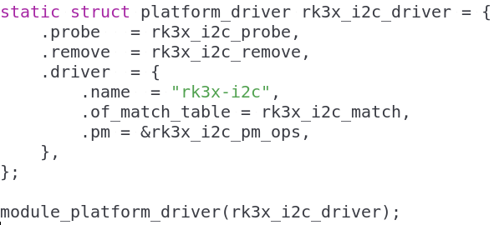
Platform Driver Register
drivers/i2c/busses/i2c-rk3x.c

Slide 8
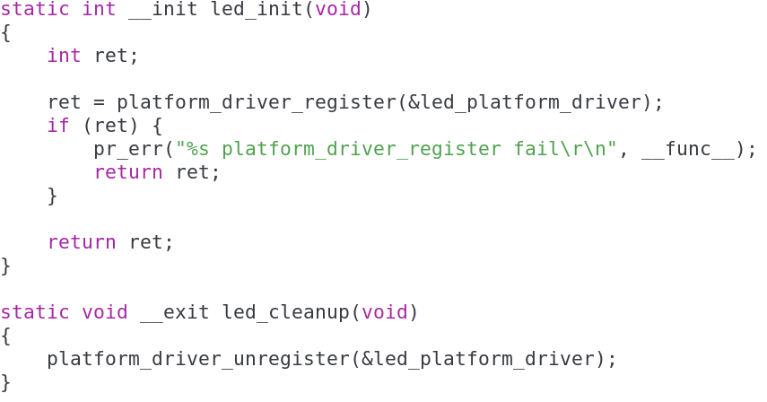
Driver LED
2-4-1-led-gpio

Slide 9
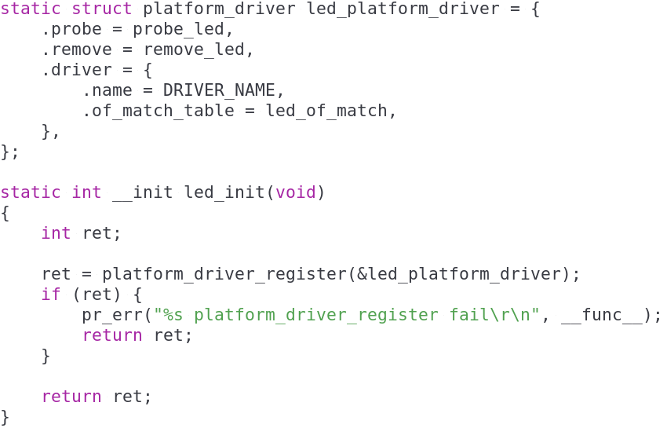

Driver LED
Register a led driver
callback function

Slide 10
Platform Driver Probe

Slide 11
Platform Driver Probe
Standard driver model convention
Provide probe() and remove() methods
Support power management and shutdown
notifications using the standard conventions

Slide 12
Platform Driver Model
probe() should general verify that the specified
device hardware actually exists
struct platform_driver {
int (*probe)(struct platform_device *);
int (*remove)(struct platform_device *);
void (*shutdown)(struct platform_device *);
int (*suspend)(struct platform_device *, pm_message_t state);
int (*resume)(struct platform_device *);
struct device_driver driver;
const struct platform_device_id *id_table;
bool prevent_deferred_probe;
};

Slide 13
I2C Host Driver
drivers/i2c/busses/i2c-rk3x.c
static struct platform_driver rk3x_i2c_driver = {
.probe = rk3x_i2c_probe,
.remove = rk3x_i2c_remove,
.driver = {
.name = "rk3x-i2c",
.of_match_table = rk3x_i2c_match,
.pm = &rk3x_i2c_pm_ops,
},
};
module_platform_driver(rk3x_i2c_driver);

Slide 14
Driver I2C Host (DTS)
arch/arm64/boot/dts/rockchip/rk3399.dtsi
i2c0: i2c@ff3c0000 {
compatible = "rockchip,rk3399-i2c";
reg = <0x0 0xff3c0000 0x0 0x1000>;
clocks = <&pmucru SCLK_I2C0_PMU>,
<&pmucru PCLK_I2C0_PMU>;
clock-names = "i2c", "pclk";
interrupts = <GIC_SPI 57 IRQ_TYPE_LEVEL_HIGH 0>;
pinctrl-names = "default";
pinctrl-0 = <&i2c0_xfer>;
#address-cells = <1>;
#size-cells = <0>;
status = "disabled";
};

Slide 15
I2C Host Driver
static const struct of_device_id rk3x_i2c_match[] = {
{
.compatible = "rockchip,rv1108-i2c",
.data = (void *)&rv1108_soc_data
},
...
{
.compatible = "rockchip,rk3399-i2c",
.data = (void *)&rk3399_soc_data
},
{},
};
MODULE_DEVICE_TABLE(of, rk3x_i2c_match);
DTS Check

Slide 16
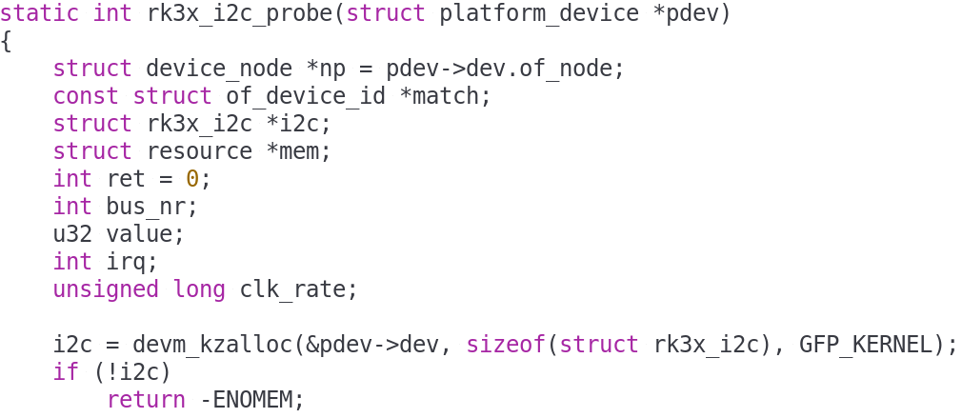
I2C Host Driver
Driver Entry

Slide 17
Platform Device

Slide 18

Platform Device
This includes
  Legacy port-based devices
  Host bridges to peripheral buses
  Most controllers integrated into system-on-chip platforms
A platform_device will be connected through a segment of some other kind of bus

Slide 19
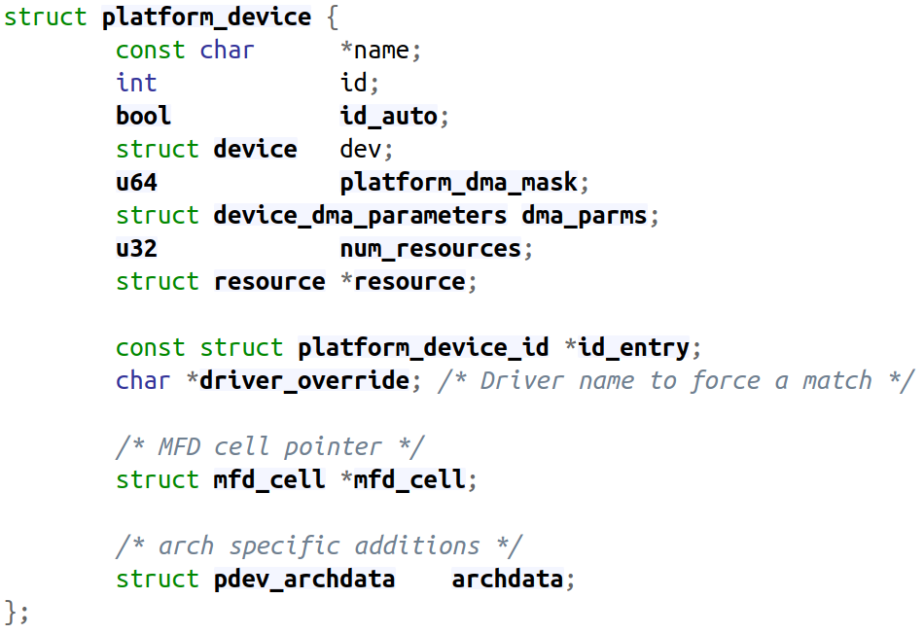
Platform Device Model
Defined at <linux/platform_device.h>
resources include such as addresses and IRQs

Slide 20
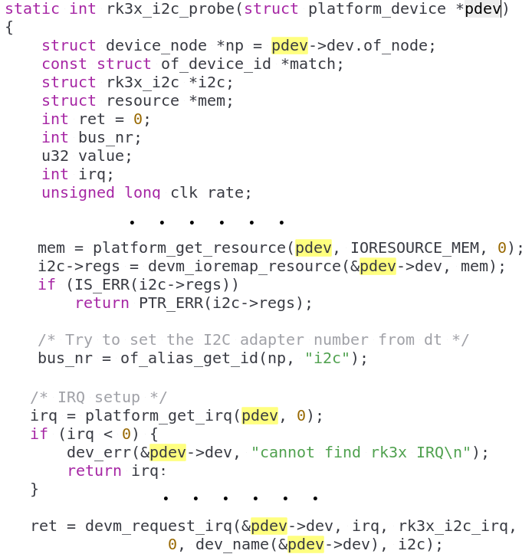
Driver I2C
Get IO
Memory
Get IRQ

Slide 21
Driver I2C Host (DTS)
arch/arm64/boot/dts/rockchip/rk3399.dtsi
i2c0: i2c@ff3c0000 {
compatible = "rockchip,rk3399-i2c";
reg = <0x0 0xff3c0000 0x0 0x1000>;
clocks = <&pmucru SCLK_I2C0_PMU>,
<&pmucru PCLK_I2C0_PMU>;
clock-names = "i2c", "pclk";
interrupts = <GIC_SPI 57 IRQ_TYPE_LEVEL_HIGH 0>;
pinctrl-names = "default";
pinctrl-0 = <&i2c0_xfer>;
#address-cells = <1>;
#size-cells = <0>;
status = "disabled";
};
IO Memory
Get IRQ

