Slide 1
IOCTL

Slide 2
ioctl
Simple data transfers
  Change hardware settings
  Eject the media
  Embedded commands in the data stream
  Driver-specific file systems

Slide 3

ioctl
Application
User Space
IOCTL CMD
Kernel Space
Char Driver
Physical
Hardware

Slide 4
ioctl
test_led_char_driver
User Space
Led Value
Kernel Space
/dev/leds
Physical
LED

Slide 5
Ioctl User Level
User-level interface
int ioctl(int fd, unsigned long cmd, …)
Variable number of arguments
Problematic for the system call interface
In this context, it is meant to pass a single optional argument
Just a way to bypass the type checking
Difficult to audit ioctl calls
E.g., 32-bit vs. 64-bit modes

Slide 6
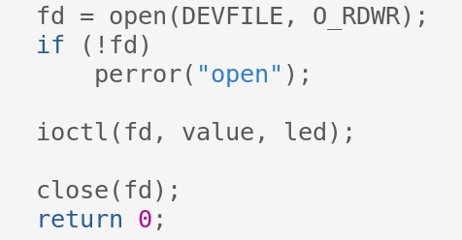
Driver LED
User Land
3-4-2/test_led_char_driver

Slide 7
Ioctl Kernel Level
Kernel-level interface
int (*ioctl) (struct inode *inode,
struct file *filp,
unsigned int cmd,
unsigned long arg);
cmd : is passed from the user unchanged
arg : can be an integer or a pointer

Slide 8
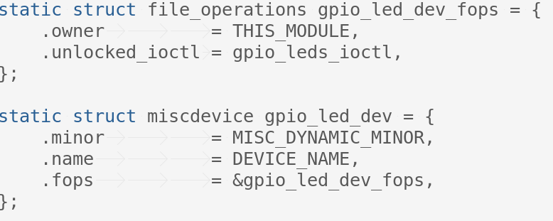
Driver LED
IOCTL Callback
File operator

Slide 9
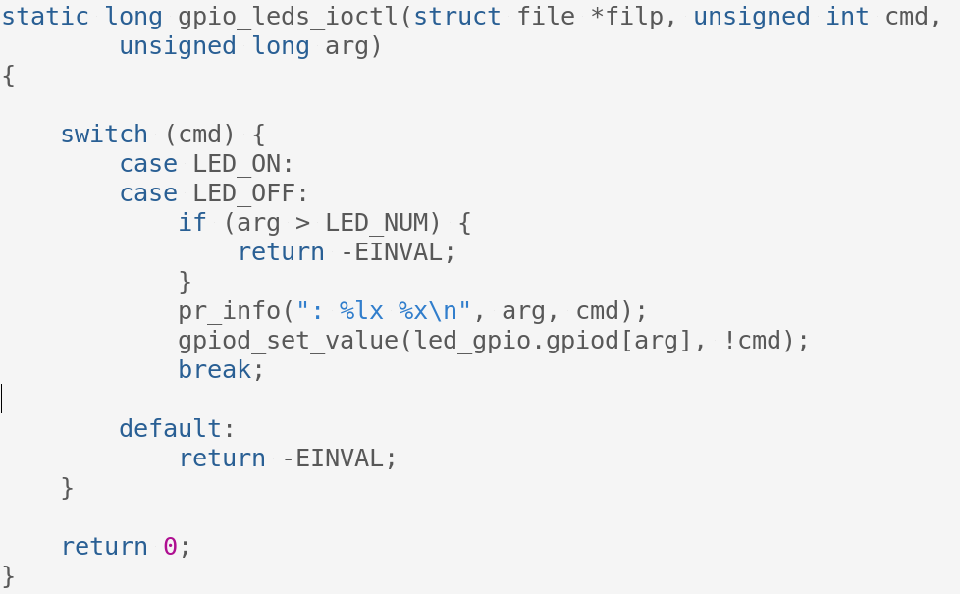
Driver LED
3-4-2/ioctl_leds.c

Slide 10
ioctl Commands
Need a numbering scheme to avoid mistakes
  Check include/asm/ioctl.h
  Documentation/ioctl-decoding.txt
    How to decode the bits of an IOCTL code
  ioctl-number.txt
    How to implement and register device/driver ioctl calls

Slide 11
ioctl Commands
A command number uses four bitfields
  Defined in <linux/ioctl.h>
  < direction, type, number, size>
  direction: direction of data transfer
    _IOC_NONE
    _IOC_READ
    _IOC_WRITE
    _IOC_READ | WRITE

Slide 12
ioctl Commands
  type (ioctl device type)
    8-bit magic number
    Associated with the device
  number
    8-bit sequential number
    Unique within device
  size: size of user data involved
    The width is either 13 or 14 bits
Example ipmi_devintf.c

Slide 13
ioctl Commands
Useful macros to encode ioctl command numbers
  _IO(type, nr)
  _IOR(type, nr, datatype)
  _IOW(type, nr, datatype)
  _IOWR(type, nr, datatype)
size = sizeof(datatype)

Slide 14
ioctl Commands
Useful macros to decode ioctl command numbers
  _IOC_DIR(nr)
  _IOC_TYPE(nr)
  _IOC_NR(nr)
  _IOC_SIZE(nr)

Slide 15
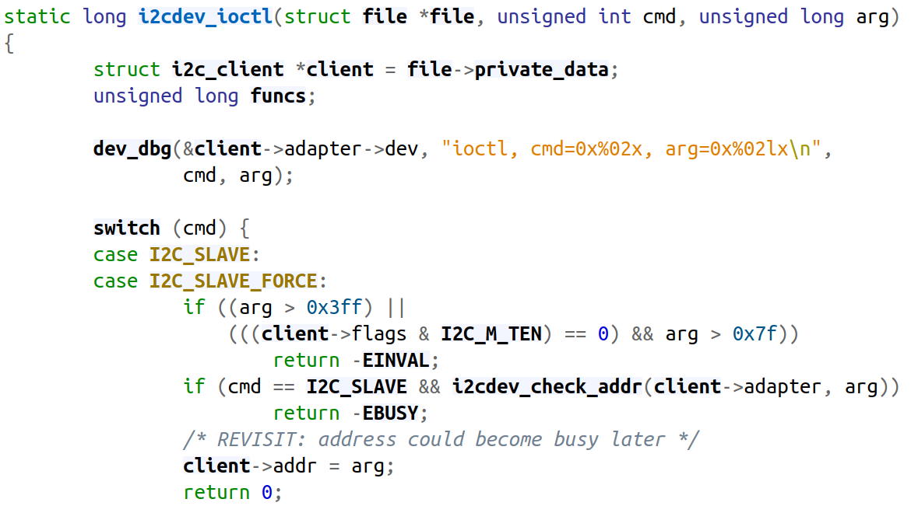
ioctl
I2c-dev.c

Slide 16
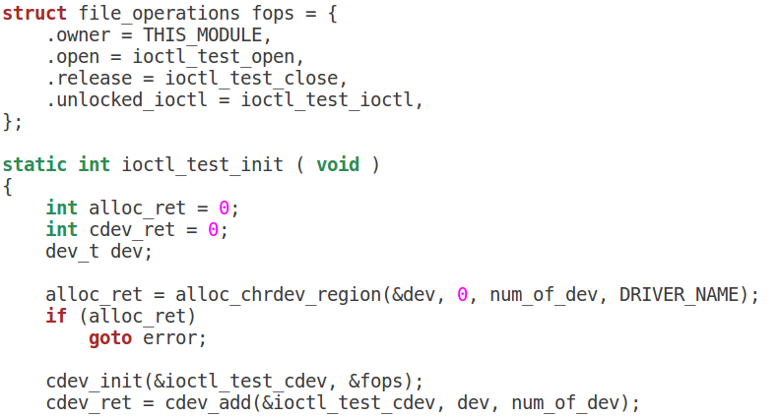
Driver IOCTL
3-4-1

Slide 17
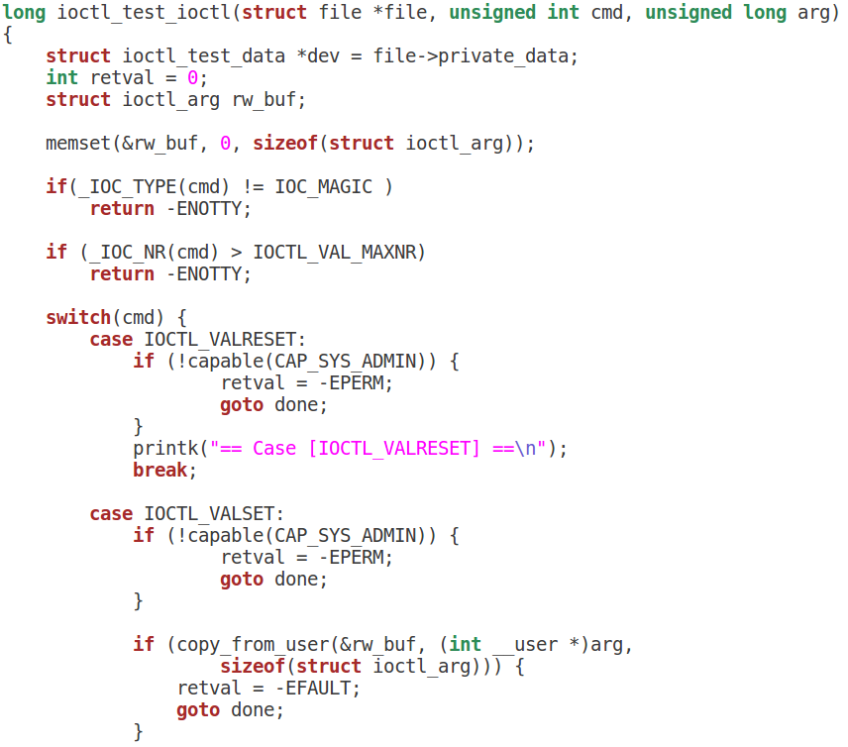
Driver IOCTL

Slide 18
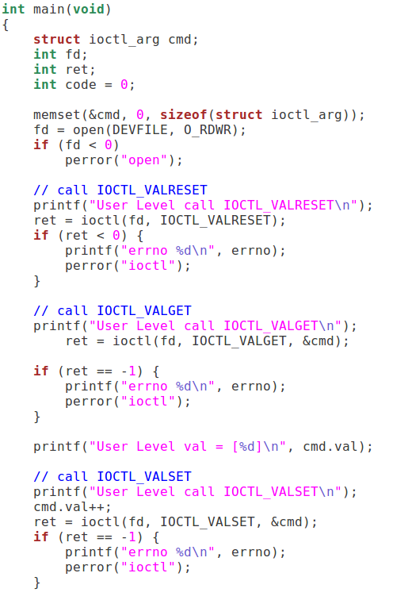
Driver IOCTL Test
CMD : Reset Value
CMD : Get Value
CMD : Set Value

