Slide 1
Allocating Memory

Slide 2
Kernel Allocate Memory API
kmalloc()
kfree
__get_free_page()
__free_page()
__get_free_pages()
__free_pages()
vmalloc()
vfree()
ioremap()
iounmap()

Slide 3
Kernel Memory Configuration
32 Bit CPU
Vector
User Space
Kernel Space
High Zero
FixMap
DMA
VMalloc
Low Memory
Normal Zero
Kernel Image

Slide 4
Kernel Memory Configuration
64 Bit ARM CPU
0xFFFFFFFFFFFFFFFF
Vector
Kernel Space
High Zero
FixMap
DMA
VMalloc
Low Memory
Normal Zero
0xFFFFFF8000000000
Kernel Image
0x0000007FFFFFFFFF
User Space
AArch64 Linux memory layout with
4KB pages + 3 levels
0x0000000000000000

Slide 5
The Flags Argument
kmalloc prototype
Flags
  GFP_KERNEL
    the most commonly used flag
    Cannot be used in atomic context
#include <linux/slab_def.h>
void *kmalloc(size_t size, int flags);

Slide 6
kmalloc
kmalloc(size_t size, gfp_t flags);
  Allocates consecutive virtual/physical memory pages
  Offset by PAGE_OFFSET
    PAGE_OFFSET 2^12 (4K)
  No changes to page tables
  Allocate memory limit : 128K

Slide 7

Memory Zones
Normal memory
  GFP_KERNEL
DMA-capable memory
  __GFP_DMA
  Platform dependent
  First 16MB of RAM on the x86 for ISA devices
  PCI devices have no such limit
High memory
  __GFP_HIGHMEM
  Platform dependent
  > 32-bit addressable range

Slide 8
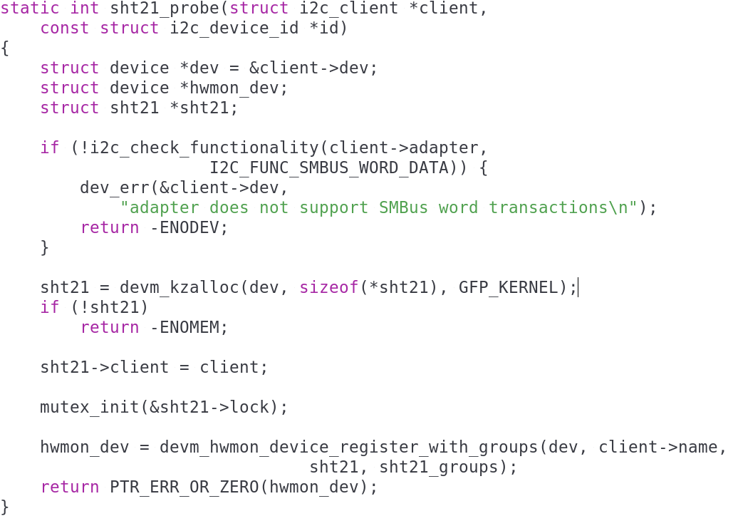
Driver SHT21
kmalloc and flag

Slide 9
The Size Argument
Kernel manages physical memory in pages
  Needs special management to allocate small memory chunks
Linux creates pools of memory objects in fixed sizes
  32-byte
  64-byte,
  128-byte memory objects
kmalloc create smallest allocation unit
  32 or 64 bytes
Largest portable allocation unit is 128KB

Slide 10
Supplement

Slide 11

get_free_page and Friends
For allocating big chunks of memory, it is more efficient to use a page-oriented allocator
To allocate pages, call
Kernel API
/* returns a pointer to a zeroed page */
get_zeroed_page(unsigned int flags);
/* does not clear the page */
__get_free_page(unsigned int flags);
/* allocates multiple physically contiguous pages */
__get_free_pages(unsigned int flags, unsigned int order);

Slide 12
get_free_page and Friends
flags
  Same as flags for kmalloc
order
  Allocate 2^{order} pages
    order = 0 for 1 page
    order = 3 for 8 pages
  Can use get_order(size)to find out order
  Maximum allowed value is about 10 or 11
  See /proc/buddyinfo statistics

Slide 13
Page and order
Order
2 ^ 10
1024 Pages
2 ^ 9
512 Pages
2 ^ 8
256 Pages
2 ^ 7
128 Pages
2 ^ 6
64 Pages
2 ^ 5
32 Pages
2 ^ 4
16 Pages
2 ^ 3
8 Pages
2 ^ 2
4 Pages
2 ^ 1
2 Pages
2 ^ 0
1 Page

Slide 14
get_free_page and Friends
Subject to the same rules as kmalloc
To free pages, call
void free_page(unsigned long addr);
void free_pages(unsigned long addr, unsigned long order);
Make sure to free the same number of pages
  Or the memory map becomes corrupted

Slide 15
Sample – get_free_page (1)
3-1-2-buddy
static int buddy_init(void)
{
printk("Buddy driver installed...\n");
order = 4;
ptr = (void *)__get_free_pages(GFP_KERNEL, order);
if (ptr)
printk("2^%d * %ld bytes allocated\n", order, PAGE_SIZE);
order2 = get_order(PAGE_SIZE * 4);
ptr2 = (void *)__get_free_pages(GFP_KERNEL, order2);
if (ptr2)
printk("2^%d * %ld bytes allocated\n", order2, PAGE_SIZE);
return 0;
}

Slide 16
Sample – get_free_page (2)
static void buddy_exit(void)
{
printk("buddy driver removed...\n");
printk("buddy driver removed order %d ...\n", order);
printk("buddy driver removed order2 %d ...\n", order2);
free_pages((unsigned long)ptr, order);
free_pages((unsigned long)ptr2, order2);
}

Slide 17
vmalloc and Friends
Allocates a virtually contiguous memory region
  Not consecutive pages in physical memory
    Each page retrieved with a separate alloc_page call
    Less efficient
  Can sleep (cannot be used in atomic context)

Slide 18
vmalloc and Friends
vmalloc-related prototypes
#include <linux/vmalloc.h>
void *vmalloc(unsigned long size);
void vfree(void * addr);
void *ioremap(unsigned long offset, unsigned long size);
void iounmap(void * addr);

Slide 19
vmalloc and Friends
ioremap builds page tables
  Does not allocate memory
  Takes a physical address (offset) and return a virtual address
    Useful to map the address of a Hardware buffer to kernel space
  Should use readb and other relation functions to access remapped memory

