Slide 1
IO MEMORY MAP

Slide 2
I/O Ports and I/O Memory
Every peripheral device is controlled by writing and reading its registers
  memory address space (memory-mapped I/O)
    Can access devices like memory
  I/O address space (port-mapped I/O)
    Need to use special instructions

Slide 3
I/O Ports and I/O Memory
CPU
IO Reg
OutPort
Memory
Controll
Input Port
Memory
IO Address
I/O Port
I/O Memory

Slide 4
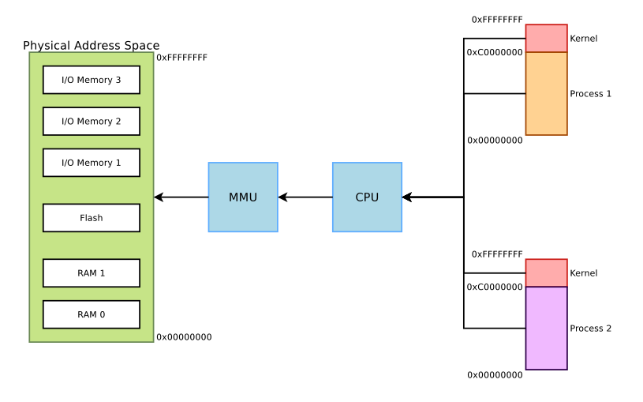
Physical and Virtual Memory
32 Bit CPU

Slide 5
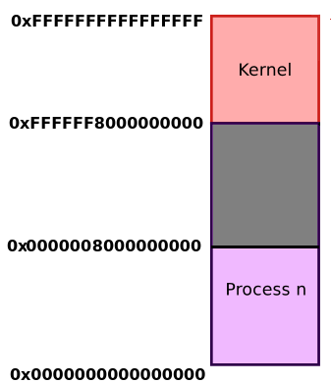

Virtual Memory Organization
64 Bit CPU
AArch64 Linux memory layout with 4KB pages + 3 levels
512GB
reserved for
kernel-space
512GB
reserved for
user space

Slide 6
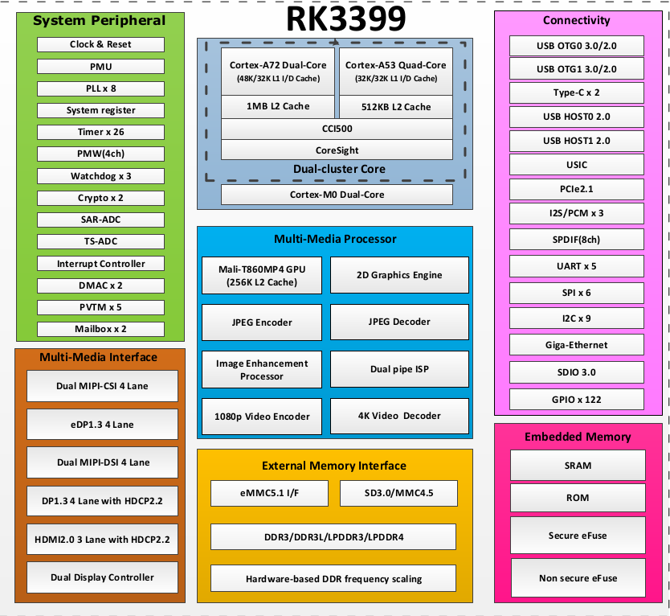
RK3399 Block Diagram

Slide 7
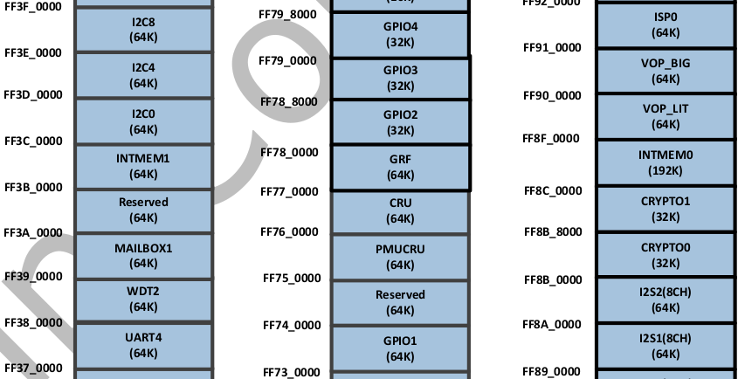
RK3399 Memory Map
Rockchip_RK3399TRM_V1.3_Part1.pdf
Physical
memory address
2.1 Address Mapping
can’t use
physical memory
address direct

Slide 8
IO REMAP

Slide 9
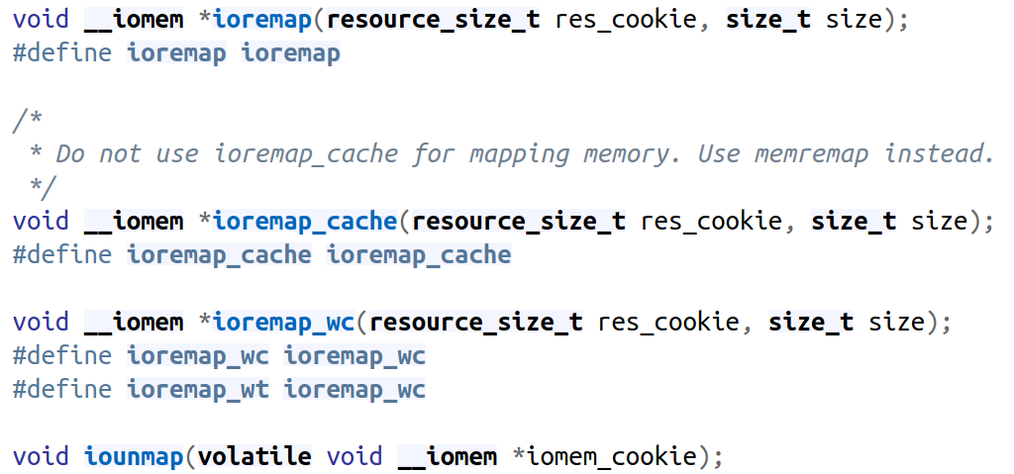
I/O Memory Allocation and Mapping
To make memory accessible, call
https://elixir.bootlin.com/linux/latest/source/arch/arm/include/asm/io.h#L386

Slide 10
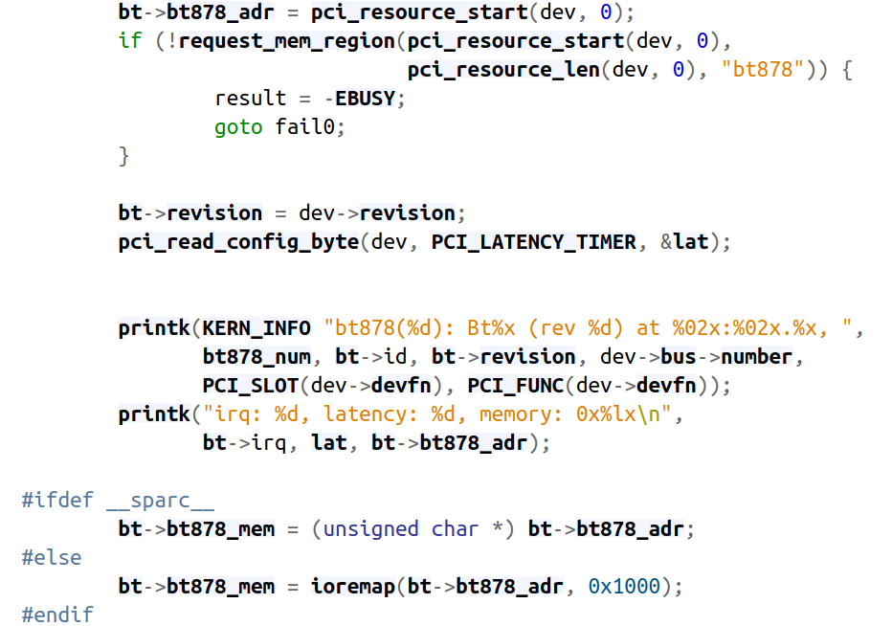
Video Capture Driver BT878
Get IO MEM
IO MEM remap

Slide 11
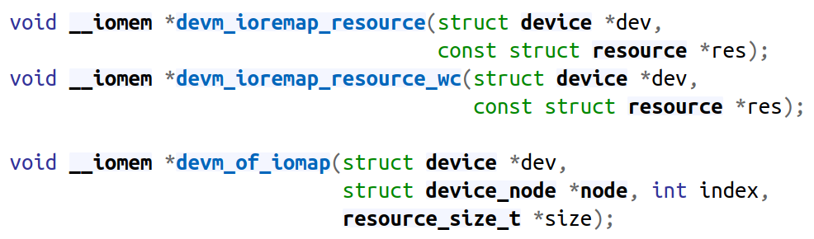
I/O Memory Allocation and Mapping
https://elixir.bootlin.com/linux/latest/source/include/linux/device.h#L234

Slide 12
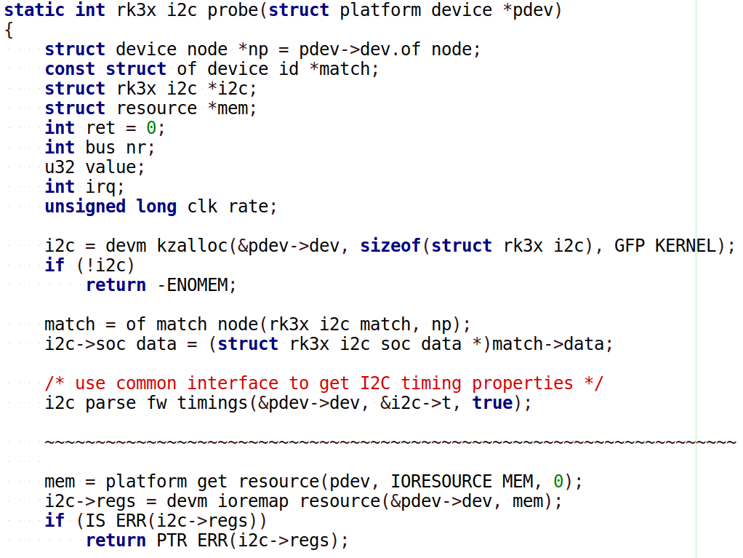
Driver I2C Bus
rockpi-kernel/drivers/i2c/busses/i2c-rk3x.c

Slide 13
Driver I2C Bus
Get IO Memory Address then remap for system (Form DTS)
struct resource *mem;
mem = platform_get_resource(pdev, IORESOURCE_MEM, 0);
i2c->regs = devm_ioremap_resource(&pdev->dev, mem);

Slide 14
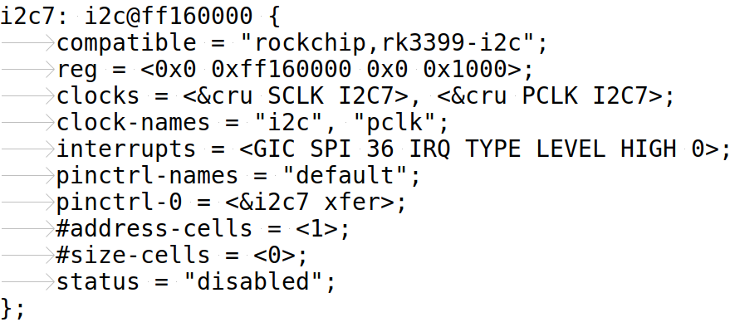
Driver I2C Bus

Slide 15
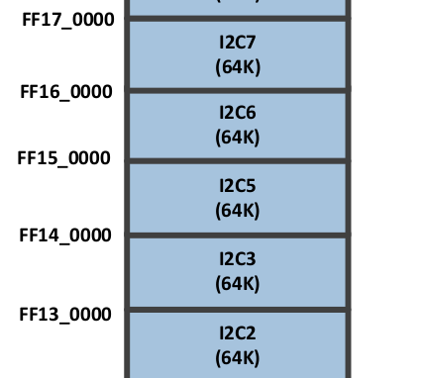
Driver I2C Bus
P29 of Rockchip_RK3399TRM_V1.3_Part1.pdf

Slide 16
IO Read / Write

Slide 17
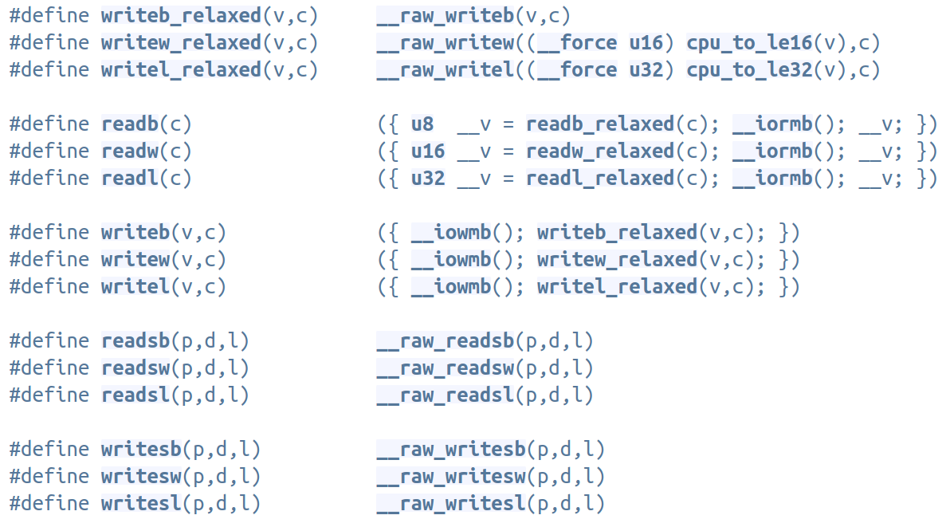
Driver I2C Bus
arm/include/asm/io.h

Slide 18
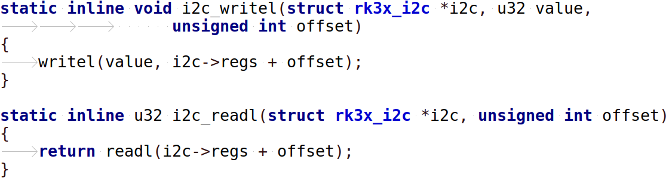
Driver I2C Bus
i2c-rk3x.c

Slide 19
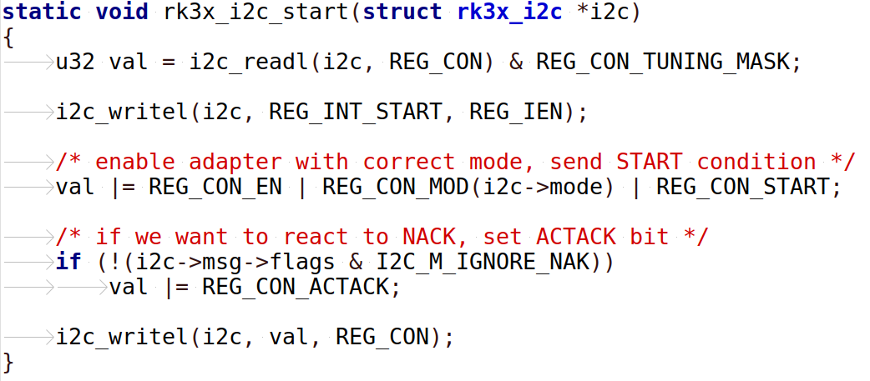
Driver I2C Bus
i2c-rk3x.c

Slide 20
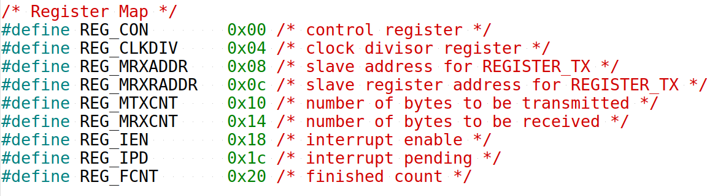
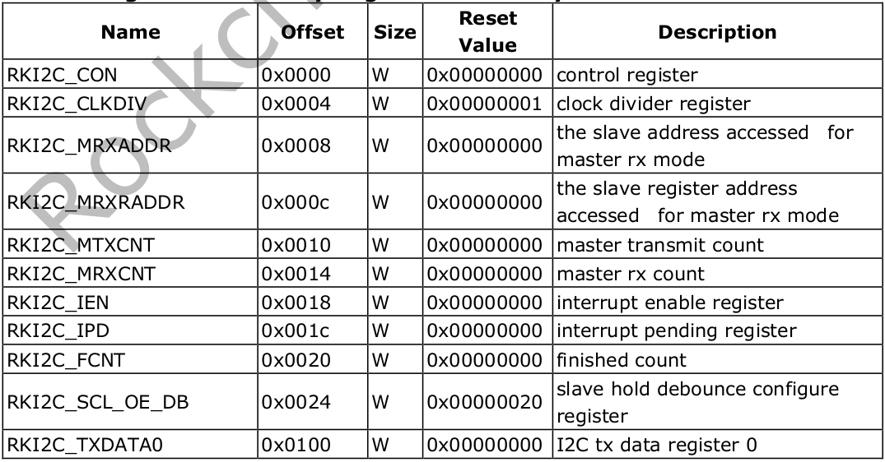
Driver I2C Bus
Rockchip_RK3399TRM_V1.3_Part2.pdf

Slide 21
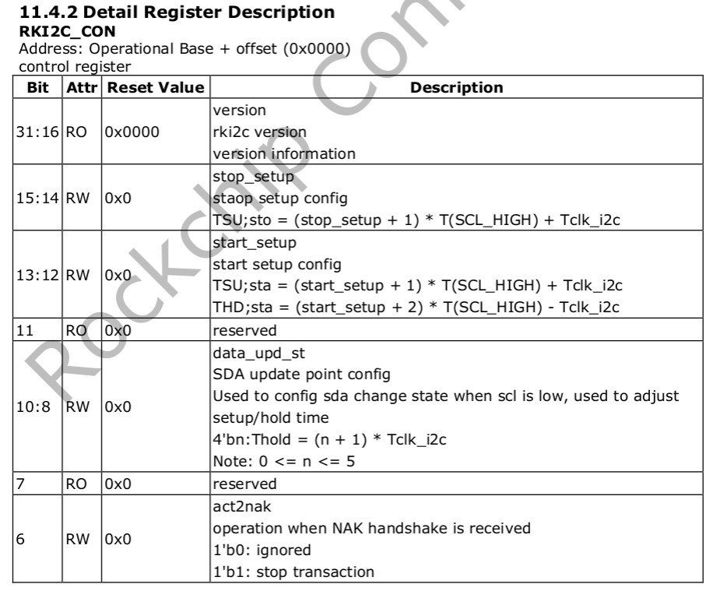
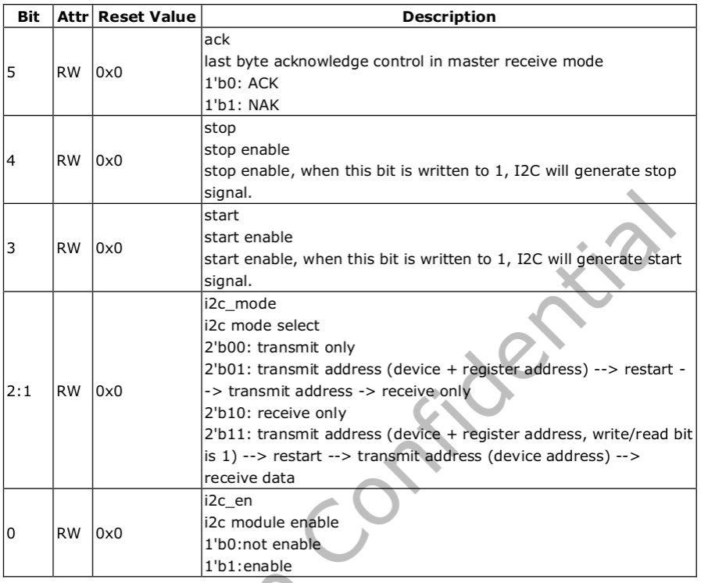
Driver I2C Bus
Read I2C control register (RKI2C_CON)
u32 val = i2c_readl(i2c, REG_CON) & REG_CON_TUNING_MASK;

