Slide 1

Time, Delays, and Deferred Work 1

Slide 2
Measuring Time Lapses
Kernel keeps track of time via timer interrupts
  Generated by the timing hardware
Every time a timer interrupt occurs, a kernel counter called jiffies is incremented
  Initialized to 0 at system boot

Slide 3
Jiffies

Slide 4
Using the jiffies Counter
Must treat jiffies as read-only
Example :
#include <linux/jiffies.h>
unsigned long j, stamp_1, stamp_half, stamp_n;
j = jiffies; /* read the current value */
stamp_1 = j + HZ; /* 1 second in the future */
stamp_half = j + HZ/2; /* half a second */
stamp_n = j + n*HZ/1000; /* n milliseconds */

Slide 5
jiffies Relation Macro
Use these macro functions
#include <linux/jiffies.h>
/* check if a is after b */
int time_after(unsigned long a, unsigned long b);
/* check if a is before b */
int time_before(unsigned long a, unsigned long b);
/* check if a is after or equal to b */
int time_after_eq(unsigned long a, unsigned long b);
/* check if a is before or equal to b */
int time_before_eq(unsigned long a, unsigned long b);

Slide 6
Time Space and jiffies
#include <linux/time.h>
unsigned long timespec_to_jiffies(struct timespec *value);
void jiffies_to_timespec(unsigned long jiffies,
struct timespec *value);
unsigned long timeval_to_jiffies(struct timeval *value);
void jiffies_to_timeval(unsigned long jiffies,
struct timeval *value);

Slide 7
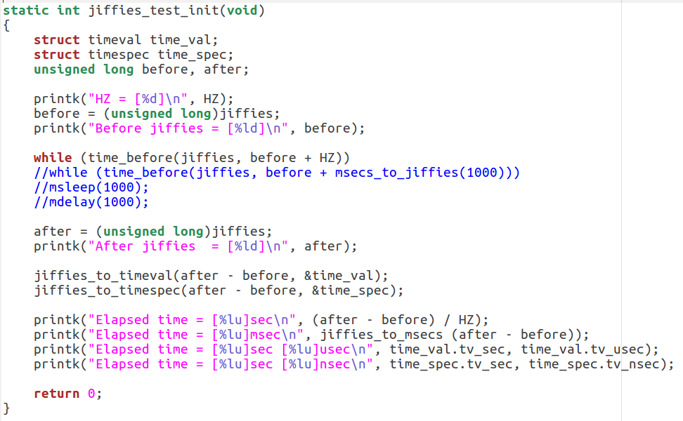
jiffies Sample

Slide 8
Time Delay - Sleep

Slide 9
Timeouts - Sleep (1)
Non-busy-wait alternatives for millisecond or longer delays
  #include <linux/delay.h>
  void msleep(unsigned int millisecs);
  void ssleep(unsigned int seconds);
msleep and ssleep are not interruptible
msleeps_interruptible returns the remaining milliseconds

Slide 10
Timeouts - Sleep (1)
Process
CPU resource free
msleep
Wait timeout

Slide 11
Time Delay - Delay

Slide 12
Timeouts – Shot Delay (2)
#include <linux/delay.h>
void ndelay(unsigned long nsecs); /* nanoseconds */
void udelay(unsigned long usecs); /* microseconds */
void mdelay(unsigned long msecs); /* milliseconds */

Slide 13
Timeouts – Shot Delay (2)
Process
CPU resource occupy
delay
Busy Wait

Slide 14
Time Delay – Wait Queue

Slide 15
Timeouts – Wait Queue (3)
  condition = 0 (no condition to wait for)
  Execution resumes when
    Someone calls wake_up()
    Timeout expires
Example
wait_queue_head_t wait;
init_waitqueue_head(&wait);
wait_event_interruptible_timeout(wait, 0, delay);

Slide 16
Timeouts – Wait Queue (3)
Ask the kernel to do it for you
  #include <linux/wait.h>
  long wait_event_timeout(wait_queue_head_t q, condition,
  long timeout);
  long wait_event_interruptible_timeout(wait_queue_head_t q,
  condition, long timeout);
  Bounded sleep
  timeout: in number of jiffies to wait, signed
  If the timeout expires, return 0
  If the call is interrupted, return the remaining jiffies

Slide 17
Timeouts – Wait Queue (3)
Process A
Process B
1
  wait_event_interruptible_timeout
3
issue event
Event trigger or timemout
2
4
wait event

Slide 18
Time Delay – Kernel Timer

Slide 19
Kernel Timers
A kernel timer schedules a function to run at a specified time, without blocking the current process
  E.g., polling a device at regular intervals

Slide 20
Kernel Timers
The scheduled function is run as a
software interrupt
  Not associated with any user-level process
  No sleeping or scheduling may be performed
    No calls to schedule(), wait_event(), kmalloc(…, GFP_KERNEL), or semaphores

Slide 21
Timer
Process A
Process B
Time out happen
Timer Initial
Excuse
timeoutFunction
Register timeout Function

Slide 22
The Timer API
Basic building blocks
#include <linux/timer.h>
struct timer_list {
/* ... */
unsigned long expires;
void (*function) (unsigned long);
unsigned long data;
};
jiffies value when the timer is expected to run
Called with data as argument; pointer cast to unsigned long

Slide 23
The Timer API
void init_timer(struct timer_list *timer);
struct timer_list TIMER_INITIALIZER(_function, expires, data);
void add_timer(struct timer_list *timer);
int del_timer(struct timer_list *timer);

Slide 24
The Timer API
Other functions
/* update the expiration time of a timer */
int mod_timer(struct timer_list *timer, unsigned long expires);
/* like del_timer, but SMP safe */
int del_timer_sync(struct timer_list *timer);
/* returns true if the timer is scheduled to run */
int timer_pending(const struct timer_list * timer);

Slide 25
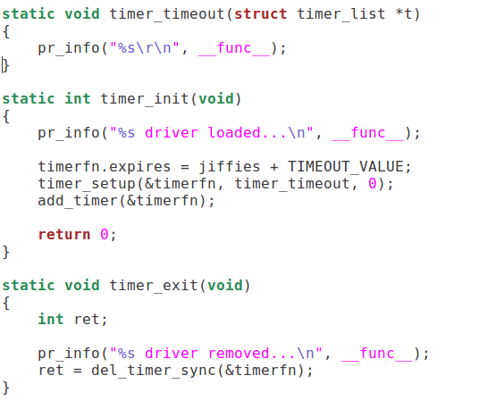
Sample

Slide 26
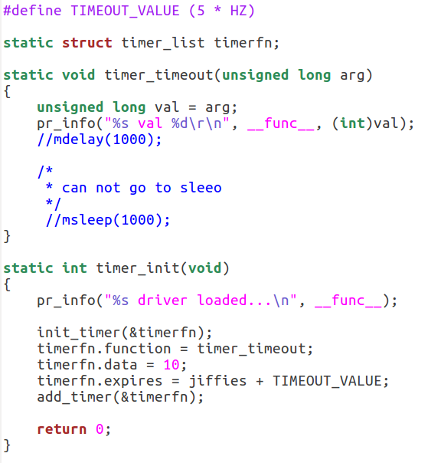
Sample

