Slide 1

Time, Delays, and Deferred Work 2

Slide 2
Tasklet

Slide 3
Tasklets
Resemble kernel timers
  Always run at interrupt time
  On the same CPU that schedules them
  Receive an unsigned long argument
  Can re-register itself
Unlike kernel timers
  Only can ask a tasklet to be run later (not at a specific time)

Slide 4
Tasklets
Useful with hardware interrupt handling
  Must be handled as quickly as possible
  A tasklet is handled later in a soft interrupt
Can be enabled / disabled (nested semantics)
Can run at normal or high priority
May run immediately, but no later than the next timer tick
Cannot be run concurrently with itself

Slide 5
Tasklet
Push Button
Process A
Process B
Tasklet Initial
Interrupt
Tasklet Function
Interrupt Initial
Tasklet Schedule
Enable

Slide 6
Tasklets
#include <linux/interrupt.h>
struct tasklet_struct {
/* ... */
void (*func)(unsigned long);
unsigned long data;
};
void tasklet_init(struct tasklet_struct *t,
void (*func) (unsigned long),
unsigned long data);
DECLARE_TASKLET(name, func, data);
DECLARE_TASKLET_DISABLED(name, func, data);

Slide 7
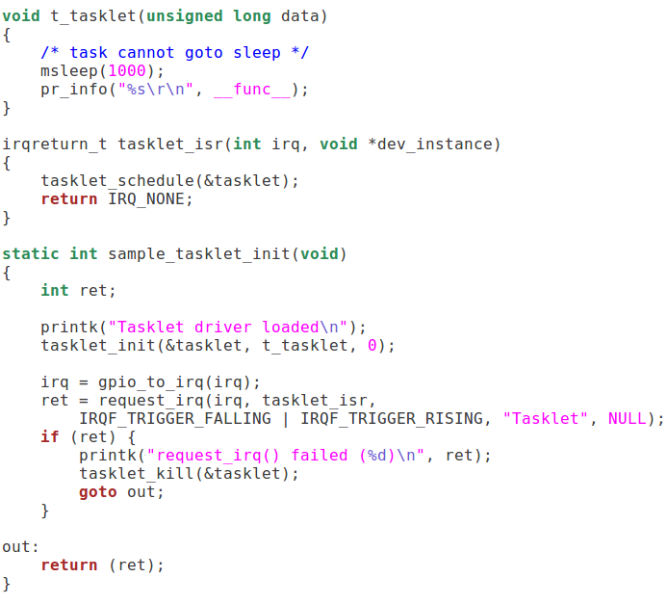
Tasklets

Slide 8
Tasklet Interface
void tasklet_disable(struct tasklet_struct *t);
void tasklet_enable(struct tasklet_struct *t);
/* If a tasklet is already running, run the tasklet again after it completes */
void tasklet_schedule(struct tasklet_struct *t);
/* ensures that the tasklet is not scheduled to run again */
/* will finish scheduled tasklet */
void tasklet_kill(struct tasklet_struct *t);

Slide 9
Work Queues

Slide 10
Workqueues
Similar to tasklets
  Kernel can request a function to be called later
  Run on the same registered CPU
  Cannot access the user space
Unlike tasklets
  Workqueue functions are associated with kernel processes
    Can sleep
  Can be delayed for an explicit interval

Slide 11

Workqueues
queue_work
Queue
New Task
Task 1
Thread work
Task 2
Task 3
schedule_work

Slide 12
Workqueues
Push Button
Process A
Process B
worker Initial
Interrupt
Work Function
Interrupt Initial
Work Schedule
Enable

Slide 13
Workqueues
Requires struct workqueue_struct
  Defined in <linux/workqueue.h>
To create a workqueue, call
  /* create one workqueue thread per processor */
  struct workqueue_struct *create_workqueue(const char *name);
  /* create a single workqueue thread */
  struct workqueue_struct *
  create_singlethread_workqueue(const char *name);

Slide 14
Workqueues
To submit a task to a workqueue, you need to fill in a work_struct structure
  At compile time (static), call
    DECLARE_WORK(name, void (*function)(void *));
  At runtime (dynamic), call one of the following
    /* does a more thorough job of initializing the structure */
    INIT_WORK(struct work_struct *work,
    void (*function) (void *));
    /* does not link the work_struct into the workqueue */
    PREPARE_WORK(struct work_struct *work,
    void (*function) (void *));

Slide 15
Workqueues
To submit work to a workqueue, call either
  /* may specify the delay in jiffies */
  int queue_delayed_work(struct workqueue_struct *queue,
  struct work_struct *work,
  unsigned long delay);
To cancel a pending workqueue entry, call
  /* returns nonzero if the entry is still pending */
  int cancel_delayed_work(struct work_struct *work);
  void flush_workqueue(struct workqueue_struct *queue);
  int queue_work(struct workqueue_struct *queue,
  struct work_struct *work);

Slide 16
Workqueues
Put work task in global workqueue
To destroy a workqueue, call
int schedule_work(struct work_struct *work)
  void destroy_workqueue(struct workqueue_struct *queue);

Slide 17
Comparisons of Various Delayed Execution Methods
 | Interruptible during the wait | No busy waiting | Good precision for Fine-grained delay | Scheduled task can access user space | Can sleep inside the scheduled task
Busy waiting | Maybe | No | No | Yes | Yes
Yielding the processor | Yes | Maybe | No | Yes | Yes
Timeouts | Maybe | Yes | Yes | Yes | Yes
msleep ssleep | No | Yes | No | Yes | Yes
msleep_interruptible | Yes | Yes | No | Yes | Yes
ndelay udelay mdelay | No | No | Maybe | Yes | Yes
Kernel timers | Yes | Yes | Yes | No | No
Tasklets | Yes | Yes | No | No | No
Workqueues | Yes | Yes | Yes | No | Yes

