Slide 1
Concurrency and Race Conditions

Slide 2
Concurrency and Its Management
Sources of concurrency
  Multiple user-space processes
  Multiple CPUs
  Device interrupts
Management
  Workqueues
  Tasklets
  Timers

Slide 3
Concurrency and Its Management
Some guiding principles
  Avoid shared resources whenever possible
    Avoid global variables
  Apply locking and mutual exclusion principles to protect shared resources

Slide 4

Concurrency
Application
Application
User Space
Kernel Space
read / write
May raise concurrency
Device Driver
May raise concurrency
interrupter
Hardware
Device

Slide 5
Semaphores and Mutexes
Atomic operation:
  all or nothing from the perspective of other threads
Critical section:
  code that can be executed by only one thread at a time
  Not all critical sections are the same
    Some involve accesses from interrupt handlers
    Some have latency constraints
    Some might hold critical resources

Slide 6
Semaphore
Process A
Process B
P function
B is going to sleep while A is
Critical Section
V function

Slide 7
The Linux Semaphore Implementation
To declare and initialize a semaphore, call
To initialize a dynamically allocated semaphore, call
#include <asm/semaphore.h>
  void sema_init(struct semaphore *sem, int val);
    DECLARE_MUTEX(name); /* initialized to 1 */
    DECLARE_MUTEX_LOCKED(name); /* initialized to 0 */
  void init_MUTEX(struct semaphore *sem);
  void init_MUTEX_LOCKED(struct semaphore *sem);

Slide 8
The Linux Semaphore Implementation
For the P function, call
down
  Just waits for the critical section
    Until the cows come home
  void down(struct semaphore *sem);
  void down_interruptible(struct semaphore *sem);
  void down_trylock(struct semaphore *sem);

Slide 9
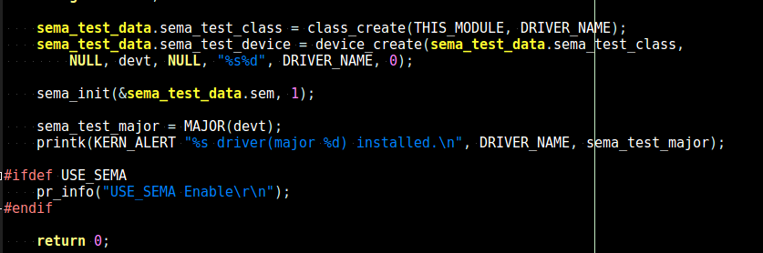
Sample Using Semaphores

Slide 10
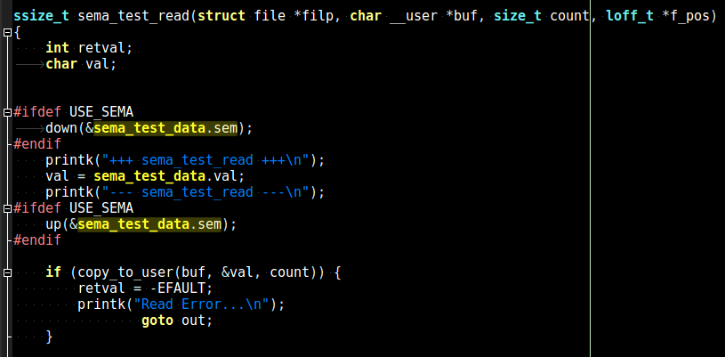
Sample Using Semaphores
Critical section

Slide 11
Example
sht21.c
static ssize_t eic_show(struct device *dev,
struct device_attribute *attr,
char *buf)
{
struct sht21 *sht21 = dev_get_drvdata(dev);
int ret;
ret = sizeof(sht21->eic) - 1;
mutex_lock(&sht21->lock);
if (!sht21->eic[0])
ret = eic_read(sht21);
if (ret > 0)
memcpy(buf, sht21->eic, ret);
mutex_unlock(&sht21->lock);
return ret;
}

Slide 12
Exercise
To know 4-2-1-sema
Add Semaphore in 4-2-3-led

Slide 13
Spinlocks
Used in code that cannot sleep
  Better performance than semaphores
Usually implemented as a single bit
  If the lock is available, the bit is set and the code continues
  If the lock is taken, the code enters a tight loop
    Repeatedly checks the lock until it become available

Slide 14
Spinlocks
Actual implementation varies for different architectures
Protect a process from other CPUs and interrupts

Slide 15
Spinlock
Process A
Process B
P Function
B is going to busy-loop while
A is processing
Critical Section
V Function

Slide 16
Introduction to Spinlock API
#include <linux/spinlock.h>
To initialize, declare
spinlock_t my_lock = SPIN_LOCK_UNLOCKED;
void spin_lock_init(spinlock_t *lock);
To acquire a lock, call
void spin_lock(spinlock_t *lock);
To release a lock, call
void spin_unlock(spinlock_t *lock);

Slide 17
Spinlocks and Atomic Context
While holding a spinlock, be atomic
  Do not sleep or relinquish the processor
    Examples of calls that can sleep
      Copying data to or from user space
        User-space page may need to be on disk…
      Memory allocation
        Memory might not be available
  Disable interrupts (on the local CPU) as needed
Hold spinlocks for the minimum time possible

Slide 18
The Spinlock Functions
The functions to acquire a spinlock
  void spin_lock(spinlock_t *lock);
  /* disables interrupts on the local CPU */
  void spin_lock_irqsave(spinlock_t *lock,
  unsigned long flags);
  /* used as the only process that disables interrupts */
  void spin_lock_irq(spinlock_t *lock);

Slide 19
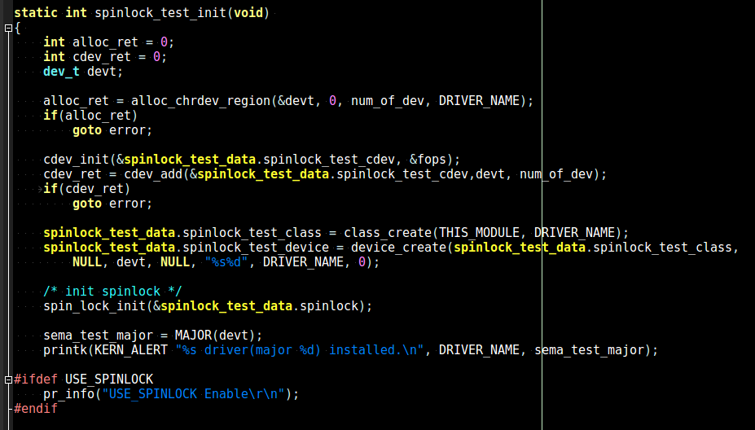
Sample - spinlock

Slide 20
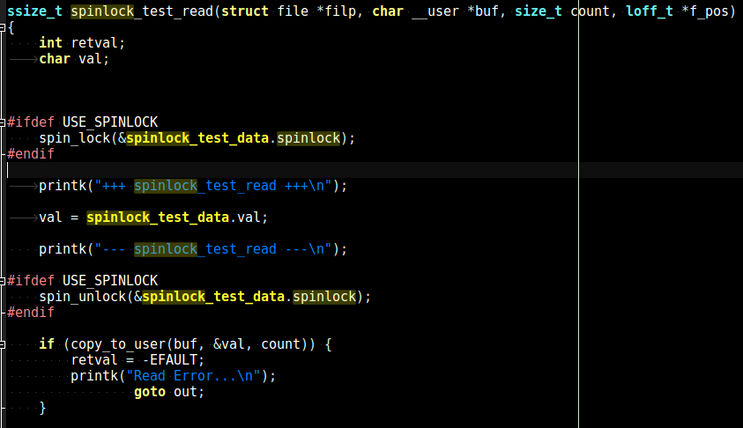
Sample - spinlock

Slide 21
Example
gpio_keys.c
static void gpio_keys_irq_timer(struct timer_list *t)
{
struct gpio_button_data *bdata = from_timer(bdata, t, release_timer);
struct input_dev *input = bdata->input;
unsigned long flags;
spin_lock_irqsave(&bdata->lock, flags);
if (bdata->key_pressed) {
input_event(input, EV_KEY, *bdata->code, 0);
input_sync(input);
bdata->key_pressed = false;
}
spin_unlock_irqrestore(&bdata->lock, flags);
}

Slide 22
Exercise
To know 4-2-2-spinlock
Add spinlock in 4-2-3-led

Slide 23
Atomic Variables
If the shared resource is an integer value
  Locking is too expensive
The kernel provides an atomic integer type, atomic_t
  Should not count on atomic_t holding > 24 bits
  atomic_t data must be access through special functions (<asm/atomic.h>)
  SMP safe

Slide 24
Atomic Variables
Atomic variables might not be sufficient
  atomic_set(v, i);
  atomic_read(v);

Slide 25
Example
linux-4.20.7/drivers/gpu/drm/exynos/exynos_drm_fimd.c
static void fimd_trigger(struct device *dev)
{
…….
if (atomic_read(&ctx->triggering))
return;
/* Enters triggering mode */
atomic_set(&ctx->triggering, 1);
…….
/*
* Exits triggering mode if vblank is not enabled yet, because when the
* VIDINTCON0 register is not set, it can not exit from triggering mode.
*/
if (!test_bit(0, &ctx->irq_flags))
atomic_set(&ctx->triggering, 0);
}

