Slide 1
Blocking I/O

Slide 2

Blocking I/O
Needed when no data is available for reads
When the device is not ready to accept data
  Output buffer is full

Slide 3
Blocking I/O
Application
Kernel
Read Data
No Data
Block Data
Data Ready
Wait Data
Copy Data
Return

Slide 4
Introduction to Sleeping
A process is removed from the
scheduler’s run queue
Certain rules
  Never sleep when running in an atomic context
    Multiple steps must be performed without concurrent accesses
    Not while holding a spinlock, seqlock, or RCU lock
    Not while disabling interrupts

Slide 5
Introduction to Sleeping
Okay to sleep while holding a semaphore
  Other threads waiting for the semaphore will also sleep
  Need to keep it short
After waking up
  The resource one is waiting for might be gone again
  Must check the wait condition again

Slide 6

Introduction to Sleeping
Wait queue:
  contains a list of processes waiting for a specific event
  #include <linux/wait.h>
  To initialize statically, call
  To initialize dynamically, call
    DECLARE_WAIT_QUEUE_HEAD(my_queue);
    wait_queue_head_t my_queue;
    init_waitqueue_head(&my_queue);

Slide 7
Simple Sleeping
Call variants of wait_event macros
wait_event(queue, condition)
  queue = wait queue head
  Waits until the boolean condition becomes true
  Puts into an un-interruptible sleep
  wait_event_interruptible(queue, condition)
  Can be interrupted by signals
  Returns nonzero if sleep was interrupted

Slide 8
Simple Sleeping
wait_event_timeout(queue, condition, timeout)
  Wait for a limited time (in jiffies)
  Returns 0 regardless of condition evaluations
wait_event_interruptible_timeout(queue,
  condition,
  timeout)

Slide 9
Simple Sleeping
To wake up, call variants of wake_up functions
  Wakes up all processes waiting on the queue
  Wakes up processes that perform an interruptible sleep
void wake_up(wait_queue_head_t *queue);
void wake_up_interruptible(wait_queue_head_t *queue);

Slide 10
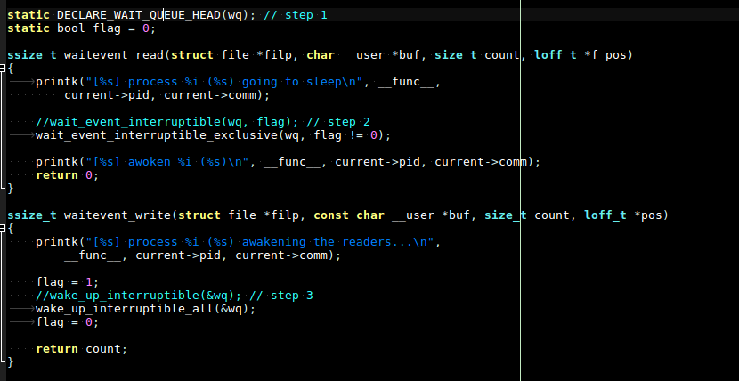
Sample - waitevent

Slide 11
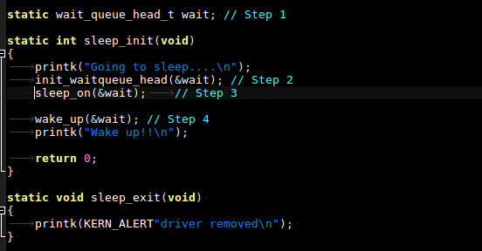
Sample - sleep

Slide 12
Exercise
To know 4-3-1-waitevent
  wait_event_interruptible (…)
  wake_up (…)
4-3-2-wakeup

