Slide 1
Embedded Linux Camera

Slide 2
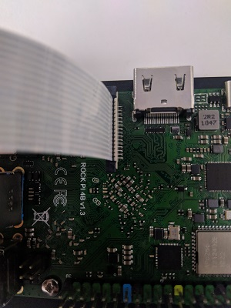
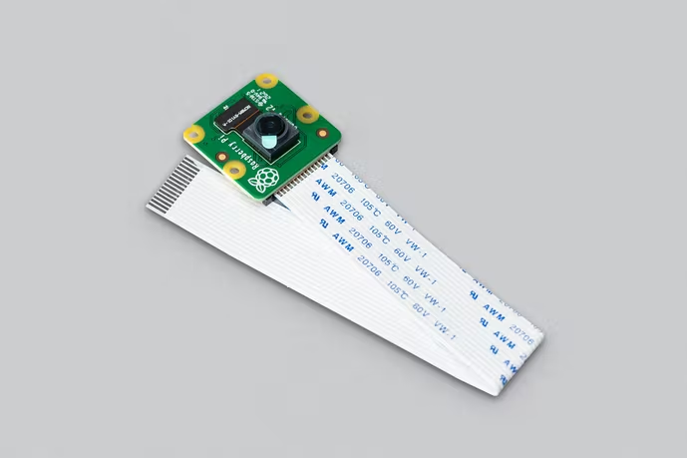
RockPi4 & Raspberry Pi Camera V2
Raspberry Pi Camera Module 2
IMX219

Slide 3
SOC Camera
SOC (RK3399)
ISP
Memory
File
DMA
Camera
Image Data
CSI-2
Frame
Buffer
Panel

Slide 4
RK3399 Media Control

Slide 5
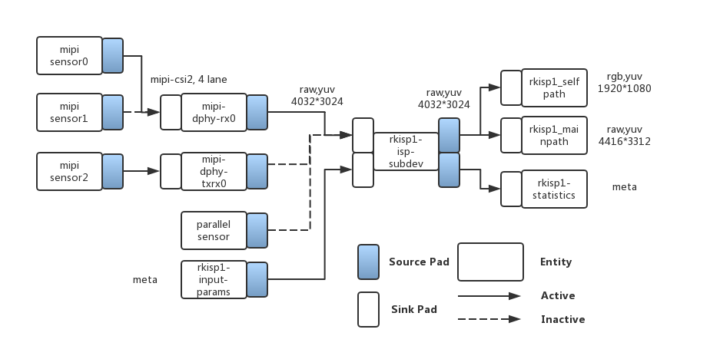
Media Control
https://opensource.rock-chips.com/wiki_Rockchip-isp1

Slide 6
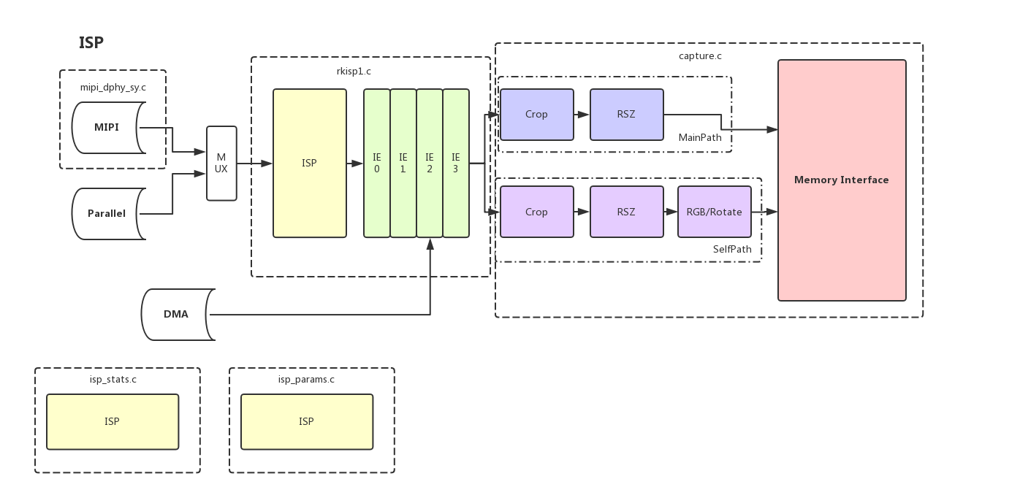
Media Control

Slide 7
MIPI CSI-2

Slide 8
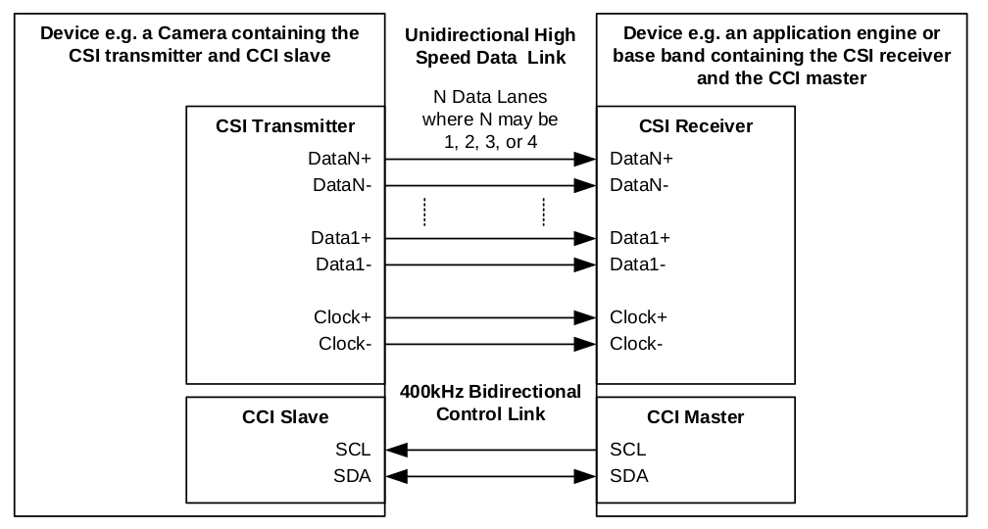
MIPI CSI-2
Data
Clock
CSI : Camera Slave Interface
CCI : Camera Control Interface
MIPI_Alliance_Specification_for_Camera_S.pdf

Slide 9
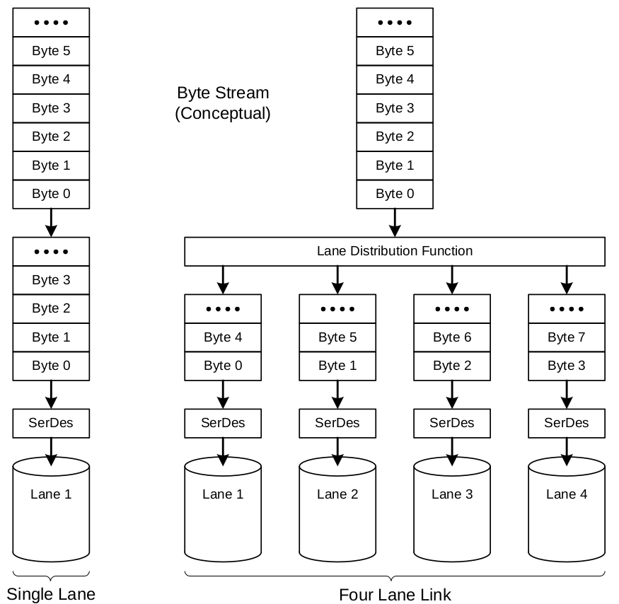
Multi-Lane Distribution and Merging
Camera
(imx219)

Slide 10
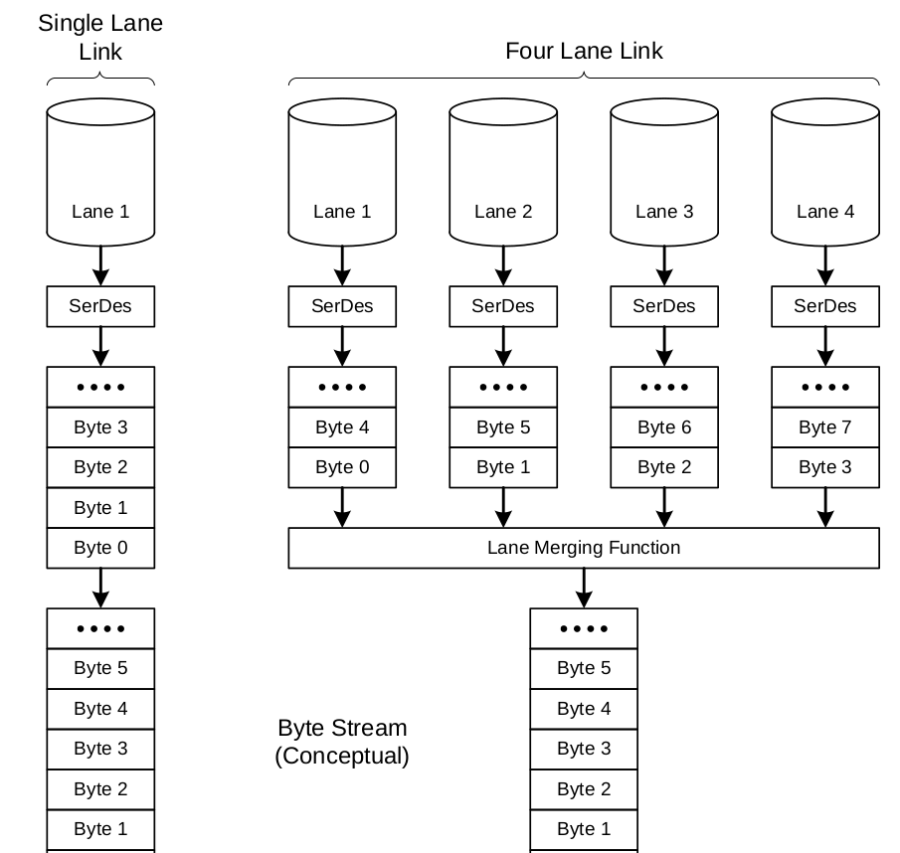
Multi-Lane Distribution and Merging
SOC
(RK3399)

Slide 11
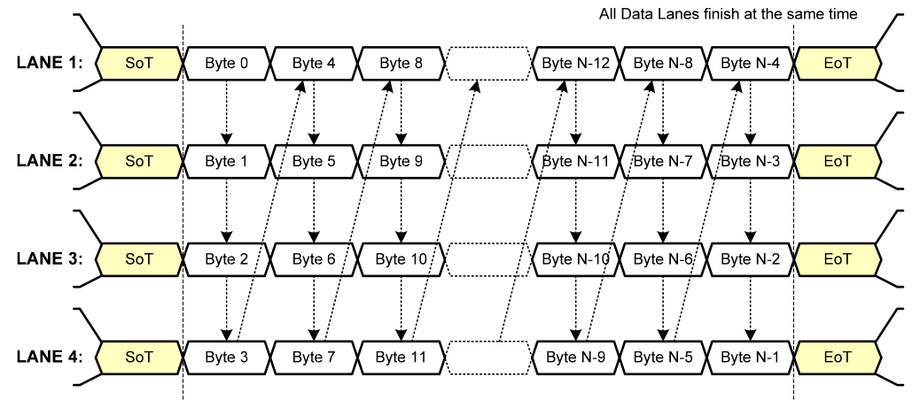
Multi-Lane Distribution and Merging

Slide 12
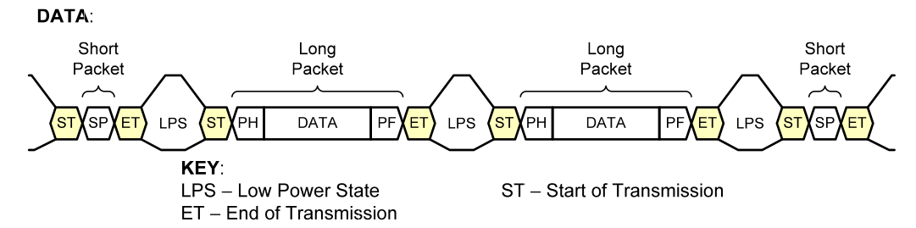
Low Level Protocol Packet

Slide 13
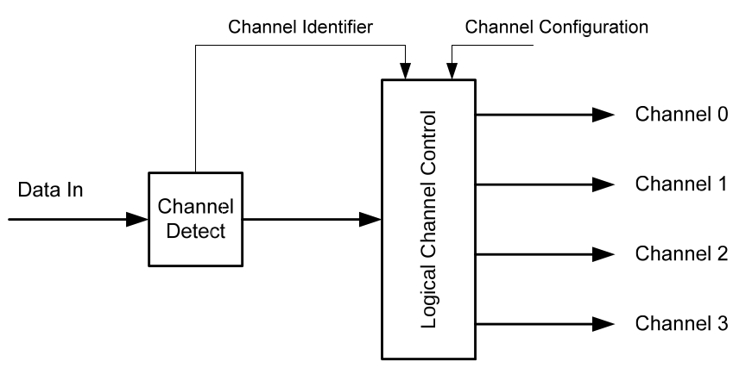
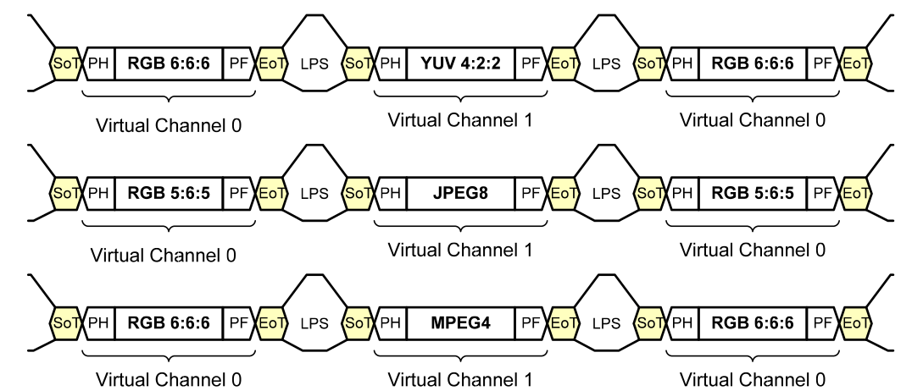
Virtual Channel

Slide 14
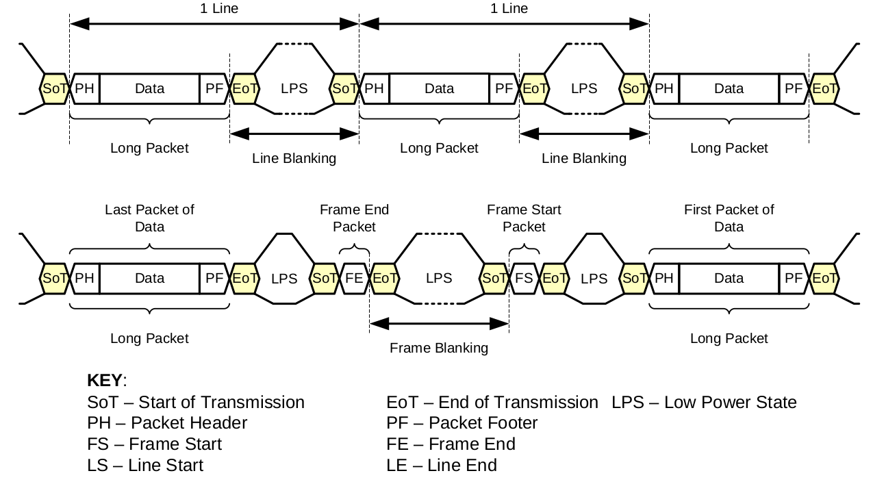
Line and Frame Blanking

Slide 15
ISP

Slide 16
Media Control

Slide 17
Image Signal Process
ISP : Image Signal Process
  Color formation transform
  De-noising
  Image Effects
  Image Resize
  3A
    Auto exposure
    Auto focus
    Auto while balance

Slide 18
V4L2

Slide 19
Video For Linux V2
V4L2 (Video For Linux V2)
  Video Device
    Video capture cards
    USB webcams
    Cameras in embedded devices
Media controller
  control interface for complex media devices
  Image pipeline discovery and configuration

Slide 20
RK339 Media Control
https://opensource.rock-chips.com/wiki_Rockchip-isp1

Slide 21
RK339 Media Control

Slide 22
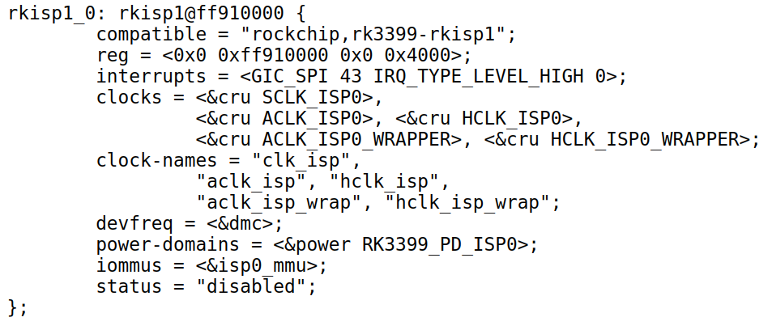
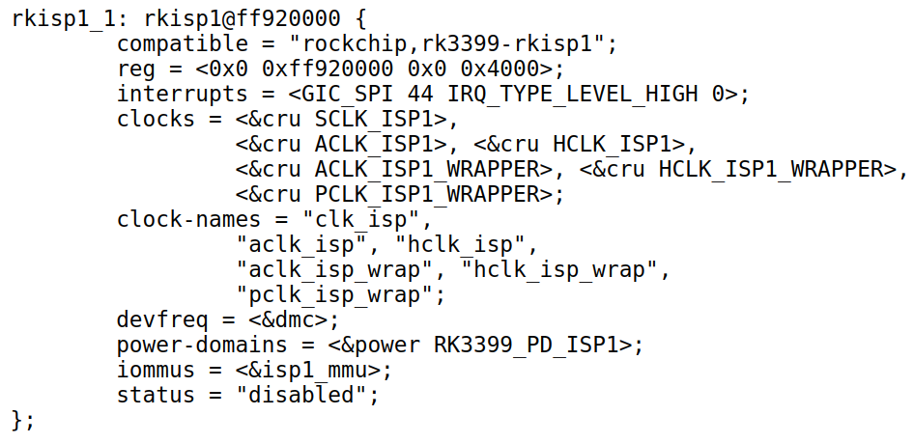
ISP Device Tree

Slide 23
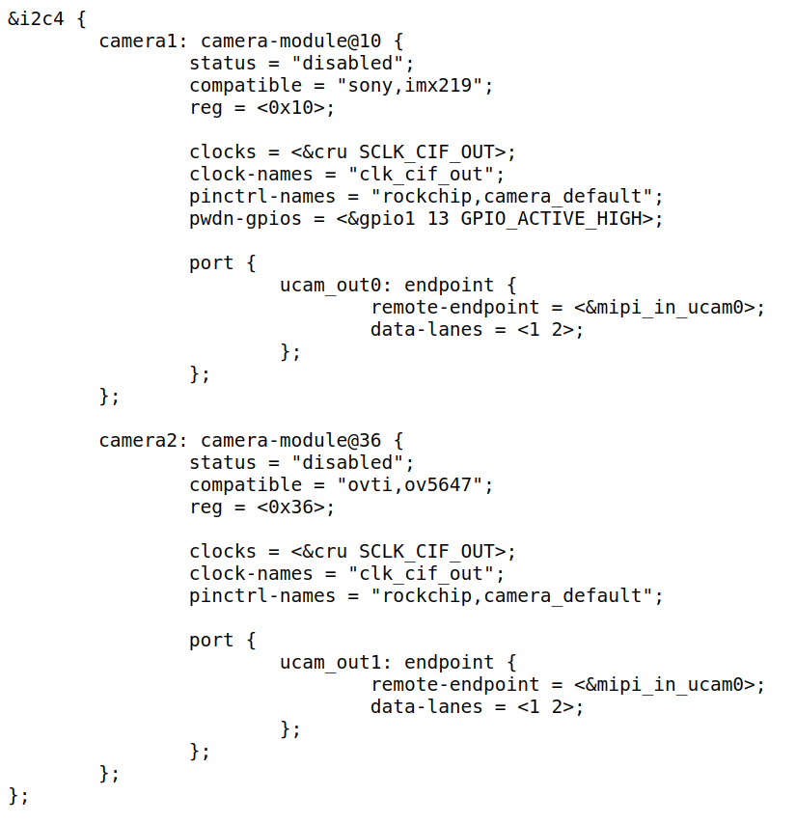
Image Sensor Device Tree

Slide 24
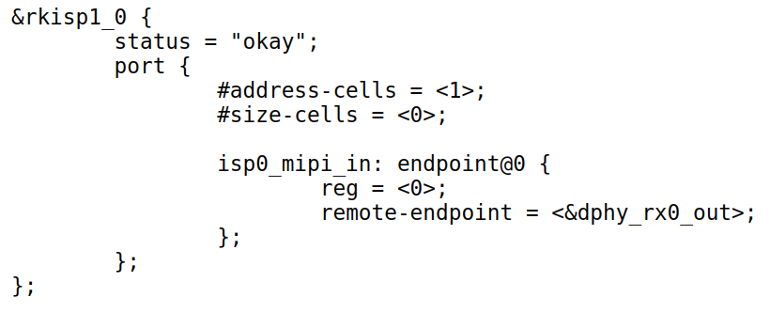
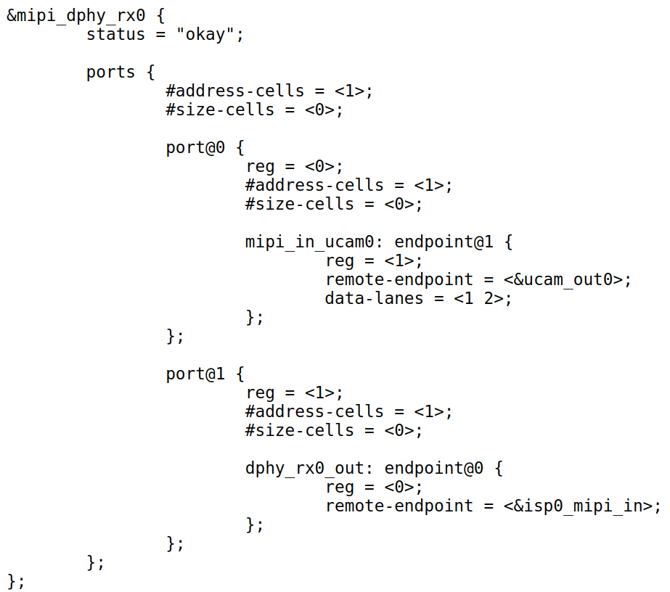
MIPI CSI-2 Device Tree

Slide 25

V4L2 and Camera
/dev/Video0
/dev/v4l-subdev0
Memory
Videobuf2
V4L2-Core
control
V4L2 device
media device
V4L2-SubDevice
Driver
V4L2-Device
Driver
ISP
V4L2_CTL_HANDLE
MIPI-CSI2
V4L2_CTL_HANDLE
imx219
I2C

Slide 26
State Machine
user-space
Query Capability
Queue Buffer
Set Formation
Stream on
Set Control
Allocate Buffer

Slide 27
V4L2 Video Capabilities
There are many video formats
  MPEG, H.264, H.265, YUV, RAW
The capture device can’t support all of formations
We have to query device capabilities by
  VIDIOC_QUERYCAP

Slide 28
V4L2 Capabilities & Profiles
/dev/Video0
/dev/v4l-subdev0
VIDIOC_QUERYCAP
V4L2-Core
V4L2-SubDevice
Driver
V4L2-Device
Driver
Support Format Report
ISP
V4L2_CTL_HANDLE
MIPI-CSI2
V4L2_CTL_HANDLE
imx219
I2C

Slide 29
V4L2 Videobuf2
Videobuf2 used to connect user-space and kernel-space
There are three types Memory Buffer in kernel
  Physical and virtual address are Not continue
    videobuf-dma-sg
    videobuf2-dma-sg
  Physical address Not continue but virtual address is
    vmalloc
  Physical and virtual address are continue
    DMA

Slide 30
V4L2 Videobuf2
Stream Models
  USERPTR types
    The buffers was allocated in userspace
    It is memory mapped via mmap() ioctl
  MMAP types
    https://www.kernel.org/doc/html/v4.8/media/uapi/v4l/func-mmap.html
    https://www.kernel.org/doc/html/v4.8/media/uapi/v4l/func-munmap.html
  Read/write access types
    https://www.kernel.org/doc/html/v4.8/media/uapi/v4l/func-read.html
    https://www.kernel.org/doc/html/v4.8/media/uapi/v4l/func-write.html
  DMABUF types

Slide 31
V4L2 Queue and Dqueue Buffer
Exchange a buffer with the driver
Applications call the VIDIOC_QBUF ioctl to enqueue an empty (capturing) or
filled (output) buffer in the driver's incoming queue.
Applications call the VIDIOC_DQBUF ioctl to dequeue a filled (capturing) or displayed (output) buffer from the driver's outgoing queue
VIDIOC_QBUF
Application
VIDIOC_DQBUF
In coming
out going
Image Data
Frame 1
...
Frame n
Frame 1
...
Frame n

Slide 32
V4L2 Video Stream
Need to implement the streaming hooks
Addresses two things:
  Memory Management: Buffer allocation, queuing and dequeuing
  Streaming control
Application
RAM
SOC
Camera
I2C
Supporting_the_Camera_Interface.pdf

Slide 33
V4L2 Control
Adjust parameter for Image quality
  3A (AE, AF, AWB)
    ISP
    Image sensor
IOCTL
v4l2-utilities
3A
I2c control
IO control
RAM
SOC
ISP
Camera

Slide 34
V4L2 Sub-device

Slide 35
V4L2_Subdev
Capture
Control
Application
yavta
v4l2-utilities
Video Device
Sub Device
RAM
SOC
Camera
I2C

Slide 36
V4L2_Subdev
Many capture drivers need to communicate with sub-devices
  For webcams common sub-devices
    Mic
    Camera
    LED
v4l2_subdev struct (v4l2-subdev.h) represent a sub-device

Slide 37
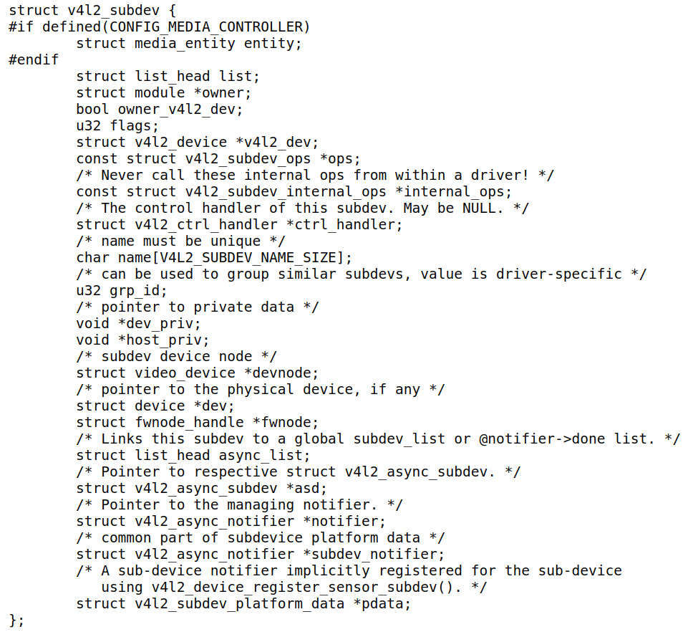
Sub-device Model
file:///home/slash/work/for_cadtc/rockpi4-b/rockpi-kernel/include/media/v4l2-subdev.h

Slide 38
Camera Sub-device
Camera
  Controller
  Image Sensor
Sony IMX219
sub-device
IMX219
Application
RAM
SOC
Camera
I2C

Slide 39
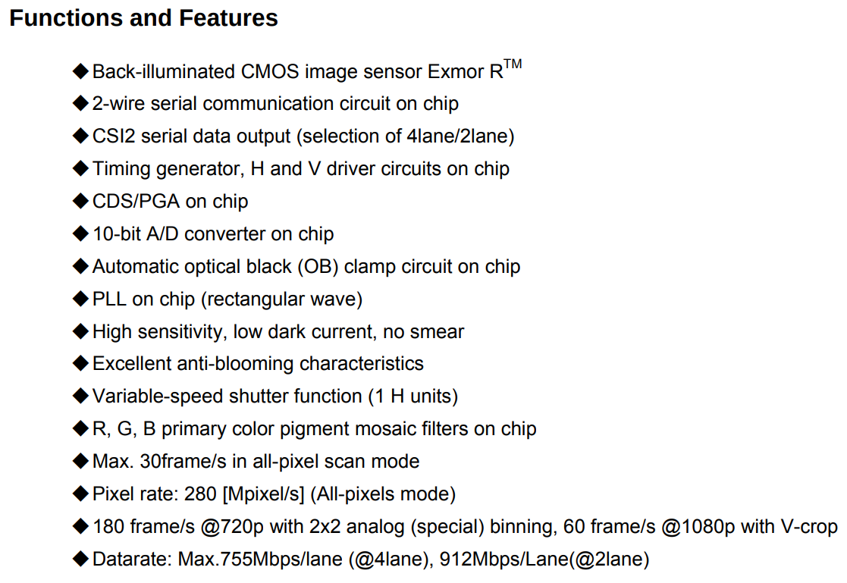
IMX219
https://www.electronicsdatasheets.com/download/5721ed8ce34e24fd697a913a.pdf

Slide 40
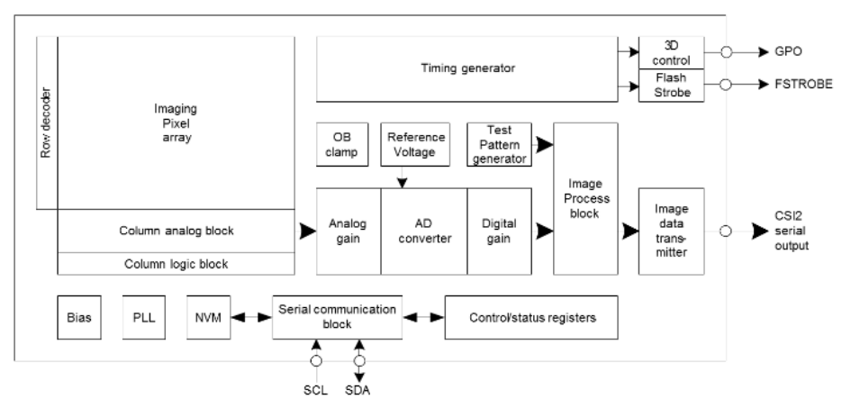
IMX219
https://www.electronicsdatasheets.com/download/5721ed8ce34e24fd697a913a.pdf

Slide 41
IMX219 DTS

Slide 42
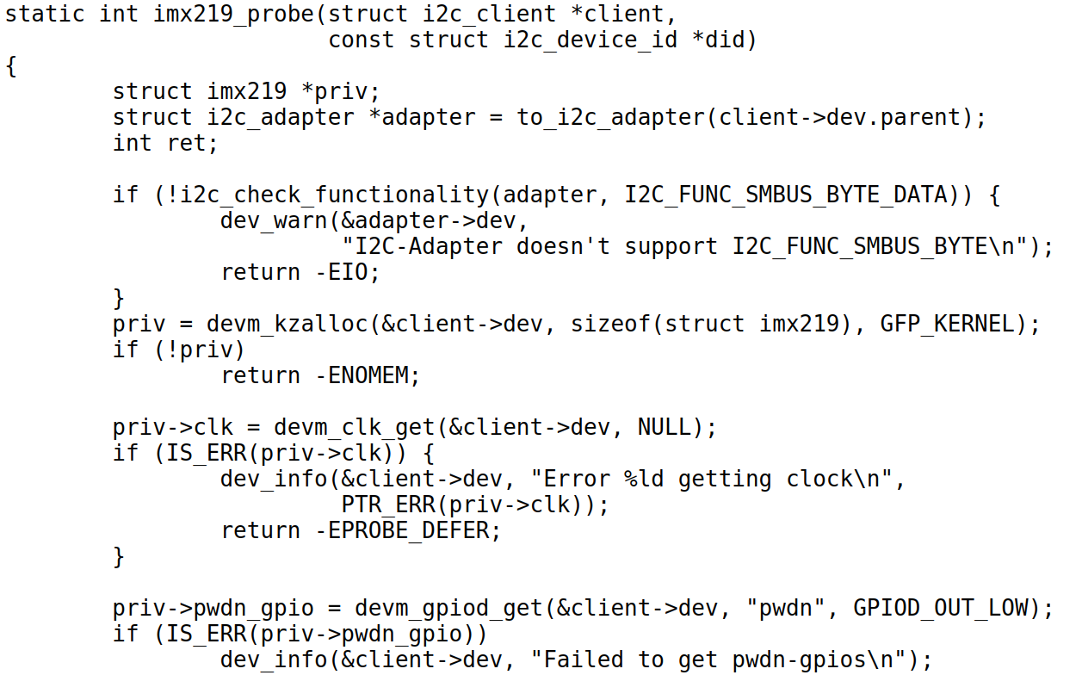
IMX219 Driver
GPIO
Power control

Slide 43
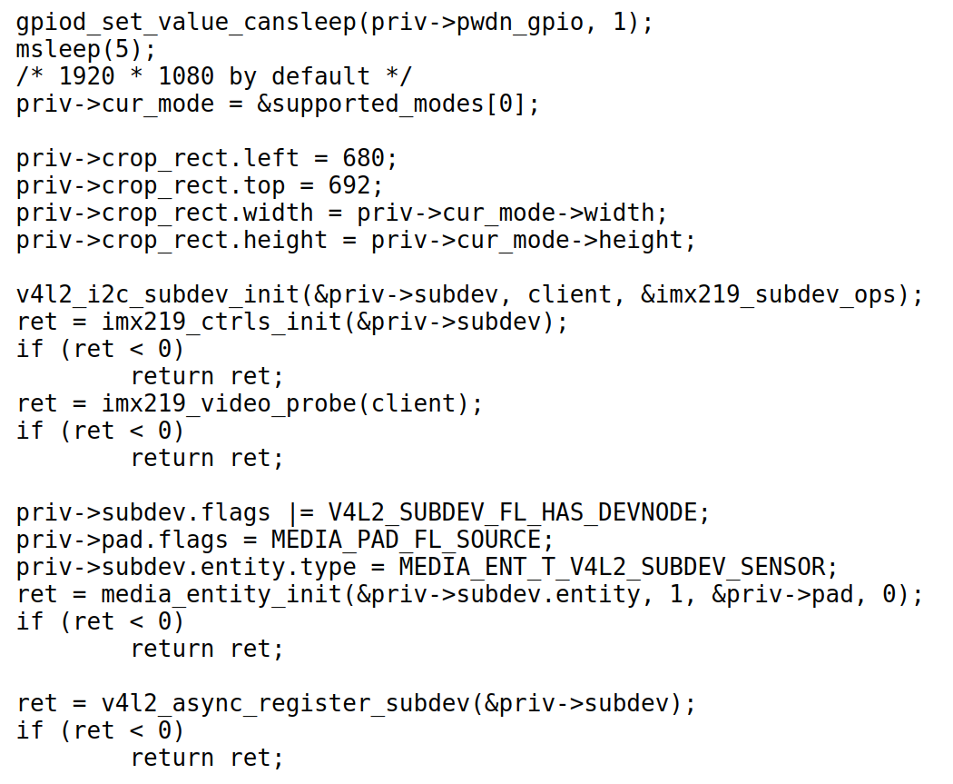
IMX219 Driver
Initial
sub-device ops
Create
sub-device node
Medial control
initial
sub-device
register

Slide 44
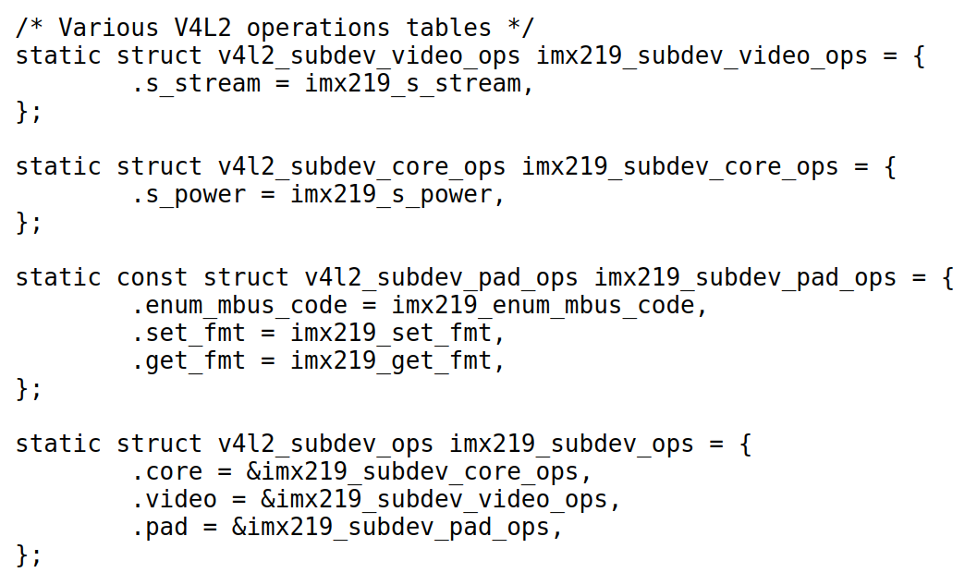
IMX219 Driver
Stream
Control
Power
Control
Media
Control

Slide 45
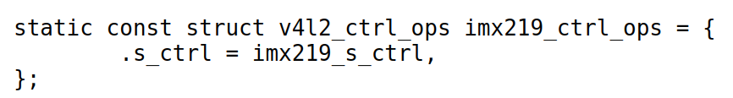
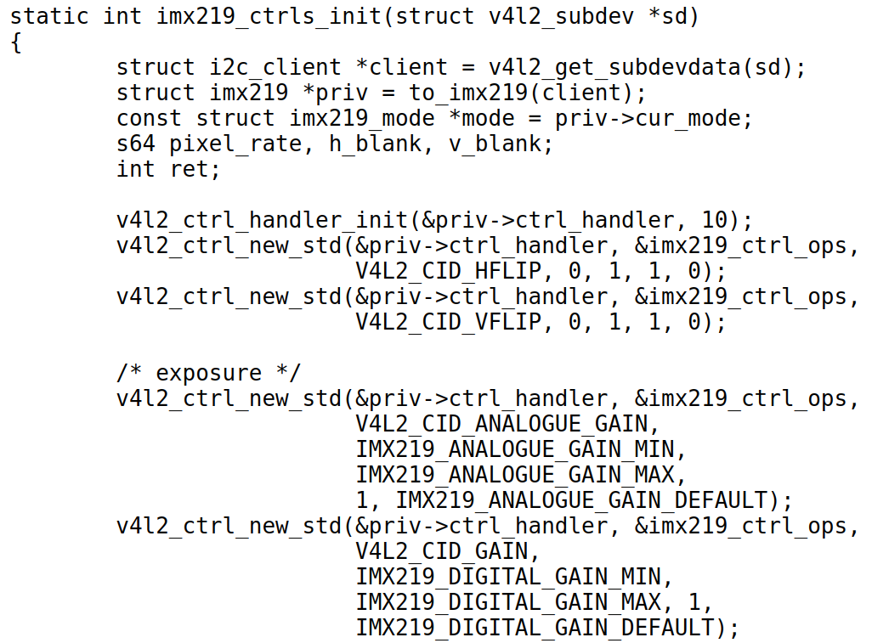
IMX219 Driver
V4l2 control
initial

Slide 46
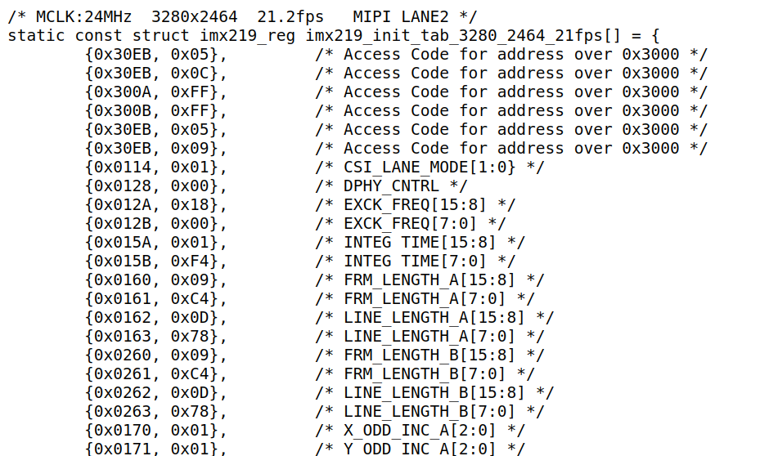
IMX219 Driver
Initial IMX291 Table1
MCLK:24MHz 3280x2464 21.2fps MIPI LANE2

Slide 47
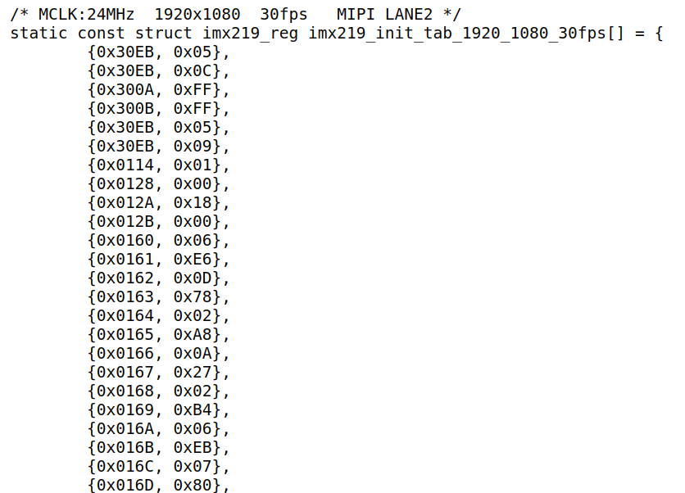
IMX219 Driver
Initial IMX291 Table2
MCLK:24MHz 1920x1080 30fps MIPI LANE2

Slide 48
Enable Camera Video
Enable Camera Module for RockPi4
  Change /boot/hw_intfc.conf:
    intfc:dtoverlay=imx219
Open Video
  gst-launch-1.0 v4l2src device=/dev/video0 io-mode=4 ! videoconvert ! autovideosink

Slide 49
Capture Image
Yavta
  Yet Another V4L2 Test Application
  https://git.ideasonboard.org/git/yavta.git/
Getting supported controls/formats/resolutions:
  yavta -l --enum-formats --enum-inputs /dev/video0
Capturing 10 frames on the disk
  yavta -F /dev/video0 --capture=10

Slide 50
Image View
Gstreamer
  gst-launch-1.0 v4l2src device=/dev/video1 io-mode=4 ! videoconvert ! video/x-raw,format=NV12,width=640,height=480 ! autovideosink
Vooya
  https://www.offminor.de/

Slide 51
v4l2-utils
Get video format
  v4l2-ctl -d /dev/video0 -V
List ctrls menus
  v4l2-ctl -d /dev/video0 -L
  v4l2-ctl -d /dev/video0 -l
Set the value of the controls
  v4l2-ctl -d /dev/video0 --set-ctrl gain=150
Help
  v4l2-ctl --help-all

