Slide 1
DRM / KMS

Slide 2


DRM
Direct Rendering Manager
  Management of buffers and free space within that memory.
  Solve Frame buffer driver cannot be used GPU and multi-user process.

Slide 3
DRM
DRM consists of
  KMS : Kernel Mode Setting
    Change resolution and depth
  DRI : Direct Rendering Infrastructure
    Interfaces to access hardware directly
  GEM : Graphics Execution Manager
    Buffer management
  DRM Driver in kernel side
    Access hardware

Slide 4
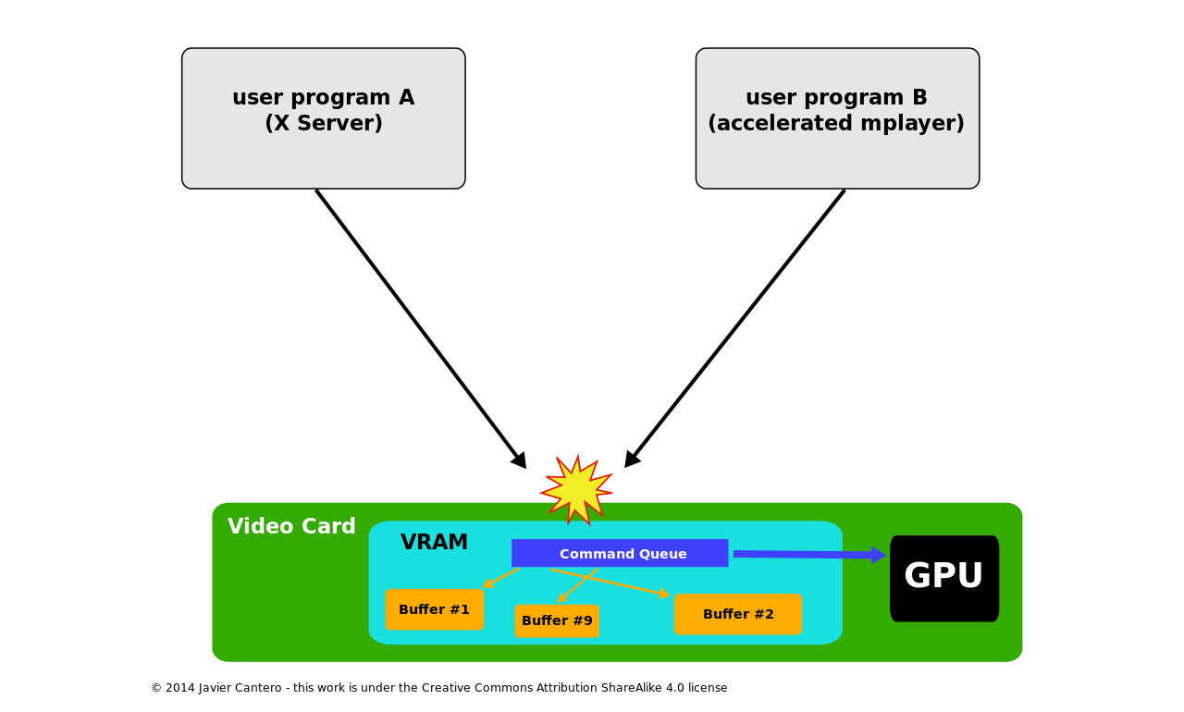
DRM
If no use DRM

Slide 5
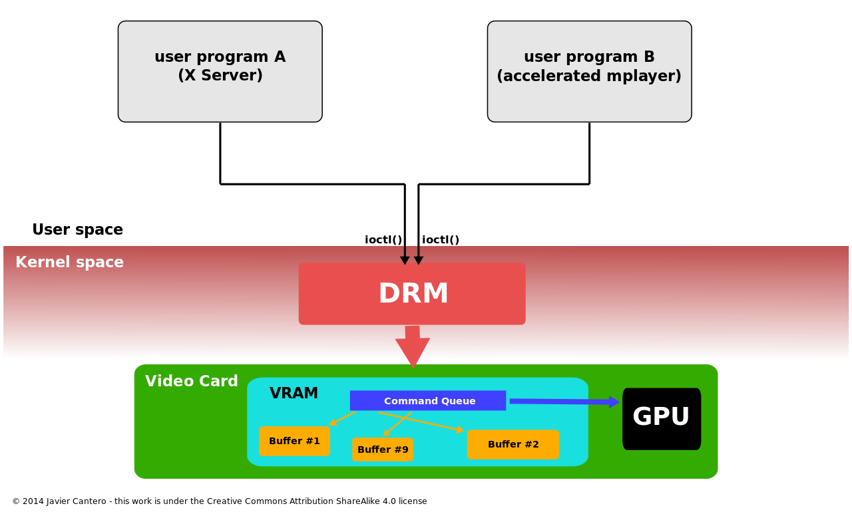
DRM
Use DRM

Slide 6

FBDEV
The frame buffer device provides an abstraction for the graphics hardware.
Application
User Space
memory
MMAP
Kernel Space
memory
FB Driver

Slide 7
V4L2
Video For Linux 2
  Multimedia, Video-In
  Rotator and Scaler
  Video codec

Slide 8
KMS
KMS device model
  CRTCs
  Connectors
  Encoders
  Planes
Kernel Mode Setting
  screen resolution
  color depth and
  refresh rate

Slide 9
KMS
linux-4.20.7/drivers/gpu/drm/
linux-4.20.7/drivers/gpu/drm/exynos
exynos_drm_crtc.c
exynos_drm_dpi.c
exynos_drm_drv.c
exynos_drm_dsi.c
exynos_drm_fb.c
exynos_drm_fbdev.c
exynos_drm_fimc.c
exynos_drm_fimd.c
exynos_drm_g2d.c
exynos_drm_gem.c
exynos_drm_gsc.c
exynos_drm_iommu.c
exynos_drm_ipp.c
exynos_drm_mic.c
exynos_drm_plane.c
exynos_drm_rotator.c
exynos_drm_scaler.c
exynos_drm_vidi.c
exynos_hdmi.c
exynos_mixer.c

Slide 10
KMS
exynos4412-tiny4412.dts
&fimd {
pinctrl-0 = <&lcd_clk &lcd_data24>;
pinctrl-names = "default";
samsung,invert-vden;
samsung,invert-vclk;
display-timings {
native-mode = <&timing0>;
timing0: timing {
clock-frequency = <33000000>;
hactive = <800>;
vactive = <480>;
hfront-porch = <90>;
hback-porch = <10>;
hsync-len = <28>;
vback-porch = <29>;
vfront-porch = <13>;
vsync-len = <3>;
vsync-active = <0>;
hsync-active = <0>;
pixelclk-active = <0>;

Slide 11
KMS
CRTC
Encode
Connecter
FrameBuffer
Planes

Slide 12
LCD Parameters
VBPD : vertical back porch
VFBD : vertical front porch
VSPW : vertical sync pulse width
HBPD : horizontal back porch
HFPD : horizontal front porth
HSPW : horizontal sync pulse width

Slide 13
LCD Display Parameters
Dotclock
  The video hardware draws pixels on the display speed
dotclock = (X-resolution + left margin + right
Margin + HSYNC length) *
(Y-resolution + upper margin + lower margin + VSYNC length) * refresh rate
pixclock = 1/dotclock

Slide 14
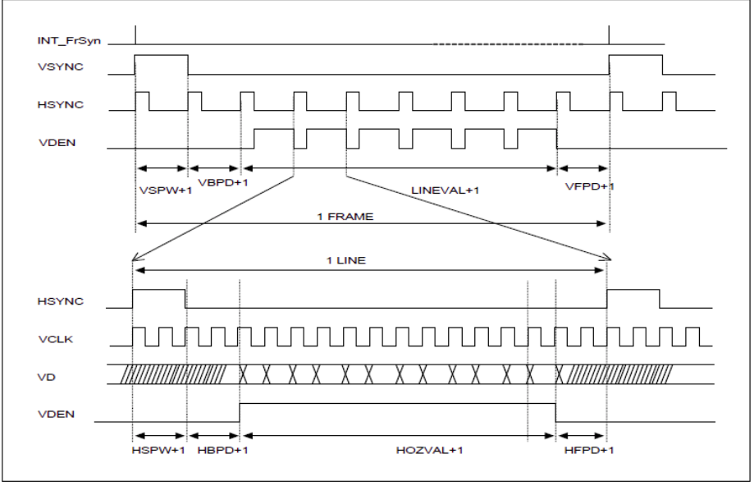
LCD Display Parameters

Slide 15
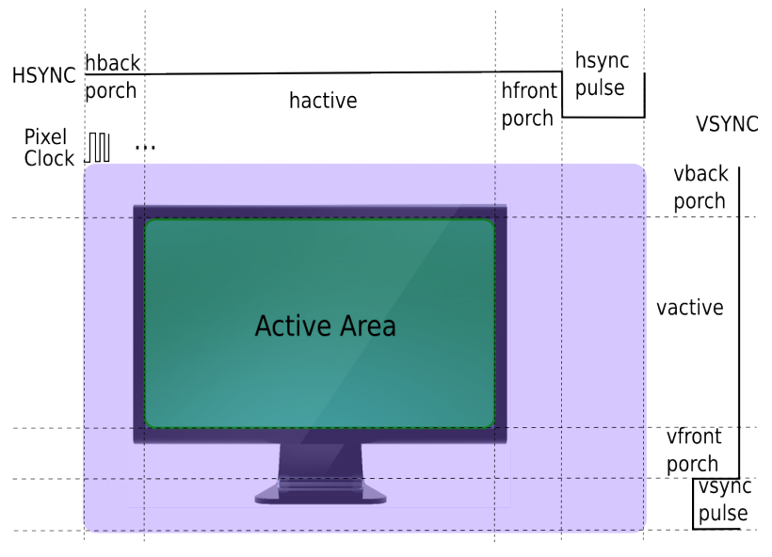
LCD Display Parameters

Slide 16
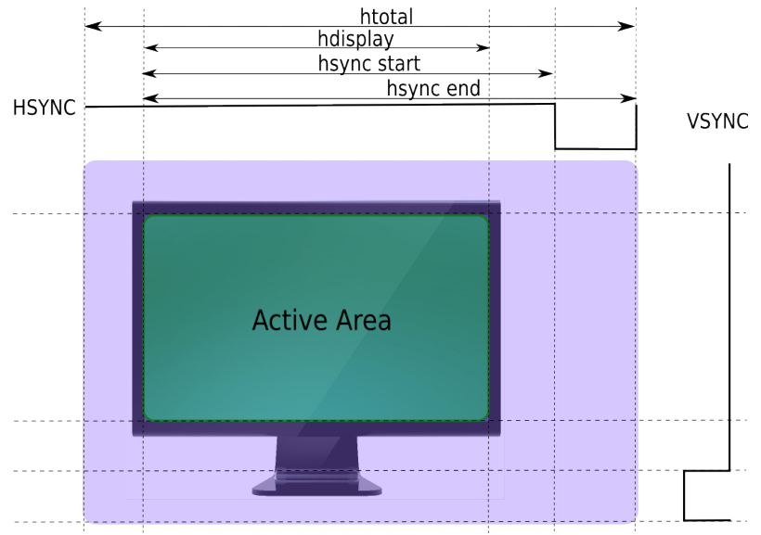
LCD Display Parameters

Slide 17
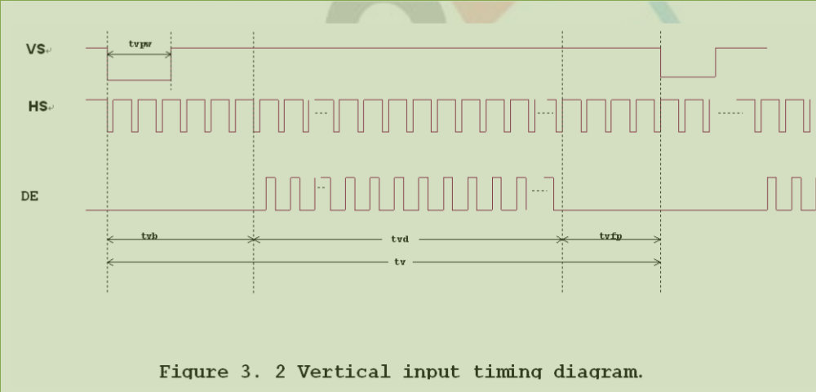
Tiny4412 LCD

Slide 18
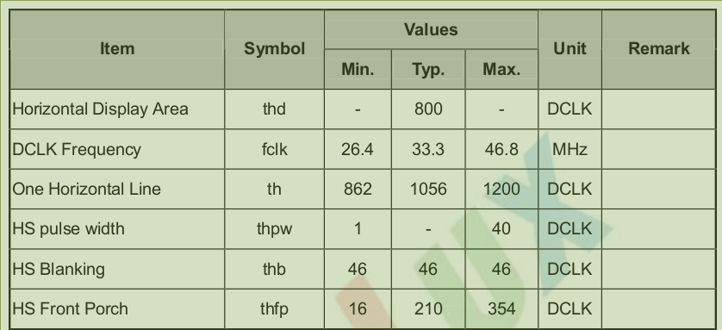
Tiny4412 LCD

Slide 19
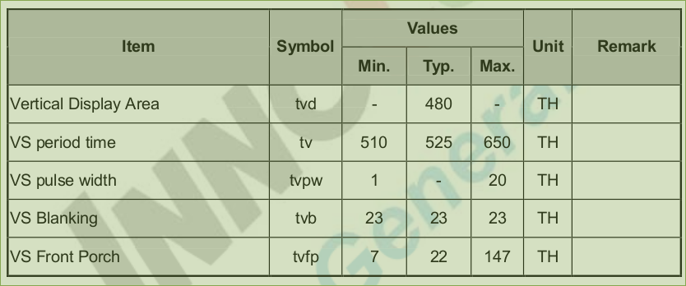
Tiny4412 LCD

Slide 20
Tiny4412 LCD

Slide 21
static int exynos_dpi_parse_dt(struct exynos_dpi *ctx)
{
[...]
np = of_get_child_by_name(dn, "display-timings");
if (np) {
struct videomode *vm;
int ret;
of_node_put(np);
[…]
ret = of_get_videomode(dn, vm, 0);
if (ret < 0) {
devm_kfree(dev, vm);
return ret;
}
[...]
return 0;
}

