Slide 1
GPIO Subsystem Driver

Slide 2
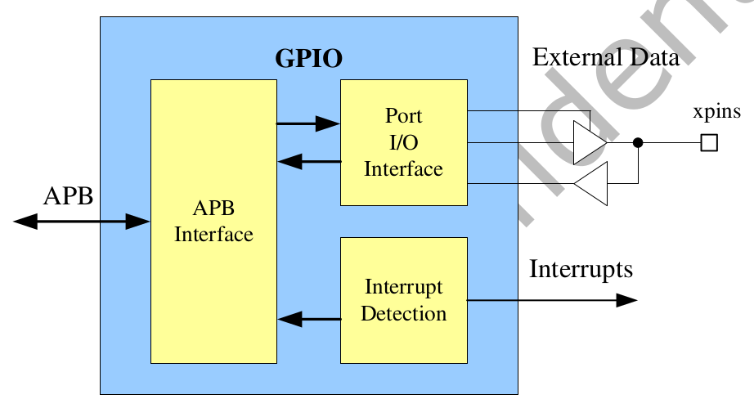
GPIO
General Purpose I/O
  Output
  Input
  Interrupt
GPIO0 ~ GPIO4

Slide 3
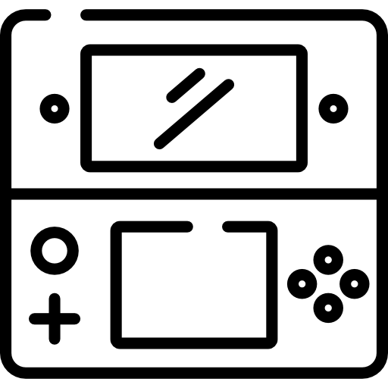
GPIO Subsystem
application
User mode
/sys/class/gpio
Kernel mode
gpiolib.c
Hwmon, iio
GPIO callback function
pinctrl-rockchip.c
Other driver
Hardware
PIN
GPIO
EXT_INT

Slide 4
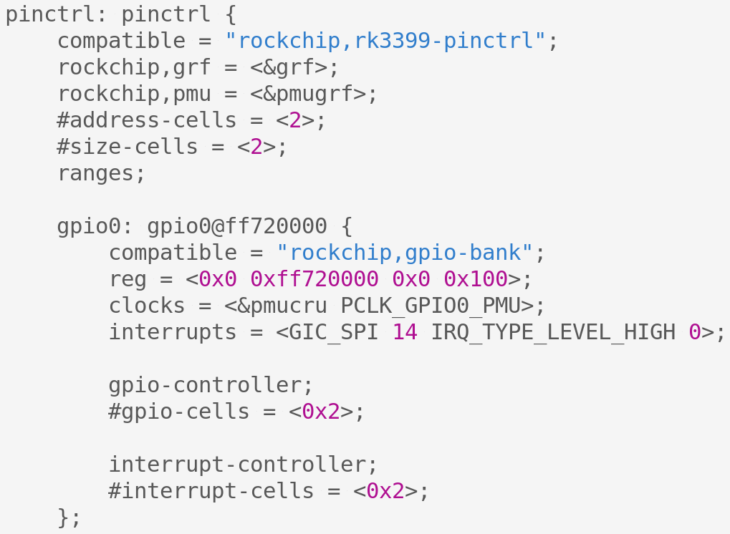
RK3399 GPIO Driver DTS
arch/arm64/boot/dts/rockchip/rk3399.dtsi

Slide 5
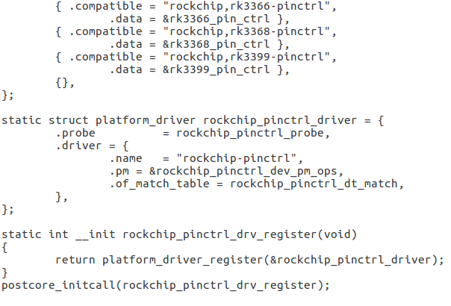
RK3399 GPIO Driver
drivers/pinctrl/pinctl-rockchip.c

Slide 6
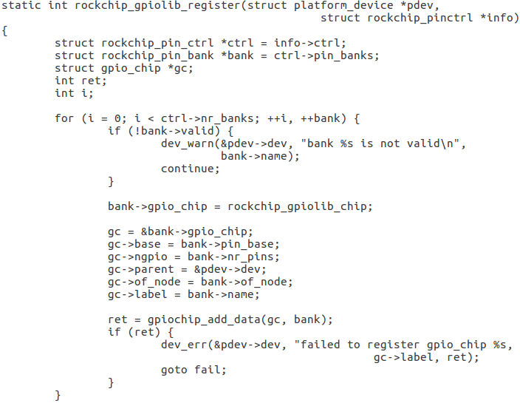

RK3399 GPIO Driver
gpio callback
function
/* register the gpiolib interface with
the gpiolib subsystem */
gpiolib

Slide 7
RK3399 GPIO Driver
GPIO Callback Function
static const struct gpio_chip rockchip_gpiolib_chip = {
.request = gpiochip_generic_request,
.free = gpiochip_generic_free,
.set = rockchip_gpio_set,
.get = rockchip_gpio_get,
.get_direction = rockchip_gpio_get_direction,
.direction_input = rockchip_gpio_direction_input,
.direction_output = rockchip_gpio_direction_output,
.to_irq = rockchip_gpio_to_irq,
.owner = THIS_MODULE,
};

Slide 8
RockPi4 GPIO Control

Slide 9
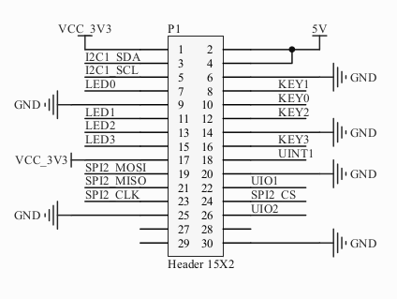
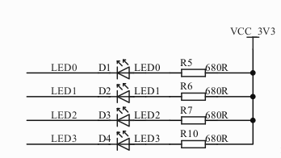
RockPi4 Ext Board LED

Slide 10
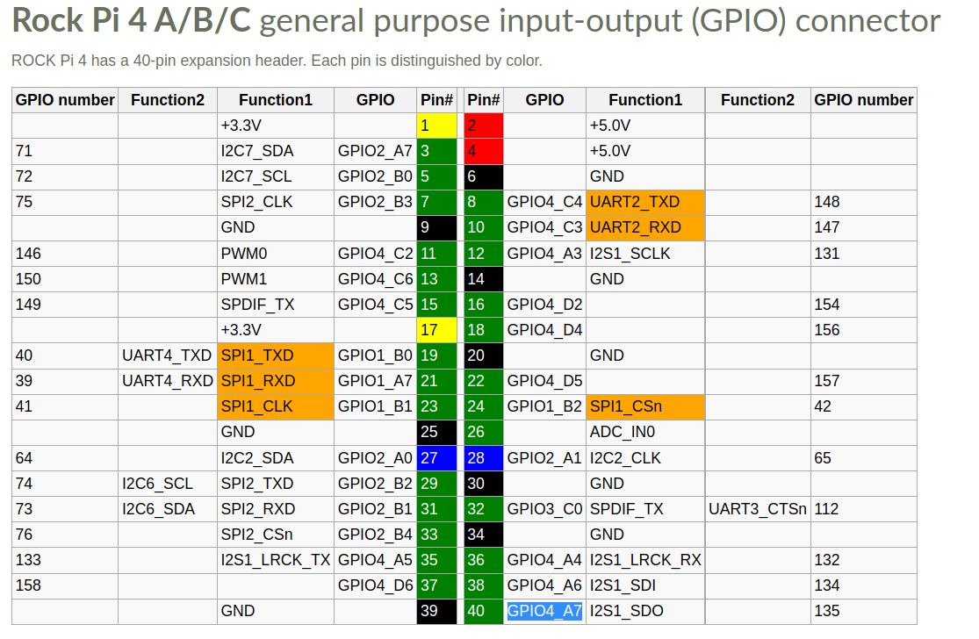
RockPi4 GPIO HEAD

Slide 11
GPIO4 in RK3399
Rockchip_RK3399_Datasheet_V2.0-20191010.pdf
  2.8 Function IO description
Rockchip_RK3399TRM_V1.3_Part1.pdf
  Chapter 4 General Register Files (GRF)
Rockchip_RK3399TRM_V1.3_Part2.pdf
  Chapter 10 GPIO

Slide 12
GPIO Control (LED) in Kernel Space
User space
/dev/leds
Kernel Space
2
1
sample_leds.c
DeviceTree
GPIO Configure
gpiolib.c
pinctrl-rockchip.c
Hardware
LED

Slide 13
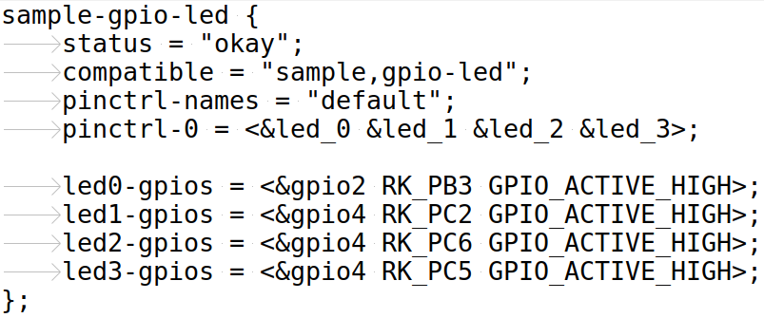
LED Driver- DTS
Pin Function Configure
Label led1-gpios present a GPIO4 pin C2 (18)

Slide 14
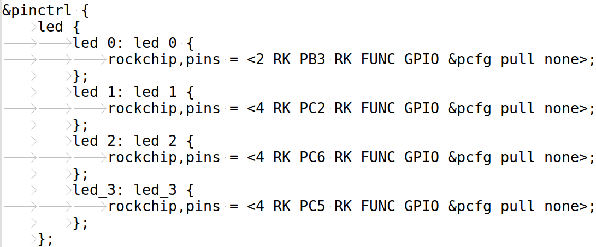
LED Driver - DTS
Pin Function Configure
GPIO4 Port C Bit 2 as GPIO Function

Slide 15
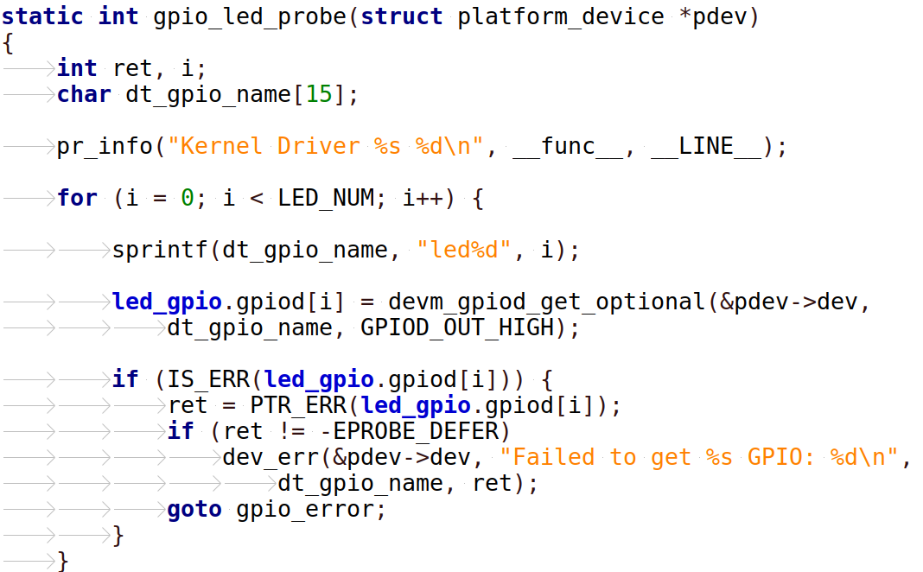
LED Driver
Get pin
control handle

Slide 16
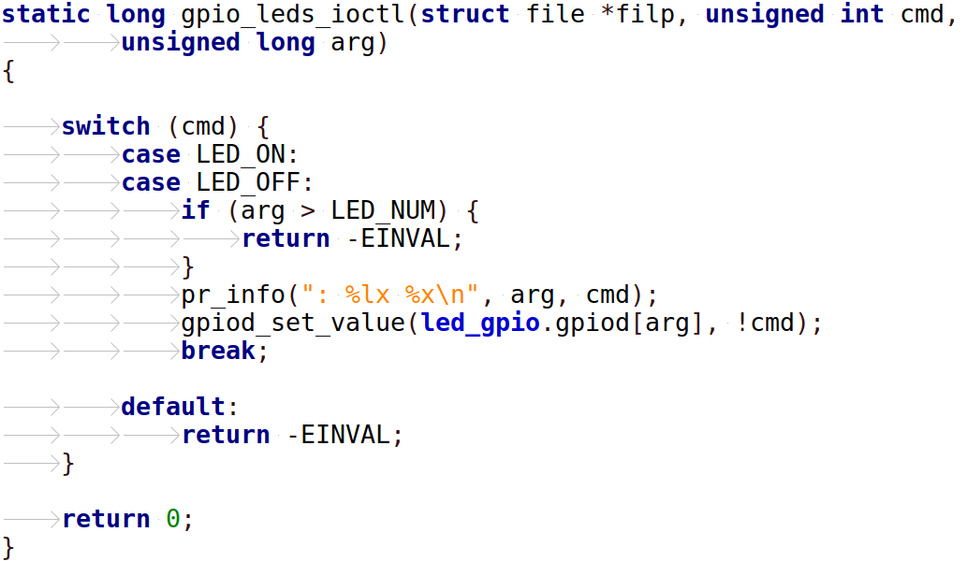
LED Driver
Set pin value

Slide 17
GPIO Control in User Space
Path in SysFS
/sys/class/gpio:
  Control interfaces used to get user-space control over GPIOs
  GPIO controllers("gpio_chip" instances)
  "export" : ask the kernel to export GPIO to userspace by writing
    "echo 19 > export"
    create a "gpio19" node in /sys/class/gpio
  "unexport" : Reverses the effect of exporting to userspace
    "echo 19 > unexport"
    remove "gpio19" node from /sys/class/gpio

Slide 18
GPIO Subsystem
application
User mode
/sys/class/gpio
Kernel mode
gpiolib.c
pinctrl-rockchip.c
Hardware
PIN
GPIO
EXT_INT

Slide 19
LED Driver – UserSpace
How to compute GPIO pin number
Control GPIO4 PC2
1 . Pin 18 => 32 * 4 + 2 * 8 + 2
2. rockpi-kernel/include/dt-bindings/pinctrl/rockchip.h
1. [CMD] cat /sys/class/gpio/gpiochip128/label
2. [CMD] echo 146 > /sys/class/gpio/export
3. [CMD] echo out > /sys/class/gpio/gpio146/direction
4. [CMD] echo 1 > /sys/class/gpio/gpio146/value
5. [CMD] echo 0 > /sys/class/gpio/gpio146/value

Slide 20
GPIO Kernel API

Slide 21
GPIO Control API
driver/gpio/gpiolib.c
Basic Function
  GPIO Setting
    int gpio_direction_input(unsigned gpio)
    int gpio_direction_output(unsigned gpio, int value)
  GPIO Access
    int gpio_get_value(unsigned gpio)
    void gpio_set_value(unsigned gpio, int value)

Slide 22
GPIO Kernel API
DTS gpio
property
struct gpio_desc *__must_check
devm_gpiod_get_optional (struct device *dev, const char *con_id,
enum gpiod_flags flags)
void gpiod_set_value(struct gpio_desc *desc, int value)
Int gpiod_get_value(const struct gpio_desc *desc);
https://elixir.bootlin.com/linux/v4.4.154/source/drivers/gpio/gpiolib.c

Slide 23
GPIO Output in DTS
sample-gpio-led {
status = "disabled";
compatible = "sample,gpio-led";
pinctrl-names = "default";
pinctrl-0 = <&led_0 &led_1 &led_2 &led_3>;
led0-gpios = <&gpio2 RK_PB3 GPIO_ACTIVE_HIGH>;
led1-gpios = <&gpio4 RK_PC2 GPIO_ACTIVE_HIGH>;
led2-gpios = <&gpio4 RK_PC6 GPIO_ACTIVE_HIGH>;
led3-gpios = <&gpio4 RK_PC5 GPIO_ACTIVE_HIGH>;
};
NAME-gpios = <&GPIO-PIN GPIO_INIT_STATUS>
devm_gpiod_get_optional (struct device *dev,
const char *con_id,
enum gpiod_flags flags)

Slide 24
GPIO Output in Kernel Space
for (i = 0; i < LED_NUM; i++) {
sprintf(dt_gpio_name, "led%d", i);
led_gpio.gpiod[i] = devm_gpiod_get_optional(&pdev->dev,
dt_gpio_name,
GPIOD_OUT_HIGH);
if (IS_ERR(led_gpio.gpiod[i])) {
….
goto gpio_error;
}
}
Get GPIO
handle

Slide 25
GPIO output in Kernel Space
static long sample_leds_ioctl(struct file *filp, unsigned int cmd,
unsigned long arg)
{
switch (cmd) {
case LED_ON:
case LED_OFF:
if (arg > LED_NUM) {
return -EINVAL;
}
gpiod_set_value(led_gpio.gpiod[arg], !cmd);
break;
...…
}
Set GPIO value

Slide 26
GPIO External Interrupt

Slide 27
GPIO and IRQ
GPIOs mapped to IRQs
  map GPIO numbers to IRQ numbers
    int gpio_to_irq(unsigned gpio)
  map IRQ numbers to GPIO numbers (avoid)
    int irq_to_gpio(unsigned irq)

Slide 28
GPIO IRQ API - 1
Get GPIO Control Handle
struct gpio_desc * devm_gpiod_get_optional ( struct device *dev,
const char *con_id,
enum gpiod_flags flags)
int gpiod_to_irq (const struct gpio_desc *desc)
Int devm_request_irq ( struct device *dev, unsigned int irq,
irq_handler_t handler, unsigned long irqflags,
const char *devname, void *dev_id)
void disable_irq (unsigned int irq);
void enable_irq (unsigned int irq);

Slide 29
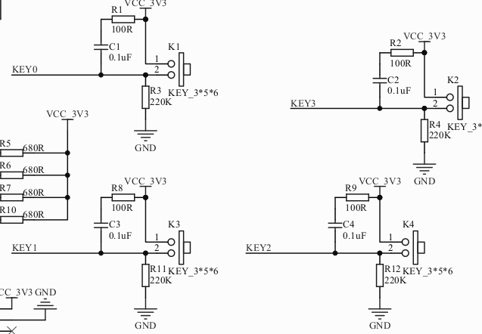
GPIO External Interrupt

Slide 30
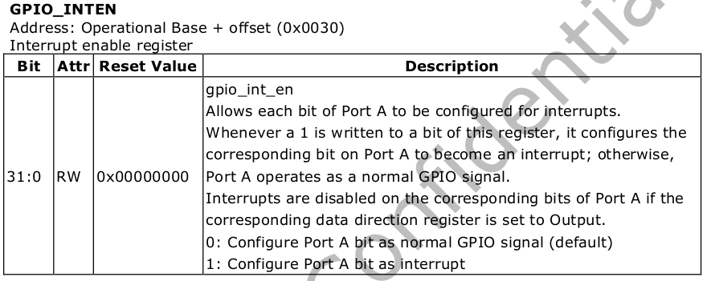
GPIO External Interrupt
Chapter 10 GPIO

Slide 31
GPIO IRQ in DTS
irq-gpio-sample {
status = "okay";
compatible = "gpiokey,irq-sample";
pinctrl-names = "default";
pinctrl-0 = <&key_0 &key_1>;
key0-gpios = <&gpio4 RK_PA3 GPIO_ACTIVE_LOW>;
key1-gpios = <&gpio4 RK_PD2 GPIO_ACTIVE_LOW>;
};
NAME-gpios = <&GPIO-PIN GPIO-PIN-NO. GPIO_INIT_STATUS>

Slide 32
GPIO IRQ in DTS
PinMux Control
&pinctrl {
btn {
key_0: key_0 {
rockchip,pins = <4 RK_PA3 RK_FUNC_GPIO &pcfg_pull_none>;
};
key_1: key_1 {
rockchip,pins = <4 RK_PD2 RK_FUNC_GPIO &pcfg_pull_none>;
};
…..
};
};
};
rockchip,pins = <PIN_GROUP
PIN_NUM
PIN_FUNCTION
PIN_VOLAGE_TYPE
>;

Slide 33
GPIO IRQ in Kernel
Example - 3-3-1-isr-key
for (i = 0; i < GPIO_NUM; i++) {
irq_gpio.irq[i] = 0;
sprintf(dt_gpio_name, "irq%d", i);
irq_gpio.gpiod[i] = devm_gpiod_get_optional(&pdev->dev,
dt_gpio_name, GPIOD_IN);
if (IS_ERR(irq_gpio.gpiod[i])) {
…….
}
Get GPIO handle

Slide 34
GPIO IRQ in Kernel
GPIO to IRQ
irq_gpio.irq[i] = gpiod_to_irq(irq_gpio.gpiod[i]);
ret = devm_request_irq(&pdev->dev, irq_gpio.irq[i],
gpio_irq_isr, IRQ_TYPE_EDGE_FALLING,
"gpio-irq", &irq_gpio.irq[i]);
if (ret) {
….
}
disable_irq_nosync(irq_gpio.irq[i]);
}
IRQ register

Slide 35
GPIO IRQ in Kernel
Interrupt Register
ret = devm_request_irq(&pdev->dev, irq_gpio.irq[i],
gpio_irq_isr, IRQ_TYPE_EDGE_FALLING,
"gpio-irq", &irq_gpio.irq[i]);
ISR
static irqreturn_t gpio_irq_isr(int irq, void *devid)
{
int *gpio_irq_num;
gpio_irq_num = (int *)devid;
pr_err("IRQ %d, gpio_irq_num %d\r\n", irq, *gpio_irq_num);
return 0;
}

Slide 36
GPIO IRQ API - 2
Get GPIO Control Handle
struct gpio_desc * devm_gpiod_get_optional ( struct device *dev,
const char *con_id,
enum gpiod_flags flags)
int platform_get_irq(struct platform_device *, unsigned int);
Int devm_request_irq ( struct device *dev, unsigned int irq,
irq_handler_t handler, unsigned long irqflags,
const char *devname, void *dev_id)

Slide 37
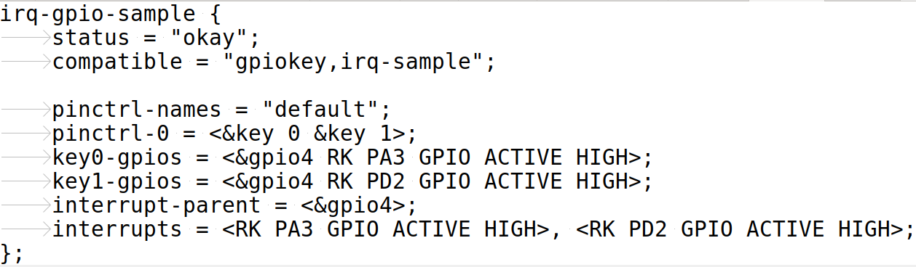
GPIO IRQ in DTS - 2
Example 3-3-2-isr-key
interrupt-parent = <&gpio4>;
IRQ Source
interrupts = <RK_PA3 GPIO_ACTIVE_HIGH>, …
IRQ Number

Slide 38
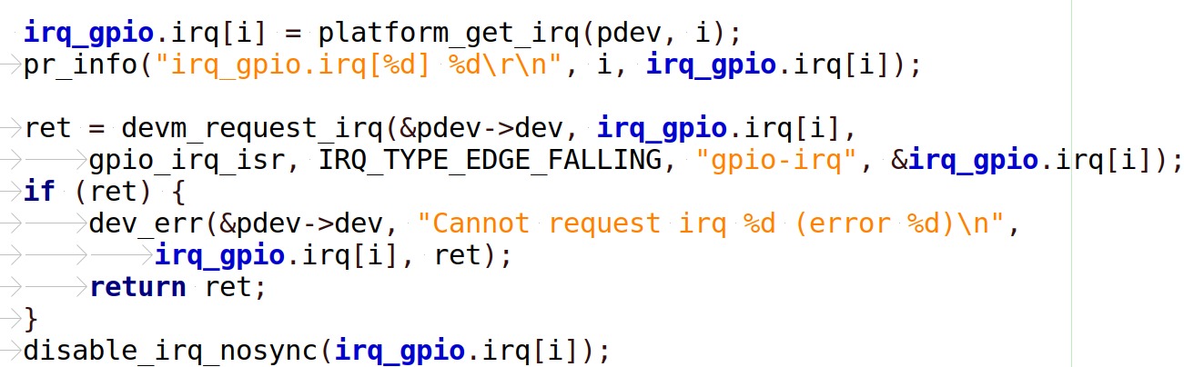
GPIO IRQ in Kernel - 2
Example 3-3-2-isr-key
Get IRQ Num
Register IRQ

