Slide 1
Hwmon Subsystem

Slide 2
Hwmon Subsystem
User
/sys/class/hwmon
attr_show
Hwmon.c
attr_store
Register
I2C driver
Hwmon driver
SPI driver
Kernel
GPIO driver
Hardware
Sensor

Slide 3


SHT2x
The supply voltage
  2.1 – 3.6V
I2C I/F
7-bit I2C device address
  0X1000000 → 0x40

Slide 4
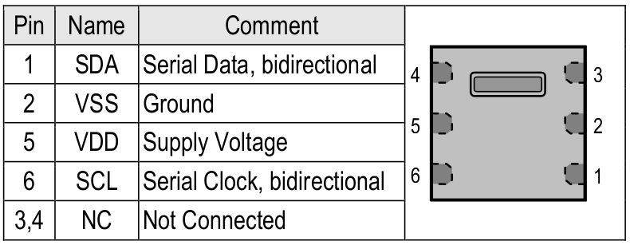
Interface Specifications

Slide 5
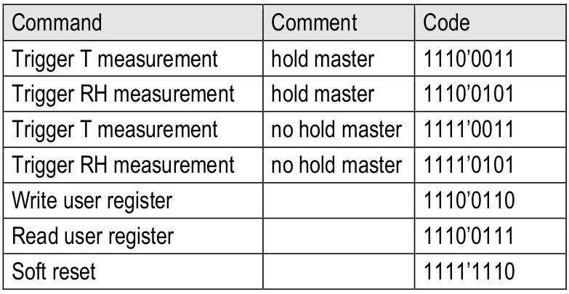
Basic command set

Slide 6
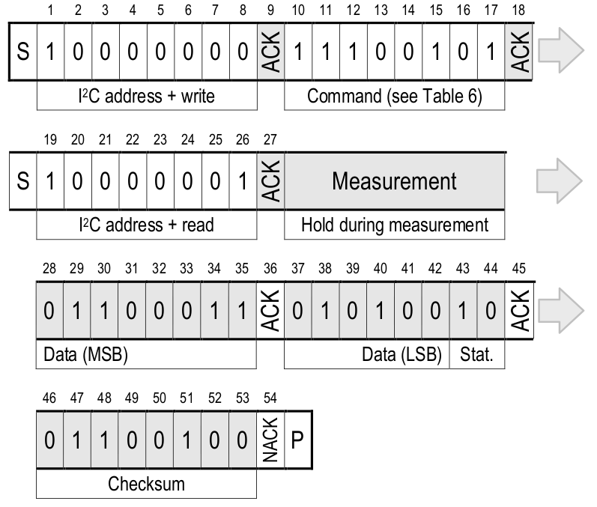
Hold Communication Sequence

Slide 7
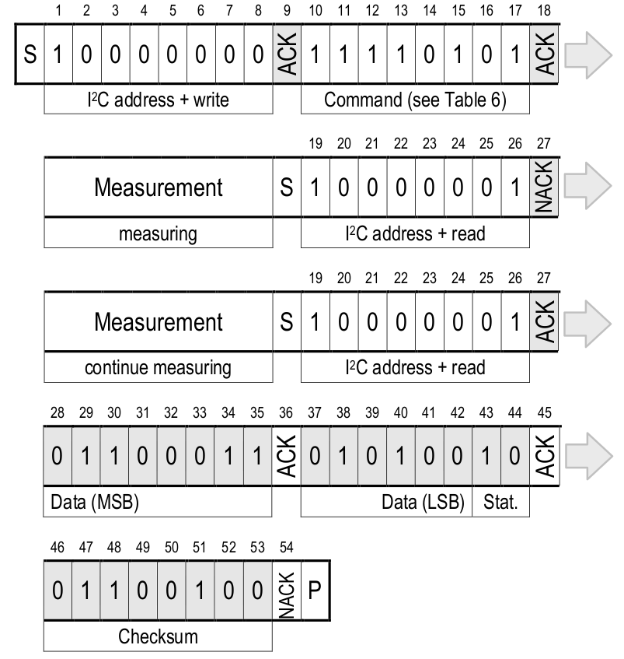
No Hold Communication Sequence

Slide 8
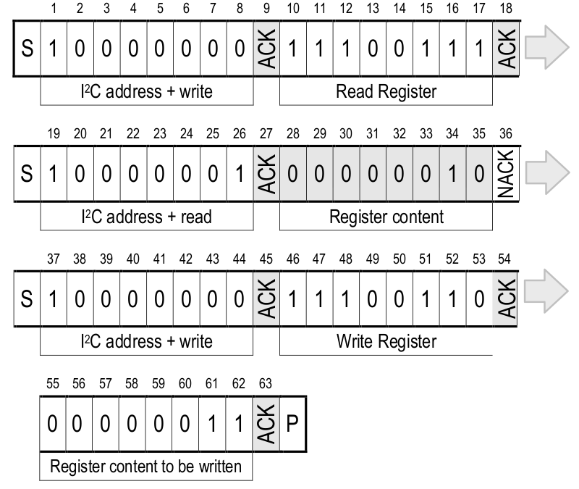
Read and Write Register Sequence

Slide 9
Read Temperature and Humiduty

Slide 10
Hwmon Driver in SysFS
ls -l /sys/class/hwmon
hwmon1 -> ../../devices/platform/sht15@0/hwmon/hwmon1
ls -l /sys/class/hwmon1/
device -> ../../../sht15@0
of_node -> ../../../../../firmware/devicetree/base/sht15@0
power
subsystem -> ../../../../../class/hwmon
uevent
Sensor attribute
DTS info

Slide 11
Hwmon Driver in SysFS
/sys/class/hwmon/hwmon1/device
driver -> ../../../bus/platform/drivers/sht15
driver_override
heater_enable
humidity1_fault
humidity1_input
hwmon
modalias
name
of_node -> ../../../firmware/devicetree/base/sht15@0
power
subsystem -> ../../../bus/platform
temp1_fault
temp1_input
uevent
Read Humidity :
$ cat humidity1_input
60486
Read Temp:
$ cat temp1_input
25640

Slide 12
Hwmon API

Slide 13
Hwmon– Kernel API
hwmon_device_register
  registers a hardware monitoring device
  sysfs attributes are expected to have been created
hwmon_device_register_with_groups
  The name parameter is a pointer to the hwmon device name
  System create a name sysfs attribute pointing to this name
  The drvdata parameter is the pointer to the local driver data
  The groups parameter is a pointer to a list of sysfs attribute groups
devm_hwmon_device_register_with_groups
  it is device managed, meaning the hwmon device does not have to be
  removed explicitly by the removal function

Slide 14
Hwmon Sensor SHT21 Driver
User
/sys/class/hwmon
attr_show
Hwmon.c
attr_store
Register
I2C driver
sht21 driver
Kernel
Hardware
SHT-21

Slide 15
Hwmon – SHT2x DTS
&i2c2 {
status = "okay";
sht21@40 {
#address-cells = <1>;
#size-cells = <0>;
compatible = "sensirion,sht21";
reg = <0x40>;
};
};
DTS Node
PinMux is same as I2C
PinMux
i2c2 {
i2c2_xfer: i2c2-xfer {
rockchip,pins =
<2 1 RK_FUNC_2 &pcfg_pull_none_12ma>,
<2 0 RK_FUNC_2 &pcfg_pull_none_12ma>;
};
};

Slide 16
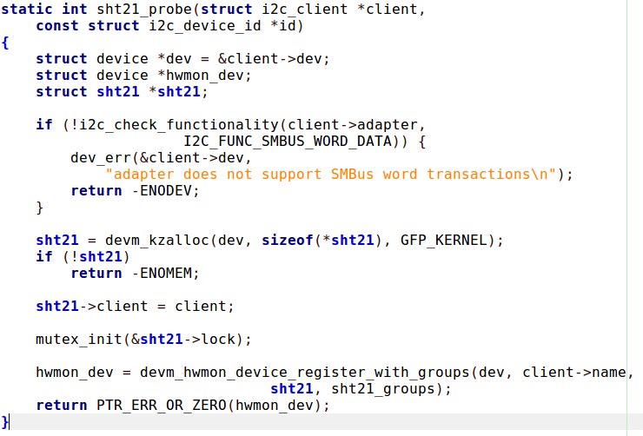
Hwmon SHT2x Driver

Slide 17
Hwmon SHT2x Driver
SHT21
/* sysfs attributes */
static SENSOR_DEVICE_ATTR(temp1_input, S_IRUGO, sht21_show_temperature,
NULL, 0);
static SENSOR_DEVICE_ATTR(humidity1_input, S_IRUGO, sht21_show_humidity,
NULL, 0);
static struct attribute *sht21_attrs[ ] = {
&sensor_dev_attr_temp1_input.dev_attr.attr,
&sensor_dev_attr_humidity1_input.dev_attr.attr,
NULL
};
ATTRIBUTE_GROUPS(sht21);
https://elixir.bootlin.com/linux/v4.4.178/source/include/linux/hwmon-sysfs.h#L36
https://elixir.bootlin.com/linux/v4.4.178/source/include/linux/sysfs.h#L152

Slide 18
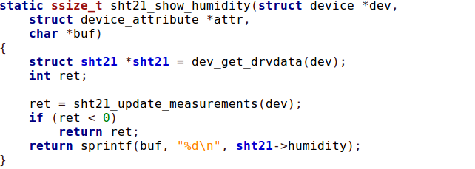
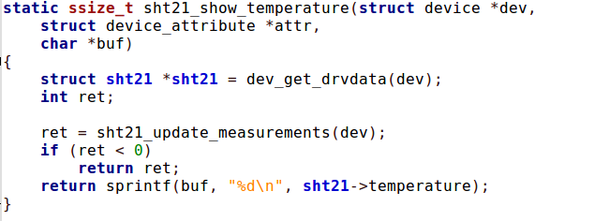
Hwmon SHT2x Driver

Slide 19
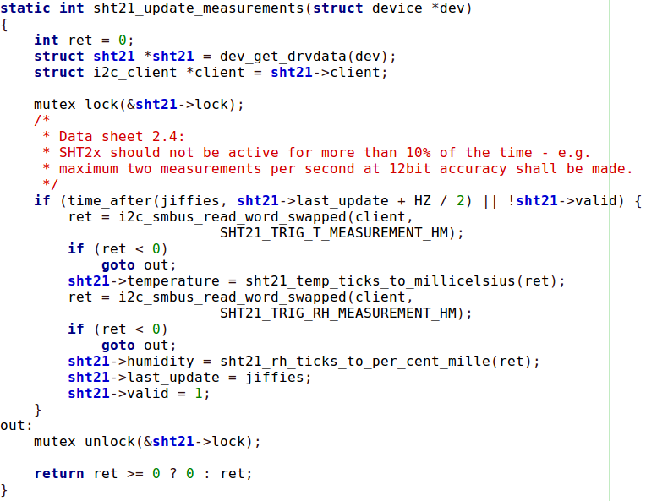
Hwmon SHT2x Driver

Slide 20
Hwmon – SHT15 Sensor
User
/sys/class/hwmon
attr_show
Hwmon.c
attr_store
Register
GPIO driver
sht15 driver
Kernel
Hardware
SHT-15

Slide 21
Hwmon – SHT15 Sensor
sht15: sht15@0 {
status = "okay";
compatible = "sensirion,sht15";
pinctrl-names = "default";
pinctrl-0 = <&sht15_sck &sht15_data>;
sck-gpios = <&gpio1 RK_PC6 GPIO_ACTIVE_HIGH>;
data-gpios = <&gpio1 RK_PC7 GPIO_ACTIVE_HIGH>;
};
DTS Node
&pinctrl {
sht15_gpio {
sht15_sck: sht15_sck {
rockchip,pins = <1 RK_PC6 RK_FUNC_GPIO &pcfg_pull_none>;
};
sht15_data: sht15_data {
rockchip,pins = <1 RK_PC7 RK_FUNC_GPIO &pcfg_pull_up>;
};
};
…..
PinMux

