Slide 1
I2C Drivers

Slide 2
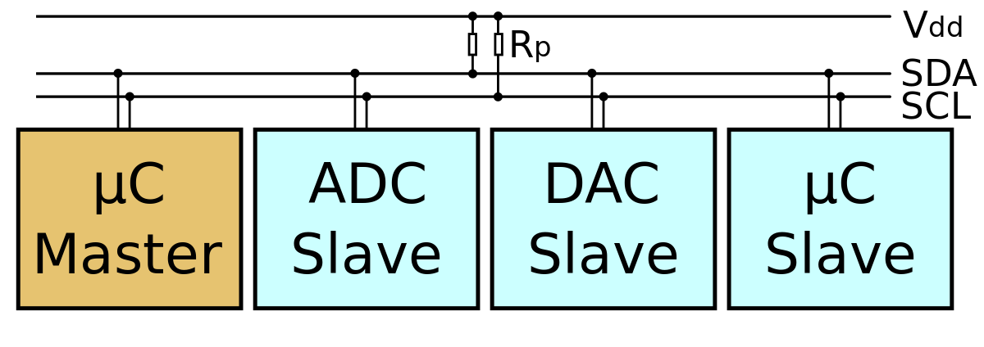
I2C Driver
https://zh.wikipedia.org/wiki/I%C2%B2C

Slide 3
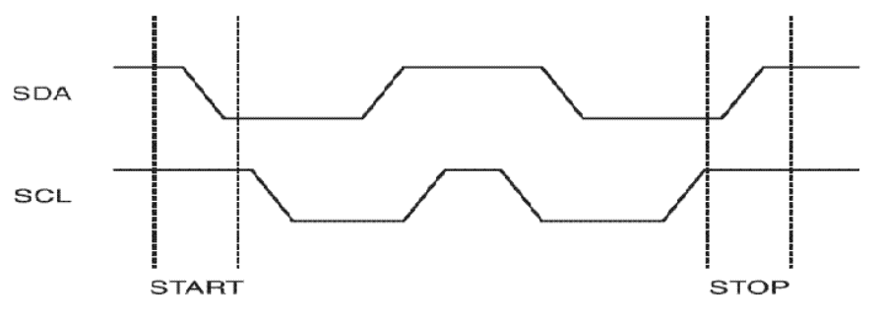


I2C protocol
Serial bus
  SDA data line
  SCL clock line

Slide 4
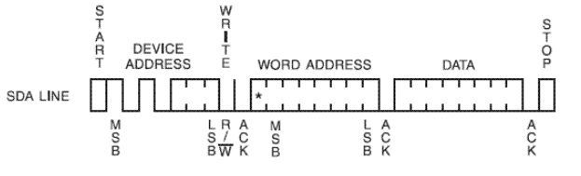
I2C protocol
Write
  byte write
  page write
Device address
Read/write bit : 0
ACK

Slide 5
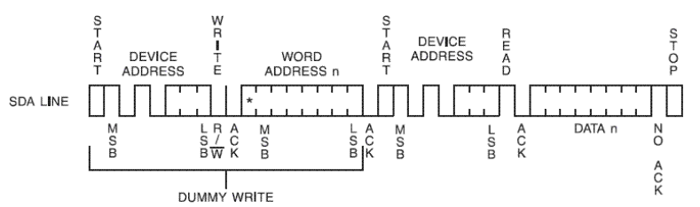
I2C protocol
Read
  byte read
  page read
Device address
Read/write bit : 1
ACK

Slide 6
I2C Host (adapter) Driver

Slide 7
Linux I2C Subsystem
Application
User mode driver
/sys/, /dev/
/dev/i2c-X
I2c-core
(API)
I2c-dev
I2c-client driver
I2c-adapter driver
I2c device
I2c Host
Controller
I2C Bus

Slide 8
Linux I2C Subsystem
Application
User mode driver
/sys/, /dev/
/dev/i2c-X
I2c-core
(API)
I2c-dev
I2c-client driver
I2c-adapter driver
I2c device
I2c Host
Controller
I2C Bus

Slide 9
I2C driver source
https://elixir.bootlin.com/linux/latest/source/drivers/i2c
i2c-boardinfo.c
i2c-core-acpi.c
i2c-core-base.c
i2c-core-of.c
i2c-core-slave.c
i2c-core-smbus.c
i2c-dev.c
i2c-mux.c
i2c-slave-eeprom.c
i2c-smbus.c
i2c-stub.c
algos/
├── built-in.a
├── i2c-algo-bit.c
├── i2c-algo-bit.o
├── i2c-algo-pca.c
├── i2c-algo-pcf.c
├── i2c-algo-pcf.h
├── Kconfig
├── Makefile
├── modules.builtin
└── modules.order
busses/
├── built-in.a
├── i2c-acorn.c
├── i2c-ali1535.c
├── i2c-ali1563.c
├── i2c-ali15x3.c
├── i2c-altera.c
├── i2c-amd756.c
├── i2c-amd8111.c
├── i2c-aspeed.c
├── i2c-at91.c
├── i2c-au1550.c
├── i2c-cadence.c
muxes/
├── built-in.a
├── i2c-arb-gpio-challenge.c
├── i2c-demux-pinctrl.c
├── i2c-mux-gpio.c
├── i2c-mux-gpmux.c
├── i2c-mux-ltc4306.c
├── i2c-mux-mlxcpld.c
├── i2c-mux-pca9541.c
├── i2c-mux-pca954x.c
├── i2c-mux-pinctrl.c
├── i2c-mux-reg.c

Slide 10
I2C Host (adapter) Driver
platform_driver_register
i2c_register_adapter
rk3x_i2c_probe
bus_for_each_drv
initialize
Wait new I2C device notify
i2c_add_numbered_adapter
I2c-rk3x.c
I2c-core-base.c

Slide 11
The bus type of the device struct bus_type
i2c-core-base.c
struct bus_type i2c_bus_type = {
.name = "i2c",
.match = i2c_device_match,
.probe = i2c_device_probe,
.remove = i2c_device_remove,
.shutdown = i2c_device_shutdown,
};
EXPORT_SYMBOL_GPL(i2c_bus_type);

Slide 12
The bus type of the device struct bus_type
static int i2c_device_match(struct device *dev, struct device_driver *drv)
{
struct i2c_client *client = i2c_verify_client(dev);
struct i2c_driver *driver;
/* Attempt an OF style match */
if (i2c_of_match_device(drv->of_match_table, client))
return 1;
…..
driver = to_i2c_driver(drv);
/* Finally an I2C match */
if (i2c_match_id(driver->id_table, client))
return 1;
return 0;
}

Slide 13
The bus type of the device struct bus_type
static int i2c_device_probe(struct device *dev)
{
~~~~~~~~~~~~~~~~~~~~~~~~~~~~
/*
* When there are no more users of probe(),
* rename probe_new to probe.
*/
if (driver->probe_new)
status = driver->probe_new(client);
else if (driver->probe)
status = driver->probe(client,
i2c_match_id(driver->id_table, client));
else
status = -EINVAL;
~~~~~~~~~~~~~~~~~~~~~~~~~~~~

Slide 14
I2C DeviceTree
rk3399.dtsi
I2c adapter driver
i2c0: i2c@ff3c0000 {
compatible = "rockchip,rk3399-i2c";
reg = <0x0 0xff3c0000 0x0 0x1000>;
clocks = <&pmucru SCLK_I2C0_PMU>,
<&pmucru PCLK_I2C0_PMU>;
clock-names = "i2c", "pclk";
interrupts = <GIC_SPI 57 IRQ_TYPE_LEVEL_HIGH 0>;
pinctrl-names = "default";
pinctrl-0 = <&i2c0_xfer>;
#address-cells = <1>;
#size-cells = <0>;
status = "disabled";
};

Slide 15
I2C DeviceTree
rk3399.dtsi
PinMux
i2c0 {
i2c0_xfer: i2c0-xfer {
rockchip,pins =
<1 15 RK_FUNC_2 &pcfg_pull_none>,
<1 16 RK_FUNC_2 &pcfg_pull_none>;
};
};

Slide 16
I2C Dev Interface

Slide 17
I2C Dev Interface
#include <linux/i2c-dev.h>
i2c tool
  i2cset, i2cget, i2cdump
  i2cdetect -l
/dev/i2c-x
  /dev/i2c-0, /dev/i2c-1, /dev/i2c-2 ...
/sys/class/i2c-dev/
  i2c-0 i2c-1 i2c-2 i2c-3 i2c-7 i2c-8 ...

Slide 18
I2C Dev Interface
Documentation/i2c/dev-interface
i2c-tools
  i2cdump
  i2cdetect
  i2cdetect
  i2cget
  i2cset

Slide 19
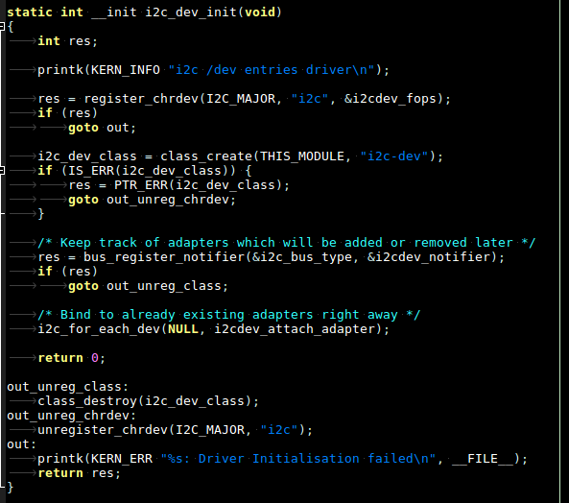
i2c-dev.c (1)

Slide 20
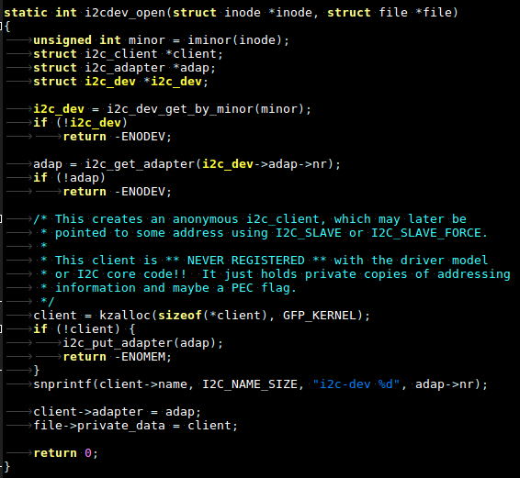
i2c-dev.c (2)

Slide 21
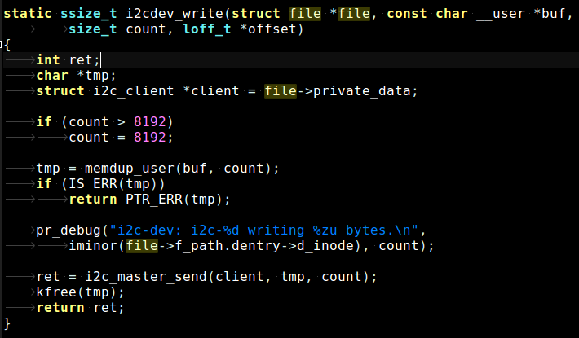
i2c-dev.c (3)

Slide 22
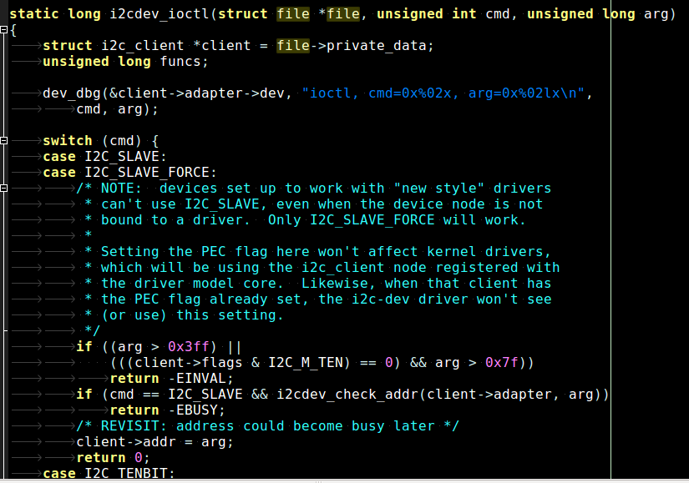
i2c-dev.c (4)

Slide 23
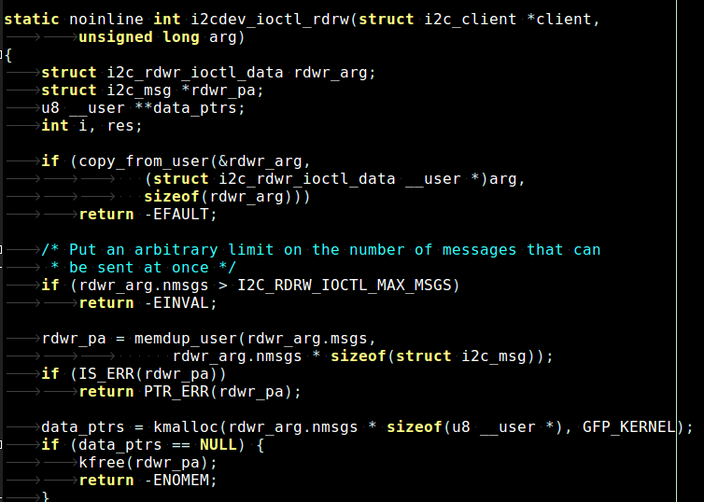
i2c-dev.c (5)

Slide 24
eeprom_test (1)
Write a data to EEPROM index
  ./i2c -w -i 10 -d 20
Read a data from EEPROM index
  ./i2c -r -i 10

Slide 25
eeprom_test (2)
Write a data to EEPROM index
  ./i2c -w -i 10 -d 20
Read a data from EEPROM index
  ./i2c -r -i 10

Slide 26
Exercise
Learn how to use i2c-tools
  EEPROM → AT24C0C

Slide 27
I2C in User mode

Slide 28
How to control I2C in User mode
Application
User mode driver
/sys/, /dev/
/dev/i2c-X
I2c-core
I2c-dev
I2c-client driver
I2c-adapter driver
I2c device
I2c Host
Controller
I2C Bus

Slide 29
I2C User mode IOCTL
$KERNEL/Documentation/i2c/dev-interface
I2C level
  ioctl(file, I2C_SLAVE, long addr)
  ioctl(file, I2C_TENBIT, long select)
  ioctl(file, I2C_PEC, long select)
  ioctl(file, I2C_FUNCS, unsigned long *funcs)
  ioctl(file, I2C_RDWR, struct i2c_rdwr_ioctl_data *msgset) ...

Slide 30

I2C User mode IOCTL
$KERNEL/Documentation/i2c/dev-interface
SMBus level
  __s32 i2c_smbus_write_quick(int file, __u8 value);
  __s32 i2c_smbus_read_byte(int file);
  __s32 i2c_smbus_write_byte(int file, __u8 value);
  __s32 i2c_smbus_read_byte_data(int file, __u8 command);
  __s32 i2c_smbus_write_byte_data(int file, __u8 command, __u8 value);

Slide 31
How to control I2C in User mode
Open the device file
int file;
int adapter_nr = 0;
char filename[20];
snprintf(filename, 19, "/dev/i2c-%d", adapter_nr);
file = open(filename, O_RDWR);
if (file < 0) {
/* ERROR HANDLING; you can check errno to see what went wrong */
exit(1);
}

Slide 32
How to control I2C in User mode
you must specify with what device address you
want to communicate
int addr = 0x40; /* The I2C address */
if (ioctl(file, I2C_SLAVE, addr) < 0) {
/* ERROR HANDLING; you can check errno to see what went wrong */
exit(1);
}

Slide 33
How to control I2C in User mode
You can now use SMBus or I2C to communicate
__u8 register = 0x10; /* Device register to access */
__s32 res;
char buf[10];
res = i2c_smbus_read_word_data(file, register);
if (res < 0)
/* ERROR HANDLING: i2c transaction failed */
else
/* res contains the read word */
/* Using SMBus commands */

Slide 34
How to control I2C in User mode
/* I2C Write ==> i2c_smbus_write_word_data(file, register, 0x6543) */
buf[0] = register;
buf[1] = 0x43;
buf[2] = 0x65;
if (write(file, buf, 3) ! =3) {
/* ERROR HANDLING: i2c transaction failed */
}

Slide 35
How to control I2C in User mode
/* I2C Read ==> i2c_smbus_read_byte(file) */
if (read(file, buf, 1) != 1) {
/* ERROR HANDLING: i2c transaction failed */
} else {
/* buf[0] contains the read byte */
}

Slide 36
EEPROM
AT24C02
2 Kbit
128 x 8-bit memory with a 2-wire serial interface
16-byte page

Slide 37
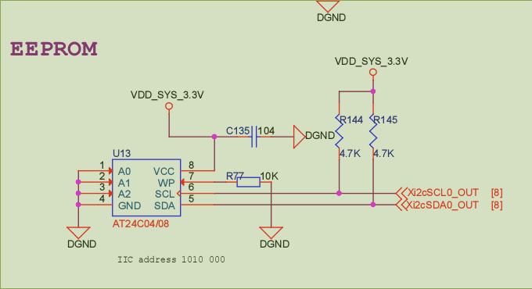
AT24C0C EEPROM

Slide 38
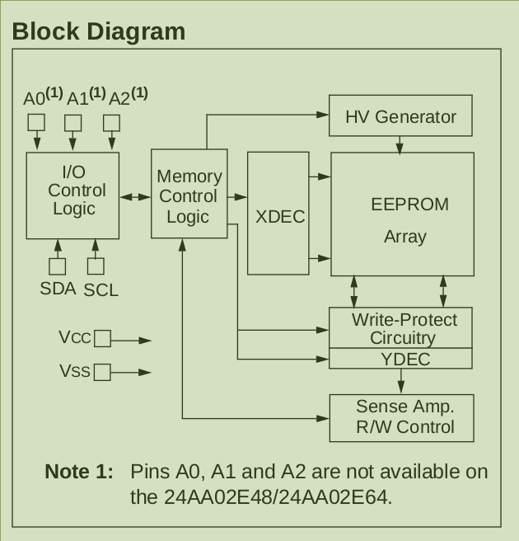
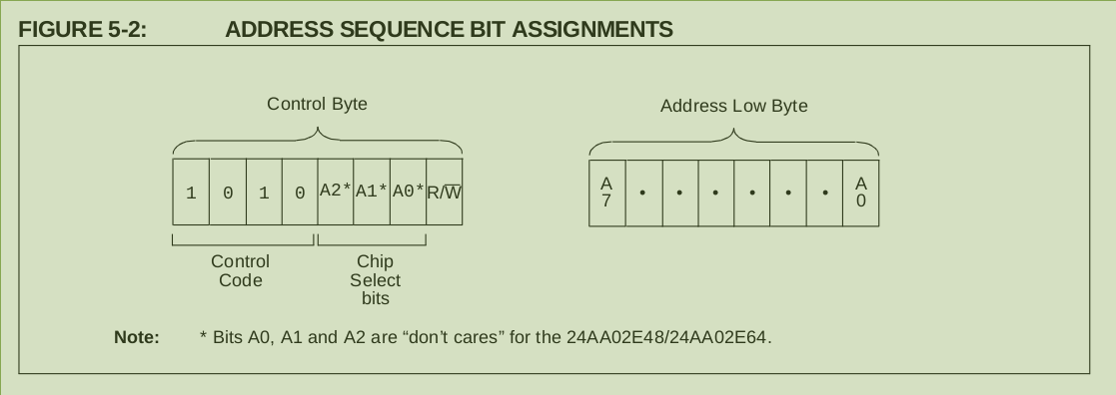
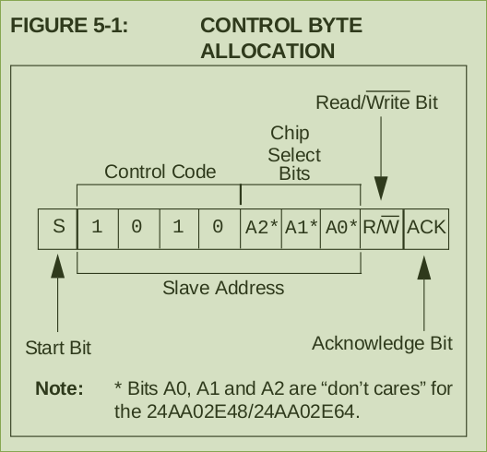
AT24C08 EEPROM

Slide 39
Exercise
AT24C02 EEPROM
eeprom_test_user

Slide 40
I2C Client Driver

Slide 41
Linux I2C Client Driver
Application
User mode driver
/sys/, /dev/
/dev/i2c-X
I2c-core
I2c-dev
I2c-client driver
I2c-adapter driver
I2c device
I2c Host
Controller
I2C Bus

Slide 42
I2C Client Driver
I2C communication
  i2c_master_send(…)
  i2c_master_recv(…)
  i2c_transfer(…)
SMBus communication
  i2c_smbus_read_byte(…)
  i2c_smbus_write_byte(…)

Slide 43
Client i2c driver
Driver model
  struct i2c_driver
    .probe(...)
    .remove(...)
I2c client model
  struct i2c_client
    i2c_smbus_read_byte_data(...)
    i2c_smbus_write_byte_data(...)

Slide 44
I2c Client Driver Example
drivers/misc/eeprom/at24c08.c
drivers/hwmon/sht21.c

Slide 45
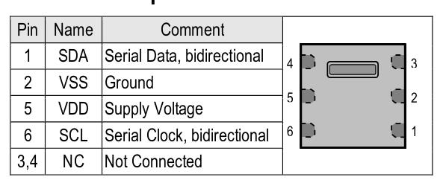
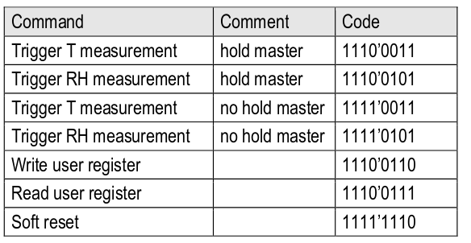
SHT21
http://www.farnell.com/datasheets/1780639.pdf

Slide 46
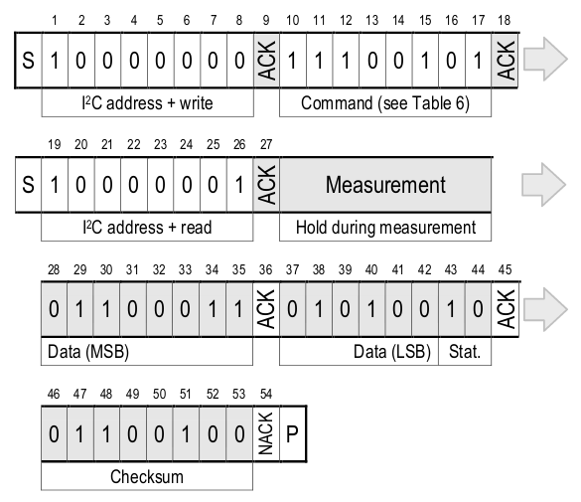
SHT21
Hold master communication sequence

Slide 47
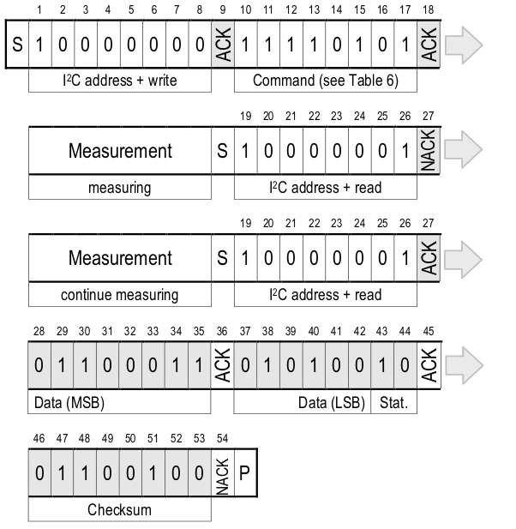
SHT21
No Hold master
communication sequence

Slide 48
SHT21
User mode
temp1_input
humidity1_input
Kernel mode
I2C Bus
sht21_show_temperature()
sht21_probe()
sht21_show_humidity()
devm_hwmon_device_
register_with_groups()

Slide 49
SHT21- Temperature
sht21_show_temperature()
User Mode
sht21_update_measurements()
Report TEMP Data
i2c_smbus_read_word_swapped()
SHT21_TRIG_T_MEASUREMENT_HM 0xe3

Slide 50
SHT21 - Humidity
sht21_show_humidity()
User Mode
sht21_update_measurements()
Report Humidity Data
i2c_smbus_read_word_swapped()
SHT21_TRIG_RH_MEASUREMENT_HM 0xe5

Slide 51
DeviceTree - SHT21
Rk3399-nanopi4-rev01.dts
&i2c_0 {
status = "okay";
sht21@40 {
#address-cells = <1>;
#size-cells = <0>;
compatible = "sensirion,sht21";
reg = <0x40>;
};
at24c08@50 {
#address-cells = <1>;
#size-cells = <0>;
compatible = "atmel,24c08";
reg = <0x50>;
};
};

Slide 52
Sht21.c – Bind I2C driver
/* Device ID table */
static const struct i2c_device_id sht21_id[] = {
{ "sht21", 0 },
{ }
};
MODULE_DEVICE_TABLE(i2c, sht21_id);
static struct i2c_driver sht21_driver = {
.driver.name = "sht21",
.probe = sht21_probe,
.remove = __devexit_p(sht21_remove),
.id_table = sht21_id,
};
module_i2c_driver(sht21_driver);
Bind I2C driver

Slide 53
Sht21.c – I2C Check Function
static int __devinit sht21_probe(struct i2c_client *client,
const struct i2c_device_id *id)
{
struct sht21 *sht21;
int err;
if (!i2c_check_functionality(client->adapter,
I2C_FUNC_SMBUS_WORD_DATA)) {
dev_err(&client->dev,
"adapter does not support SMBus word transactions\n");
return -ENODEV;
}
Check Driver Capacity

Slide 54
Sht21.c – I2C Read Function
I2C read function
if (time_after(jiffies, sht21->last_update + HZ / 2) || !sht21->valid) {
ret = i2c_smbus_read_word_swapped(client,
SHT21_TRIG_T_MEASUREMENT_HM);
if (ret < 0)
goto out;
sht21->temperature = sht21_temp_ticks_to_millicelsius(ret);
ret = i2c_smbus_read_word_swapped(client,
SHT21_TRIG_RH_MEASUREMENT_HM);
if (ret < 0)
goto out;
sht21->humidity = sht21_rh_ticks_to_per_cent_mille(ret);
sht21->last_update = jiffies;
sht21->valid = 1;
}

