Slide 1
I2C Driver

Slide 2
I2C
Inter-Integrated Circuit
Simple, low-bandwidth, short-distance protocol
Speed, Max 400Kbps
Philips originally developed I2C, current is NXP
I2C is a two-wire serial bus
  SDA → Data
  SCL → Clock
Controller : host, adapter, master
Device : device, client, slave
https://web.archive.org/web/20070926222250/http://embedded.com/story/OEG20010718S0073

Slide 3
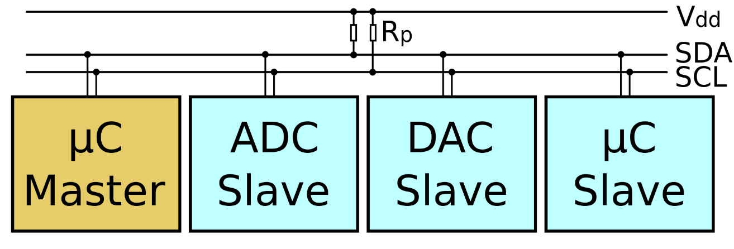
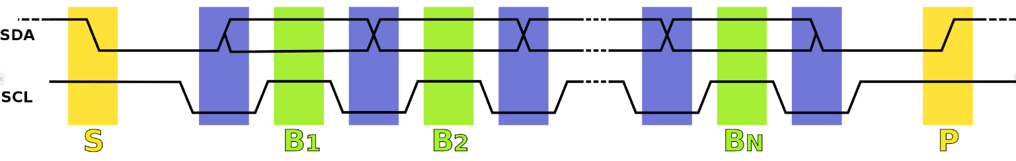
I2C Protocol
Serial bus
  SDA data line
  SCL clock line
https://en.wikipedia.org/wiki/I%C2%B2C

Slide 4
I2C Master and Client
RK3399 SOC
SHT21 sensor
I2C Master
SCL
I2C Client
SDA

Slide 5
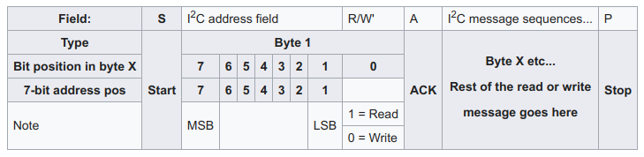
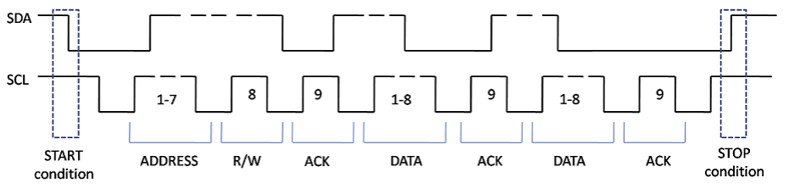
I2C Protocol
Ref_Link

Slide 6
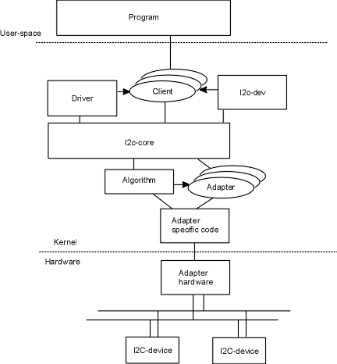
Linux and I2C
I2C Device Driver
I2C Char Driver
I2C Kernel API
I2C Protocol
RK3399 I2C Driver
https://i2c.wiki.kernel.org/index.php/File:I2c-layers.png

Slide 7

I2C Driver – Type 1
i2c_Tool
User space
/dev/i2c-dev-X
Kernel space
I2c-dev.c
i2c-core.c
I2C drivers
i2c-rk3x.c
Adapter Driver
Hardware
Device

Slide 8
I2C Driver – Type 2
Application
User space
/sys/class/hwmon/
Kernel space
I2C stack drivers
hwmon driver
I2c-dev.c
I2c-core.c
hwmon
I2C adapter drivers
i2c-rkxx.c
SHT21 Driver
Hardware
SHT21 Sensor

Slide 9
I2C Host Driver

Slide 10
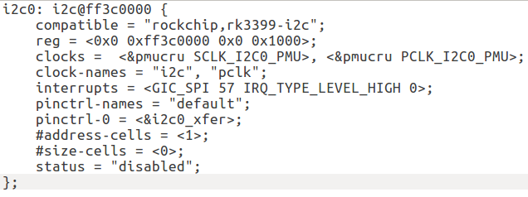
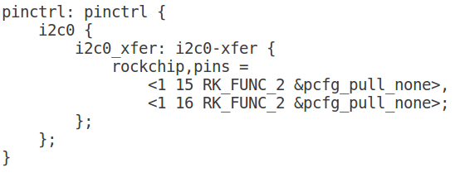
I2C Host Driver
I2C Host driver
  ${kernel}/drivers/i2c/
    i2c-core.c
    i2c-dev.c
    i2c-smbus.c
    i2c-rk3x.c
    i2c-gpio.c
I2C Device Tree
DTS Node
PinMux

Slide 11
I2C Master and Client
RK3399 SOC
i2c-rkxx.c
SHT21 sensor
I2C Master
SCL
I2C Client
SDA

Slide 12
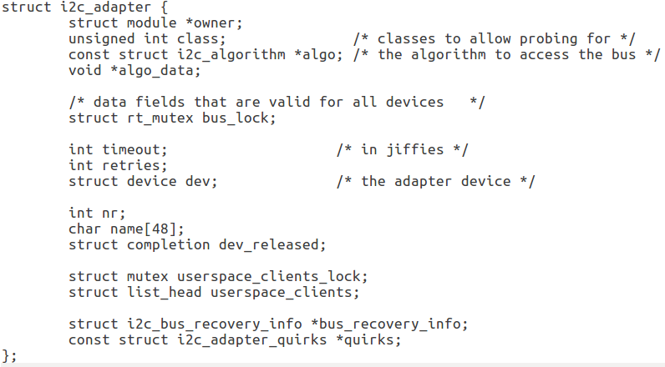
I2C Adapter Model
linux/i2c.h

Slide 13
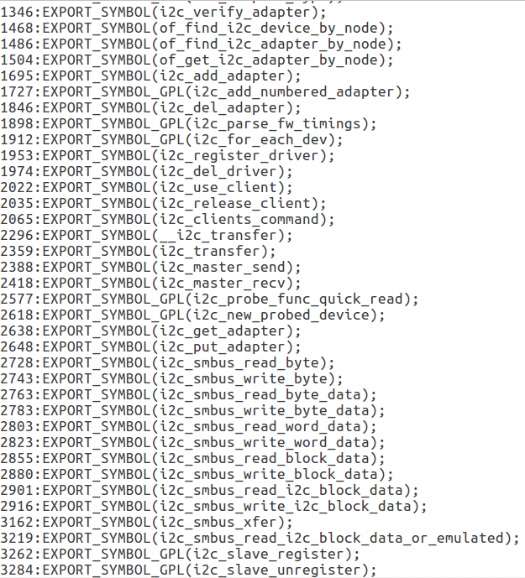
I2C Driver – i2c-core.c
I2c-core stack core
Export I2C kernel API
Construct I2C subsystem

Slide 14
I2C Driver – i2c-rk3x.c
I2C bus implement in SOC
Register for i2c-core.c
Communication with I2C device
Up-Layer
Adapter
i2c-rk3x.c
Driver
Hardware
Device

Slide 15
I2C Char Driver – i2c-dev.c
Register a I2C character driver
Use I2C kernel API to control I2C device
Convenient implement user-space driver
User space
/dev/i2c-dev-x
Kernel
Character Core
I2c-dev.c
spi.c

Slide 16
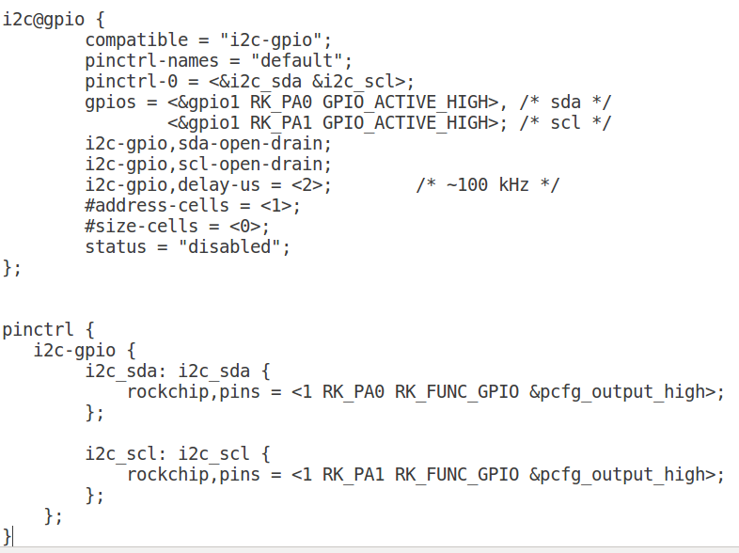
I2C Adapter – GPIO Emulator
I2C Host Driver – GPIO
  rockchip-rk3399-nanopi-m4/drivers/i2c/busse/i2c-gpio.c
DTS

Slide 17
I2C Host – GPIO Emulator
i2c_Tool
User space
/dev/i2c-dev-X
Kernel space
I2c-dev.c
i2c-core.c
I2C drivers
I2c-gpio.c
i2c-algo-bit.c
RK-GPIO
Hardware
I2C Device

Slide 18
I2C Client Driver

Slide 19
I2C Client Driver
RK3399 SOC
SHT21 sensor
EEPROM
SCL
SCL
I2C Host
I2C Client
SDA

Slide 20
I2C Client Driver – EEPROM - 1
Application
User space
/dev/at24cxx
Kernel space
I2C stack drivers
I2c-dev.c
I2c-core.c
Character Driver
I2C adapter drivers
i2c-rk3x.c
At24c08 Sample
Driver
Hardware
EEPROM

Slide 21
I2C Client Driver – EEPROM - 2
Application
User space
/sys/class/eeprom/
Kernel space
I2C stack drivers
I2c-dev.c
I2c-core.c
SYSFS API
I2C adapter drivers
i2c-rk3x.c
drivers/misc/at24.c
Hardware
EEPROM

Slide 22
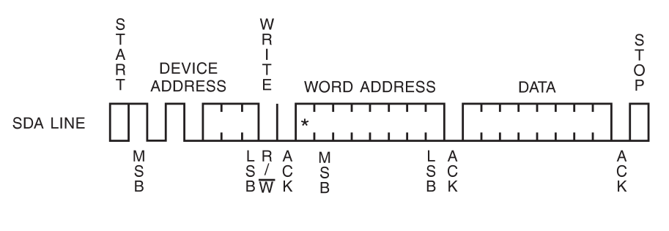
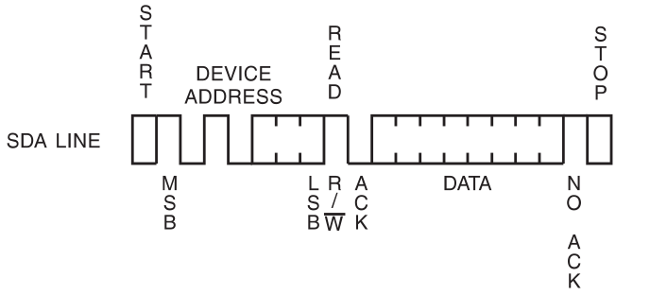
AT24C08 I2C Behave
Byte Write
Current Address Read

Slide 23
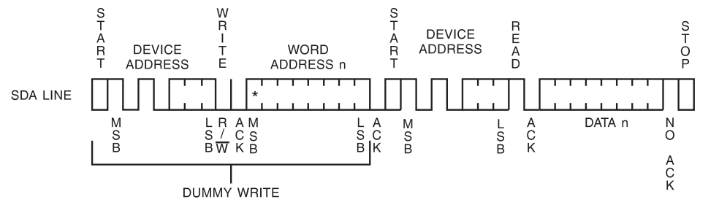
AT24C08 I2C Behave
Random Read
  Master view

Slide 24
I2C Client Driver API
module_i2c_driver()
i2c_register_driver(struct module *owner, struct i2c_driver *driver)
i2c_del_driver(struct i2c_driver *driver)

Slide 25
I2C Client Driver – SHT21
3
static int sht21_probe(struct i2c_client *client,
const struct i2c_device_id *id)
{
}
/* Device ID table */
static const struct i2c_device_id sht21_id[] = {
{ "sht21", 0 },
{ }
};
MODULE_DEVICE_TABLE(i2c, sht21_id);
static struct i2c_driver sht21_driver = {
.driver.name = "sht21",
.probe = sht21_probe,
.id_table = sht21_id,
};
module_i2c_driver(sht21_driver);
Initialize code
For DTS
2
1
rockpi-kernel/drivers/hwmon/sht21.c

Slide 26
I2C R/W Kernel API
SMBus Style

Slide 27
SMBus
SMBus is the System Management Bus
  Define by Intel
  Personal computers and servers
  For low-speed system management communications

Slide 28
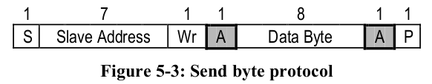
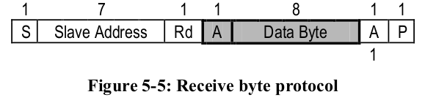
I2C R/W Kernel API - SMBus Style
Send byte
  i2c_smbus_write_byte(const struct i2c_client *client, u8 value)
Receive byte
  i2c_smbus_read_byte(const struct i2c_client *client)

Slide 29
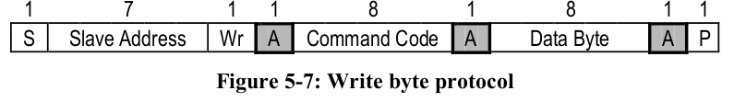
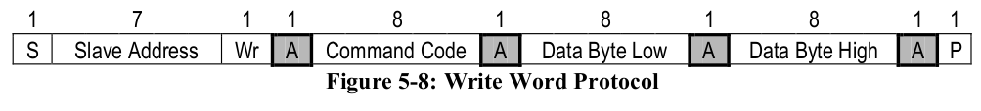
I2C R/W Kernel API - SMBus Style
Write byte/word
  i2c_smbus_write_byte_data(const struct i2c_client *client, u8 command, u8 value)

Slide 30
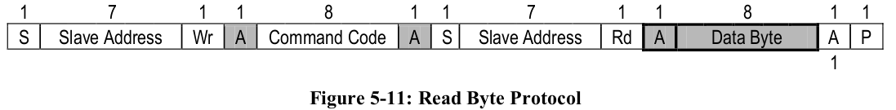
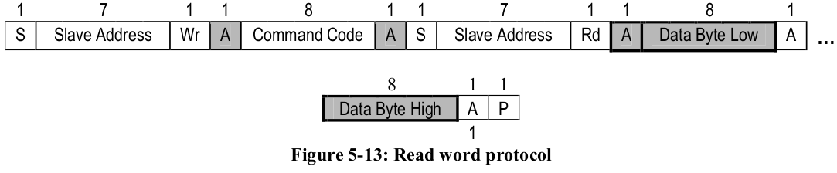
I2C R/W Kernel API - SMBus Style
Read byte/word
  i2c_smbus_read_byte_data(const struct i2c_client *client, u8 command)

Slide 31
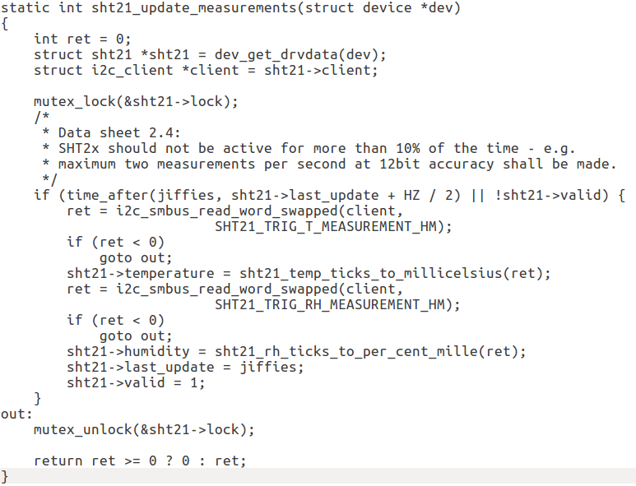
I2C R/W Kernel API - SMBus Style
rockpi-kernel/drivers/hwmon/sht21.c
Read
Temperature
Read
Humidity

Slide 32
I2C R/W Kernel API
Kernel I2C Style

Slide 33
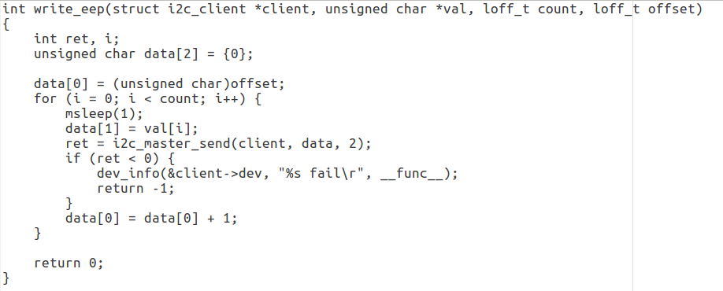
I2C R/W API - Kernel I2C Style
CH5/i2c-subsystem/eeprom_i2c/i2c-at24c08-2
I2C Write
Address offset of Data
Data will be wrote

Slide 34
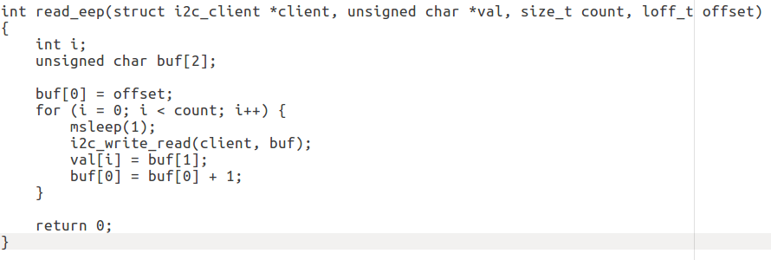
I2C R/W Kernel API - I2C Style
CH5/i2c-subsystem/eeprom_i2c/i2c-at24c08-2
I2C Read
Address offset of Data
Data return

Slide 35
I2C Client in User Space

Slide 36
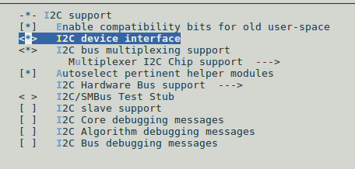
Enable I2C-dev
[CMD] make menuconfig

Slide 37
I2C Client in User Space IOCTL
ioctl(file, I2C_SLAVE, long addr)
ioctl(file, I2C_TENBIT, long select)
ioctl(file, I2C_FUNCS, unsigned long *funcs)
ioctl(file, I2C_RDWR, struct i2c_rdwr_ioctl_data *msgset)
ioctl(file, I2C_SMBUS, struct i2c_smbus_ioctl_data *args)

Slide 38
I2C Client in User Space
ioctl(file, I2C_RDWR, struct i2c_rdwr_ioctl_data *msgset)
ioctl(file, I2C_SMBUS, struct i2c_smbus_ioctl_data *args)
I2C Style
struct i2c_rdwr_ioctl_data {
struct i2c_msg __user *msgs; /* pointers to i2c_msgs */
__u32 nmsgs; /* number of i2c_msgs */
};
struct i2c_smbus_ioctl_data {
__u8 read_write;
__u8 command;
__u32 size;
union i2c_smbus_data __user *data;
};
SMBUS Style

Slide 39
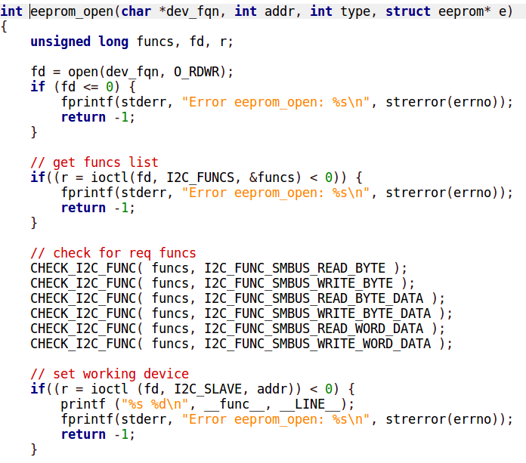
I2C Client in User Space - SMBUS Style
3-4-3/eeprom_test_user

Slide 40
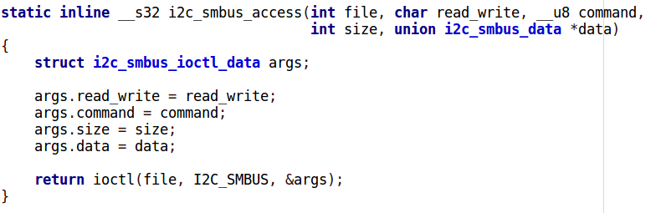
I2C Client in User Space – SMBUS Style
3-4-3/eeprom_test_user

Slide 41
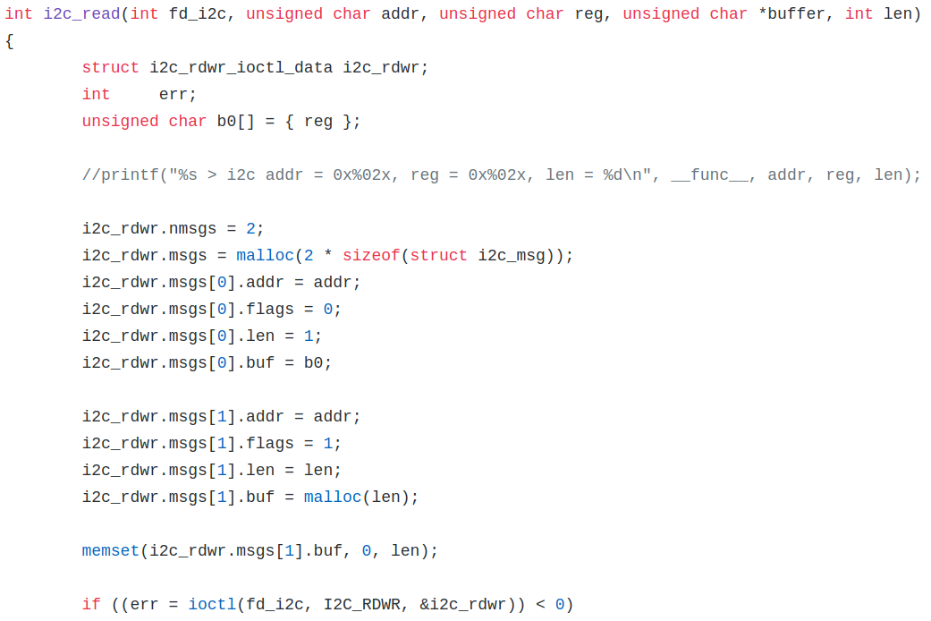
I2C Client in User Space - I2C Style
eeprom_i2c/i2c-kernel-style

Slide 42
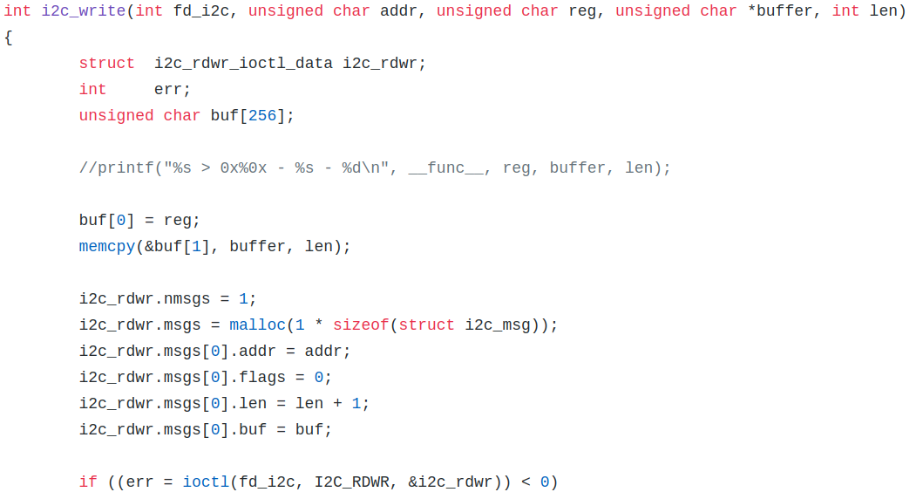
I2C Client in User Space - I2C Style
eeprom_i2c/i2c-kernel-style

