Slide 1
IIO Subsystem

Slide 2
IIO Introduction
IIO - The Industrial I/O
support for devices that in some sense
  analog to digital (ADC)
  digital to analog converters (DAC)
Devices that fall into this category are
  ADCs, Accelerometers
  Gyrosy, DAC
  Pressure Sensors
https://wiki.analog.com/software/linux/docs/iio/iio

Slide 3
IIO Introduction
Fill the gap between the somewhat similar hwmon and input subsystems
Hwmon is very much directed at low sample rate sensors used in applications
  fan speed control
  temperature measurement.

Slide 4
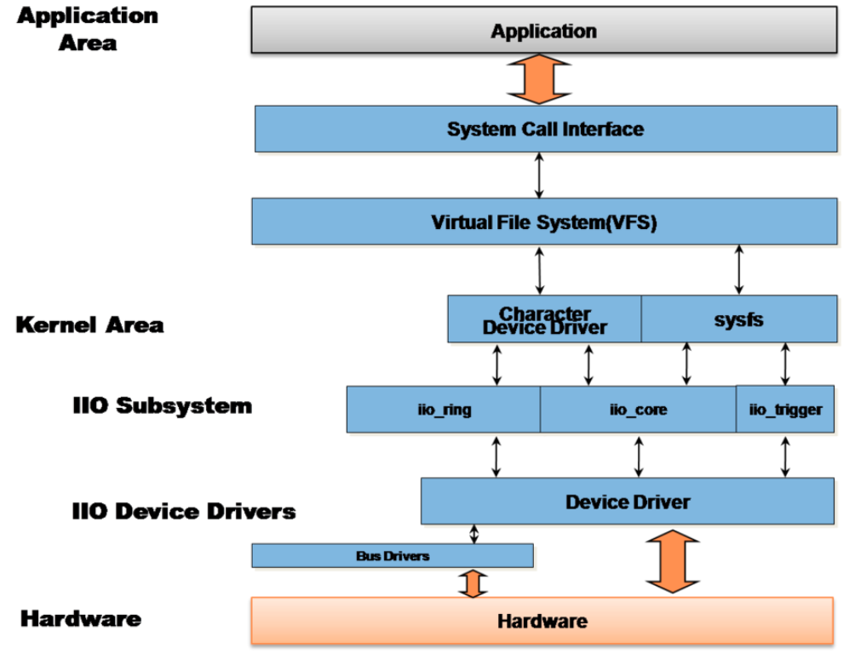
IIO Introduction

Slide 5
IIO Interface
There are 2 ways for a user space application
to interact with an IIO driver
/sys/bus/iio/iio:deviceX/
  data channels
/dev/iio:deviceX
  buffered data transfer
  events information

Slide 6
IIO Kernel API
Industrial I/O Devices
  struct iio_dev - industrial I/O device
  iio_device_alloc() - allocate an iio_dev from a driver
  iio_device_free() - free an iio_dev from a driver
  iio_device_register() - register a IIO device
  iio_device_unregister() - unregister IIO device
  void *iio_priv() - get iio private to access

Slide 7
IIO Attribute
struct iio_dev : representation of a single hardware sensor
Attribute
  operating modes
    DIRECT
    BUFFER SOFTWARE
    BUFFER HARDWARE
    BUFFER TRIGGERED

Slide 8
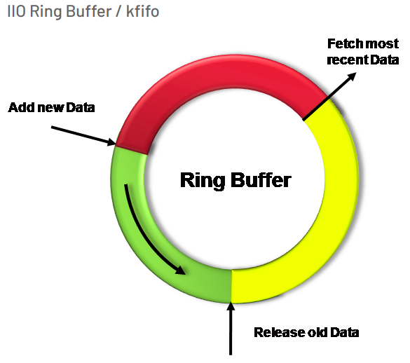
IIO Ring Buffer
https://wiki.analog.com/software/linux/docs/iio/iio

Slide 9
IIO Driver Model
struct iio_dev {
int id;
int modes;
int currentmode;
struct device dev;
struct iio_event_interface *event_interface;
struct iio_buffer *buffer;
struct list_head buffer_list;
int scan_bytes;
struct mutex mlock;
const unsigned long *available_scan_masks;
unsigned masklength;
const unsigned long *active_scan_mask;
bool scan_timestamp;
unsigned scan_index_timestamp;
struct iio_trigger *trig;
struct iio_poll_func *pollfunc;
const struct iio_info *info;
…
}

Slide 10
IIO device SysFS interface
Documentation/ABI/testing/sysfs-bus-iio
/sys/bus/iio/iio:deviceX/
  name: description of the physical chip.
  dev: shows the major:minor pair associated with /dev/iio:deviceX node.
  sampling_frequency_available : available discrete set of sampling frequency values for device.

Slide 11
IIO Device Channels
An IIO device channel is a representation
of a data channel
  one or multiple channels
    Thermometer sensor
      1 channel → temperature
    Light sensor
      2 channel
        Visible spectrum
        Infrared spectrum
    Accelerometer
      3 channel
        X, Y and Z axes

Slide 12
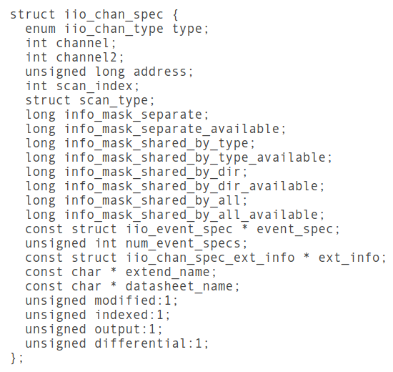
IIO Device Channels
struct iio_chan_spec

Slide 13
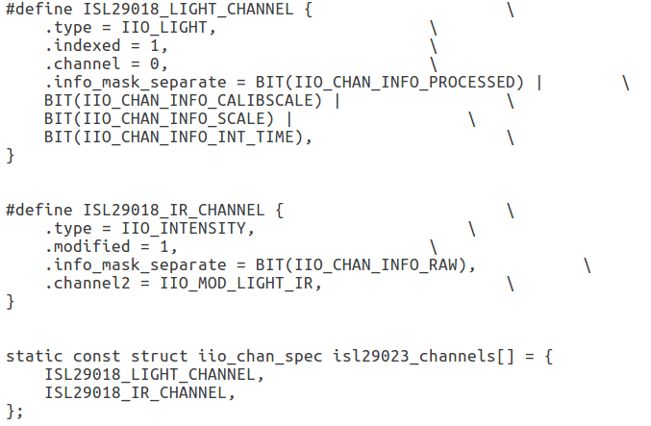
IIO Device Channels
An IIO channel is described by the struct iio_chan_spec

Slide 14
IIO Driver Info
struct iio_info {
int (*read_raw)(struct iio_dev *indio_dev,
struct iio_chan_spec const *chan,
int *val,
int *val2,
long mask);
int (*read_raw_multi)(struct iio_dev *indio_dev,
struct iio_chan_spec const *chan,
int max_len,
int *vals,
int *val_len,
long mask);
int (*write_raw)(struct iio_dev *indio_dev,
struct iio_chan_spec const *chan,
int val,
int val2,
long Mask);
...
};
* @read_raw: function to request a value from the device.
* mask specifies which value. Note 0 means a reading of
* the channel in question. Return value will specify the
* type of value returned by the device. val and val2 will
* contain the elements making up the returned value.
* @write_raw: function to write a value to the device.
* Parameters are the same as for read_raw.

Slide 15
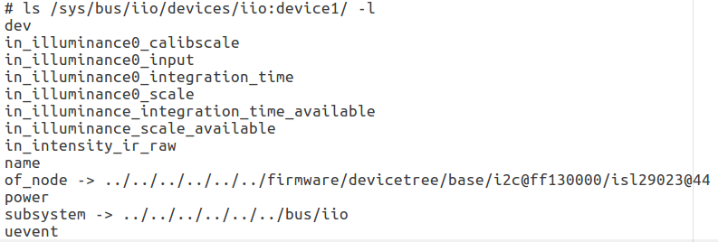
IIO Driver Info
IIO Info

Slide 16
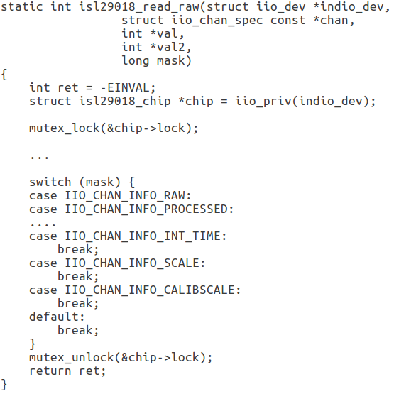
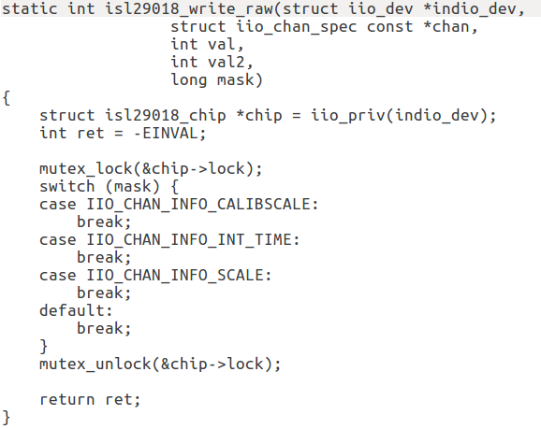
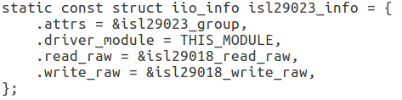
IIO struct iio_info

Slide 17
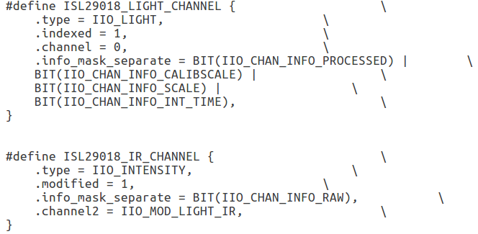
IIO Device Channels
Multiple data channels per channel type
  set .modified field of iio_chan_spec to 1
    Modifiers are specified using .channel2 field
  set .indexed field of iio_chan_spec to 1

Slide 18
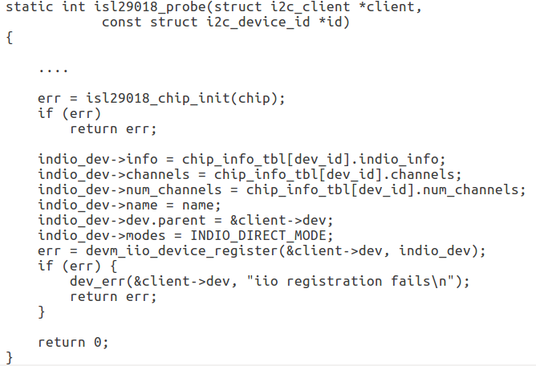
IIO Register
IIO initial
Register

Slide 19
IIO Device Channels
Above channel’s definition will generate
  two separate sysfs files for raw data
    /sys/bus/iio/iio:deviceX/in_intensity_ir_raw
    /sys/bus/iio/iio:deviceX/in_intensity_both_raw
  one shared sysfs file for sampling frequency
    /sys/bus/iio/iio:deviceX/sampling_frequency
  one file for processed data
    /sys/bus/iio/iio:deviceX/in_illuminance_input

Slide 20
IIO ISL29023
Example
  ${KERNEL}/drivers/staging/iio/light
  isl29018.c

Slide 21
ISL29023
User-space
/dev/iio\:deviceX
/sys/bus/iio/devices/iio:deviceX
industrialio-core
register
is29023 iio driver
I2C driver
kernel
Hardware
Is29023 Light Sensor

