Slide 1
Input Subsystem

Slide 2
Input Subsystem
Qt
Weston
Xwindow
User-space
/dev/input/eventX
Input Core
Input Device Driver
Input Event Driver
Bus Driver (serial, i2c, spi, USB ...)
kernel-space
Hardware
Device (keyboard, button, mouse ...)

Slide 3

Input Subsystem
Documentation/input
Documentation/input/event-codes.txt
Mouse, keyboard, button, joystick ...
/dev/input
  event0, event1, event2 …
  mouse0 …
  misc0 ...

Slide 4
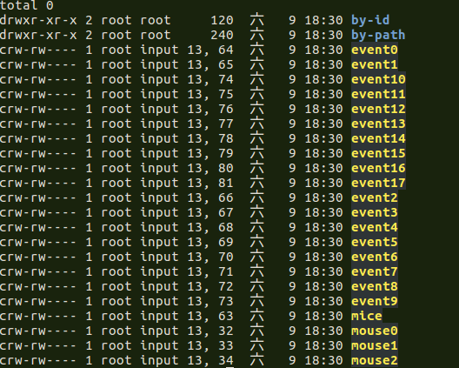
How to Check Input Event
[CMD] cat /dev/input/event1 | hexdump -C
[CMD] evtest cat /dev/input/event1

Slide 5
Input Device Driver

Slide 6
Input Device Driver
The input protocol uses a map of types and codes
to express input device values to user-space
$(KERNEL)/drivers/input
  input.c, evdev.c
  drivers/input/keyboard/
    gpio_keys.c
    gpio_keys_polled.c
    simple_keys.c
  drivers/input/touchscreen/
    edt-ft5x06.c

Slide 7
Input device Event and Key code
include/uapi/linux/input.h
include/uapi/linux/input-event-codes.h
Event Types
  EV_KEY
  EV_ABS …
Keys Codes
  KEY_ESC
  KEY_1
  KEY_BACKSPACE ...

Slide 8
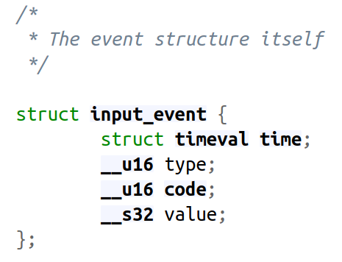
Event Structure
rockpi-kernel/include/uapi/linux/input.h

Slide 9
Event Types - Code
EV_SYN
  Used as markers to separate events
EV_KEY
  Used to describe state changes of KEY
    keyboards, buttons
    or other key-like devices
EV_ABS
  Used to describe absolute axis value changes
    touchscreen

Slide 10
Event Types - Code
EV_SYN
  SYN_REPORT
    Used to synchronize and separate events into
    packets of input data changes occurring at the
    same moment in time
  SYN_MT_REPORT
    Used to synchronize and separate touch
    events. See the multi-touch-protocol.txt
    document for more information

Slide 11
Event Types - Code
EV_KEY
  EV_KEY events take the form
    KEY_<name> or BTN_<name>
    For example : KEY_A
  BTN_TOUCH
    used for touch contact

Slide 12
Key - Code
#define KEY_R 19
#define KEY_T 20
#define KEY_Y 21
#define KEY_U 22
#define KEY_I 23
#define KEY_O 24
#define KEY_P 25
#define KEY_A 30
#define KEY_S 31
#define KEY_F1 59
#define KEY_F2 60
#define KEY_F3 61
#define KEY_RESERVED 0
#define KEY_ESC 1
#define KEY_1 2
#define KEY_2 3
#define KEY_3 4
#define KEY_4 5
#define KEY_5 6
#define KEY_6 7
#define KEY_7 8
#define KEY_8 9
#define KEY_9 10
#define KEY_0 11

Slide 13
Input Driver API
Allocate managed input device
struct input_dev *devm_input_allocate_device(struct device *dev)
Register device with input core
int input_register_device(struct input_dev *dev)
Report new input event
void input_event(struct input_dev *dev,
unsigned int type, unsigned int code, int value)

Slide 14
Input Driver API
Report new input event
static inline void input_sync(struct input_dev *dev)
{
input_event(dev, EV_SYN, SYN_REPORT, 0);
}
void input_event(struct input_dev *dev,
unsigned int type, unsigned int code, int value)

Slide 15
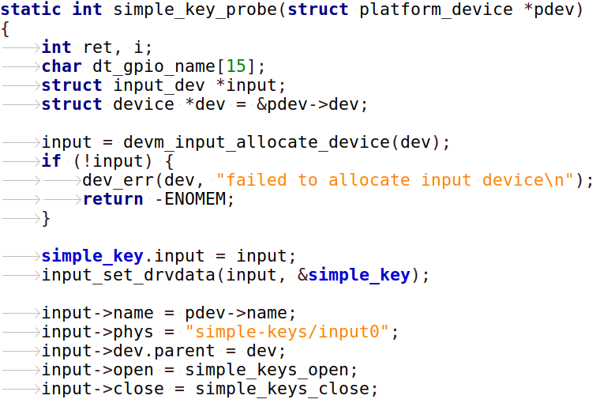
Input Driver API
simple_key
Allocate managed input device

Slide 16
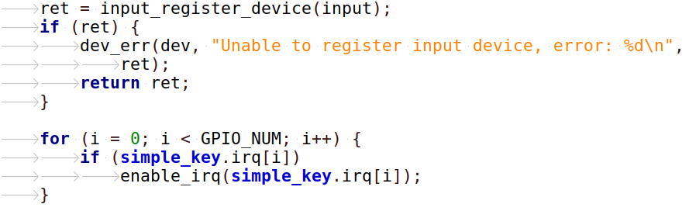
Input Driver API
Register device with input core

Slide 17
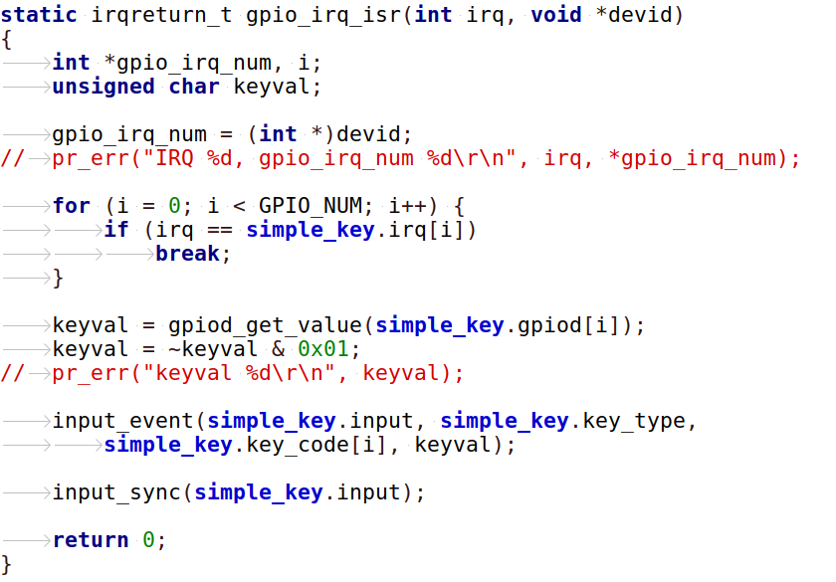
Input Driver API
Report new input event

Slide 18
simple_keys

Slide 19
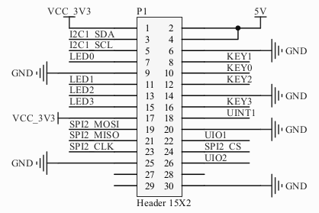
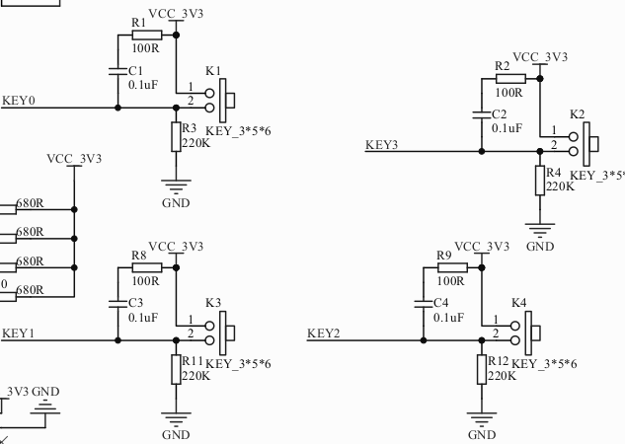
simple_keys.c
$(KERNEL)/driver/char/simple_keys.c

Slide 20
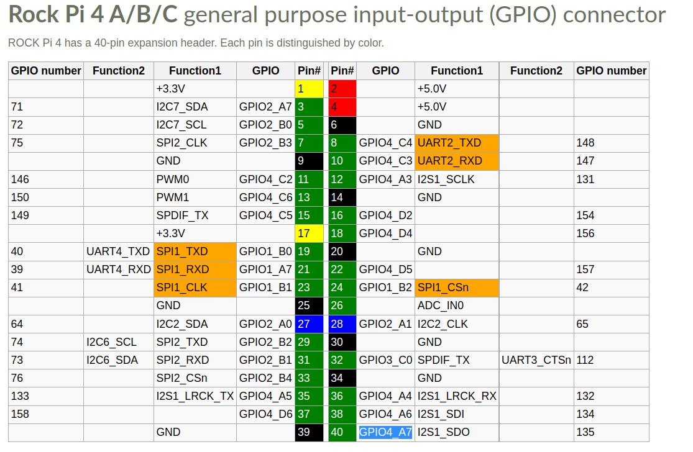
simple_keys.c

Slide 21
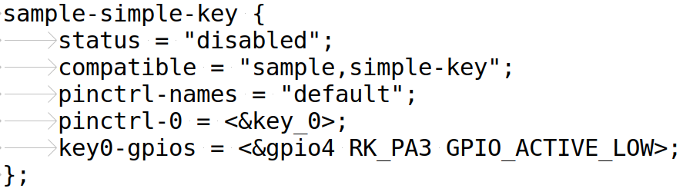
simple_keys.c - DTS
Physical GPIO-Key

Slide 22

simple_keys.c
static int simple_key_probe(struct platform_device *pdev)
{
int ret, i;
char dt_gpio_name[15];
struct input_dev *input;
struct device *dev = &pdev->dev;
input = devm_input_allocate_device(dev);
if (!input) {
dev_err(dev, "failed to allocate input device\n");
return -ENOMEM;
}
Alloc a input device

Slide 23
simple_keys.c
input->name = pdev->name;
input->phys = "sample-keys/input0";
input->dev.parent = dev;
input->open = simple_keys_open;
input->close = simple_keys_close;
input->id.bustype = BUS_HOST;
input->id.vendor = 0x0001;
input->id.product = 0x0001;
input->id.version = 0x0100;
input_set_capability(input, EV_KEY, BTN_0);
simple_key.key_type = EV_KEY;
simple_key.key_code[0] = BTN_0;
Key Code Map

Slide 24
simple_keys.c
for (i = 0; i < GPIO_NUM; i++) {
simple_key.irq[i] = 0;
sprintf(dt_gpio_name, "key%d", i);
simple_key.gpiod[i] = devm_gpiod_get_optional(&pdev->dev,
dt_gpio_name, GPIOD_IN);
...
simple_key.irq[i] = gpiod_to_irq(simple_key.gpiod[i]);
ret = devm_request_irq(&pdev->dev, simple_key.irq[i],
gpio_irq_isr, IRQ_TYPE_EDGE_BOTH, "key-irq", &simple_key.irq[i]);
…
disable_irq_nosync(simple_key.irq[i]);
}
Key Interrupt
Setting

Slide 25
simple_keys.c
ret = input_register_device(input);
if (ret) {
dev_err(dev, "Unable to register input device, error: %d\n",
ret);
return ret;
}
for (i = 0; i < GPIO_NUM; i++) {
if (simple_key.irq[i])
enable_irq(simple_key.irq[i]);
}
Register device
with input core

Slide 26
simple_keys.c
static irqreturn_t gpio_irq_isr(int irq, void *devid)
{
int *gpio_irq_num, i;
unsigned char keyval;
gpio_irq_num = (int *)devid;
for (i = 0; i < GPIO_NUM; i++) {
if (irq == simple_key.irq[i])
break;
}
keyval = gpiod_get_value(simple_key.gpiod[i]);
keyval = ~keyval & 0x01;
pr_err("keyval %d\r\n", keyval);
input_event(simple_key.input, simple_key.key_type,
simple_key.key_code[i], keyval);
input_sync(simple_key.input);
return 0;
}
Report new
input event

Slide 27
gpio_keys_polled

Slide 28
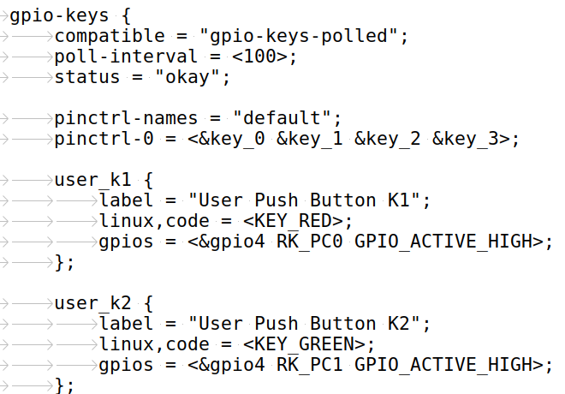
gpio_keys_polled and DTS
drivers/input/keyboard/gpio_keys.c
Key Code

Slide 29
gpio_key.c
User-space
/dev/input/eventX
/sys/class
GPIO INT
ISR
Input core
GPIO driver
Input core
Report key
event
work-queue
kernel-space
hardware
Button

Slide 30
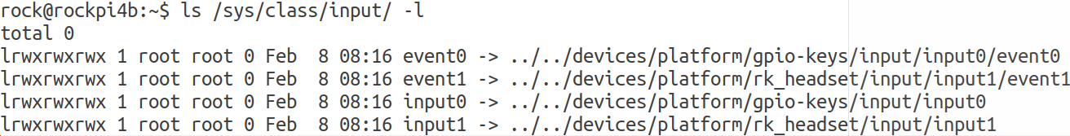
Input Subsystem - Test
From SysFS
  # ls -l /sys/class/input/ -l
Use gpio-keys Driver

Slide 31
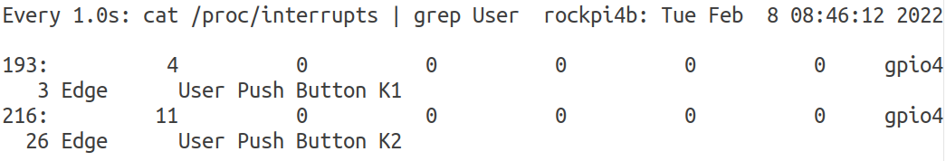
Input Subsystem – Test 2
From Interrupt
  # watch -n 1 "cat /proc/interrupts | grep User "
Use gpio-keys Driver
IRQ Trigger
IRQ Device

Slide 32
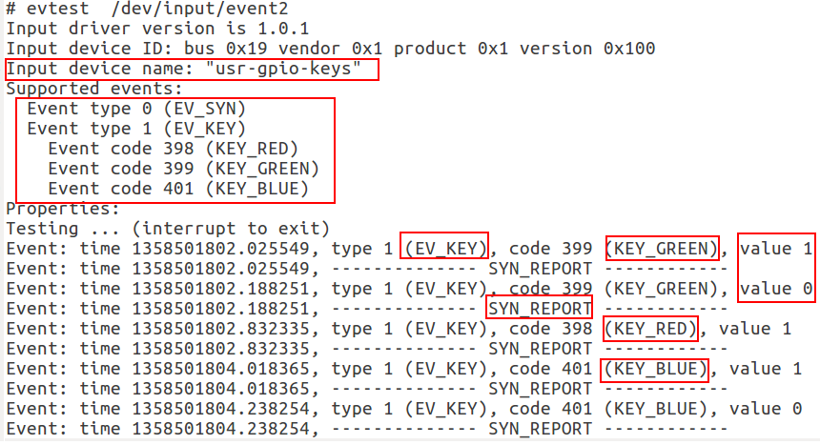
Input Subsystem – Test 3
Use evtest
  [CMD] evtest /dev/input/event1
Use gpio-keys Driver

