Slide 1
PWM

Slide 2
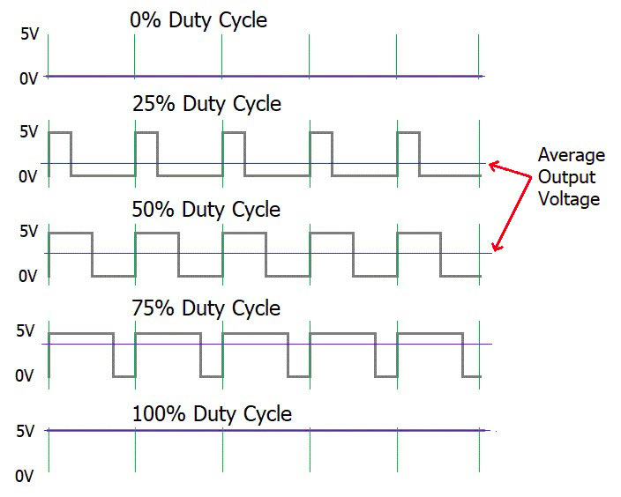

PWM
PWM : Pulse Width Modulation
https://circuitdigest.com/tutorial/what-is-pwm-pulse-width-modulation

Slide 3
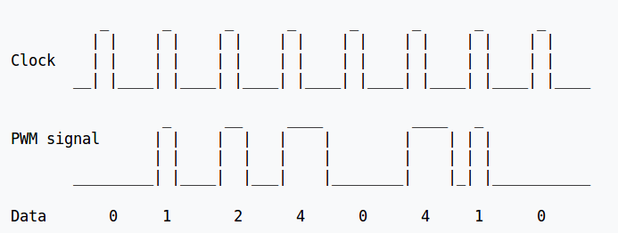
PWM
https://en.wikipedia.org/wiki/Pulse-width_modulation

Slide 4
PWM Parameter in Linux
Period
  The total period of the PWM signal
  Value is in nanoseconds
  sum of the active and inactive time of the PWM
duty_cycle
  The active time of the PWM signal
  Value is in nanoseconds
  must be less than the period.
Polarity
  The polarity of the PWM signal
Enable

Slide 5

PWM Driver
$(KERNEL_SRC)/Documentation/pwm.txt
Platform Driver
  drivers/pwm/
  drivers/pwm/core.c
  drivers/pwm/pwm-samsung.c

Slide 6
PWM Subsystem
Application 1
Application 2
User Space
/sys/class/pwm
/dev/dev-mg996rs
Kernel Space
core.c
tiny4412_mg996r.c
Callback implement
and register
pwm-samsung.c
MG996R

Slide 7
PWM DeviceTree
exynos4.dtsi
pwm: pwm@139d0000 {
compatible = "samsung,exynos4210-pwm";
reg = <0x139D0000 0x1000>;
interrupts = <GIC_SPI 37 IRQ_TYPE_LEVEL_HIGH>,
<GIC_SPI 38 IRQ_TYPE_LEVEL_HIGH>,
<GIC_SPI 39 IRQ_TYPE_LEVEL_HIGH>,
<GIC_SPI 40 IRQ_TYPE_LEVEL_HIGH>,
<GIC_SPI 41 IRQ_TYPE_LEVEL_HIGH>;
clocks = <&clock CLK_PWM>;
clock-names = "timers";
#pwm-cells = <3>;
status = "disabled";
};

Slide 8
PWM DeviceTree
exynos4412-tiny4412.dts
&pwm {
/* PWM 0 -- For MG996R */
pinctrl-0 = <&pwm0_out>;
pinctrl-names = "default";
samsung,pwm-outputs = <0>;
status = "okay";
};

Slide 9
PWM SYSFS
/sys/class/pwm/pwmchip0
device export npwm power subsystem uevent unexport
echo 0 > export
capture enable polarity uevent duty_cycle period power
echo “20000000” > period
//20ms, 50 Hz
echo "2000000" > duty_cycle
//2ms
echo 1 > enable
//Enable

Slide 10
PWM - MG996G
mg996r {
compatible = "tiny4412,mg996r-sample";
pwms = <&pwm 0 20000000 100>;
/* PWM 0 -- For MG996R */
status = "okay";
};

Slide 11
PWM - API
/**
* devm_of_pwm_get() - resource managed of_pwm_get()
* @dev: device for PWM consumer
* @np: device node to get the PWM from
* @con_id: consumer name
*
* This function performs like of_pwm_get() but the acquired PWM device will
* automatically be released on driver detach.
*
* Returns: A pointer to the requested PWM device or an ERR_PTR()-encoded
* error code on failure.
*/
struct pwm_device *devm_of_pwm_get(struct device *dev, struct device_node *np,
const char *con_id)

Slide 12
PWM - API
/**
* pwm_config() - change a PWM device configuration
* @pwm: PWM device
* @duty_ns: "on" time (in nanoseconds)
* @period_ns: duration (in nanoseconds) of one cycle
*
* Returns: 0 on success or a negative error code on failure.
*/
static inline int pwm_config(struct pwm_device *pwm, int duty_ns,
int period_ns)

Slide 13
PWM - API
/**
* pwm_enable() - start a PWM output toggling
* @pwm: PWM device
*
* Returns: 0 on success or a negative error code on failure.
*/
static inline int pwm_enable(struct pwm_device *pwm)
/**
* pwm_disable() - stop a PWM output toggling
* @pwm: PWM device
*/
static inline void pwm_disable(struct pwm_device *pwm)

Slide 14
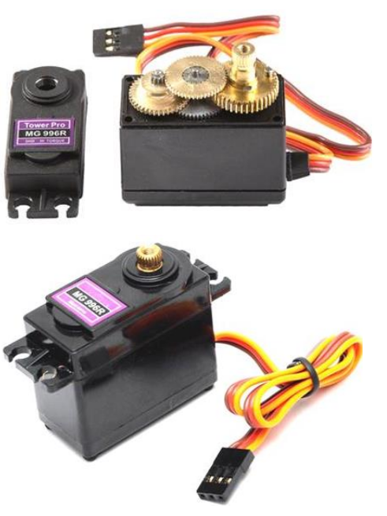
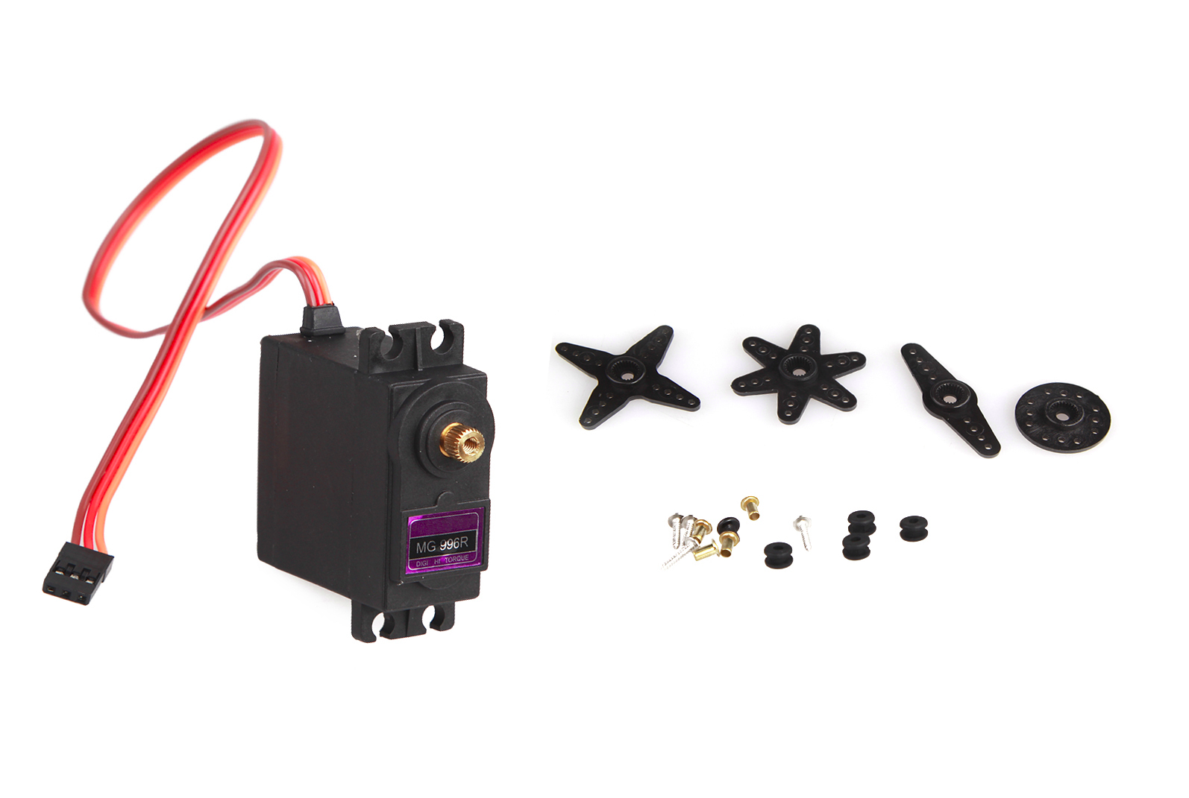
MG966R

Slide 15
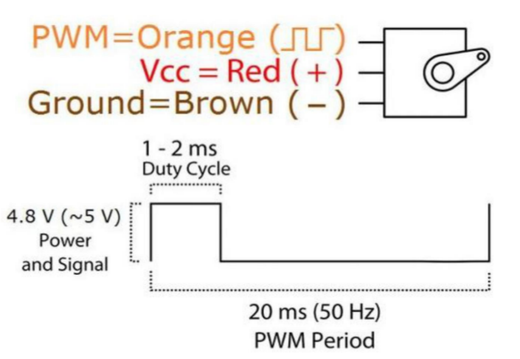
MG966R

Slide 16
Tiny4412-mg966r.c
Tiny4412-mg966r.c
static int tiny4412_mg996r_probe(struct platform_device *pdev)
{
int ret;
struct device_node *node = pdev->dev.of_node;
mg996r.pwm_device = devm_of_pwm_get(&pdev->dev, node, NULL);
pwm_config(mg996r.pwm_device, MG996R_TURN_RIGHT, MG996R_PERIOD);
pr_err("period:%d, duty:%d\r\n",
pwm_get_period(mg996r.pwm_device),
pwm_get_duty_cycle(mg996r.pwm_device));
ret = misc_register(&tiny4412_mg996r_dev);
if (ret) {
dev_err(&pdev->dev, "misc_register fail\r\n");
return ret;
}
return 0;
}

Slide 17
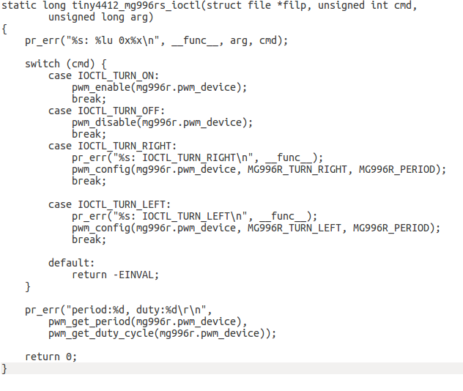
Tiny4412-mg966r.c
Tiny4412-mg966r.c

