Slide 1
RTC

Slide 2


RTC
RTC : Real Time Clock
It can store the time
  Second, Minute, Hour
  Day, Month, and Year data
It can operate using the backup battery while the system power is off
RTC unit works with an external 32.768 kHz crystal
RK808

Slide 3
RTC Subsystem
Application 1
Application 2
User Space
/sys/class/rtc
/dev/rtc
Kernel Space
class.c
rtc-dev.c
rtc-rk808.c
Interface.c
RK808

Slide 4
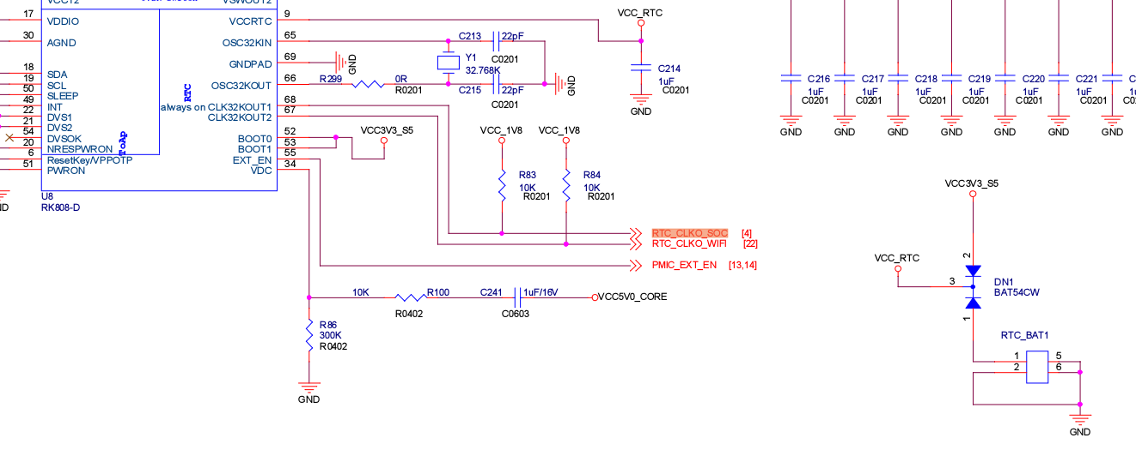
RTC - RK808

Slide 5

Tick Time Interrupt
The RTC tick timer is an up-counter and raises tick interrupt
Period = (n + 1)/(Tick clock source frequency) second (n = tick counter value)

Slide 6
RTC Linux Driver
$KERNEL/drivers/rtc/
  Rtc-rk808.c

Slide 7
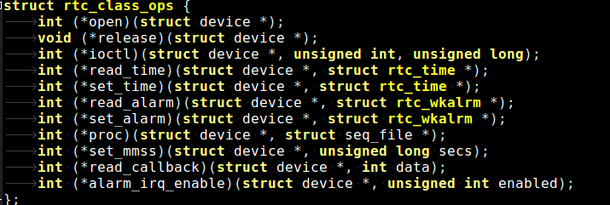
rtc.h
$KERNEL/include/linux/rtc.h

Slide 8
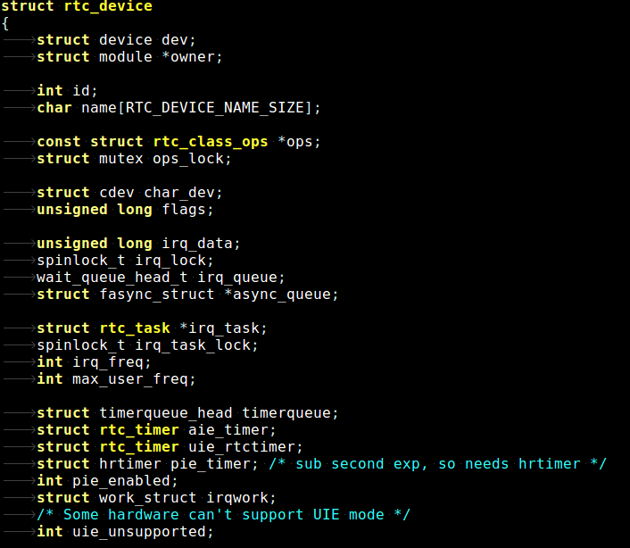
rtc.h

Slide 9
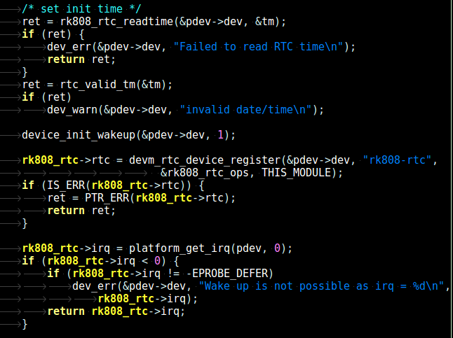
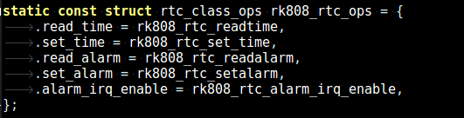
rtc-rk808

