Slide 1
SPI Drivers

Slide 2
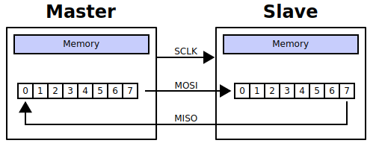
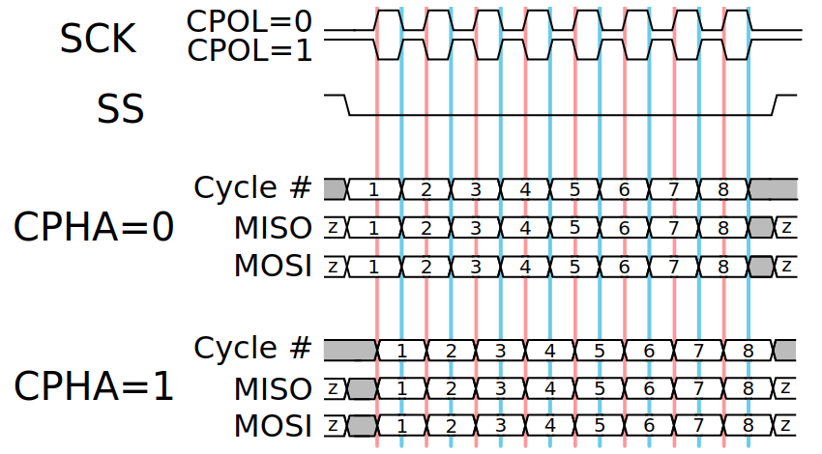


SPI Protocol - 1
Serial Peripheral Interface (SPI)
  synchronous serial communication
  Signals
    SCK (clock)
    SS (chip select)
    MISO (Data-In)
    MOSI (Data-Out)
SPI
https://en.wikipedia.org/wiki/Serial_Peripheral_Interface

Slide 3
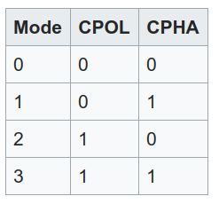
SPI Protocol - 2
SPI Mode
  CPOL determines the polarity of the clock
    CPOL=0 is a clock which idles at 0, and fetch data at pulse of 1
    CPOL=1 is a clock which idles at 1, and fetch data at pulse of 0
  CPHA determines the timing of the data bits relative
  to the clock pulses
    For CPHA=0,
      1. data on the trailing edge of the clock cycle
      2. captures the data on the leading edge of the clock cycle
    For CPHA=1,
      1. data on the leading edge of the clock cycle
      2. captures the data on the trailing edge of the clock cycle
https://en.wikipedia.org/wiki/Serial_Peripheral_Interface#/media/File:SPI_timing_diagram2.svg

Slide 4
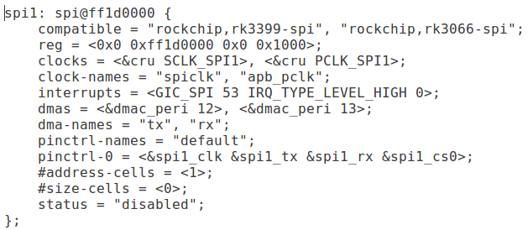
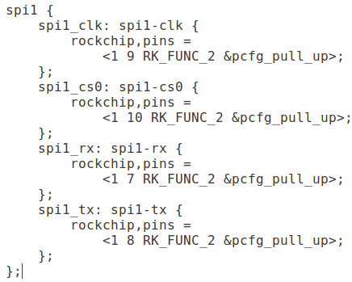
SPI Host
SPI Host driver
  rockpi-kernel/drivers/spi/
    spi.c
    spidev.c
    spi-rockchip.c
    Spi-gpio.c
SPI Device Tree
Node
PinMux

Slide 5
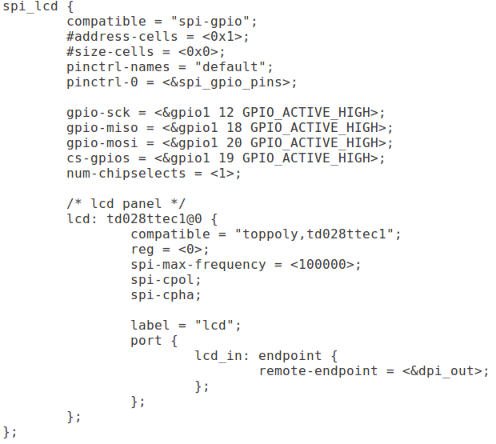
SPI Host - GPIO
SPI Host Driver – GPIO
  rockpi-kernel/drivers/spi/spi-gpio.c
DTS

Slide 6
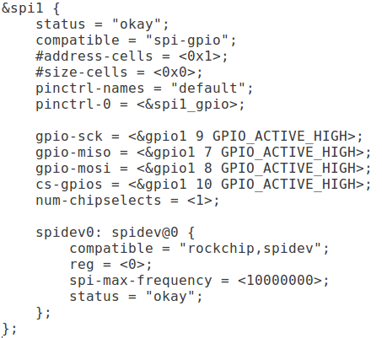
SPI Host - GPIO
DTS

Slide 7
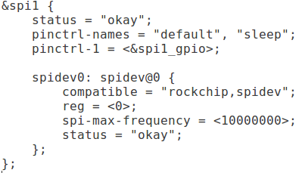
Spidev – User Space Control
drivers/spi/spidev.c
include/linux/spi/spidev.h
Documentation/spi/
  spidev
character device
  major number 153
  /dev/spidev1.0
  sys/class/spi_master/spi1
  /sys/class/spidev/spidev1.0

Slide 8
SPI Driver - 1
spidev_tool
User space
/dev/spidev1.0
Kernel space
spidev.c
spi.c
SPI drivers
spi-rockchip.c
Hardware
Device

Slide 9
SPI Driver - 2
Application
User space
/dev/mtdblock
Kernel space
SPI drivers
MTD drivers
spidev.c
spi.c
MTD
spi-rockchip.c
SPI Nor-Flash Driver
Hardware
SPI Nor-Flash

Slide 10
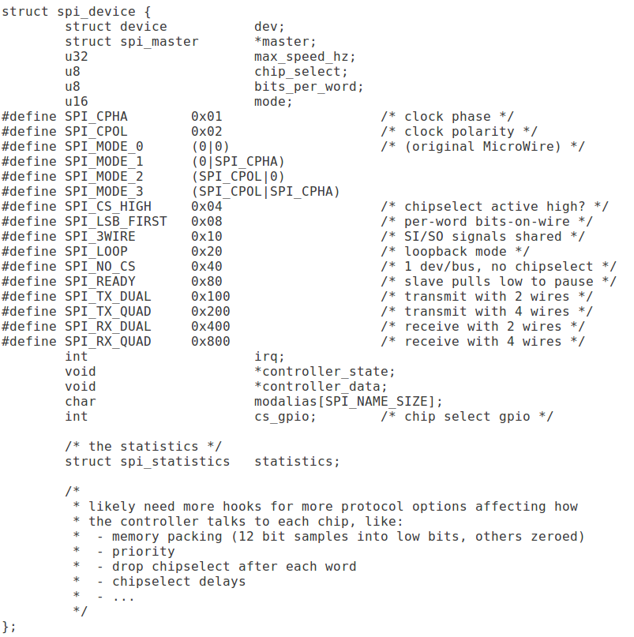
SPI Driver – SPI Model
$KERNEL/include/linux/spi/spi.h

Slide 11
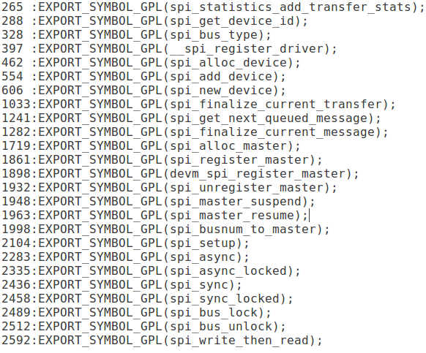
SPI Driver – spi.c
SPI stack core
Export SPI kernel API
Construct SPI subsystem

Slide 12
SPI Driver – spi-rockchip.c
SPI bus implement in SOC
Register for spi.c
Communication with SPI device
Up-Layer
spi-rockchip.c
Driver
Hardware
Device

Slide 13
SPI Driver – spi-dev.c
Register a SPI character driver
Use SPI kernel API to control SPI device
Convenient implement user-space driver
User space
/dev/spidev1.0
Kernel
Character Core
spidev.c
spi.c

Slide 14
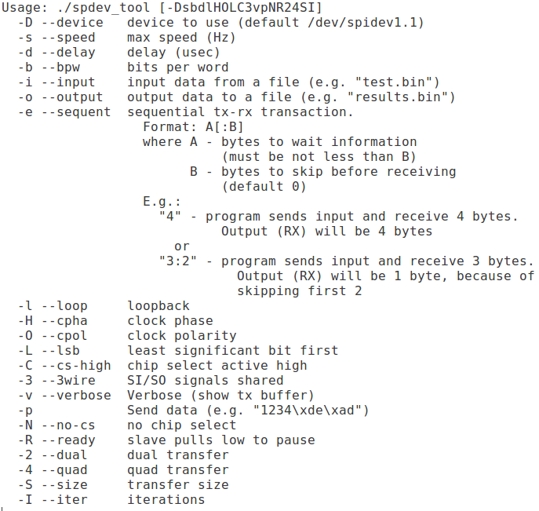
Spidev – User Space Control
spidev_tool
  https://github.com/xlloss/spidev_tool
spidev_tool
User space
/dev/spidev1.0
Kernel space
SPI Driver
Hardware
Device

Slide 15
Spidev – User Space Control
spidev_tool
User space
/dev/spidev1.0
Kernel space
spidev.c
spi.c
SPI drivers
spi-rockchip.c
Hardware
Device

Slide 16
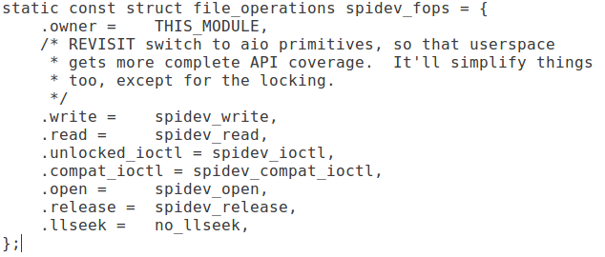
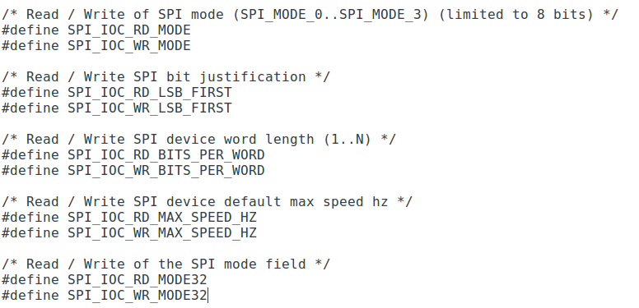
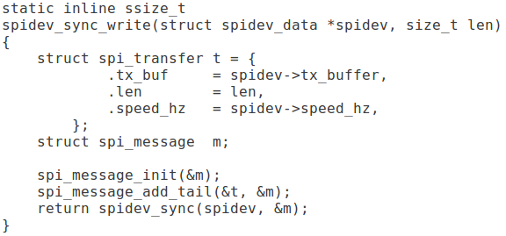
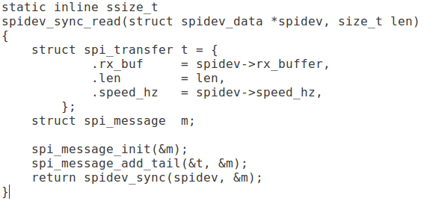
Spidev – User Space Control

Slide 17
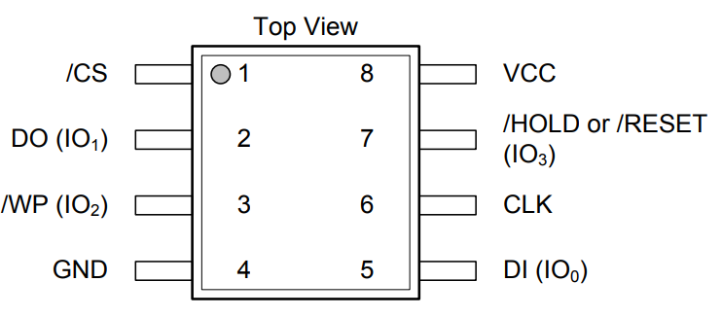
W25Q128 SPI Flash
MISO
MOSI
RK3399
SS
SCLK
https://www.winbond.com/resource-files/w25q128fv%20rev.l%2008242015.pdf

Slide 18
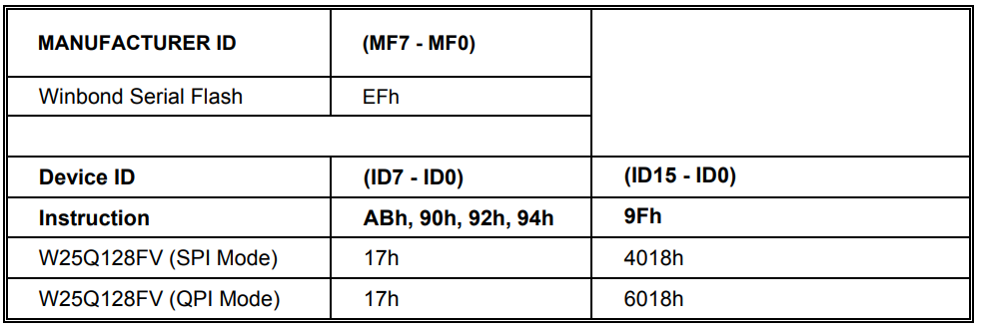
W25Q128 SPI Flash - ID
Device ID and Instruction Set Table

Slide 19
W25Q128 SPI Flash - ID
Device ID and Instruction Set Table

Slide 20
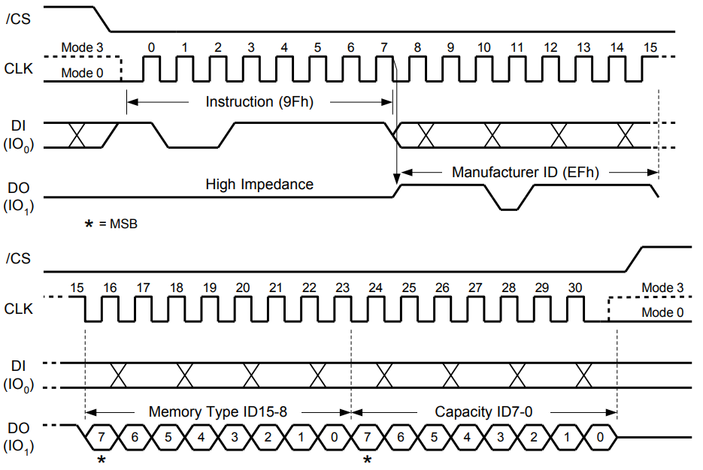
W25Q128 SPI Flash - ID
Read JEDEC ID Instruction - SPI Mode

Slide 21
Exercise - 1
Read ID with spidev_tool
For example
  ./spdev_tool -D /dev/spidev1.0 -s 10000 -p "\x9F\x00\x00\x00" -v

Slide 22
Exercise - 2
Add a MTD Nor-Flash driver
Read, write, mount, umount MTD block device
  $ mount /dev/mtdblock2 /tmp/mtd_device/
  $ touch /tmp/mtd_device/test_file
  $ umount /dev/mtdblock2

Slide 23
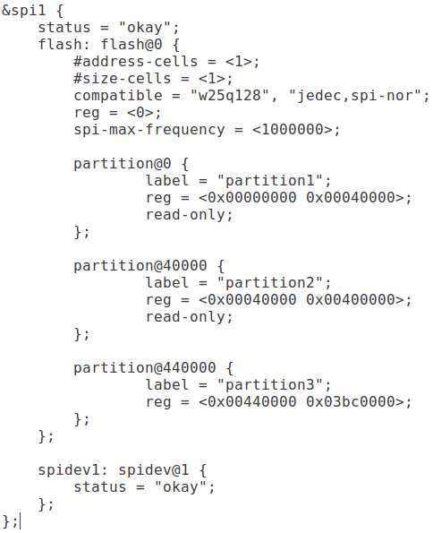
MTD Subsystem – spi-nor
drivers/mtd/
drivers/mtd/spi-nor
  spi-nor.c
drivers/mtd/devices
  m25p80.c
DTS

Slide 24
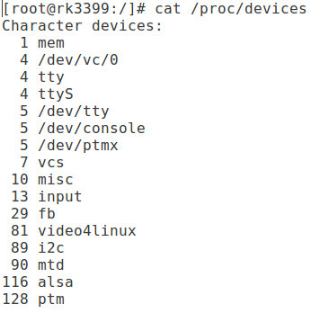
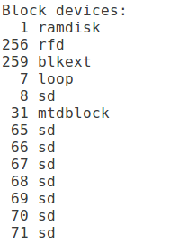
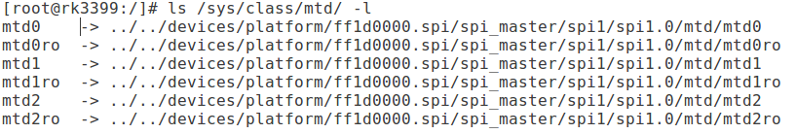
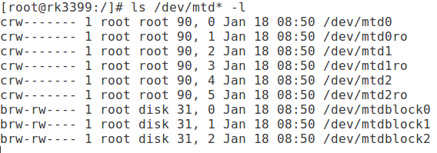
MTD Subsystem – spi-nor

