Slide 1
IIO Subsystem

Slide 2
IIO Introduction
IIO - The Industrial I/O
support for devices that in some sense
  analog to digital (ADC)
  digital to analog converters (DAC)
Devices that fall into this category are
  ADCs
  Accelerometers
  Gyros
  DAC
  Pressure Sensors

Slide 3
IIO Introduction
Fill the gap between the somewhat similar hwmon and input subsystems
Hwmon is very much directed at low sample rate sensors used in applications
  fan speed control
  temperature measurement.
Input is, as it's name suggests focused on human interaction input devices

Slide 4
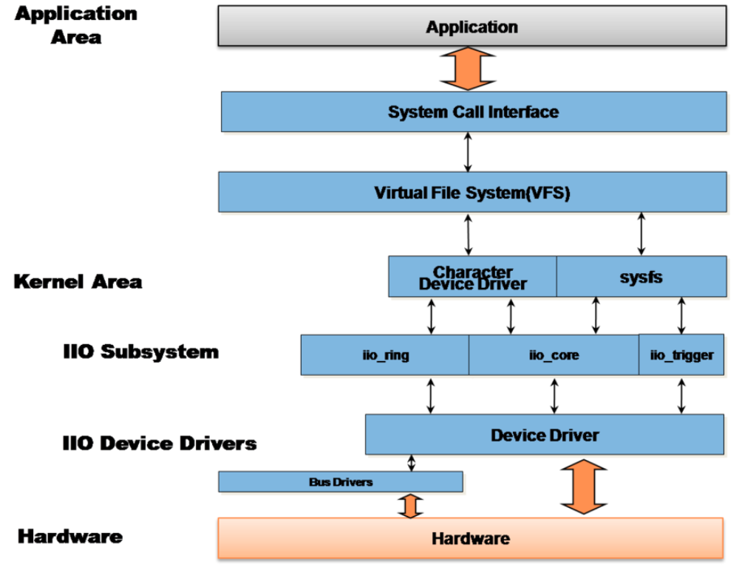
IIO Introduction

Slide 5
IIO Interface
There are 2 ways for a user space application
to interact with an IIO driver
/sys/bus/iio/iio:deviceX/
  data channels
/dev/iio:deviceX
  buffered data transfer
  events information

Slide 6
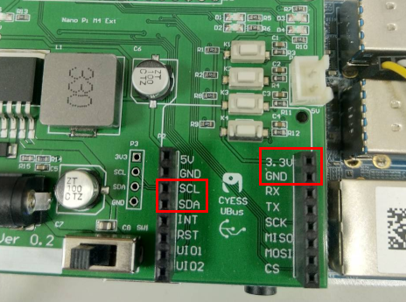
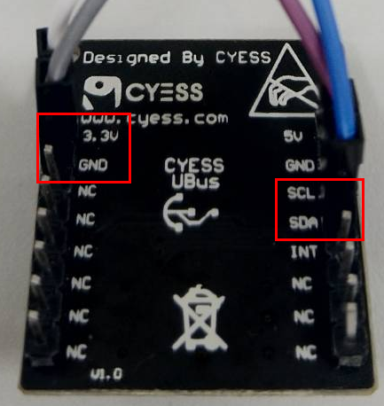
ISL29023
I2C

