Slide 1
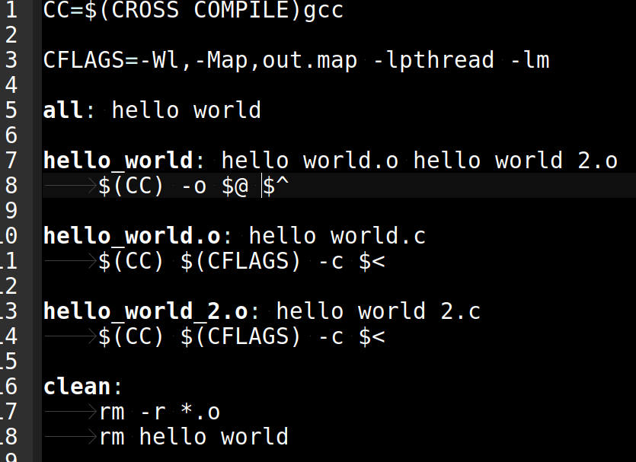
The Automatic Variables

Slide 2
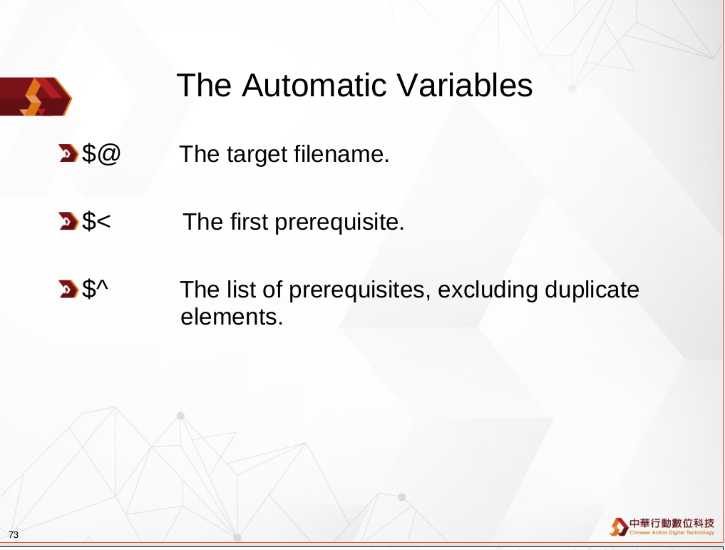
The Automatic Variables

Slide 3
The Automatic Variables

