Slide 1
RK3399 and SOC

Slide 2
RockPi WiKi
Rock Pi Wiki
  https://wiki.radxa.com/Rockpi4
Rock Pi Hardware
  https://wiki.radxa.com/Rockpi4/hardware/rockpi4
Rock Pi Image
  https://wiki.radxa.com/Rockpi4/downloads

Slide 3
CPU

Slide 4
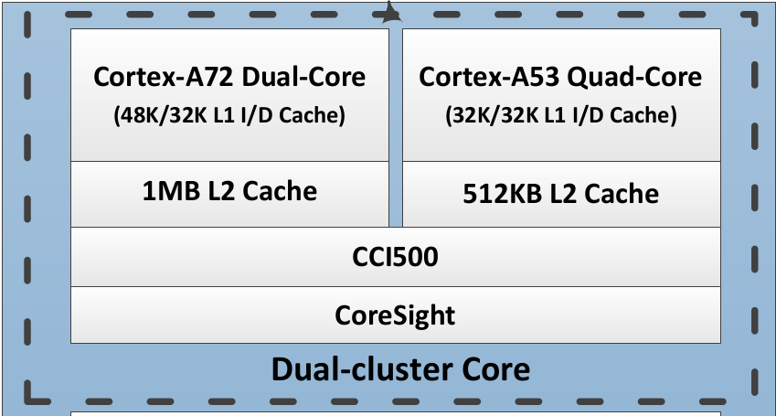
CPU (1)
Two CPU clusters
  Big cluster with dual-core Cortex-A72
    high-performance
  Little cluster with quad-core Cortex-A53
    low power

Slide 5
CPU (2)
Arm big.LITTLE technology
  ”LITTLE” processors are designed for maximum power efficiency
  ”big” processors are designed to provide maximum compute performance.
big
LITTLE
https://www.arm.com/zh-TW/technologies/big-little

Slide 6
Memory

Slide 7
Memory (1)
Internal ROM
  Internal BootRom (Size : 32KB)
  boot from
    SPI, eMMC, SD/MMC
External
  DDR3/DDR3L/LPDDR3/LPDDR4
  SPI NOR/NAND Flash
  EMMC5.1
  SD3.0/MMC4.51

Slide 8
Memory (2)
Internal ROM
  Internal BootRom (Size : 32KB)
  boot from
    SPI, eMMC, SD/MMC
Internal RAM
  200KB

Slide 9
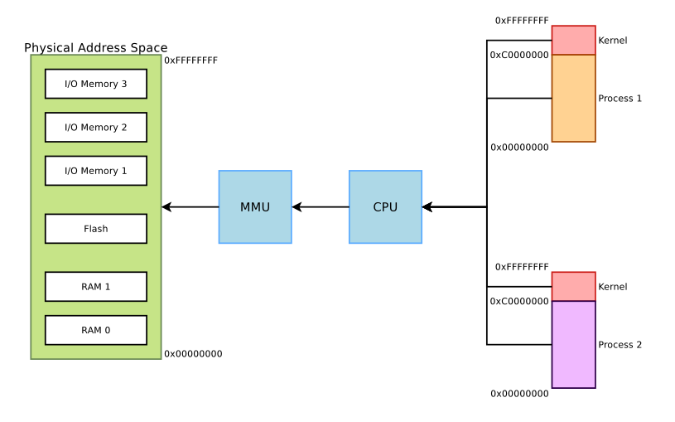
MMU (1)
32 Bit CPU
Physical Address
Virtual Address

Slide 10
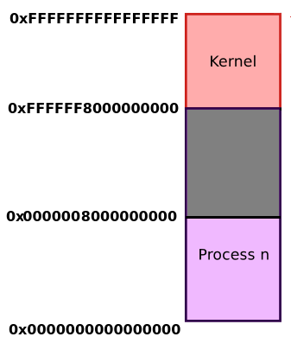

MMU (2)
64 Bit CPU
AArch64 Linux memory layout with 4KB pages + 3 levels
512GB
reserved for
kernel-space
512GB
reserved for
user space

Slide 11
MMU (3)
The MMU divides memory into 4KB pages
2-level page table structure
  The First level
    Page Directory consists of 1024 Directory Table Entries (DTEs)
    Each pointing to a Page Table.
  The Second level
    The Page Table consists of 1024 Page Table Entries (PTEs)
    Each pointing to a page in memory

Slide 12
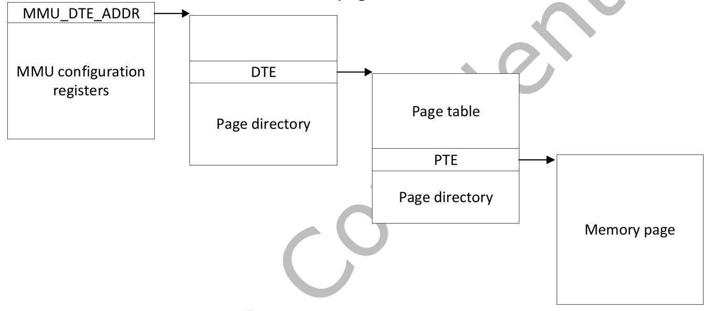
MMU (4)
31
22
21
12
11
0
DTE index
PTE index
Page Offset

Slide 13
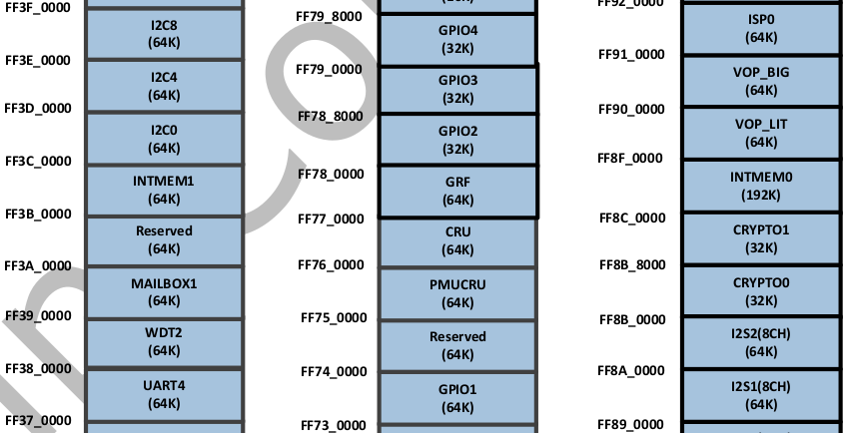
MMU (5)
Physical
memory address
I/O Address Mapping
can’t use
physical memory
address direct
Rockchip_RK3399TRM_V1.3_Part1.pdf

Slide 14
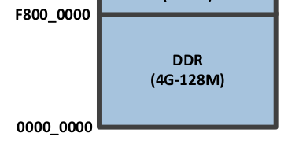
MMU (6)
DDR SD RAM Memory

Slide 15
Interconnect Connect

Slide 16
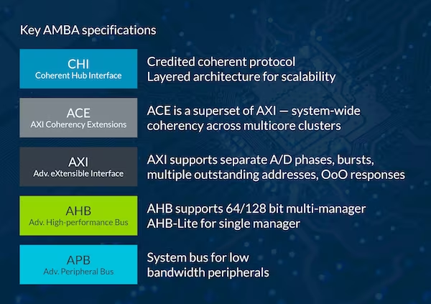
Bus Architecture
AMBA : Advanced Microcontroller Bus Architecture
  AXI
  AHB
  APB
https://www.arm.com/zh-TW/architecture/system-architectures/amba

Slide 17
GPU

Slide 18
Graphics Engine (1)
Graphics Process Unit
Mali-T860MP4 GPU
  OpenGL ES1.1/2.0/3.0, OpenCL1.2,
  3DGraphics Engine
  2D Graphics Engine
Rockchip_RK3399TRM_V1.3_Part1.pdf

Slide 19
Graphics Engine (2)
OpenGL
  Open Graphics Library
OpenGL ES
  OpenGL for Embedded Systems
EGL
  Native Platform Graphics Interface
https://www.khronos.org/egl

Slide 20
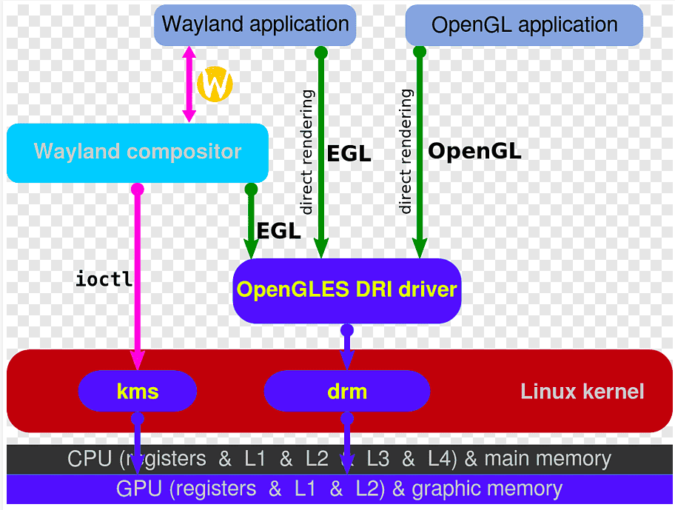
Graphics Engine (3)
https://en.wikipedia.org/wiki/EGL_%28API%29#/media/File:Wayland_display_server_protocol.svg

Slide 21
Connect

Slide 22
USB (1)
USB Host
  RK3399
  OHCI : 1.1. Hardware Complex
  UHCI : 1.0, 1.1 Software Complex
  EHCI : 2.0
  XHCI : 3.0
USB Device
  USB Storage

Slide 23
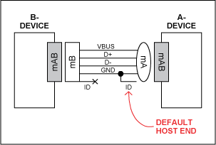
USB (2)
USB OTG
  USB_ID信號爲低時，該設備應作爲Host
  USB_ID信號爲高時，該設備作爲Slave

Slide 24
UART
The Universal Asynchronous Receiver/Transmitter
  Write Data
    CPU → Data → APB → UART
  Read Data
    Data → UART → APB → CPU
RockPi4B
PC
TX
TX
RX
RX
GND
GND
Rockchip_RK3399TRM_V1.3_Part2.pdf

Slide 25
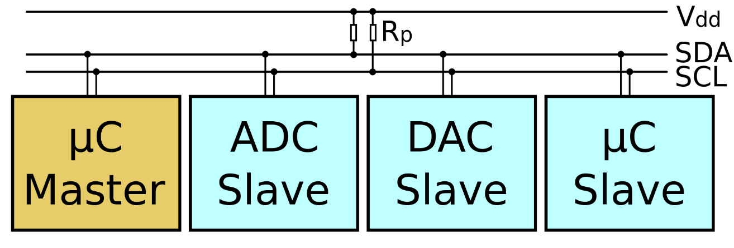
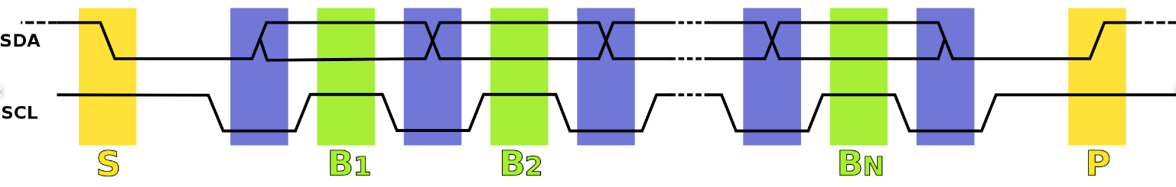
I2C (1)
Serial bus
  SDA data line
  SCL clock line
Protocol
https://en.wikipedia.org/wiki/I%C2%B2C

Slide 26
I2C (2)
Master and Client
RK3399 SOC
SHT21 sensor
I2C Master
SCL
I2C Client
SDA

Slide 27
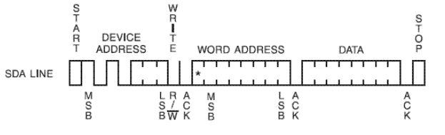
I2C protocol
Write
  byte write
  page write
Device address
Read/write bit : 0
ACK

Slide 28
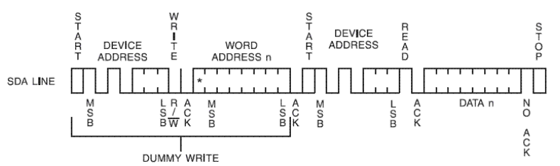
I2C protocol
Read
  byte read
  page read
Device address
Read/write bit : 1
ACK

Slide 29
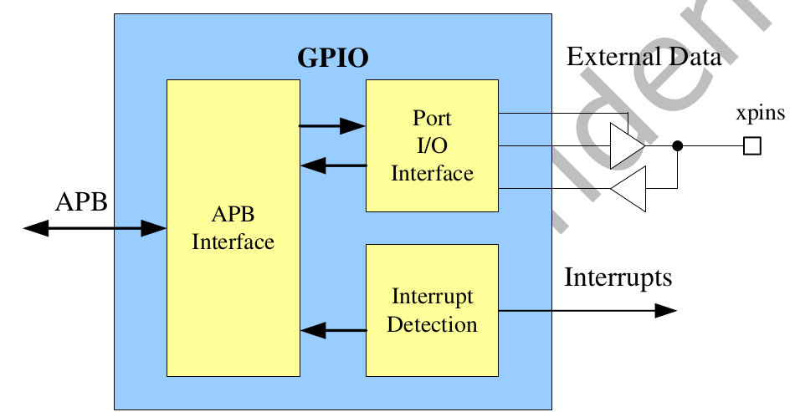
GPIO
General Purpose Programming I/O
GPIO controls the output data and direction of external I/O pads

Slide 30
WiFi Basic

Slide 31
WIFI – 802.11 (1)
IEEE 802.11 – 無線區域網路
Application
Presentation
ISO
OSI
7-layer
model
Session
IEEE 802
standards
Transport
Network
Logical Link Control
Data Link
Medium Access (MAC)
Physical
Physical (PHY)
https://ptolemy.berkeley.edu/projects/ofdm/ergen/docs/IEEE-802.11overview.ppt

Slide 32
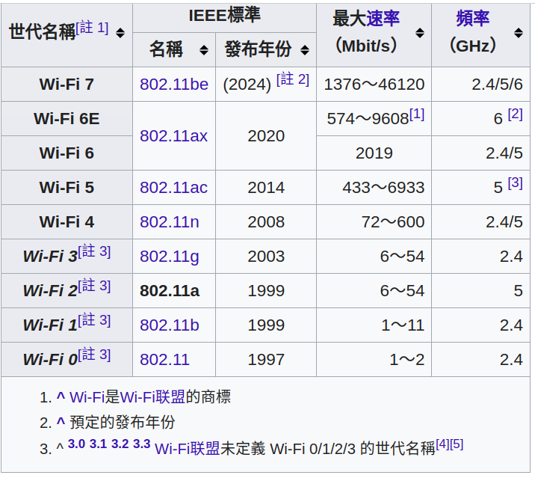
WIFI – 802.11 (2)
https://zh.wikipedia.org/wiki/IEEE_802.11a-1999

Slide 33
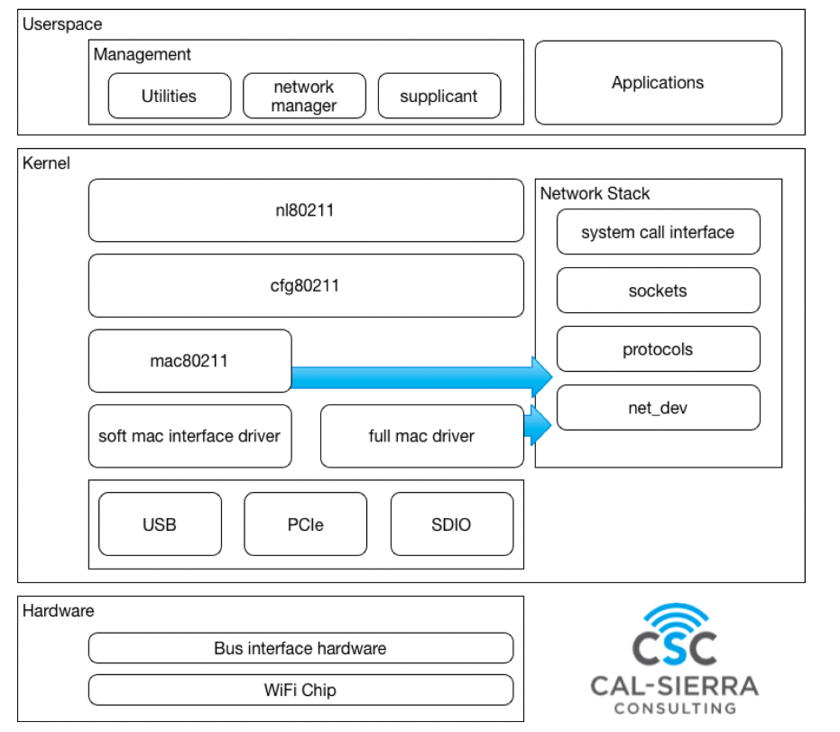
WIFI – Linux & 802.11 (1)
https://hackmd.io/@0xff07/BJkDzazVK#iwd

Slide 34
WIFI – Linux & 802.11 (2)
Mac80211
  most associated to hardware offloading
  the 802.11 protocol state machine lives here
cfg80211
  middle-layer Handles Everything Configurable
nl80211
  The API between user-land and kernel-land
  Relies on the netlink protocol to exchange messages between the two worlds
https://www.linuxembedded.fr/2020/05/emulating-wlan-in-linux-part-i-the-80211-stack

Slide 35
WIFI – Tool
Show / manipulate wireless devices and their configuration
  iw
For connecting to a WPA/WPA2 network
  wpa_supplicant

Slide 36
Audio

Slide 37
ALSA Overview
Advanced Linux Sound Architecture
  Linux kernel
  Software framework
Sound Servers
  PulseAudio, JACK ...
ALSA stream is a data flow representing sound
  PCM (Pulse-code modulation)
https://en.wikipedia.org/wiki/Advanced_Linux_Sound_Architecture

Slide 38
ALSA Overview
Audio Codec
  Audio Codec就是音樂訊號（Audio）壓縮/解壓縮(Compress/DECompress)
  的演算法或程式, 前後加起來就是Audio Codec.
Parameters of the hardware
  sampling rate : 44100 Hz
  sample width : 8 bit, 16 bit, 24 bit
  sample encoding : endianness
  number of channels : 1 channel, 2 channel ...
https://en.wikipedia.org/wiki/Advanced_Linux_Sound_Architecture

Slide 39
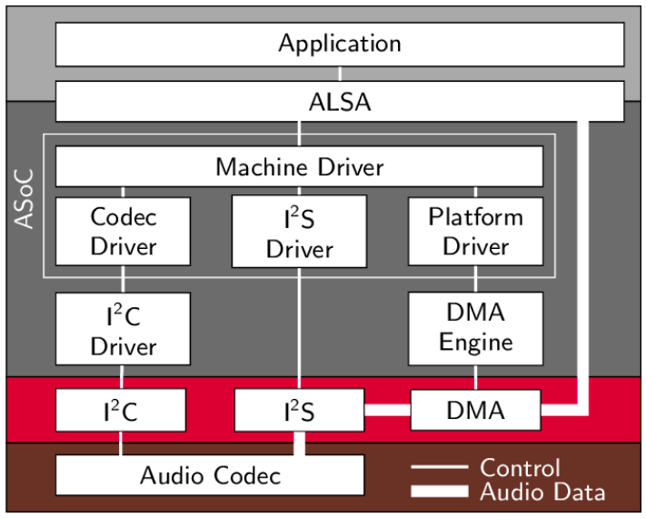
ALSA Overview
https://www.researchgate.net/figure/Structure-of-ASoC-and-the-embedment-into-the-Linux-audio-framework_fig2_262112720

Slide 40
Sound Card in Linux (1)
ls /proc/asound/ -l
lrwxrwxrwx 1 root root 5 Apr 30 06:51 HDMICODEC -> card1
dr-xr-xr-x 4 root root 0 Apr 30 06:51 card0
dr-xr-xr-x 3 root root 0 Apr 30 06:51 card1
-r--r--r-- 1 root root 0 Apr 30 06:51 cards
-r--r--r-- 1 root root 0 Apr 30 06:51 devices
-r--r--r-- 1 root root 0 Apr 30 06:51 hwdep
-r--r--r-- 1 root root 0 Apr 30 06:51 pcm
lrwxrwxrwx 1 root root 5 Apr 30 06:51 rockchipes8316c -> card0
dr-xr-xr-x 2 root root 0 Apr 30 06:51 seq
-r--r--r-- 1 root root 0 Apr 30 06:51 timers
-r--r--r-- 1 root root 0 Apr 30 06:51 version

Slide 41
Sound Card in Linux (2)
Sound card 0
cat /proc/asound/cards
0 [rockchipes8316c]: rockchip_es8316 - rockchip,es8316-codec
rockchip,es8316-codec
1 [HDMICODEC ]: HDMI-CODEC - HDMI-CODEC
HDMI-CODEC
Sound card 1

Slide 42
Sound Card in Linux (3)
rockchipes8316c
ls -l /proc/asound/card0/
-r--r--r-- 1 root root 0 Apr 30 06:59 id
dr-xr-xr-x 3 root root 0 Apr 30 06:59 pcm0c
dr-xr-xr-x 3 root root 0 Apr 30 06:59 pcm0p
capture
playback
ls -l /proc/asound/card1/
-r--r--r-- 1 root root 0 Apr 30 07:01 id
dr-xr-xr-x 3 root root 0 Apr 30 07:01 pcm0p

Slide 43
Linux Display Subsystem

Slide 44
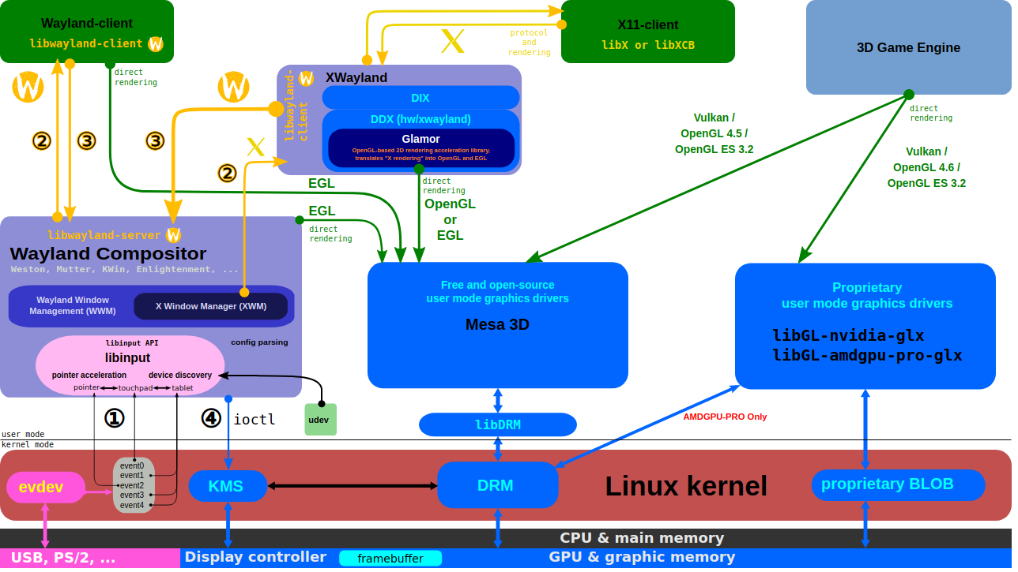
X Server and Wayland Compositor
https://upload.wikimedia.org/wikipedia/commons/2/2d/The_Linux_Graphics_Stack_and_glamor.svg

Slide 45
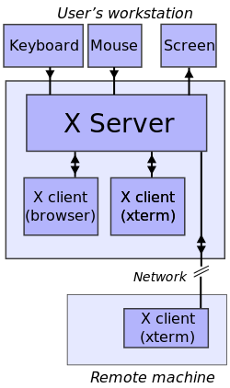
Linux Windows System (1)
https://en.wikipedia.org/wiki/File:X_client_sever_example.svg

Slide 46
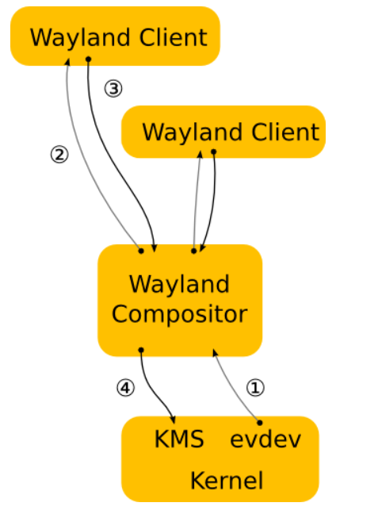
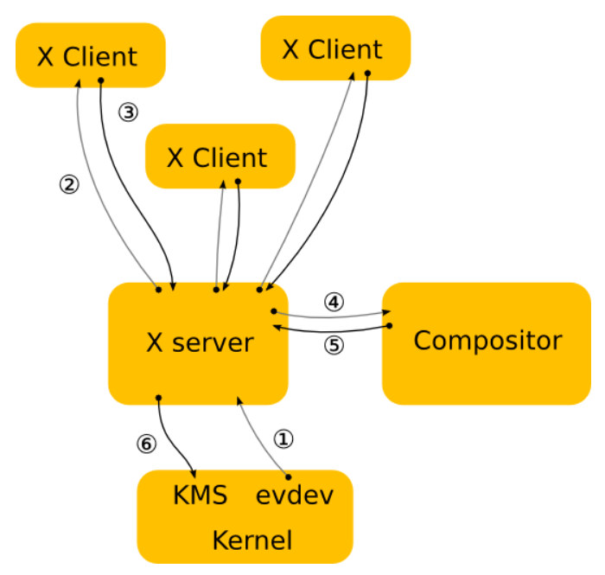
Linux Windows System (2)
Wayland is a replacement for the X11 window system protocol
https://wayland.freedesktop.org/architecture.html

Slide 47
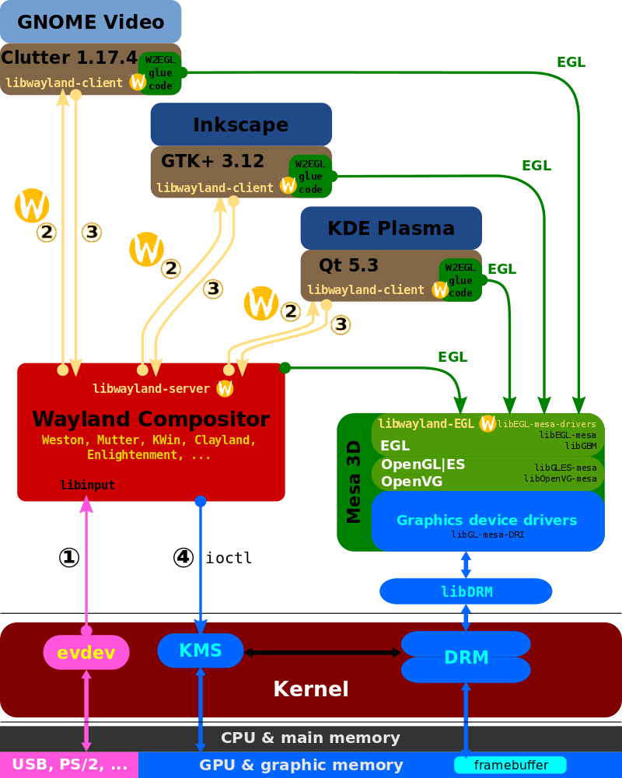
Wayland Display Server and EGL
https://www.wikiwand.com/ja/Wayland

Slide 48
GTK and Gnome
GTK
  GTK (formerly GTK+) is a free and open-source cross-platform widget toolkit for creating graphical user interfaces (GUIs).
GNOME
  GNOME is the default desktop environment of many major Linux distributions
  originally an acronym for GNU Network Object Model Environment
  free and open-source desktop environment for Linux and other Unix-like[10] operating systems
https://en.wikipedia.org/wiki/GNOME
https://en.wikipedia.org/wiki/GTK

Slide 49
OpenGL and EGL
EGL
  EGL Native Platform Graphics Interface is an interface portable layer for graphics resource management.
  works between rendering APIs such as OpenGL ES or OpenVG and the underlying native platform window system
OpenGL
  OpenGL (Open Graphics Library) is a cross-language, cross-platform application programming interface (API) for rendering 2D and 3D vector graphics
Mesa
  Mesa, also called Mesa3D and The Mesa 3D Graphics Library
  it is an open source implementation of OpenGL, Vulkan, and other graphics API specifications
https://www.khronos.org/egl/
https://en.wikipedia.org/wiki/OpenGL
https://en.wikipedia.org/wiki/Mesa_(computer_graphics)

Slide 50
Direct Rendering Manager (DRM)
Direct Rendering Manager
  Management of buffers and free space within that memory.
  Solve Frame buffer driver cannot be used GPU and multi-user process.
DRM consists of
  libdrm
    libdrm provides a user space library for accessing the DRM
  KMS : Kernel Mode Setting
    Change resolution and depth
  DRI : Direct Rendering Infrastructure
    Interfaces to access hardware directly
  GEM : Graphics Execution Manager
    Buffer management
  DRM Driver in kernel side
    Access hardware

Slide 51
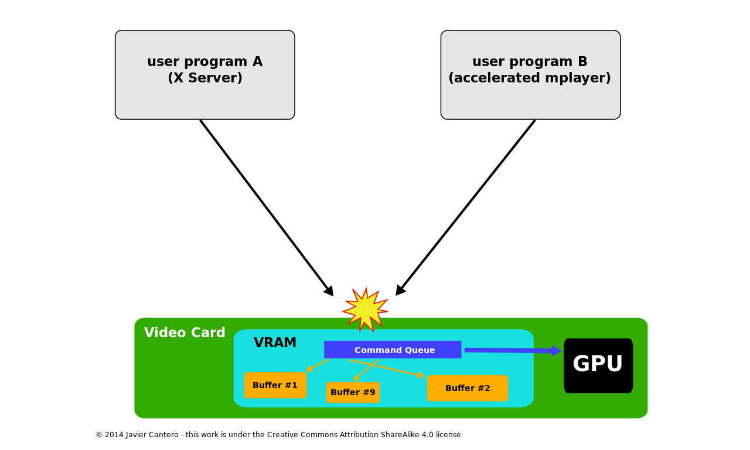
Direct Rendering Manager (DRM)
If no use DRM

Slide 52
Direct Rendering Manager (DRM)
https://upload.wikimedia.org/wikipedia/commons/2/2d/The_Linux_Graphics_Stack_and_glamor.svg

Slide 53
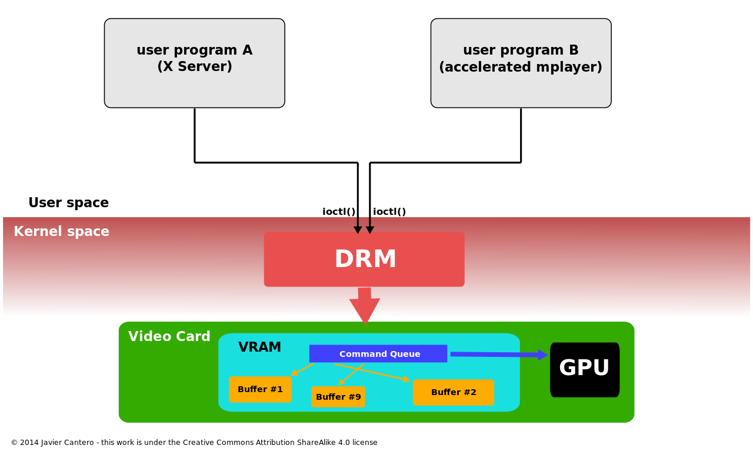
Direct Rendering Manager (DRM)
Use DRM

Slide 54
Kernel Mode Setting (KMS)
KMS device model
  CRTCs
  Connectors
  Encoders
  Planes
Kernel Mode Setting
  screen resolution
  color depth and
  refresh rate

Slide 55
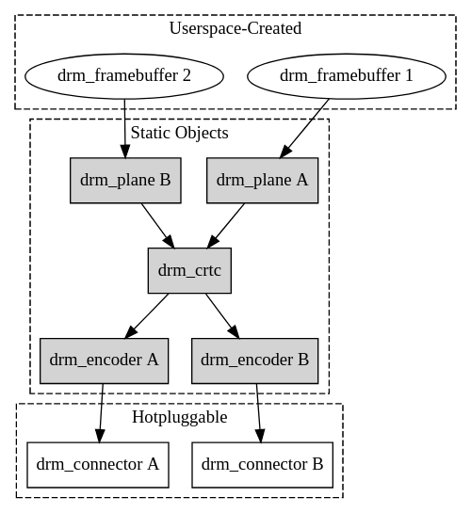
Kernel Mode Setting (KMS)
https://www.kernel.org/doc/html/v4.15/gpu/drm-kms.html

Slide 56
Kernel Mode Setting (KMS)
https://upload.wikimedia.org/wikipedia/commons/2/2d/The_Linux_Graphics_Stack_and_glamor.svg

Slide 57
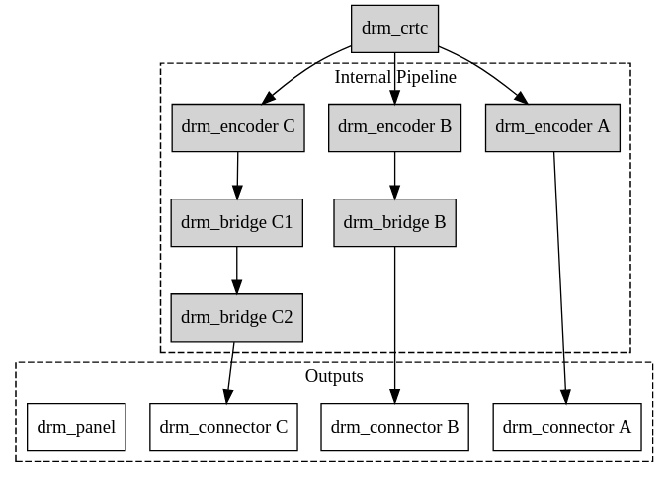
Kernel Mode Setting (KMS)
https://www.kernel.org/doc/html/v4.15/gpu/drm-kms.html

Slide 58

Video Frame Buffer
The frame buffer device provides an abstraction for
the graphics hardware.
Application
memory
User Space
MMAP
Kernel Space
memory
FB Driver

Slide 59
Kernel Mode Setting (KMS)
CRTC
Encode
Connecter
FrameBuffer
Planes

