Slide 1
Embedded Linux

Slide 2
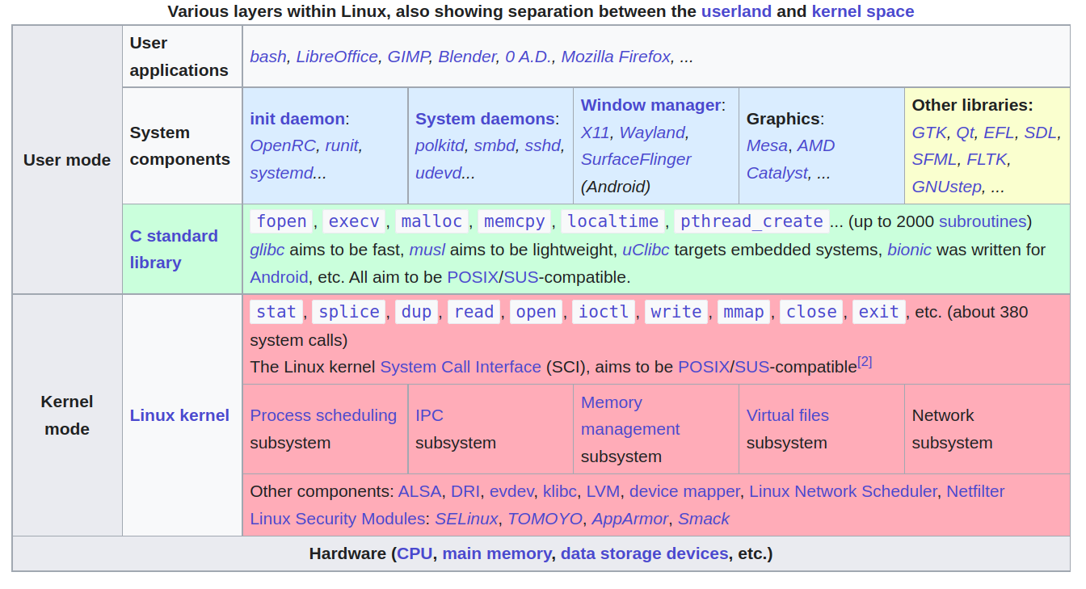
Various Layers within Linux
https://en.wikipedia.org/wiki/User_space_and_kernel_space

Slide 3

Embedded Linux System
Usr App
Library
C library
User Space
System Call
Device Driver
Linux kernel
Kernel Space
Hard ware

Slide 4
Linux kernel key features
Portability and hardware support
Scalability
Exhaustive networking support
Stability and reliability
Modularity
Easy to program.

Slide 5
System Start Up

Slide 6









Linux Start Up
1. ROM Code Start Up
3. Read Linux Kernel Image To DDR RAM
DDR RAM
4. Start Linux Kernel
2. Read Boot-loader
and Init DDR RAM
5. mount RootFS
Yocto
Buildroot
Debian

Slide 7
SOC RK3399

Slide 8
Embedded Linux System Booting
Boot
Initialize HW
Loader
Load OS to memory
Linux
DTB
OS initial / load driver
RootFS
OS running (Debian)

Slide 9
RK3399 System Boot
Reference:
Page 30 of Rockchip_RK3399TRM_V1.3_Part1.pdf

Slide 10

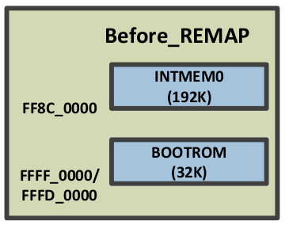
RK3399 System Boot (1)
Power On
ROM
SRAM
1
DDR RAM
CPU
eMMC
SDMMC
SPI
NOFlash
SPI
NOFlash
Cortex-A53 get first instruction from address 0xffff0000 romcode start to run

Slide 11
RK3399 System Boot (2)
ROM
SRAM
DDR RAM
CPU
2
eMMC
SDMMC
SPI
NOFlash
SPI
NOFlash
Check ID BLOCK from external SPI Nor Flash

Slide 12
RK3399 System Boot (3)
ROM
SRAM
DDR RAM
CPU
3
eMMC
SDMMC
SPI
NOFlash
SPI
NandFlash
Check ID BLOCK fromexternal SPI Nand Flash

Slide 13
RK3399 System Boot (4)
ROM
SRAM
DDR RAM
CPU
4
eMMC
SDMMC
SPI
NOFlash
SPI
NandFlash
Check ID BLOCK from external eMMC

Slide 14
RK3399 System Boot (5)
BL1
ROM
SRAM
work in cache
DDR RAM
IDB_Loader
CPU
5
eMMC
SDMMC
SPI
NOFlash
SPI
NandFlash
Check ID BLOCK from external SDMMC

Slide 15
RK3399 System Boot (6)
ROM
SRAM
DDR RAM
CPU
6
5
eMMC
SDMMC
SPI
NOFlash
SPI
NandFlash
5. Check ID BLOCK from external SDMMC
6. Read 2nK SDRAM initialization image code to internal SRAM

Slide 16
RK3399 System Boot (7)
BL2
ROM
SRAM
work in cache
DDR RAM Init
DDR RAM
CPU
6
7
5
eMMC
SDMMC
SPI
NOFlash
SPI
NandFlash
5. Check ID BLOCK from external SDMMC
6. Read 2nK SDRAM initialization image code to internal SRAM
7. Run boot code to do DDR initialization

Slide 17
RK3399 System Boot (8)
ROM
SRAM
DDR RAM
CPU
6
7
8
5
eMMC
SDMMC
SPI
NOFlash
SPI
NandFlash
5. Check ID BLOCK from external SDMMC
6. Read 2nK SDRAM initialization image code to internal SRAM
7. Run boot code to do DDR initialization
8. Transfer boot code to DDR then Run boot code

Slide 18
RK3399 System Boot (9)
BL3
ROM
SRAM
work in DDR RAM
DDR RAM
UBoot
CPU
9
eMMC
SDMMC
SPI
NOFlash
SPI
NandFlash
Run UBoot

Slide 19
RK3399 System Boot (10)
ROM
SRAM
work in DDR RAM
DDR RAM
Linux
CPU
10
eMMC
SDMMC
SPI
NOFlash
SPI
NandFlash
Run Linux

Slide 20
Boot
Power On BootROM code (work in cache)
  Load BL1
BL1 (work in cache - IDB_Loader)
  Initial simple exception vectors, PLL (clock)
  Initial Multi-CPU
  Load BL2
BL2 (work in cache)
  Initial DDR memory
  Initial C environment (stack, heap, )
  Load BL31

Slide 21
Boot
BL31 (work in DDR)
  Initial exception vectors
  Load BL32 (u-boot)
BL32 U-boot (work in DDR)
  Initial storage device
  Load Linux Kernel
Kernel (work in DDR)
  kernel/Documentation/arm64/booting.txt
  Load RootFS

Slide 22

Embedded Linux System
User land
C Library
Qt
OpenCV
GLib
Virtual File System (VFS)
Kernel
Linux System Call
Linux Device Driver
Hardware
Disk
Image Sensor
Keyboard
mouse
Panel

