Slide 1
CH 7 Root File System

Slide 2
File System in Linux
Directory
Virtual File System (VFS)
JFFS
YAFFS
RAMFS
EXTx
MTD
Nor Flash
Nand Flash
RAM
SD/MMCCARD

Slide 3
File System
A file system defines how files are named, stored, and retrieved from a storage device
For desktop users
  FAT32, NFS, EXT3, EXT4
For embedded system
  Cramfs
  JFFS2
  Squashfs
  YAFFS2
  EXT2, EXT3

Slide 4
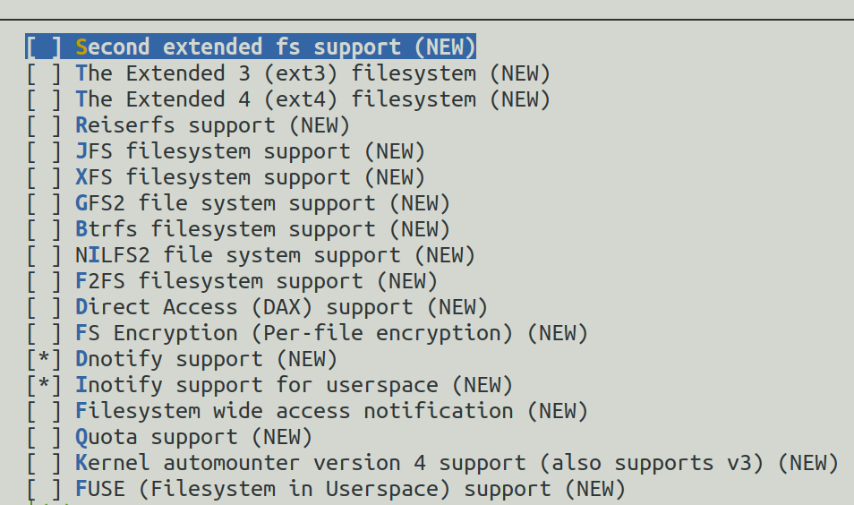
File System and Kernel
[CMD] make menuconfig
  File systems

Slide 5
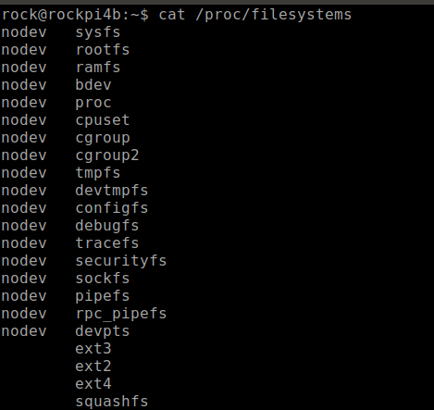
Mount a File System Driver
Make sure which File-System be supported
  [CMD] cat /proc/filesystems

Slide 6
Mount a File System Driver
Make sure which File-System be supported
  mount -t ${FILE_SYS_TYPE} ${DISK} ${MOUNT_FOLDER}
  Fake Image_Disk Test
    [CMD] sudo dd if=/dev/zero of=/home/rock/vdidk.img bs=1M count=5 status=progress
    [CMD] sudo mkfs.vfat ./vdidk.img
    [CMD] sudo mount -t vfat ./vdidk.img /tmp/vfat_folder/
    [CMD] lsblk -f

Slide 7
Root File System

Slide 8
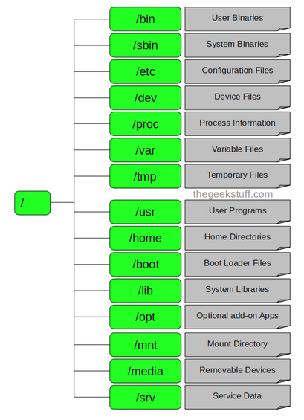
Root File System Structure

Slide 9
Root
Every single file and directory starts from the root directory
Only root user has write privilege under this directory
Please note that /root is root user’s home directory, which is not same as /

Slide 10
/bin – User Binaries
Contains binary executables.
Common linux commands you need to use in single-user modes are located under this directory.
Commands used by all the users of the system are located here.
For example: ps, ls, ping, grep, cp.

Slide 11
/sbin – System Binaries
Just like /bin, /sbin also contains binary executables.
But, the linux commands located under this directory are used typically by system aministrator, for system maintenance purpose.
For example: iptables, reboot, fdisk, ifconfig, swapon

Slide 12
/etc – Configuration Files
Contains configuration files required by all programs.
This also contains startup and shutdown shell scripts used to start/stop individual programs.
For example: /etc/resolv.conf, /etc/logrotate.conf

Slide 13
/dev – Device Files
Contains device files.
These include terminal devices, usb, or any device attached to the system.
For example: /dev/tty1, /dev/usbmon0

Slide 14
/proc – Process Information
Contains information about system process.
This is a pseudo filesystem contains information about running process. For example: /proc/{pid} directory contains information about the process with that particular pid.
This is a virtual filesystem with text information about system resources. For example: /proc/uptime

Slide 15
/var – Variable Files
var stands for variable files.
Content of the files that are expected to grow can be found under this directory.
This includes — system log files (/var/log); packages and database files (/var/lib); emails (/var/mail); print queues (/var/spool); lock files (/var/lock); temp files needed across reboots (/var/tmp);

Slide 16
/tmp – Temporary Files
Directory that contains temporary files created by system and users.
Files under this directory are deleted when system is rebooted.

Slide 17
/usr – User Programs
Contains binaries, libraries, documentation, and source-code for second level programs.
/usr/bin contains binary files for user programs. If you can’t find a user binary under /bin, look under /usr/bin. For example: at, awk, cc, less, scp
/usr/sbin contains binary files for system administrators. If you can’t find a system binary under /sbin, look under /usr/sbin. For example: atd, cron, sshd, useradd, userdel
/usr/lib contains libraries for /usr/bin and /usr/sbin
/usr/local contains users programs that you install from source. For example, when you install apache from source, it goes under /usr/local/apache2

Slide 18
/home – Home Directories
Home directories for all users to store their personal files.
For example: /home/john, /home/nikita

Slide 19
/boot – Boot Loader Files
Contains boot loader related files.
Kernel initrd, vmlinux, grub files are located under /boot

Slide 20
/lib – System Libraries
Contains library files that supports the binaries located under /bin and /sbin
Library filenames are either ld* or lib*.so.*

Slide 21
/opt – Optional add-on Applications
opt stands for optional.
Contains add-on applications from individual vendors.
add-on applications should be installed under either /opt/ or /opt/ sub-directory.

Slide 22
/mnt – Mount Directory
Temporary mount directory where sysadmins can mount filesystems.

Slide 23
Linux System Initial Program

Slide 24
System V
Unix System Five (V)
AT&T developed
The first initial process is → init
  PID=1
SystemV handles startup processes through shell scripts in /etc/init*
  /etc/inittab
  /etc/init.d/ and /etc/init.d/rcS

Slide 25
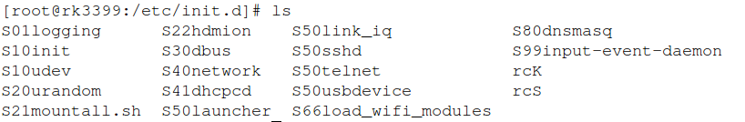
System V
/etc/init.d/S*
  initial system script
Start a Service
  [CMD] etc/init.d/S50sshd start
  [CMD] etc/init.d/S50sshd stop

Slide 26
System D
System Daemon
/sbin/init -> /lib/systemd/systemd
  PID=1
SystemD is the new system that many distros are moving to
SystemD handles startup processes through .service files

Slide 27
System D Configure File
The unit configuration files are loaded from a set of paths
  "/lib/systemd/system":
    OS default configuration files
  "/etc/systemd/system":
    system administrator configuration files
    override the OS default
  "/run/systemd/system":
    un-time generated configuration files
    override the installed configuration files

Slide 28
Service Control
systemctl ${CTL} ${SERVICE}
  [CMD] systemctl enable ssh
  [CMD] systemctl status ssh
  [CMD] systemctl start ssh
  [CMD] systemctl stop ssh

Slide 29
Linux Distribution

Slide 30
Linux Distribution
Boot-loader
Linux kernel
RootFS
Application
Library
Linux driver moudes

Slide 31




Build Distribution by Tool
Build Tool
BootLoader
Embedded Linux
Distributions
Linux Kernel Image
Applications
Library
RootFS

Slide 32
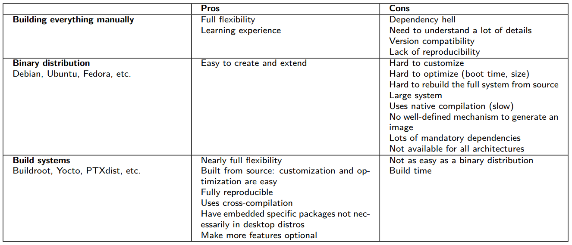
System integration
https://bootlin.com/doc/training/buildroot/buildroot-slides.pdf

Slide 33
Debian

Slide 34
RockPi4B Debian
https://wiki.radxa.com/Rockpi4/dev/Debian
https://github.com/radxa/rk-rootfs-build/tree/rockchip-debian

