Slide 1
CH Embedded Linux & Device

Slide 2
I2C

Slide 3
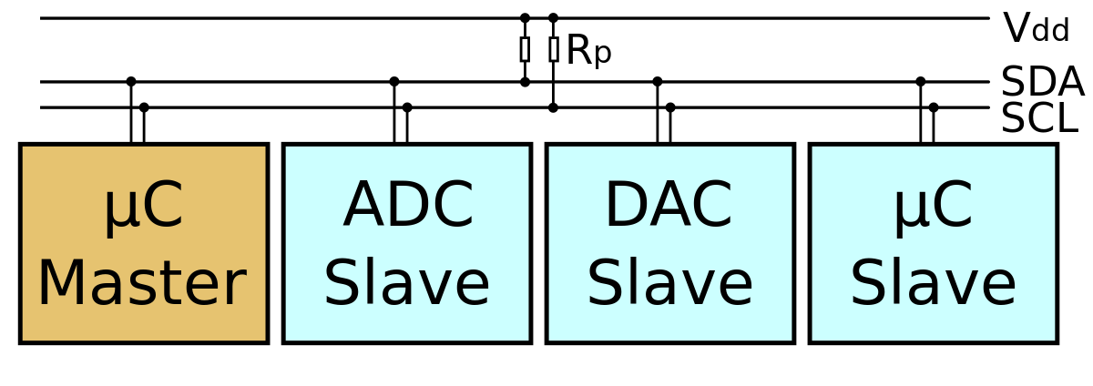
I2C Driver
https://zh.wikipedia.org/wiki/I%C2%B2C

Slide 4
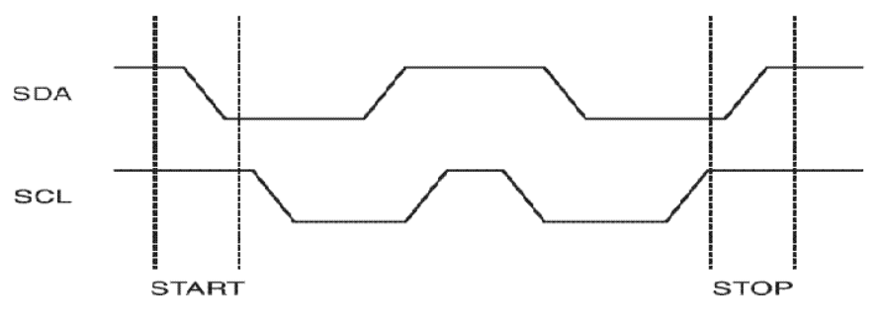
I2C protocol
Serial bus
  SDA data line
  SCL clock line

Slide 5
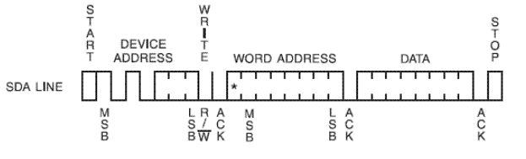
I2C protocol
Write
  byte write
  page write
Device address
Read/write bit : 0
ACK

Slide 6
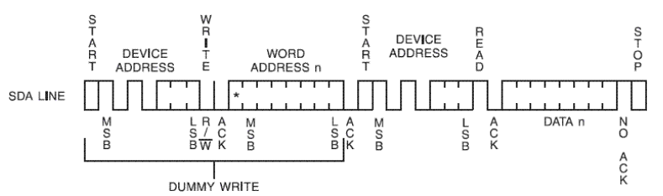
I2C protocol
Read
  byte read
  page read
Device address
Read/write bit : 1
ACK

Slide 7
WiFi Basic

Slide 8
WIFI – 802.11 (1)
IEEE 802.11 – 無線區域網路
Application
Presentation
ISO
OSI
7-layer
model
Session
IEEE 802
standards
Transport
Network
Logical Link Control
Data Link
Medium Access (MAC)
Physical
Physical (PHY)
https://ptolemy.berkeley.edu/projects/ofdm/ergen/docs/IEEE-802.11overview.ppt

Slide 9
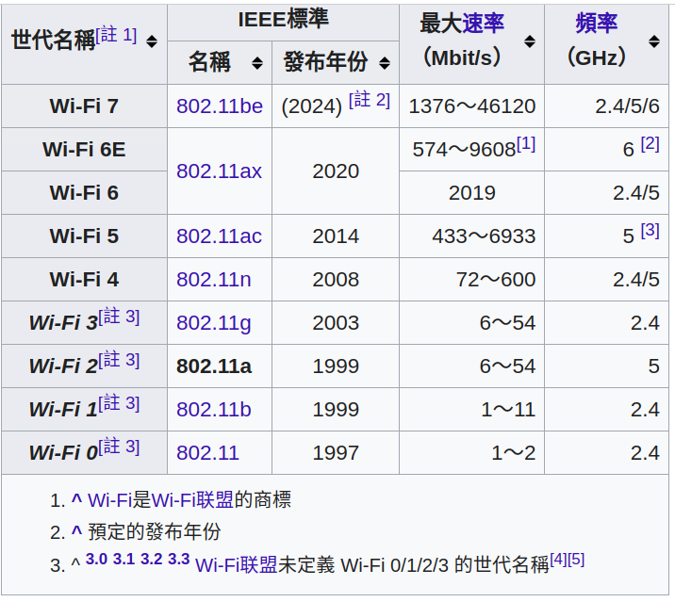
WIFI – 802.11 (2)
https://zh.wikipedia.org/wiki/IEEE_802.11a-1999

Slide 10
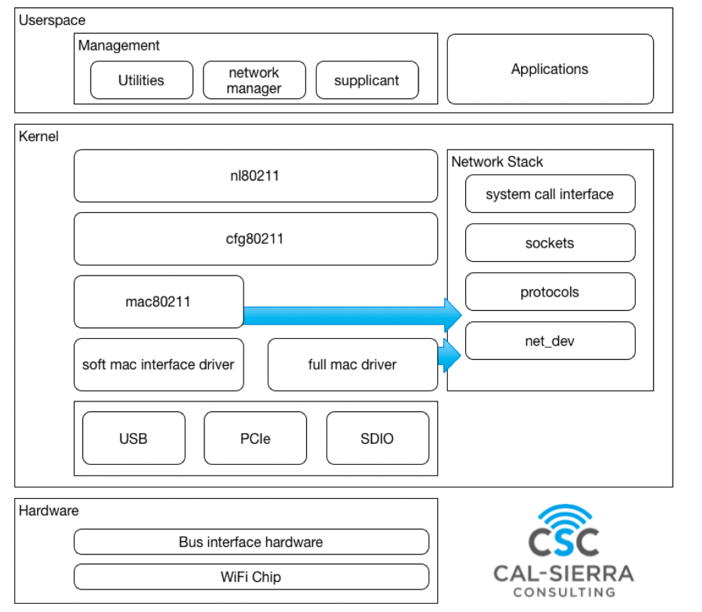
WIFI – Linux & 802.11 (1)
https://hackmd.io/@0xff07/BJkDzazVK#iwd

Slide 11
WIFI – Linux & 802.11 (2)
Mac80211
  most associated to hardware offloading
  the 802.11 protocol state machine lives here
cfg80211
  middle-layer Handles Everything Configurable
nl80211
  The API between user-land and kernel-land
  Relies on the netlink protocol to exchange messages between the two worlds
https://www.linuxembedded.fr/2020/05/emulating-wlan-in-linux-part-i-the-80211-stack

Slide 12
WIFI – tool
Show / manipulate wireless devices and their configuration
  iw
For connecting to a WPA/WPA2 network
  wpa_supplicant

Slide 13
Advanced Linux Sound Architecture

Slide 14
ALSA Overview
Advanced Linux Sound Architecture
  ALSA
  Linux kernel
  Software framework
Sound Servers
  PulseAudio, JACK ...
ALSA stream is a data flow representing sound
  PCM (Pulse-code modulation)
https://en.wikipedia.org/wiki/Advanced_Linux_Sound_Architecture

Slide 15
ALSA Overview
Audio Codec
  Audio Codec就是音樂訊號（Audio）壓縮/解壓縮(Compress/DECompress)
  的演算法或程式, 前後加起來就是Audio Codec.
Parameters of the hardware
  sampling rate : 44100 Hz
  sample width : 8 bit, 16 bit, 24 bit
  sample encoding : endianness
  number of channels : 1 channel, 2 channel ...
https://en.wikipedia.org/wiki/Advanced_Linux_Sound_Architecture

Slide 16
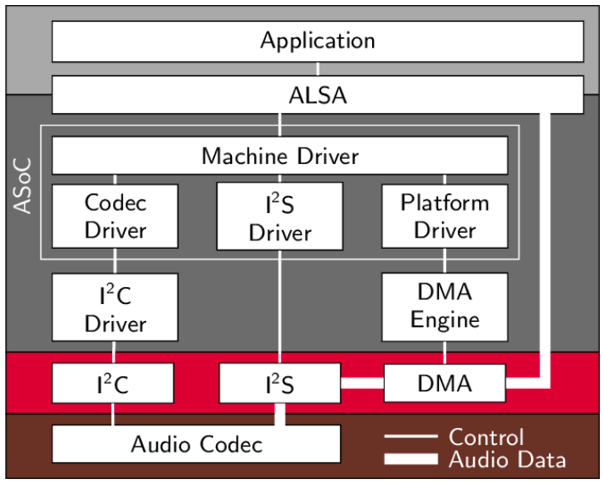
ALSA Overview
https://www.researchgate.net/figure/Structure-of-ASoC-and-the-embedment-into-the-Linux-audio-framework_fig2_262112720

Slide 17
Sound Card in Linux (1)
ls /proc/asound/ -l
lrwxrwxrwx 1 root root 5 Apr 30 06:51 HDMICODEC -> card1
dr-xr-xr-x 4 root root 0 Apr 30 06:51 card0
dr-xr-xr-x 3 root root 0 Apr 30 06:51 card1
-r--r--r-- 1 root root 0 Apr 30 06:51 cards
-r--r--r-- 1 root root 0 Apr 30 06:51 devices
-r--r--r-- 1 root root 0 Apr 30 06:51 hwdep
-r--r--r-- 1 root root 0 Apr 30 06:51 pcm
lrwxrwxrwx 1 root root 5 Apr 30 06:51 rockchipes8316c -> card0
dr-xr-xr-x 2 root root 0 Apr 30 06:51 seq
-r--r--r-- 1 root root 0 Apr 30 06:51 timers
-r--r--r-- 1 root root 0 Apr 30 06:51 version

Slide 18
Sound Card in Linux (2)
Sound card 0
cat /proc/asound/cards
0 [rockchipes8316c]: rockchip_es8316 - rockchip,es8316-codec
rockchip,es8316-codec
1 [HDMICODEC ]: HDMI-CODEC - HDMI-CODEC
HDMI-CODEC
Sound card 1

Slide 19
Sound Card in Linux (3)
rockchipes8316c
ls -l /proc/asound/card0/
-r--r--r-- 1 root root 0 Apr 30 06:59 id
dr-xr-xr-x 3 root root 0 Apr 30 06:59 pcm0c
dr-xr-xr-x 3 root root 0 Apr 30 06:59 pcm0p
capture
playback
ls -l /proc/asound/card1/
-r--r--r-- 1 root root 0 Apr 30 07:01 id
dr-xr-xr-x 3 root root 0 Apr 30 07:01 pcm0p

Slide 20
Linux Display Subsystem

Slide 21
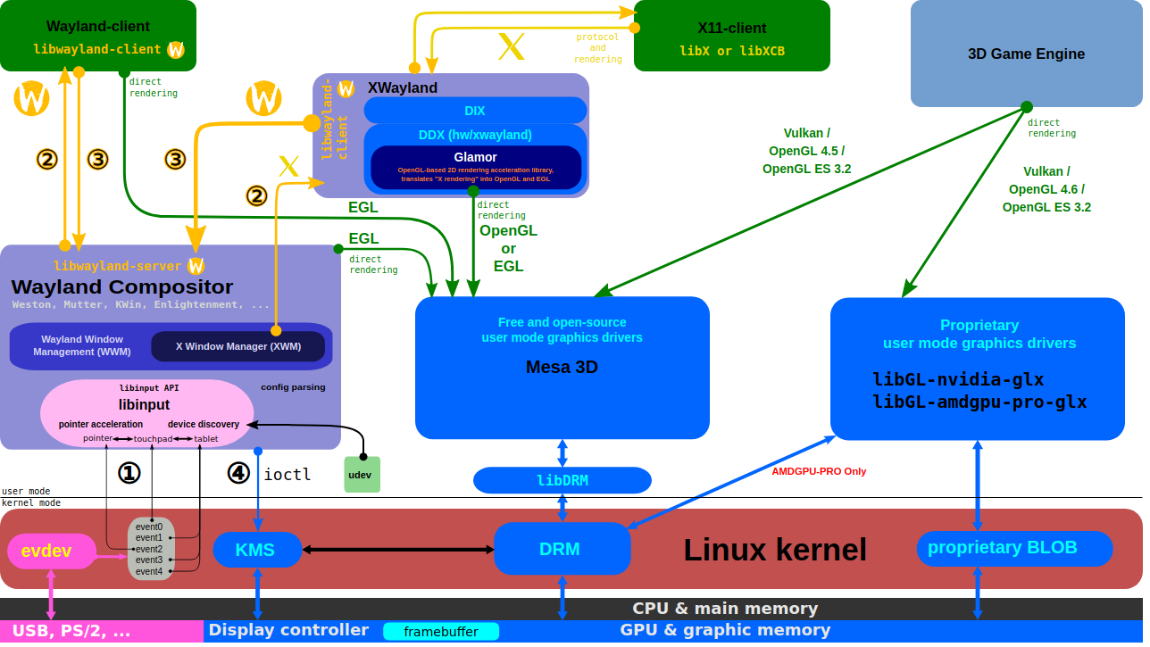
X Server and Wayland Compositor
https://upload.wikimedia.org/wikipedia/commons/2/2d/The_Linux_Graphics_Stack_and_glamor.svg

Slide 22
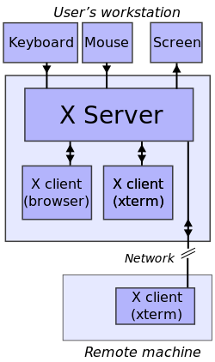
Linux Windows System (1)
https://en.wikipedia.org/wiki/File:X_client_sever_example.svg

Slide 23
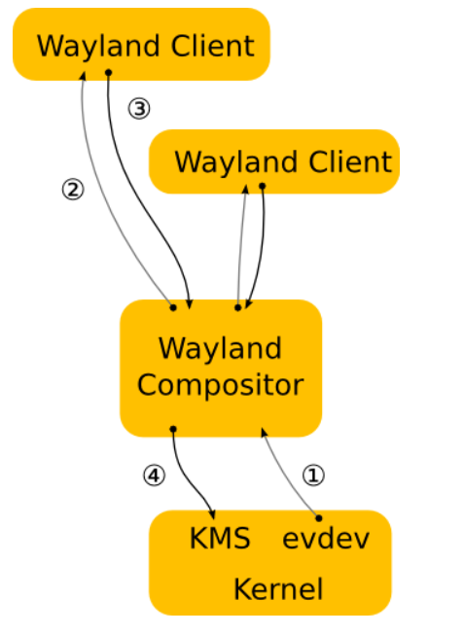
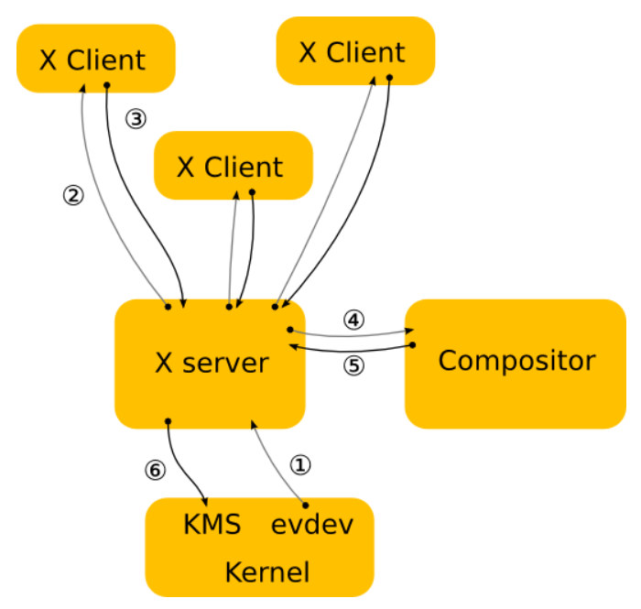
Linux Windows System (2)
Wayland is a replacement for the X11 window system protocol
https://wayland.freedesktop.org/architecture.html

Slide 24
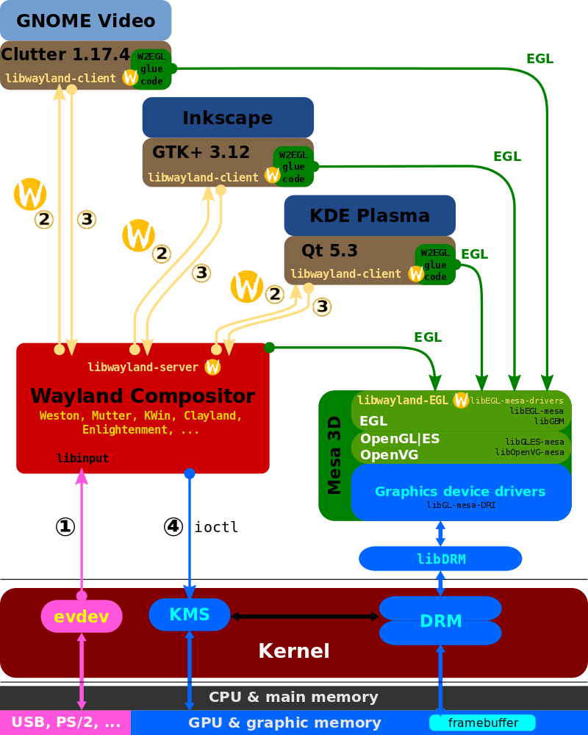
Wayland Display Server and EGL
https://www.wikiwand.com/ja/Wayland

Slide 25
GTK and Gnome
GTK
  GTK (formerly GTK+) is a free and open-source cross-platform widget toolkit for creating graphical user interfaces (GUIs).
GNOME
  GNOME is the default desktop environment of many major Linux distributions
  originally an acronym for GNU Network Object Model Environment
  free and open-source desktop environment for Linux and other Unix-like[10] operating systems
https://en.wikipedia.org/wiki/GNOME
https://en.wikipedia.org/wiki/GTK

Slide 26
OpenGL and EGL
EGL
  EGL Native Platform Graphics Interface is an interface portable layer for graphics resource management.
  works between rendering APIs such as OpenGL ES or OpenVG and the underlying native platform window system
OpenGL
  OpenGL (Open Graphics Library) is a cross-language, cross-platform application programming interface (API) for rendering 2D and 3D vector graphics
Mesa
  Mesa, also called Mesa3D and The Mesa 3D Graphics Library
  it is an open source implementation of OpenGL, Vulkan, and other graphics API specifications
https://www.khronos.org/egl/
https://en.wikipedia.org/wiki/OpenGL
https://en.wikipedia.org/wiki/Mesa_(computer_graphics)

Slide 27
Direct Rendering Manager (DRM)
Direct Rendering Manager
  Management of buffers and free space within that memory.
  Solve Frame buffer driver cannot be used GPU and multi-user process.
DRM consists of
  libdrm
    libdrm provides a user space library for accessing the DRM
  KMS : Kernel Mode Setting
    Change resolution and depth
  DRI : Direct Rendering Infrastructure
    Interfaces to access hardware directly
  GEM : Graphics Execution Manager
    Buffer management
  DRM Driver in kernel side
    Access hardware

Slide 28
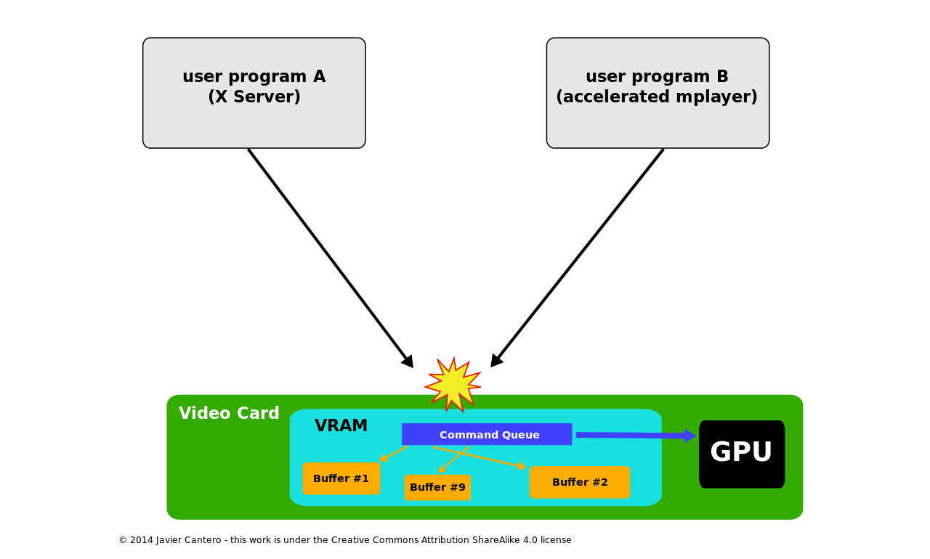
Direct Rendering Manager (DRM)
If no use DRM

Slide 29
Direct Rendering Manager (DRM)
https://upload.wikimedia.org/wikipedia/commons/2/2d/The_Linux_Graphics_Stack_and_glamor.svg

Slide 30
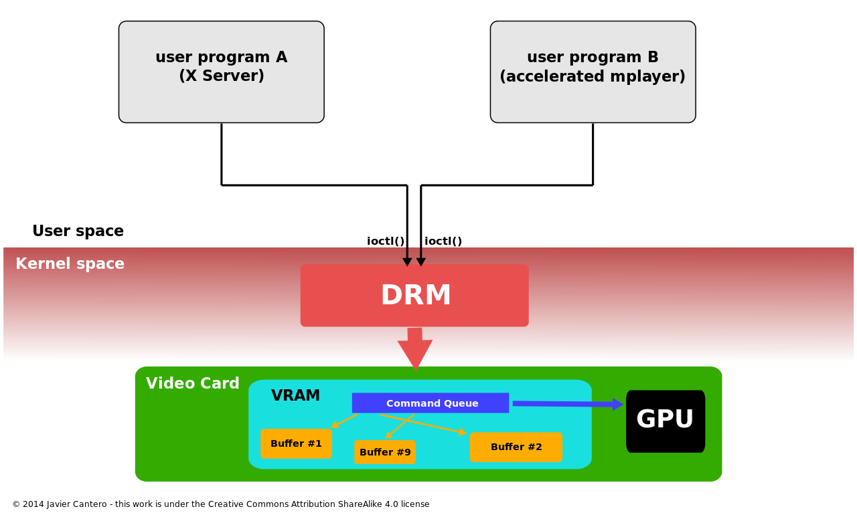
Direct Rendering Manager (DRM)
Use DRM

Slide 31
Kernel Mode Setting (KMS)
KMS device model
  CRTCs
  Connectors
  Encoders
  Planes
Kernel Mode Setting
  screen resolution
  color depth and
  refresh rate

Slide 32
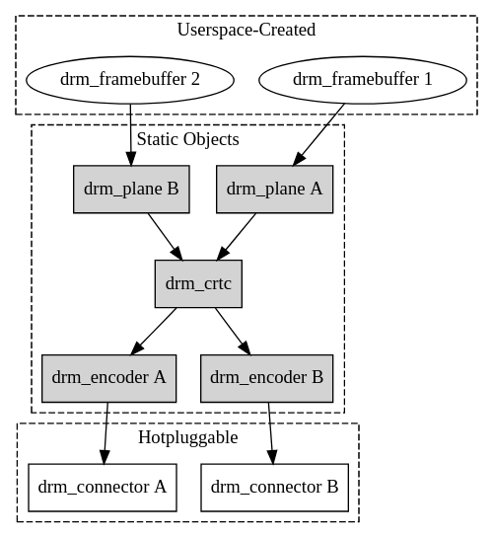
Kernel Mode Setting (KMS)
https://www.kernel.org/doc/html/v4.15/gpu/drm-kms.html

Slide 33
Kernel Mode Setting (KMS)
https://upload.wikimedia.org/wikipedia/commons/2/2d/The_Linux_Graphics_Stack_and_glamor.svg

Slide 34
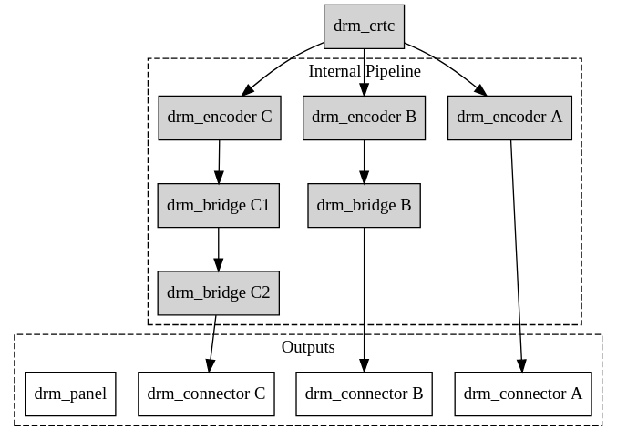
Kernel Mode Setting (KMS)
https://www.kernel.org/doc/html/v4.15/gpu/drm-kms.html

Slide 35

Video Frame Buffer
The frame buffer device provides an abstraction for
the graphics hardware.
Application
memory
User Space
MMAP
Kernel Space
memory
FB Driver

Slide 36
Kernel Mode Setting (KMS)
CRTC
Encode
Connecter
FrameBuffer
Planes

