Slide 1
1.在dts增加的裝置,怎麼在系統確定有被增加了
2. &led_0~3的名稱連結到下面的描述, led0-gpios的作用是? 為什麼還要再定義一次腳位?
led-ioctl {
status = "okay";
compatible = "gpio,led-sample";
pinctrl-names = "default";
pinctrl-0 = <&led_0 &led_1 &led_2 &led_3>;
led0-gpios = <&gpio2 RK_PB3 GPIO_ACTIVE_LOW>;
led1-gpios = <&gpio4 RK_PC2 GPIO_ACTIVE_LOW>;
led2-gpios = <&gpio4 RK_PC6 GPIO_ACTIVE_LOW>;
led3-gpios = <&gpio4 RK_PC5 GPIO_ACTIVE_LOW>;
};
&pinctrl {
led {
led_0: led_0 {
rockchip,pins = <2 RK_PB3 RK_FUNC_GPIO &pcfg_pull_none>;
};
led_1: led_1 {
rockchip,pins = <4 RK_PC2 RK_FUNC_GPIO &pcfg_pull_none>;
};
led_2: led_2 {
rockchip,pins = <4 RK_PC6 RK_FUNC_GPIO &pcfg_pull_none>;
};
led_3: led_3 {
rockchip,pins = <4 RK_PC5 RK_FUNC_GPIO &pcfg_pull_none>;
};
};
};
3.在 /proc/device-tree/pinctrl/ 有相同名稱的裝置,就是依照&pinctrl裡定義的名稱嗎?

Slide 2
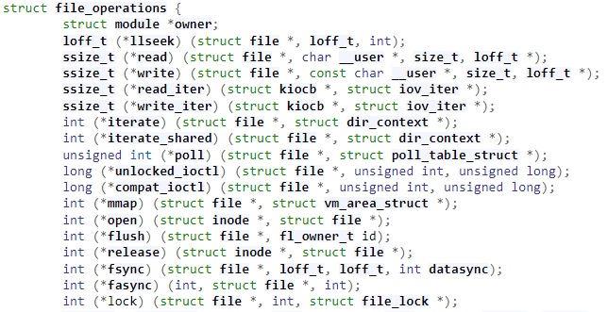

4. driver怎麼連接到dts描述的裝置,怎麼知道要控制的是那一個裝置?
5. User的指令和kernel的函式怎麼對起來的?
User app裡的ioctl(fd, value, led);是對應到driver裡的gpio_leds_ioctl
在driver裡有宣告結構, 就是指令的對應函式? .unlocked_ioctl = ioctl ??

