Slide 1
Build Linux Modules

Slide 2
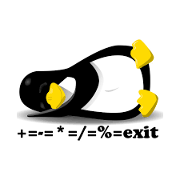

Linux Kernel
https://www.kernel.org/
Kernel source code
Kernel Documentation
Linux Cross Reference

Slide 3
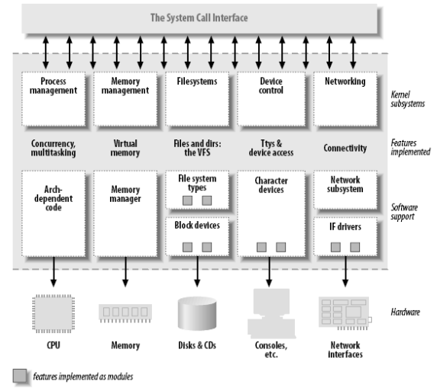
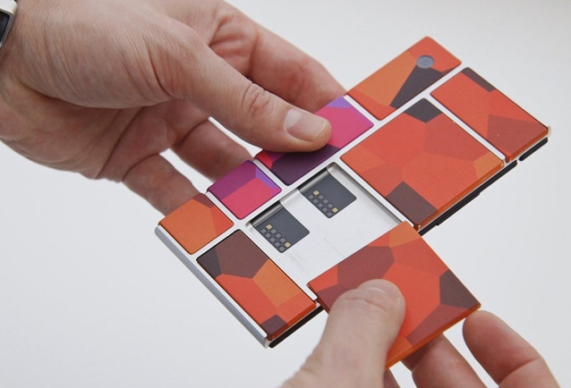
Kernel Modularization

Slide 4
Linux Kernel
User App
System Call
C library
User Space
Device driver
Linux kernel
Kernel Space
Hard ware

Slide 5
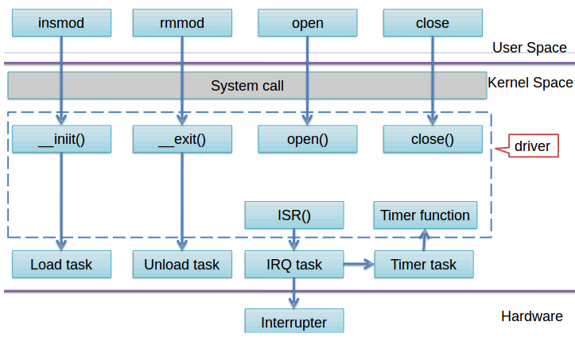
Kernel Module Execute Flow

Slide 6
Kernel Module

Slide 7
Kernel Module - Hello World
Install
#include <linux/init.h>
#include <linux/module.h>
static int __init hello_init(void)
{
printk("Hello world!!\n");
return 0;
}
static void __exit hello_exit(void)
{
printk("Goodbye, Hello world!!\n");
}
module_init(hello_init);
module_exit(hello_exit);
Remove

Slide 8
Build Kernel Module

Slide 9
Source Code Type
Out of Kernel tree
  the code is outside of the kernel source tree, in a different directory
Inside the kernel tree
  it’ll integrated into the kernel configuration compilation process

Slide 10
Modules Type
Build-in to kernel Image
  Install auto when system start up
  No depend problem
  Kernel Image size problem
Build a Module type
  Install by insmod command
  Need confirm depend
  Down size kernel image

Slide 11
Out of Kernel Tree

Slide 12
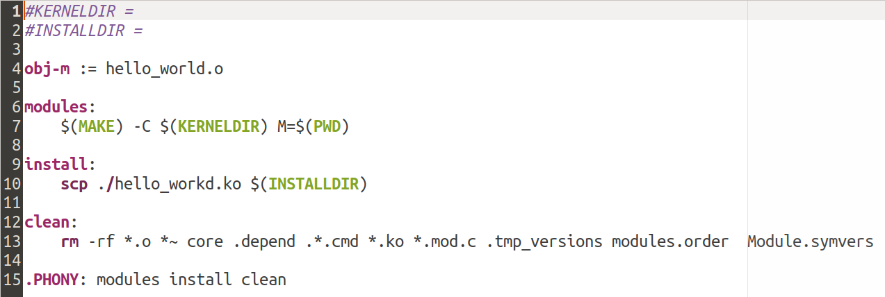
Out of Kernel Tree - Makefile
Driver Build Type
1-3-1-hello_world
Kernel source code path

Slide 13
Inside of Kernel Tree

Slide 14
Menuconfig (1)
Details on compiling the kernel
  Documentation/kbuild
Menuconfig
  [CMD] make menuconfig
  Need ncurses libraries
    If menuconfig has error, install below package
    sudo apt-get install libncurses5 libncurses5-dev libncursesw5

Slide 15
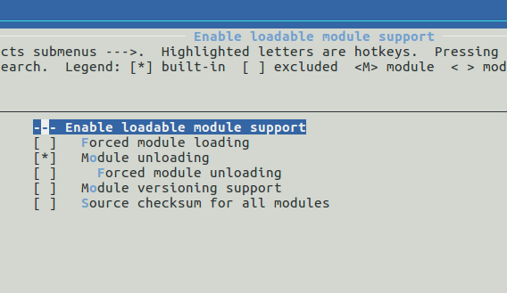
Menuconfig (2)
Enter menuconfig setting
Enable kernel module function

Slide 16
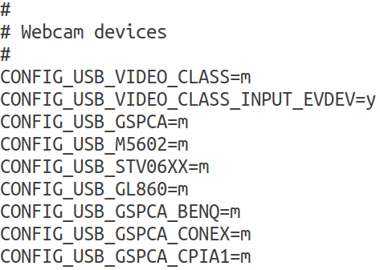
Menuconfig (3)
Save to .config file
  Hide file, use [CMD] ls -la to check
  Involve Driver build options

Slide 17
Menuconfig (3) - Kconfig
drivers/char/Kconfig
Kconfig
Tristate
    [ * ] Build in kernel
    [ m ] Build module
    [ ] Nothing to build
  Bool
  Select
  Depends
  Help

Slide 18
Menuconfig (4) - Makefile
[CMD] vim drivers/char/Makefile
obj-y = module_name.o
obj-m = module_name.o
obj-$(CONFIG_XXXX) = module_name.o
Example :
drivers/char/hello_world.c
drivers/char/Makefile
drivers/char/Kconfig

Slide 19
Menuconfig (5) - Makefile
Build in to kernel image
→ obj-y = module_name.o
Build a kernel module
→ obj-m = module_name.o
Enable kernel driver or not
→ obj-$(CONFIG_XXXX) = module_name.o

Slide 20
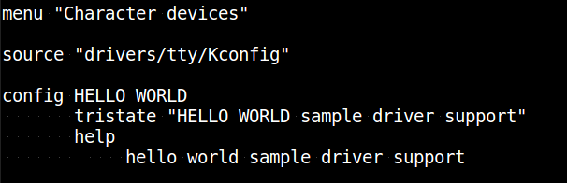
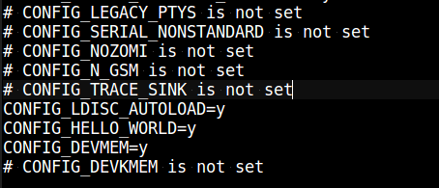
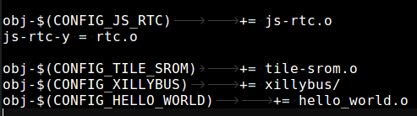
Menuconfig
Kconfig, .config and Makefile (1)
Kconfig
.config
Makefile

Slide 21
Menuconfig
Kconfig, .config and Makefile (2)
Driver Build Type
menuconfig
menuconfig
CONFIG_HELLO_WORLD=m
hello_world.ko
CONFIG_HELLO_WORLD
.config
CONFIG_HELLO_WORLD=y
obj-$(CONFIG_HELLO_WORLD) += hello_world.o
Driver Build
in kernel
Makefile

Slide 22
Menuconfig
Source Code In Kernel Tree
.config
  menuconfig
rockchip_linux_defconfig
  KERNEL_SRC/arm64/configs
KERNEL_SRC/.config
  [CMD] vim $KERNEL_SRC/arch/arm64/configs/XXX_defconfig
    CONFIG_XXXX=y
    CONFIG_XXXX=m
    #CONFIG_XXXX is not set

Slide 23
Supplement - Module Symbol

Slide 24
Symbols exported to modules
Two macros are used in the kernel to export functions and variables:
  EXPORT_SYMBOL(symbolname)
    exports a function or variable to all modules
  EXPORT_SYMBOL_GPL(symbolname)
    exports a function or variable only to GPL modules

Slide 25
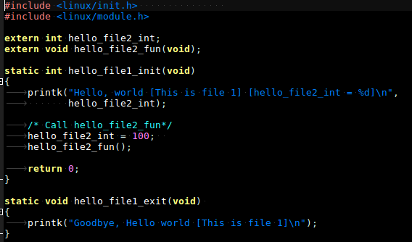
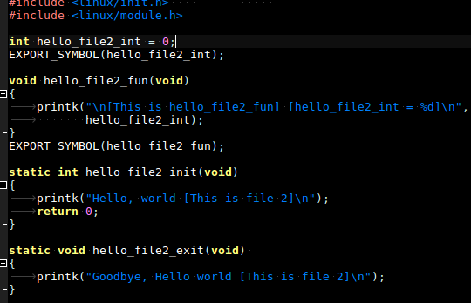
Sample - hello_exprot
1-3-2-hello_exprot

Slide 26
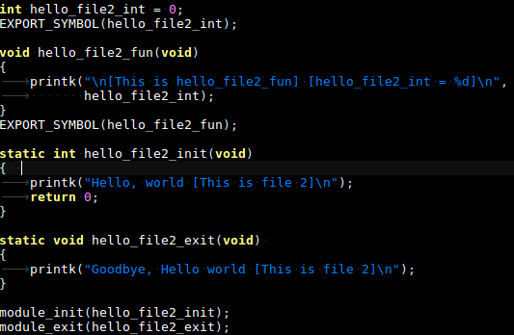
Sample - hello_exprot
1-3-2-hello_exprot/hello_file2.c

Slide 27
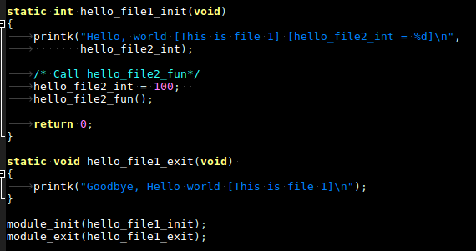
Sample - hello_exprot
1-3-2-hello_exprot/hello_file1.c

