Slide 1
Linux Driver Debug

Slide 2
Debugging System Faults
A fault usually ends the current process, while the system continues to work
Potential side effects
  Hardware left in an unusable state
  Kernel resources in an inconsistent state
  Corrupted memory

Slide 3
Debugging by Printing

Slide 4
Output Kernel Message
messages according to priority to send
  printk
  printk(KERN_DEBUG “HelloWorld\n”);
8 loglevels (0 – 7)
  linux/printk.h

Slide 5
printk
KERN_EMERG
  For emergency messages
KERN_ALERT
  For a immediate action
KERN_ERR
  Used to report error conditions
KERN_CRIT
  Critical conditions, related to serious hardware or software failures

Slide 6
printk
Without specified priority
If [current priority > console_loglevel]
DEFAULT_MESSAGE_LOGLEVEL = KERNEL_WARNING
Message output

Slide 7

printk
console_loglevel
  can be modified
  using /proc/sys/kernel/printk
Read debug level
  [CMD] cat /proc/sys/kernel/printk
Modify debug level
  [CMD] echo 6 > /proc/sys/kernel/printk
Current default minimum boot-time-default
0 4 1 7

Slide 8
Kernel Message

Slide 9
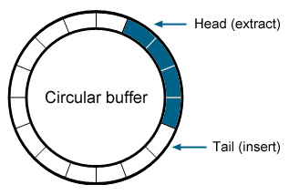
Display Message
Print or control the kernel ring buffer
  [CMD] man dmesg
https://camera-sdk.com/p_6554-how-to-implement-circular-buffer-video-recording-in-c-sharp.html

Slide 10
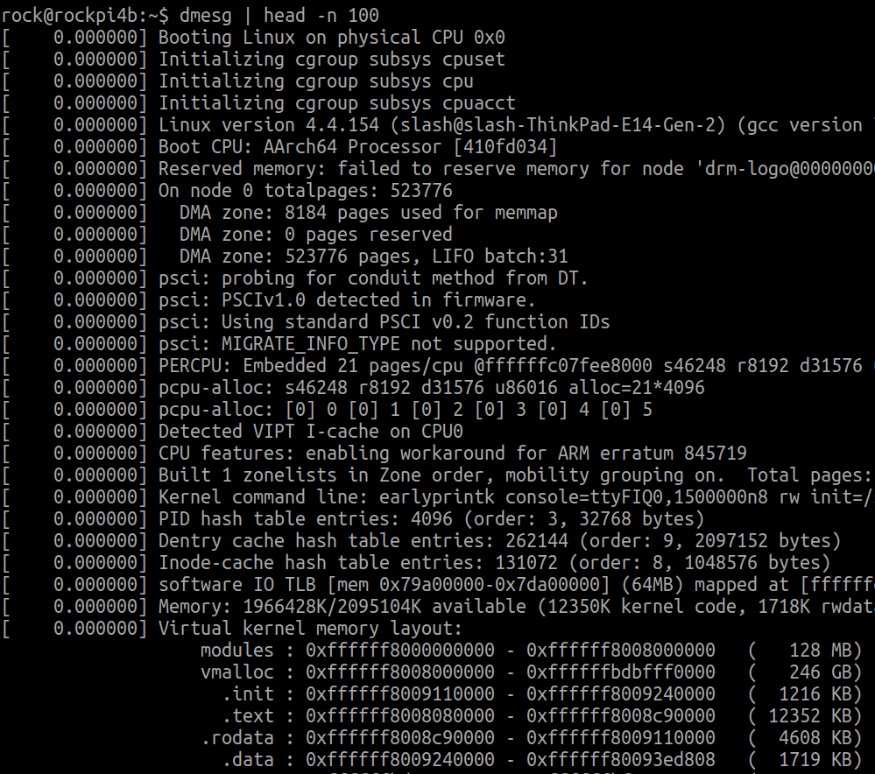
Display Message
[CMD] dmesg

Slide 11
Display Message
[CMD] dmesg
[CMD] dmesg | grep “Search PATTEN”
[CMD] dmesg | head -n 10
[CMD] dmesg | tail -n 10

Slide 12
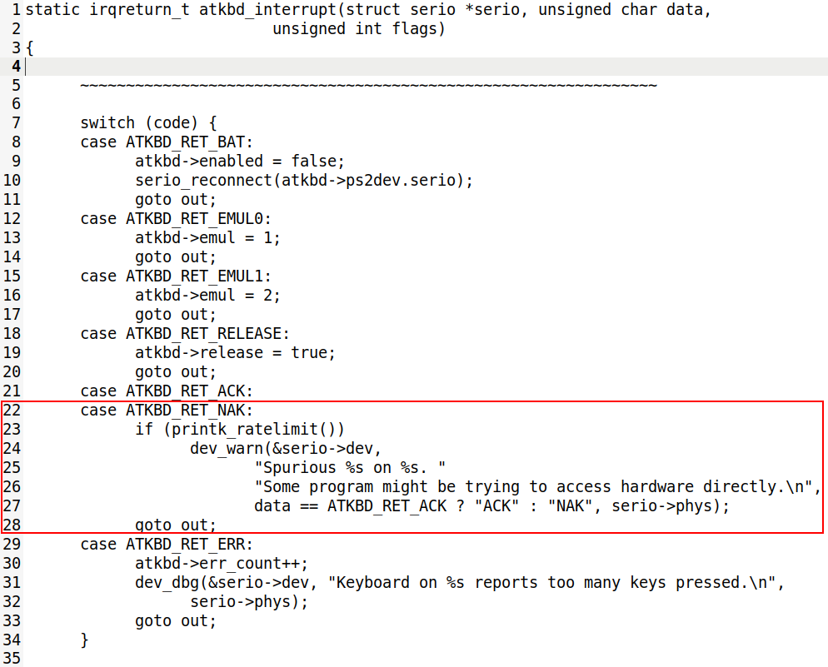
Rate Limiting

Slide 13
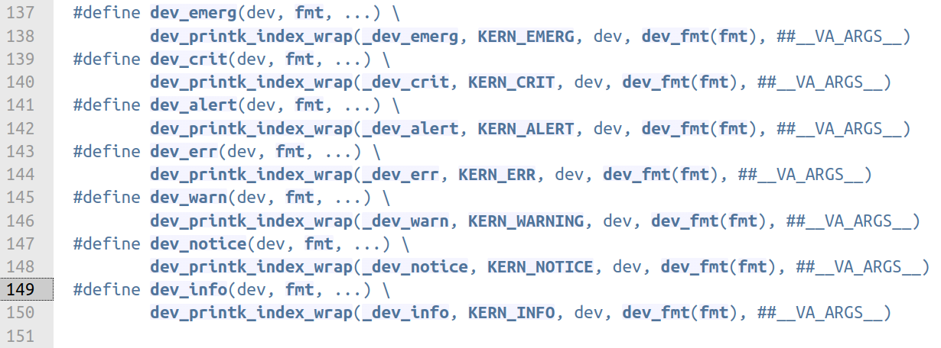
Another Print Function

Slide 14
SysFS for Kernel Debug

Slide 15
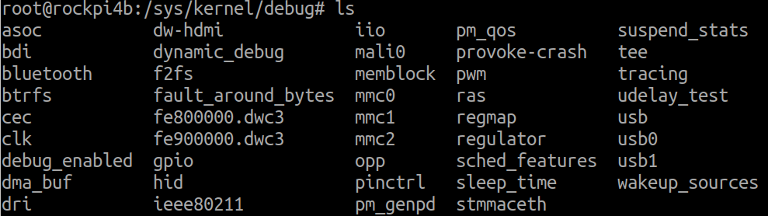
SysFS for Kernel Debug
[CMD] ls /sys/kernel/debug

Slide 16
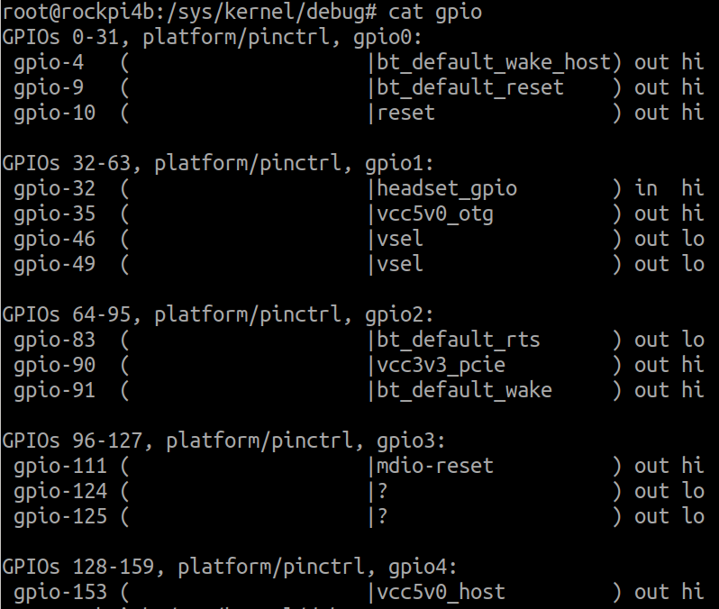
SysFS for GPIO Debug
[CMD] cat /sys/kernel/debug/gpio

Slide 17
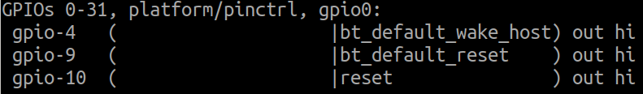
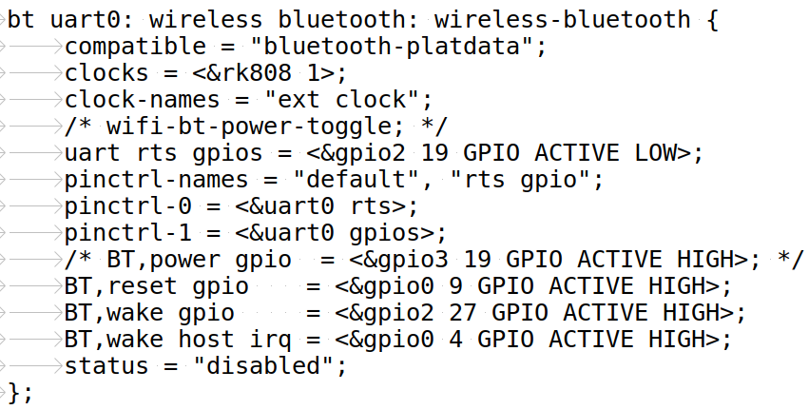
SysFS for GPIO Debug
arch/arm64/boot/dts/rockchip/rk3399-rock-pi-4.dtsi

Slide 18
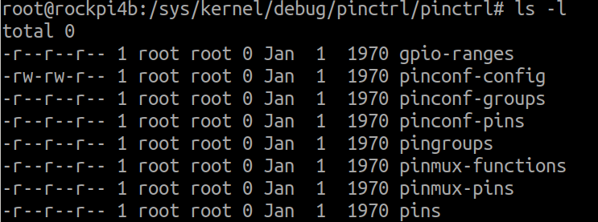
SysFS for PinCtrl Debug
[CMD ] ls /sys/kernel/debug/pinctrl/pinctrl

Slide 19
SysFS for PinCtrl Debug
[CMD ] cat /sys/kernel/debug/pinctrl/pinctrl/pinmux-pins
pin 4 (gpio0-4): (MUX UNCLAIMED) gpio0:4
pin 91 (gpio2-27): (MUX UNCLAIMED) gpio2:91
Read form pinmux-pins

Slide 20
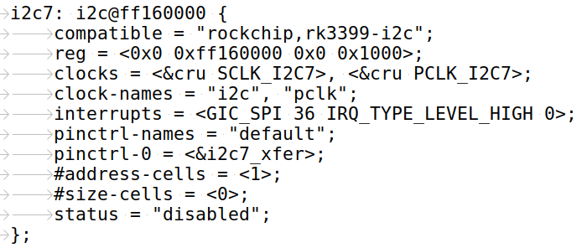
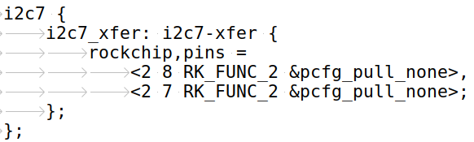
SysFS for PinCtrl Debug
[CMD ] cat /sys/kernel/debug/pinctrl/pinctrl/pinmux-pins
pin 71 (gpio2-7): ff160000.i2c (GPIO UNCLAIMED) function i2c7 group i2c7-xfer
pin 72 (gpio2-8): ff160000.i2c (GPIO UNCLAIMED) function i2c7 group i2c7-xfer
Read form pinmux-pins

Slide 21
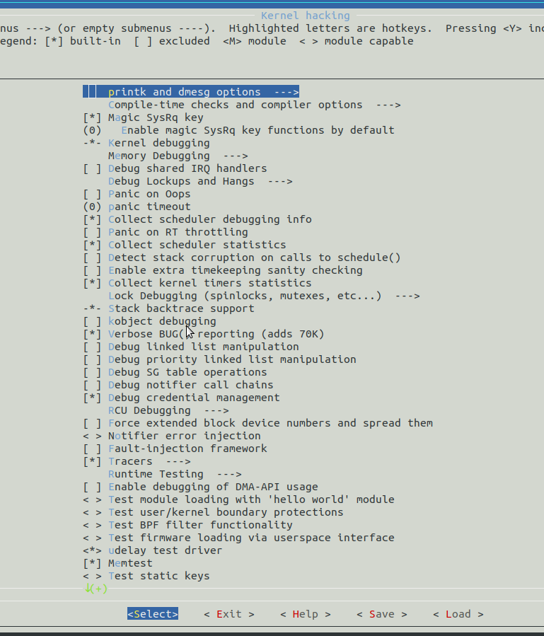
Kernel Hacking Configure

