Slide 1

Interrupt Handling

Slide 2

Interrupts
Prevent CPU from busy waiting
A signal that the hardware can send when it wants the CPU’s attention
Need to pay attention to concurrency issues
ISR : Interrupt Service Route

Slide 3
Driver ISR
Linux Driver
ISR
ISR Thread
IRQ Event

Slide 4
Install ISR API
To register an interrupt handler, call
#include <linux/interrupt.h>
int request_irq(unsigned int irq,
irqreturn_t (*handler) (int, void *, struct pt_regs *),
unsigned long flags, const char *dev_name,
  void *dev_id);
  irq: the requested interrupt number
  handler: the interrupt handler function pointer
  dev_name: for /proc/interrupts
  dev_id: pointer for shared interrupt lines
  (can be set to NULL if not shared)

Slide 5
IRQ API Flag

Slide 6
Interrupt API Flag
Interrupt line behaviour
include/linux/Interrupt.h
Flag
  IRQF_TRIGGER_NONE
  IRQF_TRIGGER_RISING
  IRQF_TRIGGER_FALLING
  IRQF_TRIGGER_HIGH
  IRQF_TRIGGER_LOW

Slide 7

Interrupt API Flag
TRIGGER_RISING
TRIGGER_FALLING

Slide 8
Top and Bottom Halves
Top Halves
Interrupt Event
Perform Time critical work
Perform Remaining work
Defer Bottom Halves For executing
at late time
Bottom Halves

Slide 9
Top and Bottom Halves
TOP | Bottom
Processing task in ISR | Processing tasks in kernel context
Interrupt be disabled | Interrupt not be disabled
Add Deferrable function | Handles Deferrable functions

Slide 10
Installing an ISR
The example
ISR
result = request_irq(short_irq, short_interrupt,
IRQF_TRIGGER_RISING, "short", NULL);

Slide 11
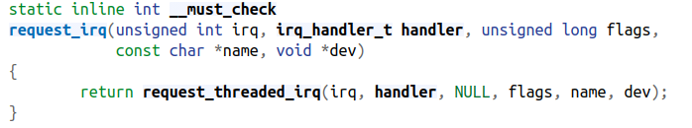
Detail request_irq
Interrupt is a the another thread process

Slide 12
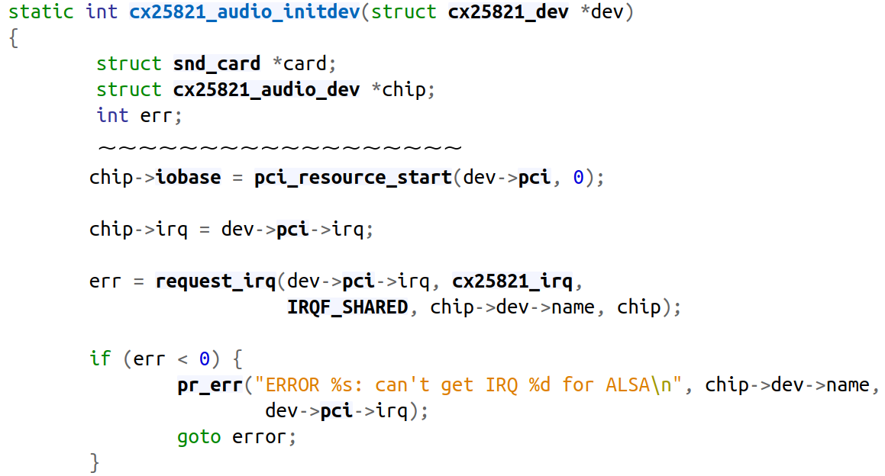
Driver CX25821
cx25821-alsa.c
Interrupt ISR

Slide 13
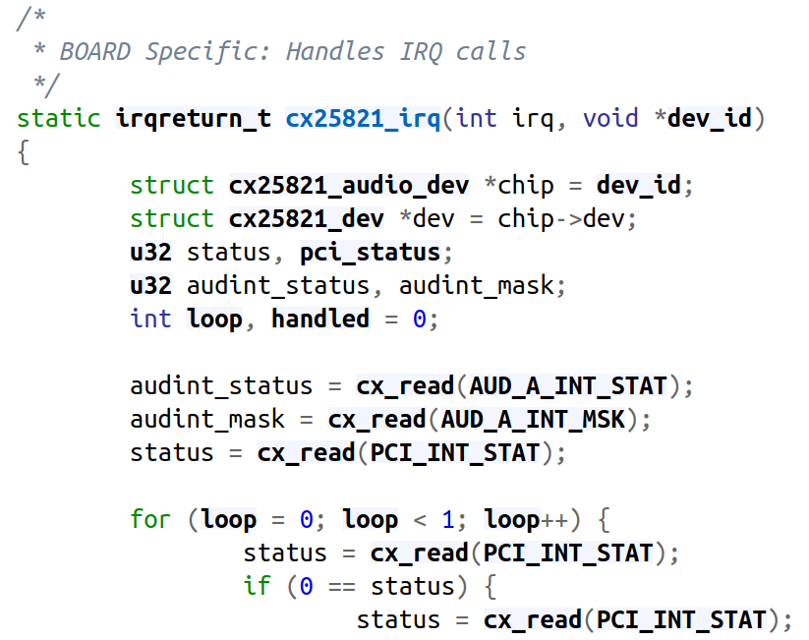
Driver CX25821
Interrupt Handle

Slide 14
Driver CX25821
CX25821 Driver
CX25821_IRQ
ISR Thread
IRQ Event

Slide 15
Another Install ISR API

Slide 16
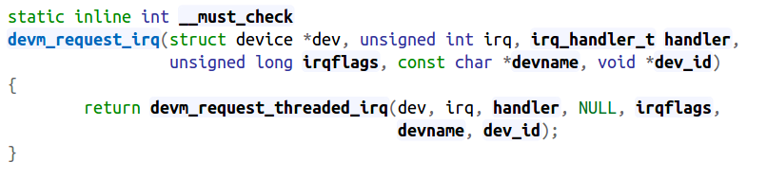
devm_request_irq
Use in Platform Device Driver
We can get IRQ num form device tree (DTS)

Slide 17
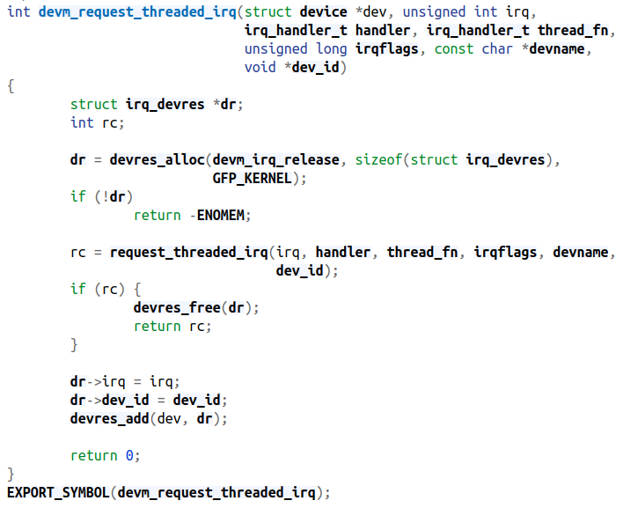
devm_request_irq

Slide 18
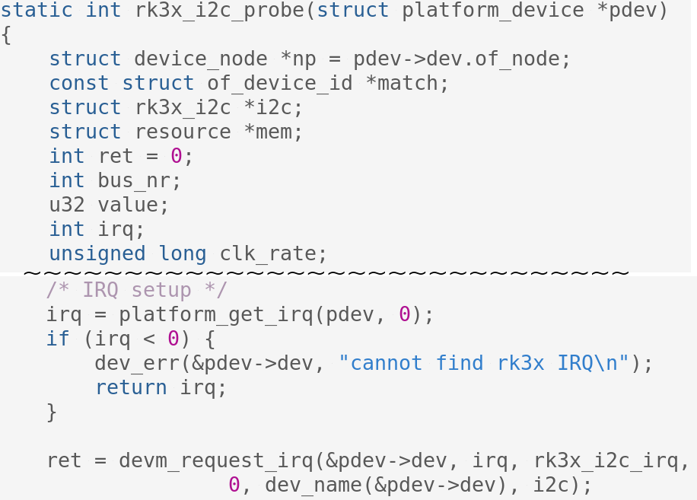
Driver I2C Bus
i2c-rk3x.c
IRQ
ISR

Slide 19
Get IRQ Number

Slide 20
Get Interrupt Resource
Get IRQ resource form device tree
  IRQ number
int platform_get_irq(struct platform_device *dev, unsigned int num)

Slide 21
IRQ in Resource Struct
include/linux
struct resource {
resource_size_t start;
resource_size_t end;
const char *name;
unsigned long flags;
struct resource *parent, *sibling, *child;
};
#define IORESOURCE_IO 0x00000100
#define IORESOURCE_MEM 0x00000200
#define IORESOURCE_IRQ 0x00000400
#define IORESOURCE_DMA 0x00000800
#define IORESOURCE_BUS 0x00001000

Slide 22
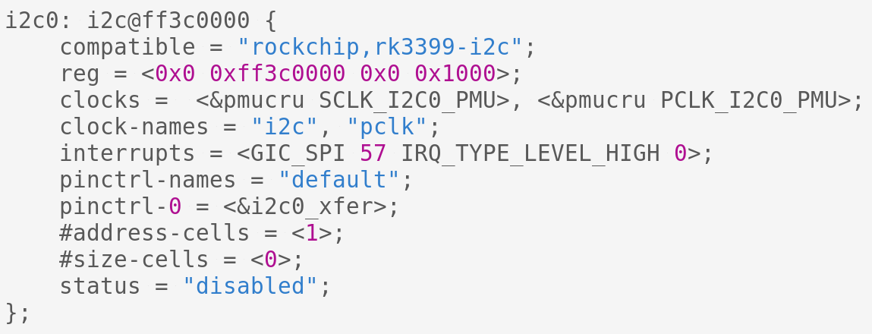
Driver I2C Bus
I2C IRQ

Slide 23
Driver I2C Bus
i2c-rk3x.c
Get IRQ
ISR

Slide 24
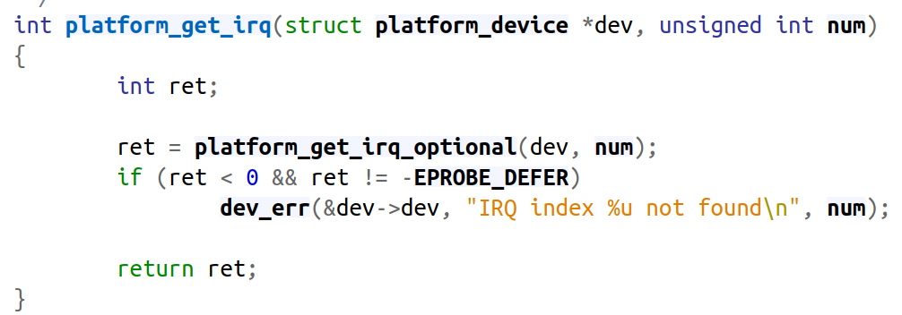
Driver I2C Bus

Slide 25
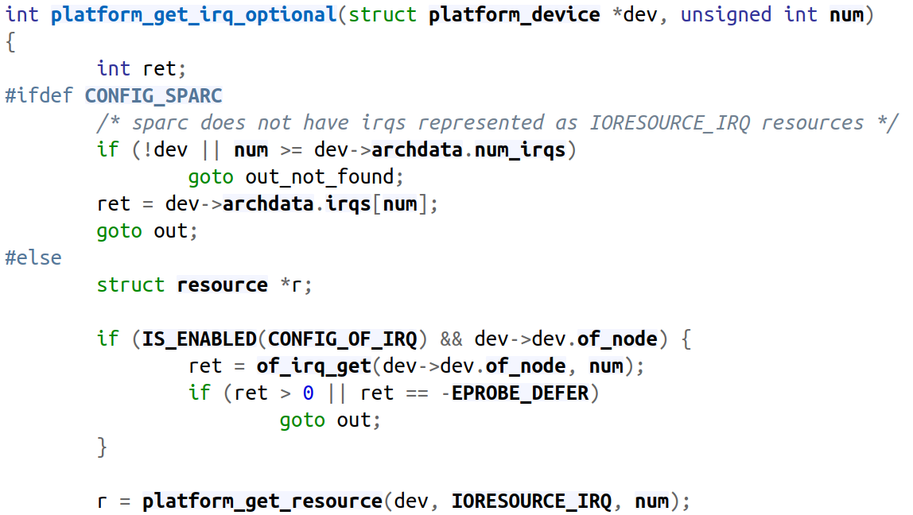
Driver I2C Bus
Get IRQ

Slide 26
Disabling a Single Interrupt
Three functions
  Their use is discouraged
#include <asm/irq.h>
void disable_irq(int irq);
void disable_irq_nosync(int irq);
void enable_irq(int irq);
Calls can be nested
  If disable_irq is called twice, two enable_irq
  calls are required to re-enable the IRQ

Slide 27
Interrupt in Userland

Slide 28
The /proc Interface
/proc/interrupts shows interrupts with installed handlers
[CMD] cat /proc/interrupts
CPU0 CPU1
0: 4848108 34 IO-APIC-edge timer
2: 0 0 XT-PIC cascade
8: 3 1 IO-APIC-edge rtc
10: 4335 1 IO-APIC-level aic7xxx
11: 8903 0 IO-APIC-level uhci_hcd
12: 49 1 IO-APIC-edge i8042
interrupt controller
ISR name
IRQ Trigger Times

Slide 29
IRQ in RK3399

Slide 30
IRQ in RK3399
Software Generated Interrupt (SGI)
  This interrupt is generated explicitly by software
Private Peripheral Interrupt (PPI)
  This interrupt is generated by a peripheral that
  is private to an individual core
Shared Peripheral Interrupt (SPI)
  This interrupt is generated by a peripheral that
  the Interrupt Controller can route to more than
  one core

Slide 31
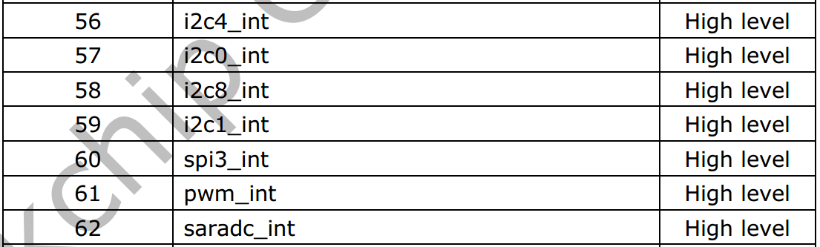
I2C-0 IRQ in RK3399
Rockchip_RK3399TRM_V1.3_Part1.pdf P.36

Slide 32
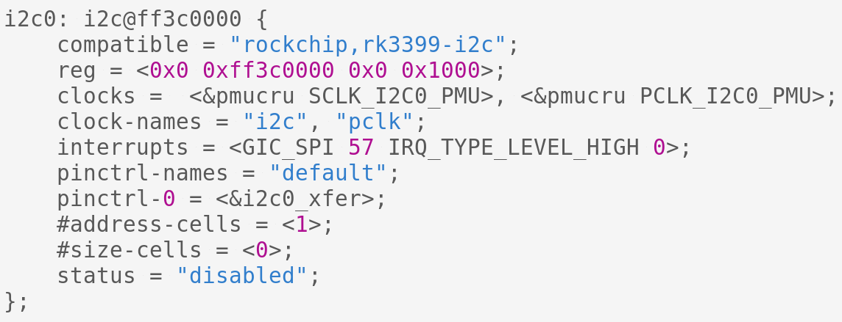
I2C-0 IRQ in RK3399 (DTS)
rk3399.dtsi
IRQ Number

Slide 33
Driver Key-Input (DTS)
irq-gpio-sample {
status = "okay";
compatible = "gpiokey,irq-sample";
pinctrl-names = "default";
pinctrl-0 = <&key_0 &key_1 &key_2 &key_3>;
key0-gpios = <&gpio4 RK_PC0 GPIO_ACTIVE_LOW>;
key1-gpios = <&gpio4 RK_PC1 GPIO_ACTIVE_LOW>;
key2-gpios = <&gpio1 RK_PC2 GPIO_ACTIVE_LOW>;
key3-gpios = <&gpio1 RK_PC6 GPIO_ACTIVE_LOW>;
};

Slide 34
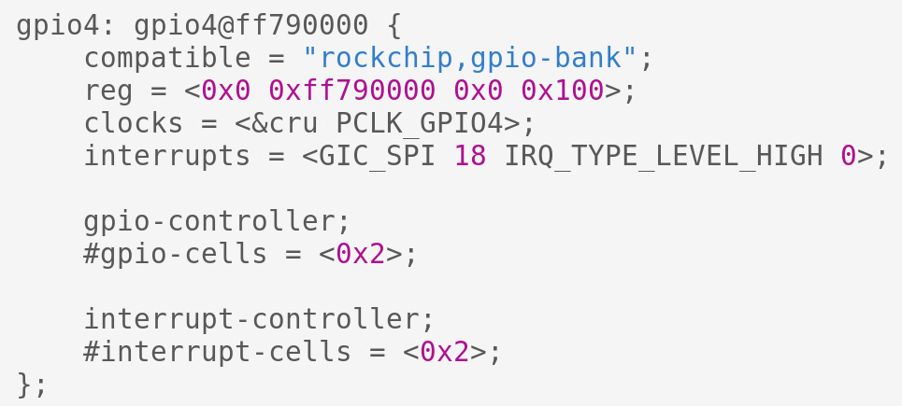
Driver Key-Input (DTS)

Slide 35
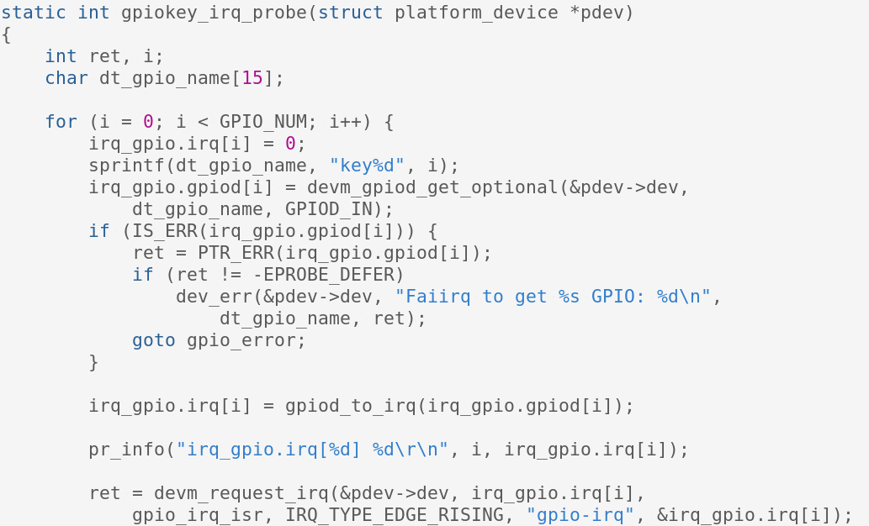
Driver Key-Input (DTS)
3-3-1-isr-key/module_key_irq.c

Slide 36
Supplement - Tasklet

Slide 37
Top and Bottom Halves
Top Halves
Interrupt Event
Perform Time critical work
Bottom Halves
Perform Remaining work
Defer Bottom Halves For executing
at late time

Slide 38
Top and Bottom Halves
TOP | Bottom
Processing task in ISR | Processing tasks in kernel context
Interrupt be disabled | Interrupt not be disabled
Add Deferrable function | Handles Deferrable functions

Slide 39
Top and Bottom Halves
Interrupt handling sometimes needs to perform lengthy tasks
  This problem is resolved by splitting the interrupt handler into two halves
    Top half responds to the interrupt
      The one registered to request_irq
      Saves data to device-specific buffer and schedules the bottom half
    Bottom half is scheduled by the top half to execute later
      With all interrupts enabled
      Wakes up processes, starts I/O operations, etc.

Slide 40
Top and Bottom Halves
Two mechanisms may be used to implement bottom halves
  Tasklets → No sleep
  Workqueues → Can sleep

Slide 41
Tasklets
Cannot run in parallel with itself
Can run in parallel with other tasklets on SMP systems
Guaranteed to run on the same CPU that first scheduled them

Slide 42
Tasklets
In the short example, use Tasklet to install the tasklet-based interrupt handler
void short_do_tasklet(unsigned long);
DECLARE_TASKLET(short_tasklet, short_do_tasklet, 0);
irqreturn_t short_interrupt(int irq, void *dev_id, struct pt_regs *regs
{
tasklet_schedule(&short_tasklet);
short_wq_count++; /* record that an interrupt arrived */
return IRQ_HANDLED;
}

Slide 43
Workqueues
Can sleep
Cannot copy data to and from user space

Slide 44
Workqueues
In the short example, set wq=1 to install the workqueue-based interrupt handler
static struct work_struct short_wq;
/* this line is in the short_init() */
INIT_WORK(&short_wq, (typeof(short_wq.func)) short_do_tasklet, NULL);
irqreturn_t short_wq_interrupt(int irq, void *dev_id,
struct pt_regs *regs) {
schedule_work(&short_wq);
short_wq_count++; /* record that an interrupt arrived */
return IRQ_HANDLED;
}

