Slide 1
Rock Pi4B

Slide 2
RockPi WiKi
Rock Pi Wiki
  https://wiki.radxa.com/Rockpi4
Rock Pi Hardware
  https://wiki.radxa.com/Rockpi4/hardware/rockpi4
Rock Pi Image
  https://wiki.radxa.com/Rockpi4/downloads

Slide 3
Create Boot SD Card
Rock Pi Image
  https://wiki.radxa.com/Rockpi4/downloads
Write Image to SD Card
  https://wiki.radxa.com/Rockpi4/getting_started
Etcher Tool
  Linux -64 bit
  Linux-32 bit
  Windows

Slide 4
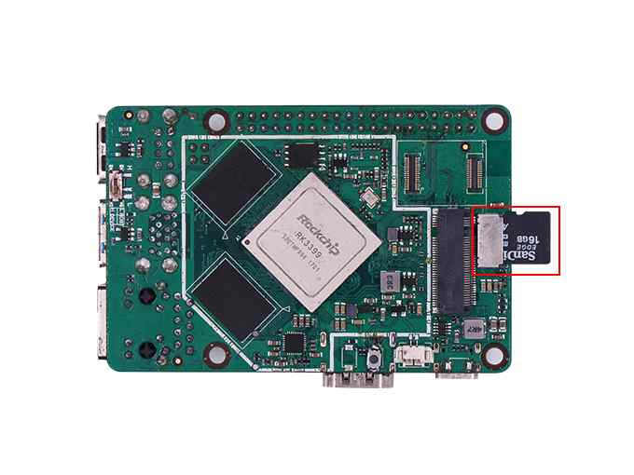
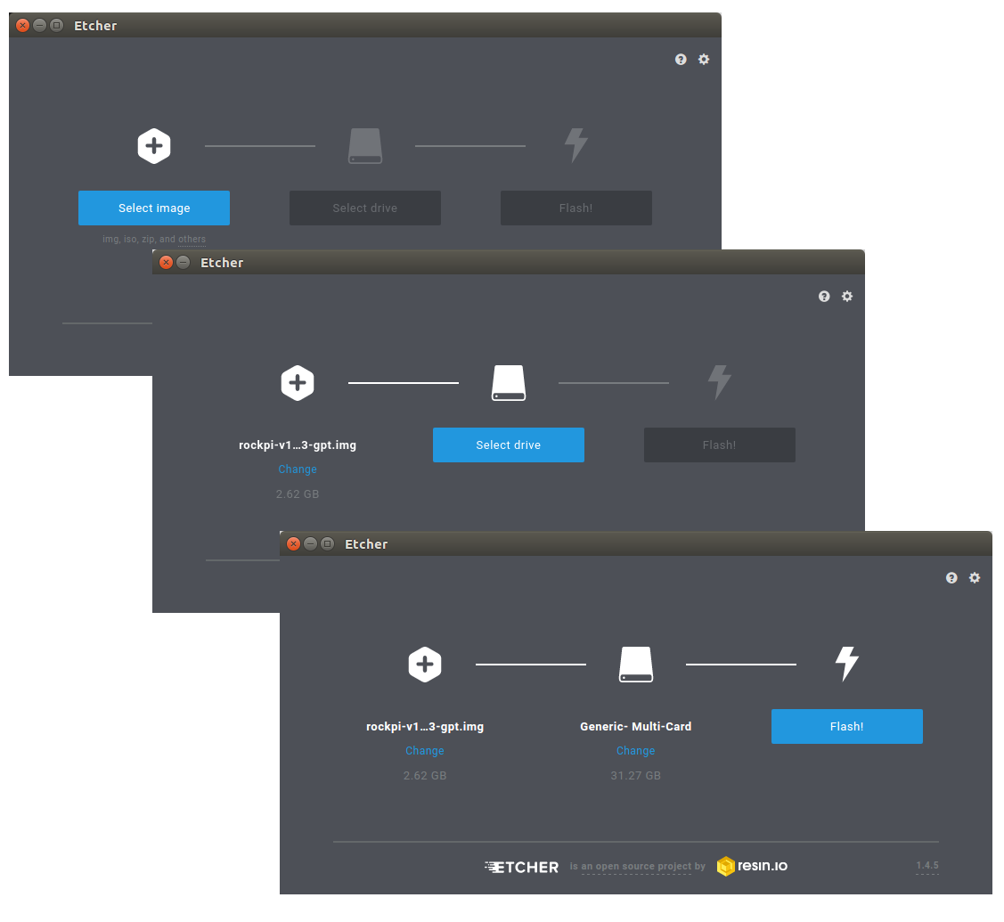
Update Image
[CMD] ./etcher-etcher-electron-1.4.5

Slide 5
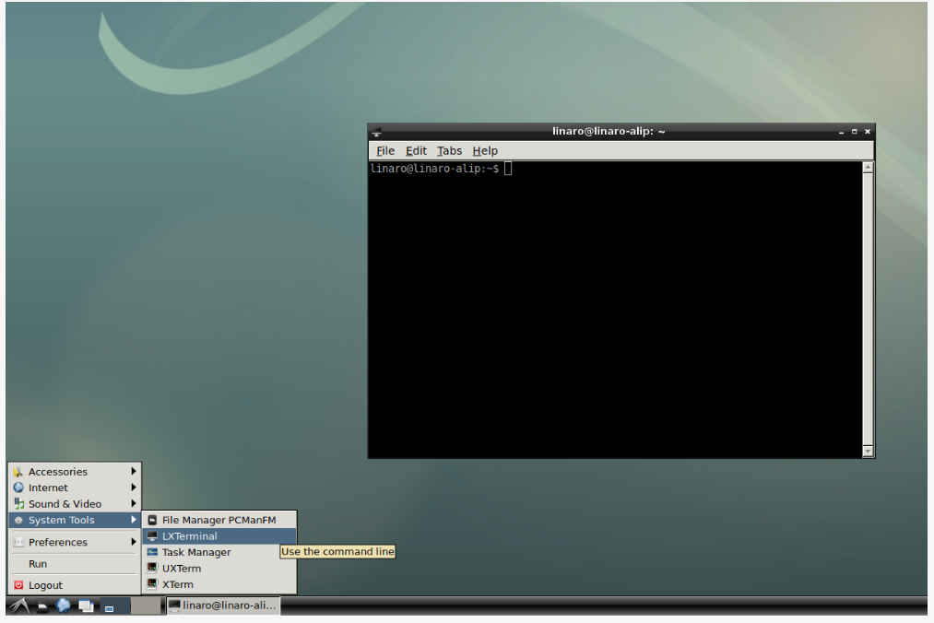
Debian
Rock Pi Debian
  https://wiki.radxa.com/Rockpi4/Debian

Slide 6
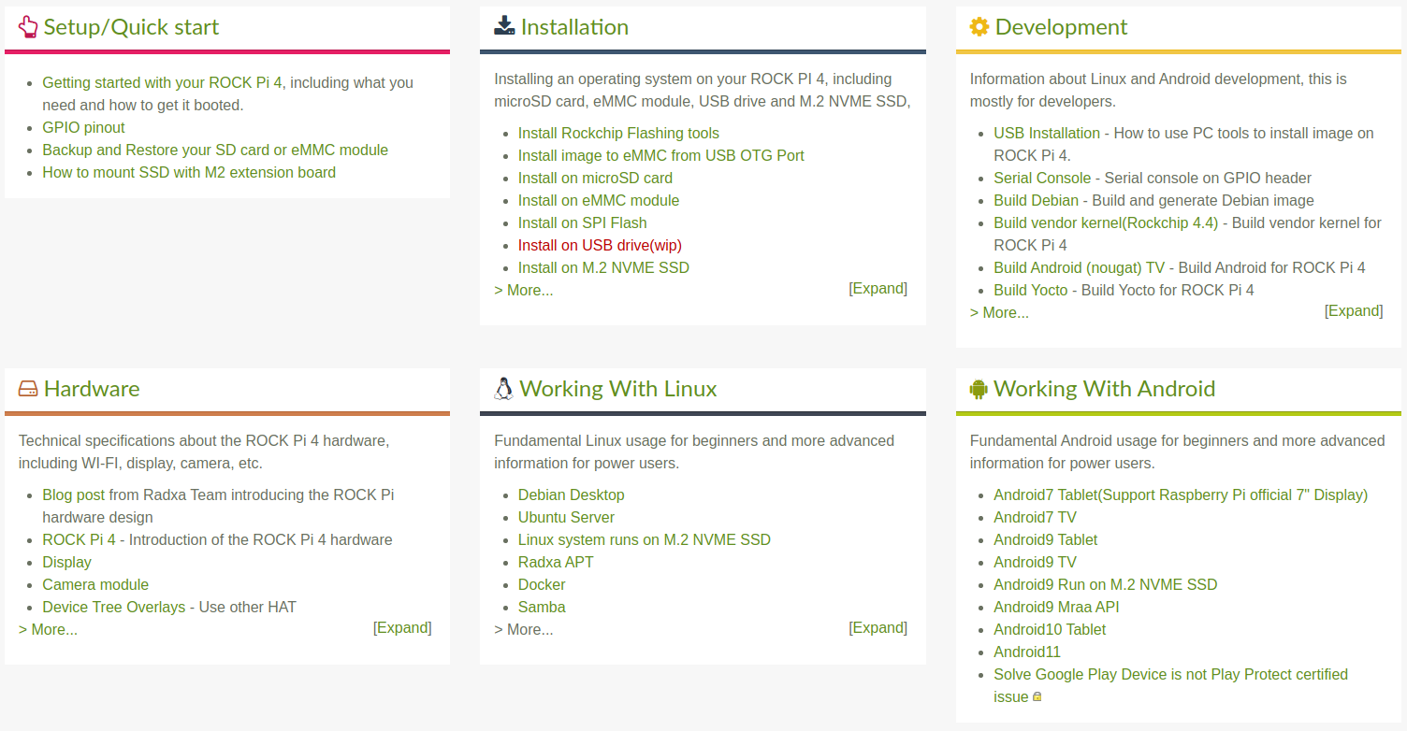
RockPi Develop Data
https://wiki.radxa.com/Rockpi4

Slide 7
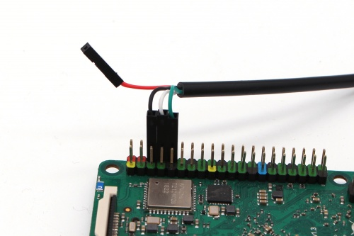
Debug Port
Debug Port
ROCK Pi 4 | USB to TTL cable
RX(pin 10) | TX
TX(pin 8) | RX
GND(pin 6) | GND
https://wiki.radxa.com/Rockpi4/dev/serial-console

Slide 8
Serial Console
Serial setting on host PC
baud-rate: 1500000
data bit : 8
stop bit : 1
parity : none
flow control: none
https://wiki.radxa.com/Rockpi4/dev/serial-console

Slide 9
Update
Linux Kernel
Linux DeviceTree
Linux Kernel Modules
https://wiki.radxa.com/Rockpi4/dev/kernel-4.4

Slide 10
Update Kernel/DTB - 1
Build Linux kernel image
  1. Enter linux kernel source code
  [CMD] cd rockpi-kernel
  2. Create a hide file
  [CMD] touch .scmversion
  3. Build kernel Image
  [CMD] make rockchip_linux_defconfig
  [CMD] make -j8

Slide 11
Update Kernel/DTB - 2
Package DEB file
  Enter linux kernel source code
  [CMD] cd ${KERNEL_SRC}
  [CMD] make bindeb-pkg -j8
Transfer below to target board
  linux-firmware-image-4.4.154_4.4.154-4_all.deb
  linux-image-4.4.154_4.4.154-4_all.deb
  linux-libc-dev_4.4.154-4_all.deb
  [CMD] scp ${FILE} rock@TARGET_IP:/home/rock/

Slide 12
Update Kernel/DTB - 3
Below operator in Target Board
[CMD] sudo su
[CMD] dpkg -i linux-firmware-image-4.4.154_4.4.154-4_all.deb
[CMD] dpkg -i linux-image-4.4.154_4.4.154-4_all.deb
[CMD] dpkg -i linux-libc-dev_4.4.154-4_all.deb

