Slide 1
Linux Device Driver Overview

Slide 2



Introduction
Device drivers
  Black boxes to hide details of hardware devices
  Use standardized calls
Task2
Task1
Task3

Slide 3
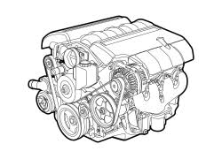

Classes of Devices and Modules
Character devices
Block devices
Network devices

Slide 4
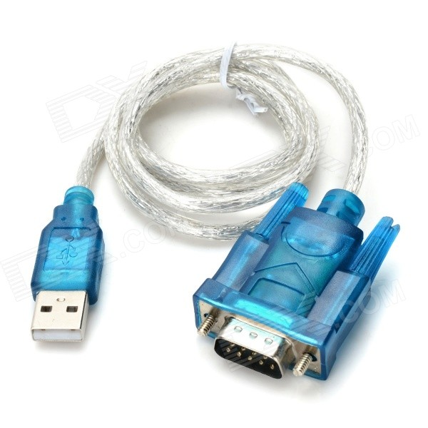
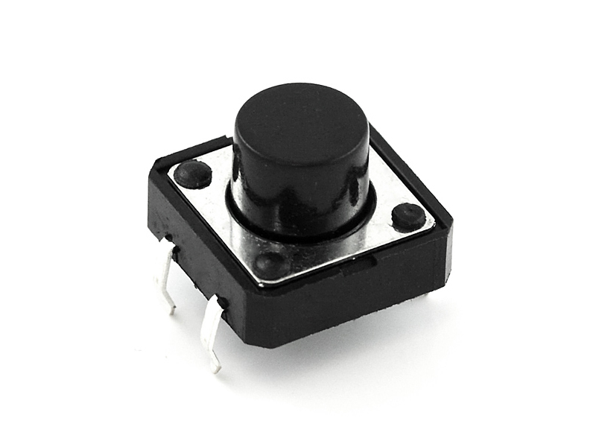
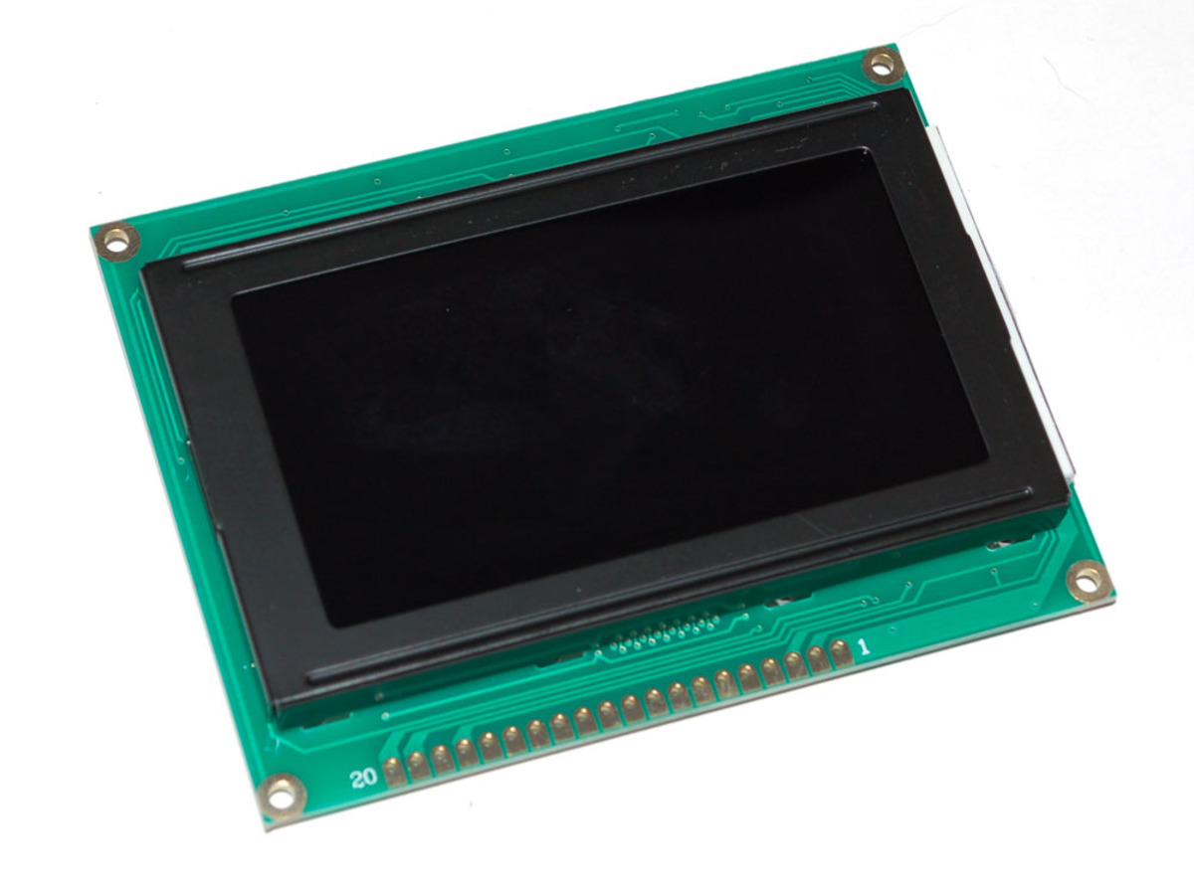
Character Devices
Abstraction: a stream of bytes
  Examples
    Text console (/dev/console)
    Serial ports (/dev/ttyS0)

Slide 5
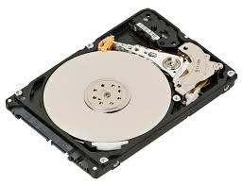

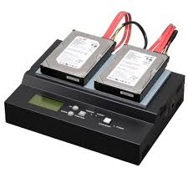
Block Devices
Applications can access block device in bytes
  Block and char devices differ only at the kernel level
  A block device can host a file system

Slide 6
Block VS Char
Char Device
  Character devices support byte streams
Block Device
  Block devices are fixed size (512 bytes)
  Variable depending on your device type

Slide 7
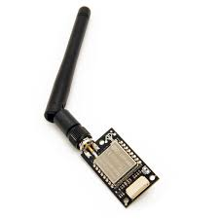
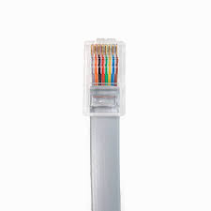
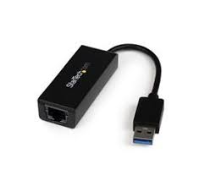
Network Devices
Abstraction: data packets
Send and receive packets
Have unique names (e.g., eth0)

Slide 8
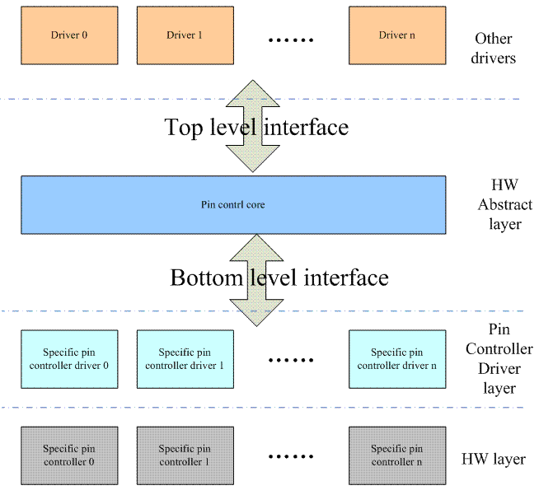
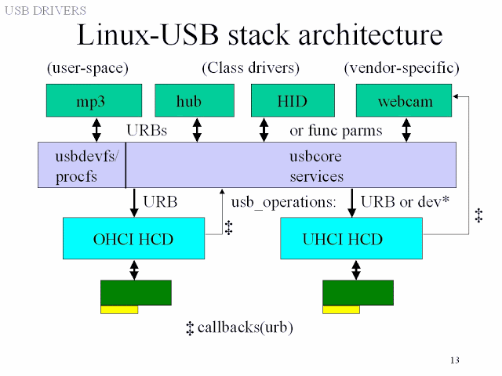
Subsystem
DRM Subsystem
GPIO Subsystem
I2C Subsystem
SPI Subsystem
http://abhishekkd.blogspot.com/2013/03/usb-and-mmc.html
https://0uyangsheng.github.io/2018/06/08/Linux-GPIO-Pinctrl-Subsystem/

