Slide 1
Device Tree

Slide 2
Device Tree
The DT was originally created by Open Firmware
Provide a way to describe hardware
Manage all kind of hardware platform
A data structure describing the hardware components
A DT representation Flattened Device Tree (FDT)
Be passed to the kernel

Slide 3
Device Tree
Linux uses DTS data for three major purposes
  platform identification
  runtime configuration
  device population
https://www.kernel.org/doc/Documentation/devicetree/usage-model.txt

Slide 4
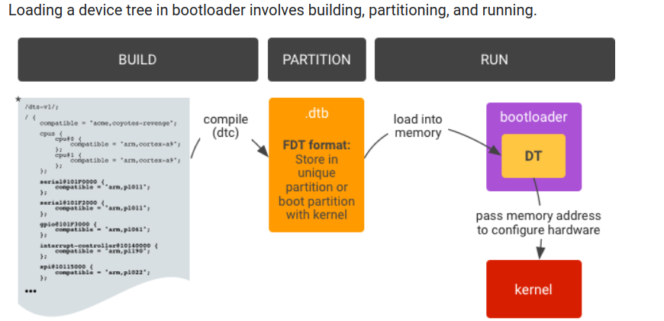

DTS and Kernel
DTS
DTB
https://source.android.com/docs/core/architecture/dto

Slide 5
Old ARM Code Style
arch/arm/
  Related to the ARM core
  kernel, mm, lib, boot …
arch/arm/mach-<foo>/
  Related to the SOC / Board
  arch/arm/mach-<foo>/board-<bar>.c

Slide 6
Old ARM Code Style
Description SOC and board HW property
  IRQ
  LCD
  BUS
  CLOCK ...
There are some problem
  The code is too much that we hard to maintain
  Can not supply multi-platform

Slide 7
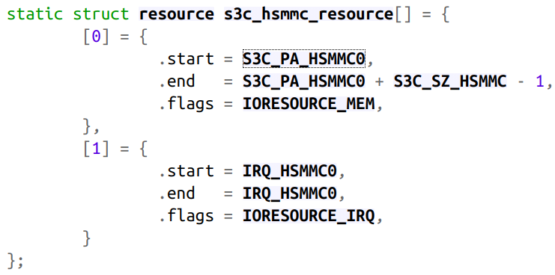
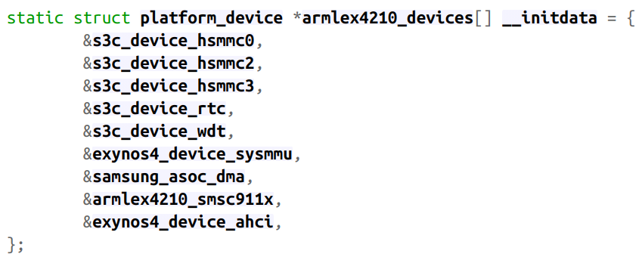
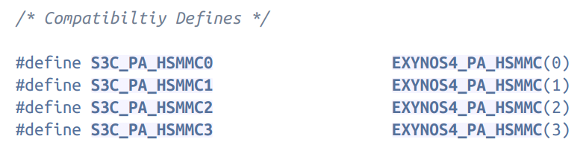
Hard to Maintain
kernel_2_6_34/arch/arm/mach-exynos

Slide 8
Device Tree Style

Slide 9
Look at a Device-Tree
${KERNEL_SRC}/arch/arm64/boot/dts/rockchip/rk3399.dtsi
i2c0: i2c@ff3c0000 {
compatible = "rockchip,rk3399-i2c";
reg = <0x0 0xff3c0000 0x0 0x1000>;
clocks = <&pmucru SCLK_I2C0_PMU>,
<&pmucru PCLK_I2C0_PMU>;
clock-names = "i2c", "pclk";
interrupts = <GIC_SPI 57 IRQ_TYPE_LEVEL_HIGH 0>;
pinctrl-names = "default";
pinctrl-0 = <&i2c0_xfer>;
#address-cells = <1>;
#size-cells = <0>;
status = "disabled";
};

Slide 10
Devicetree and Rock P4B
Enable Device Tree Support
  menuconfig → boot options → flattened device tree
  USE_OF select by Y (default Y)
Build the Devicetree
  [CMD] make dtbs
  $KERNEL/arch/arm64/boot/dst/rockchip/
    rk3399-rock-pi-4b.dts → rk3399-rock-pi-4b.dtb
Boot Linux kernel
  [CMD] bootm KERNEL_ADDR – DEVICETREE_ADDR
  [CMD] boot KERNEL_ADDR (use DTB append kernel)

Slide 11
DTS Kernel API

Slide 12

DTS and GPIO Driver
CH2/CH2-4-Devicetree/2-4-2-led-gpio/leds_gpio.c
static int led_probe(struct platform_device *pdev)
{
int ret, i;
char dt_gpio_name[15];
for (i = 0; i < LED_NUM; i++) {
sprintf(dt_gpio_name, "led%d", i);
led_gpio.gpiod[i] = devm_gpiod_get_optional(&pdev->dev,
dt_gpio_name, GPIOD_OUT_HIGH);
….
}
Get which GPIO pin
from DTS

Slide 13
DTS Kernel API
$KERNEL/drivers/of/
$KERNEL/drivers/base/
DTS kernel API For Example
of_find_node_by_phandle(phandle handle)
of_find_node_by_name(struct device_node *from, const char *name)
of_find_property(const struct device_node *np,
const char *name,
int *lenp)
https://elixir.bootlin.com/linux/v4.4.155/source/drivers/base/platform.c
https://elixir.bootlin.com/linux/v4.4.155/source/drivers/of

Slide 14
DTS Kernel API
struct gpio_desc *__must_check gpiod_get_index(struct device *dev,
const char *con_id,
unsigned int idx,
enum gpiod_flags flags)
{
…..
if (dev) {
/* Using device tree? */
if (IS_ENABLED(CONFIG_OF) && dev->of_node) {
desc = of_find_gpio(dev, con_id, idx, &lookupflags);
} else if (ACPI_COMPANION(dev)) {
desc = acpi_find_gpio(dev, con_id, idx, &flags, &lookupflags);
}
}
DTS API

Slide 15
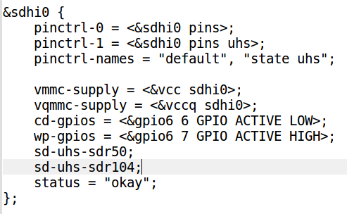
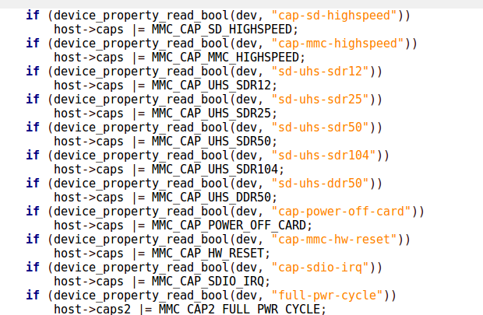
DTS Kernel API
r8a7793.dts
mmc/core/host.c

Slide 16
Device Tree Basic

Slide 17
Device Tree Basic
Node name
/{
node1@0 {
string-property = "A string";
string-list-property = "first string", "second string";
byte-data-property = [0x01 0x23 0x34 0x56];
child-node1@0 {
first-child-property;
second-child-property = <1>;
third-child-property = <&node2>;
a-string-property = "Hello, world";
};
child-node2@1 {
};
};
node2: node2@1 {
an-empty-property;
a-cell-property = <1 2 3 4>; /* each number (cell) is a uint32 */
child-node1 {
};
};
};
root
property values
ID
Phandle
Label

Slide 18
Device Tree Basic
Nodes
  Groupings of properties and child nodes
Properties
  Key-Value Pairs
    Text strings “my string”
    Cells (32-bit) <0xdeadbeef 11 0xf00d>
    Binary data [0x01 0x02 0x03 0x04]
Phandles
  Reference to another node

Slide 19
#address-cells and #size-cells
cpus {
#address-cells = <1>;
#size-cells = <0>;
cpu@0 {
compatible = "arm,cortex-a9";
reg = <0>;
};
cpu@1 {
compatible = "arm,cortex-a9";
reg = <1>;
};
};

Slide 20
#address-cells and #size-cells
/dts-v1/;
/ {
#address-cells = <1>;
#size-cells = <1>;
serial@101f0000 {
compatible = "arm,pl011";
reg = <0x101f0000 0x1000 >;
};
gpio@101f3000 {
compatible = "arm,pl061";
reg = <0x101f3000 0x1000
0x101f4000 0x0010>;
};

Slide 21
#address-cells and #size-cells
external-bus {
#address-cells = <2>;
#size-cells = <1>;
ethernet@0,0 {
compatible = "smc,smc91c111";
reg = <0 0 0x1000>;
};
i2c@1,0 {
compatible = "acme,a1234-i2c-bus";
reg = <1 0 0x1000>;
rtc@58 {
compatible = "maxim,ds1338";
};
};
flash@2,0 {
compatible = "samsung,k8f1315ebm", "cfi-flash";
reg = <2 0 0x4000000>;
};
};

Slide 22
Compatible
i2c0: i2c@ff3c0000 {
compatible = "rockchip,rk3399-i2c";
reg = <0x0 0xff3c0000 0x0 0x1000>;
clocks = <&pmucru SCLK_I2C0_PMU>,
<&pmucru PCLK_I2C0_PMU>;
clock-names = "i2c", "pclk";
…
status = "disabled";
};

Slide 23
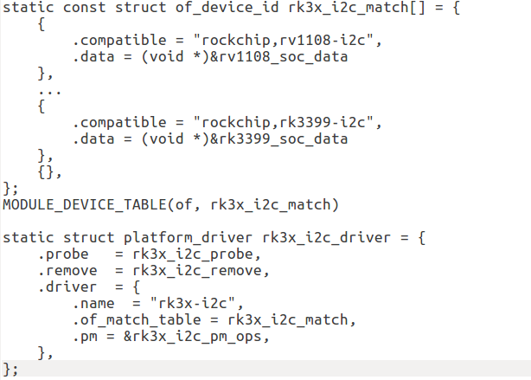
Compatible
drivers/i2c/busses/i2c-rk3x.c
Compatible Name
Probe will be run when a matching
compatible string is found

Slide 24
Status and Phandle
rk3399-nanopi4-common.dtsi
Enable or Disable
&i2s0 {
status = "okay";
rockchip,i2s-broken-burst-len;
rockchip,playback-channels = <8>;
rockchip,capture-channels = <8>;
#sound-dai-cells = <0>;
};
Parent handle

Slide 25
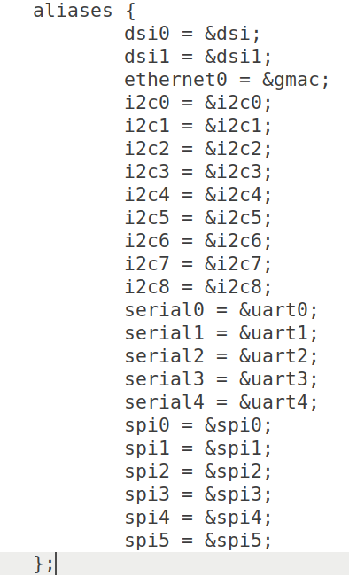
aliases
The "/aliases" node contains properties that are aliases

Slide 26
aliases
Once an alias is defined in the DTS
  simply searching
  simply searching for the aliases rather than searching for it in the entire DTS
  The function find_node_by_alias() in the Linux kernel source
https://stackoverflow.com/questions/17738709/dts-file-explanation-aliases

Slide 27
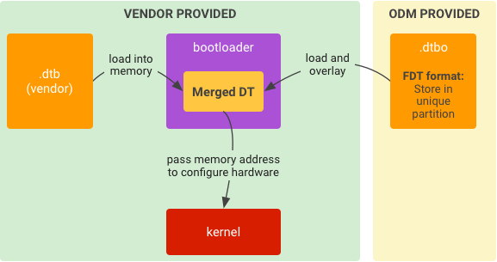
Device Tree Overlay
A Device Tree's overlay purpose is to modify the kernel's live tree
https://devdotnet.org/post/rabota-s-gpio-na-primere-banana-pi-bpi-m64-chast-2-device-tree-overlays/
https://www.kernel.org/doc/Documentation/devicetree/overlay-notes.txt

Slide 28
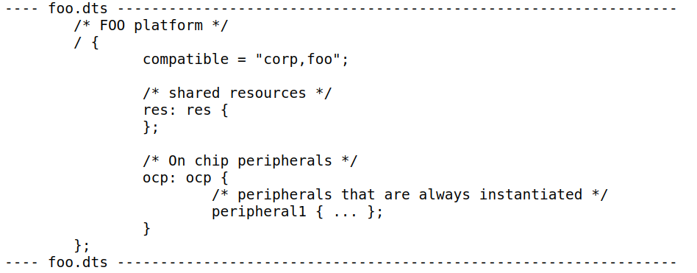
Device Tree Overlay

Slide 29
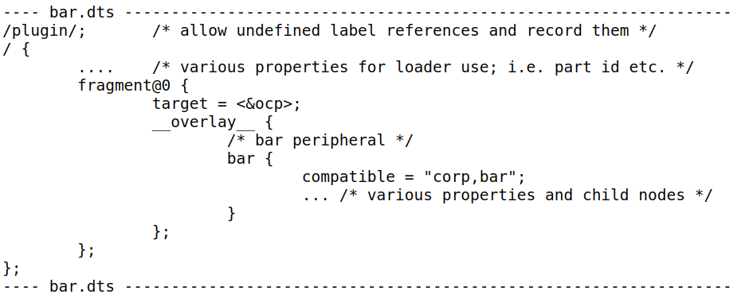
Device Tree Overlay

Slide 30
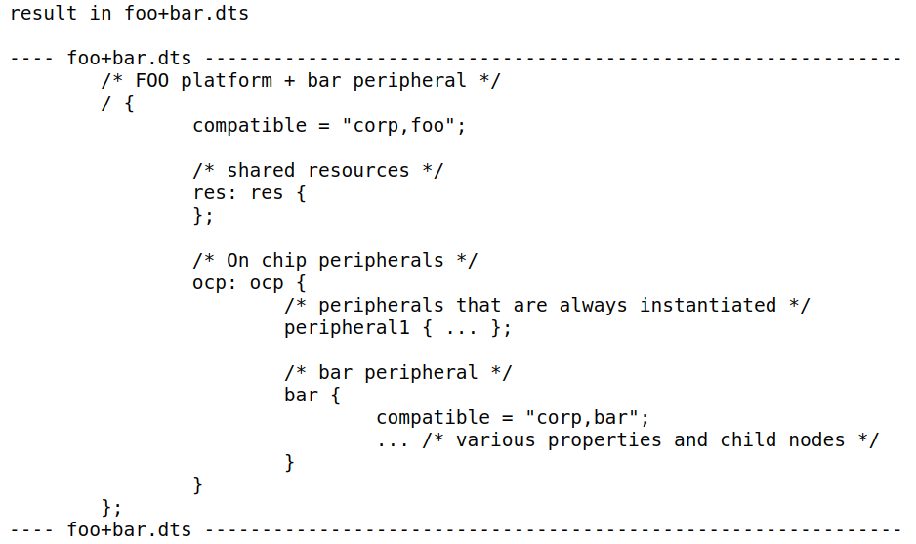
Device Tree Overlay

Slide 31
Pin-MUX Pin-Control

Slide 32
Pin-MUX Pin-Control
Documentation/pinctrl.txt
I2C
I2C-0
GPIO-0
MUX
PWM-0
PIN-A
GPIO
UART-0
PWM
I2C-1
GPIO-1
MUX
PIN-B
PWM-1
UART
UART-1

Slide 33
PIN-MUX PIN-CTRL
Documentation/pinctrl.txt
PINCTRL (PIN CONTROL) subsystem
  Enumerating and naming controllable pins
  Multiplexing of pins, pads, fingers (etc)
  Configuration of pins, pads, fingers (etc)

Slide 34
PIN-MUX PIN-CTRL
General Register Files (GRF)
  IOMUX control
  Control the state of GPIO in power-down mode
  GPIO PAD pull down and pull up control

Slide 35
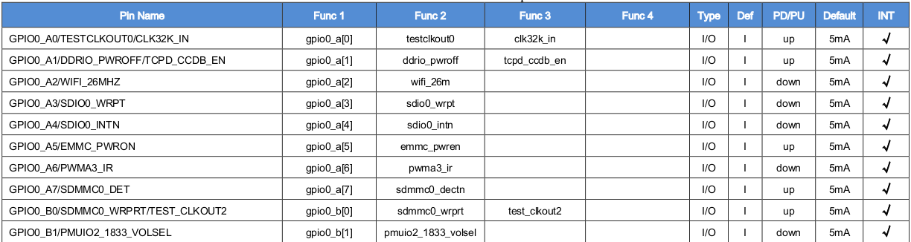
PIN-MUX PIN-CTRL
RK3399 Datasheet
  Rockchip_RK3399_Datasheet_V2.0-20191010.pdf
Function IO description

Slide 36
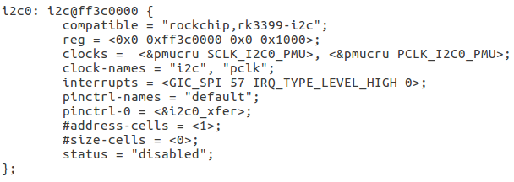
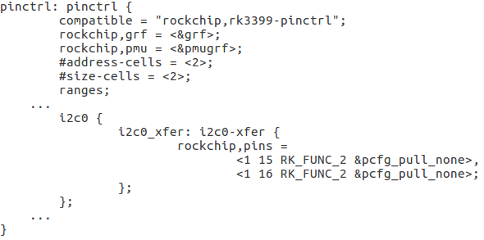
PIN-MUX PIN-CTRL
rk3399.dtsi

Slide 37
PIN-MUX PIN-CTRL
P.53 of Rockchip_RK3399_Datasheet_V2.0-20191010.pdf

Slide 38
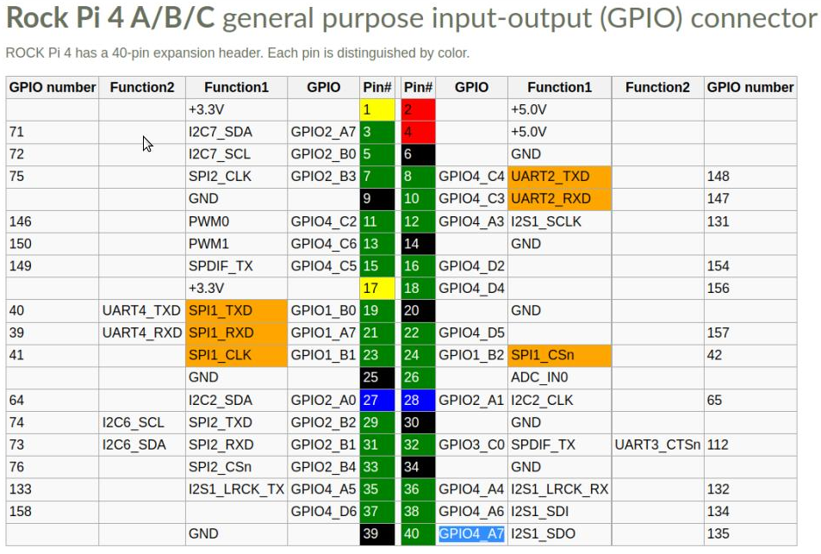
Enable UART4
UART4

Slide 39
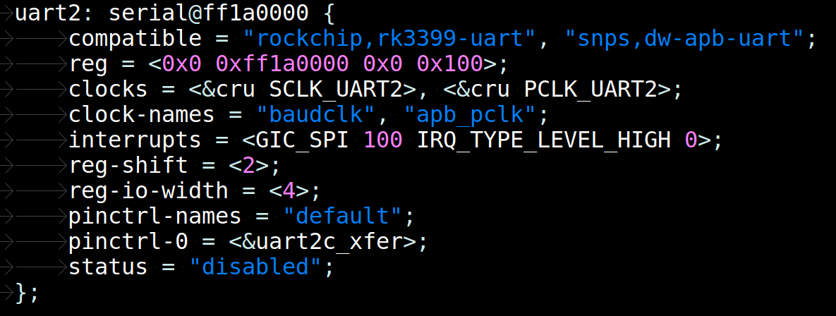
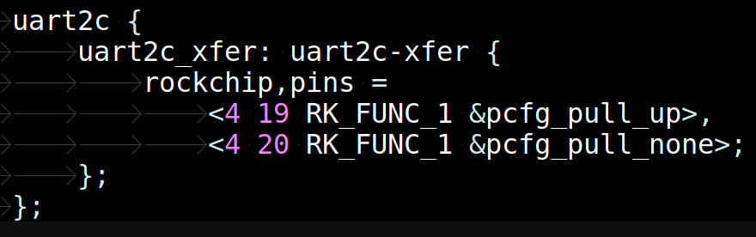
Enable UART4
Rk3399.dtsi

Slide 40
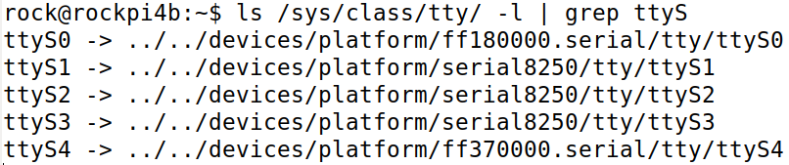
Enable UART4
Enable UART4
rk3399-rock-pi-4b.dts
&uart4 {
status = "okay";
};
UART4
Device Node

