Slide 1
LED Drivers

Slide 2
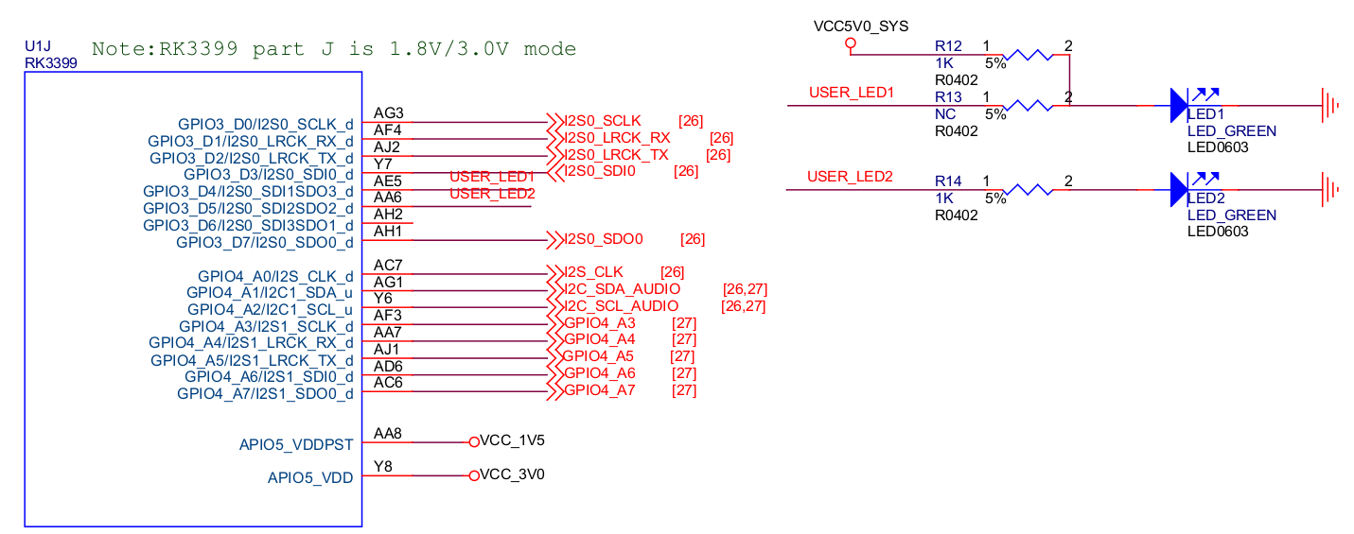
LED Schematic
GPIO3_D4/I2S0_SDI1SDO3_d → LED1
GPIO3_D5/I2S0_SDI2SDO2_d → LED2

Slide 3
LED Subsystem
Control LED convenient with SysFS
  For example
    echo 1 > /sys/class/leds/user-led2/shot
Switch different LED trigger type in SysFS
  For example
    echo "gpio" > /sys/class/leds/user-led2/trigger
    echo "1" > /sys/class/leds/user-led2/brightness
    echo "0" > /sys/class/leds/user-led2/brightness

Slide 4
LED Subsystem
user-space
/sys/class/led/
kernel-space
Trigger driver
led-class.c
led-triggers.c
switch
led-core.c
leds-gpio.c
led driver
hardware
LED

Slide 5
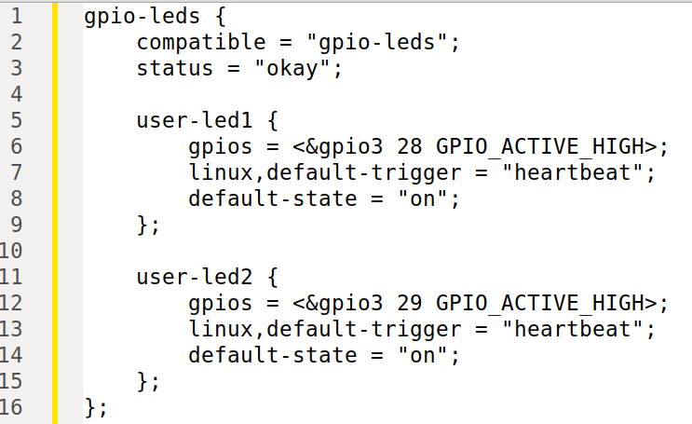

LED DTS
rk3399-rock-pi-4.dtsi
SysFS Name
Trigger Type

Slide 6
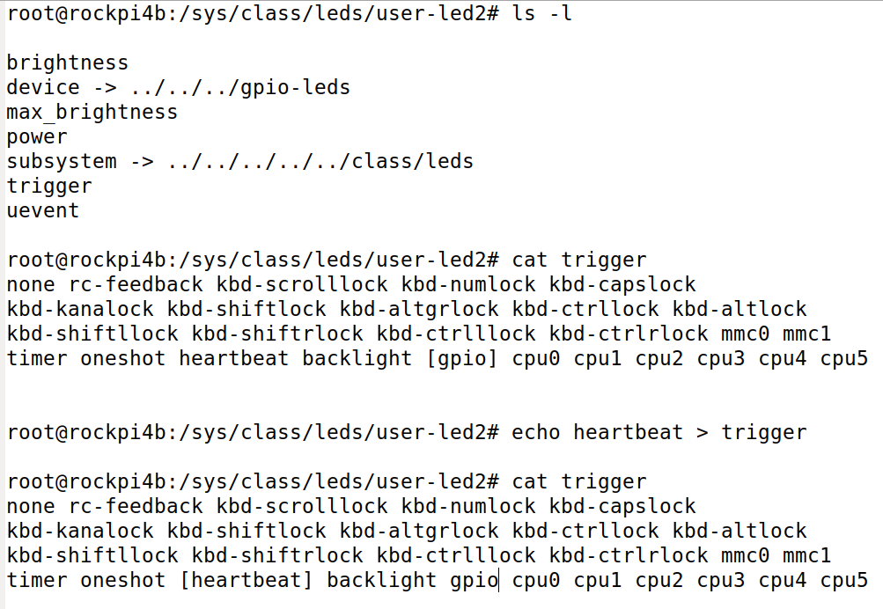
LED SysFS
Check trigger type
Switch trigger type

Slide 7
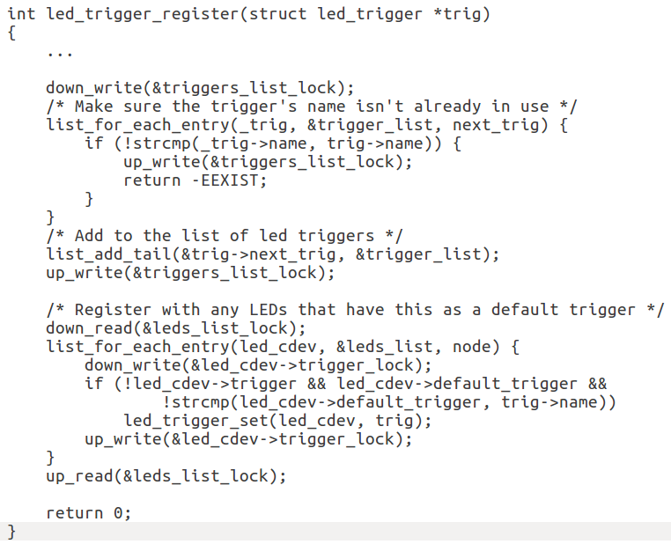
LED led-trigger.c - 1
Search
trigger driver

Slide 8
LED led-trigger.c - 2
rk3399-rock-pi-4.dtsi
SysFS Name
Ledtrig-heartbeat.c

