Slide 1
12
11
1
10
2
9
3
8
4
7
5
6

Slide 2
12
11
1
10
2
9
3
8
4
7
5
6

Slide 3
12
11
1
10
2
9
3
8
4
7
5
6

Slide 4
12
11
1
10
2
9
3
8
4
7
5
6

Slide 5
12
11
1
10
2
9
3
8
4
7
5
6

Slide 7
12
11
1
10
2
9
3
8
4
7
5
6

Slide 8
12
11
1
10
2
9
3
8
4
7
5
6

Slide 9
12
11
1
10
2
9
3
8
4
7
5
6

Slide 11
12
11
1
10
2
9
3
8
4
7
5
6

Slide 12
120

Slide 25
22
22
12
12
11
12
2
11
2
10

Slide 26
9
1234567890
20
1 2 3 4 567890
15
10
5
3
0
1 2 3 4 5 6 7 8 9 10 11 12 13 14 15 16

Slide 27
12
11
1
10
2
9
3
8
4
7
5
6

Slide 28
12
11
1
10
2
9
3
8
4
7
5
6

Slide 30
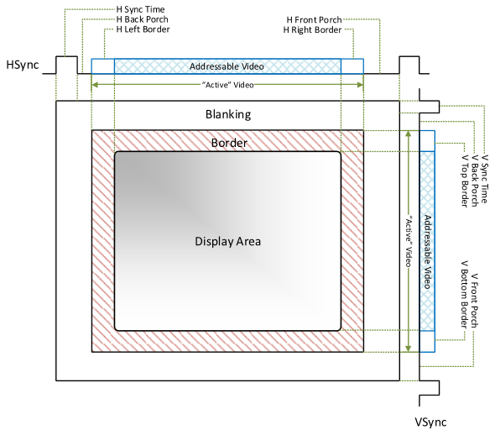
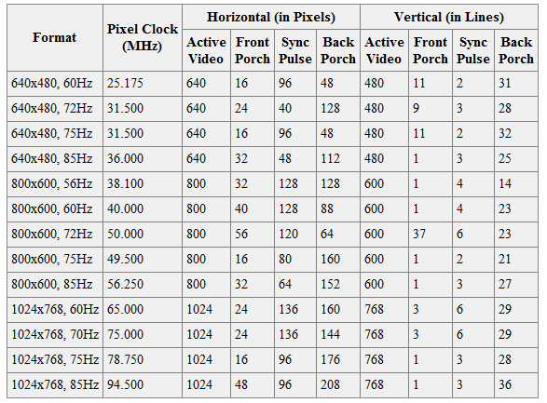
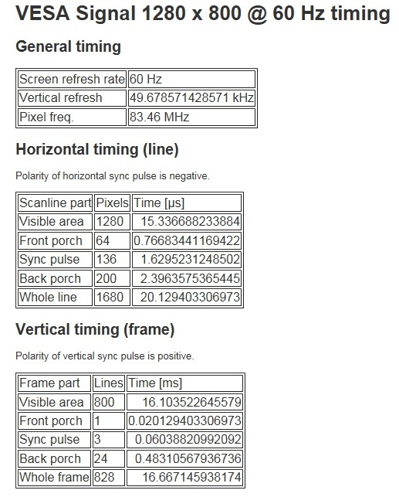
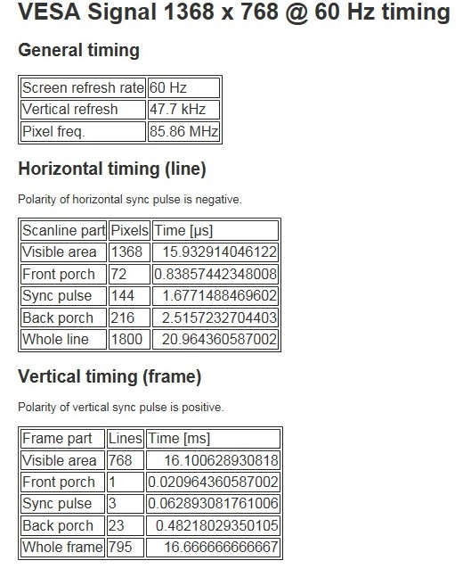
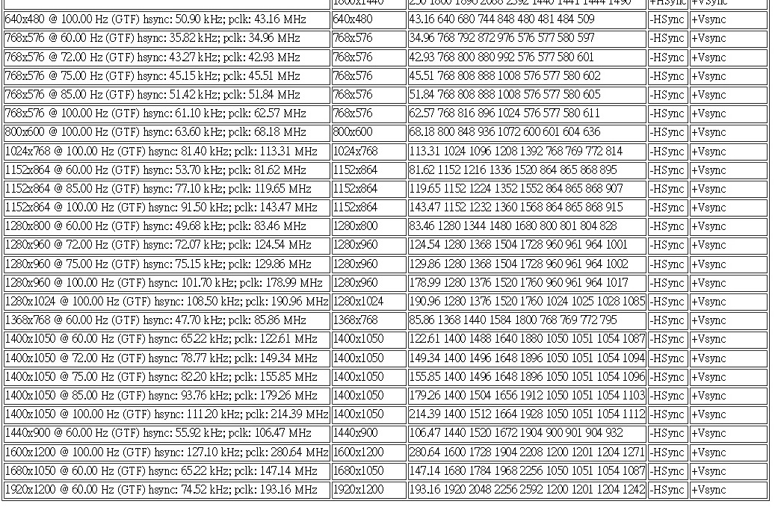
Resolution Decimal Hexadecimal MB/2b
800x480x4 1536000 0x177000 4
800x600x4 1920000 0x1D4C00 4
1024x480x4 1966080 0x1E0000 4
1024x600x4 2457600 0x258000 5
1024x768x4 3145728 0x300000 6
1280x480x4 2457600 0x258000 5
1280x600x4 3072000 0x2EE000 6
1280x800x4 4096000 0x3E8000 8
1366x720x4 3934080 0x3C0780 8
1366x768x4 4196352 0x400800 8.1

Slide 31
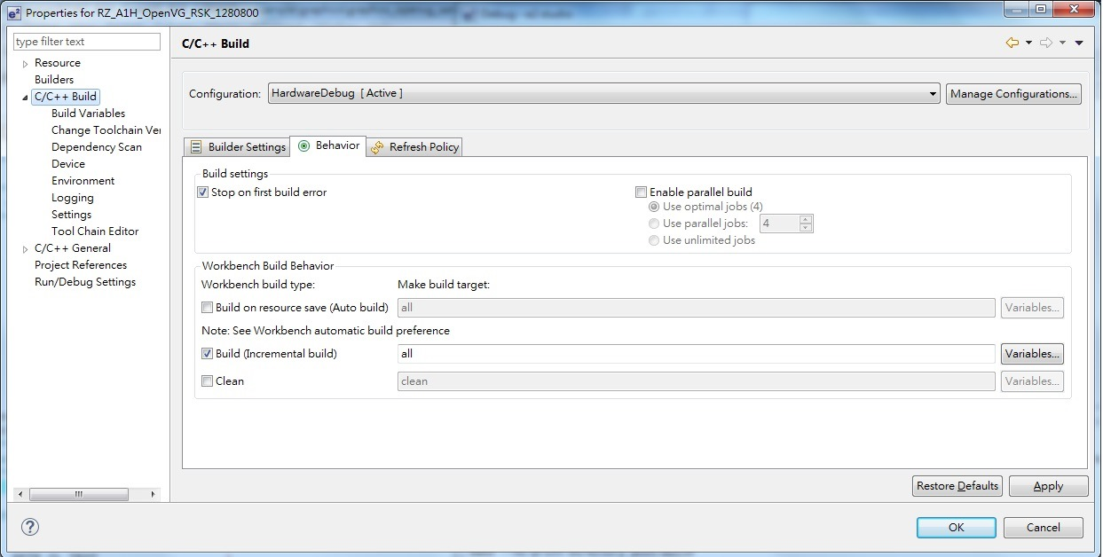
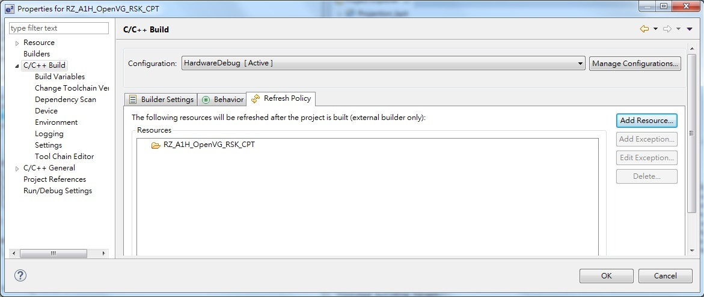
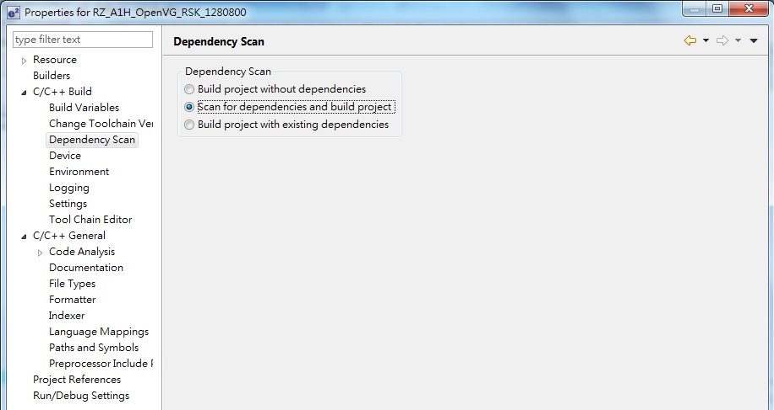
Why always re-compile all
If project is copied,
Check Project Name
De-click, apply, Click again
De-click, apply,
Click again

Slide 32
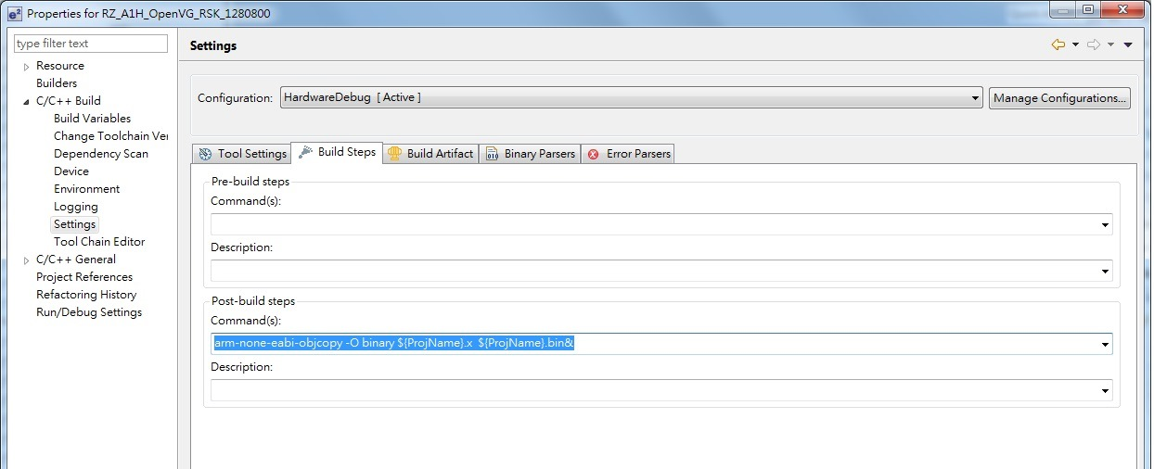
Why .BIN is not output
If project ever been copied
Check Project Name whether same as before

