Slide 1
Employment Analysis Project
Logan Miller
Video link

Slide 2
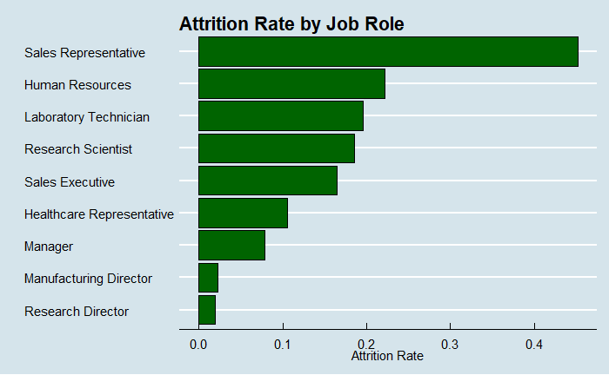
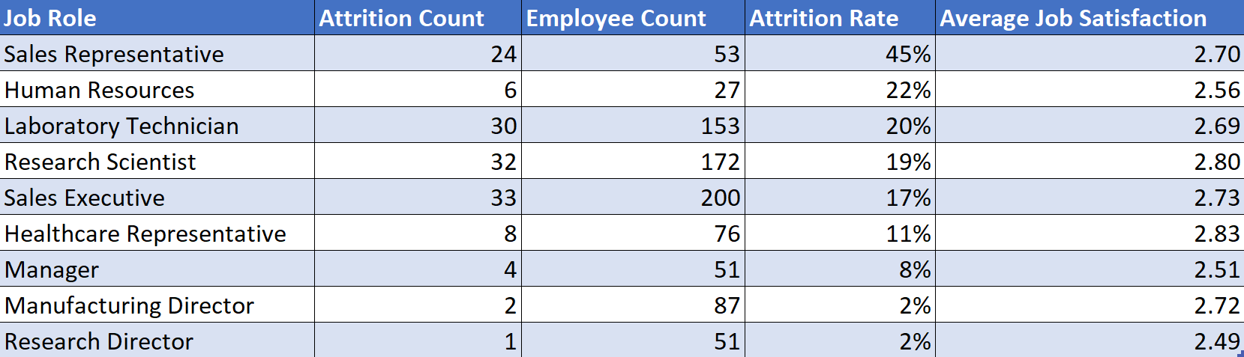
Attrition by Job Roles
Sales Representatives have double the attrition rate of the next highest Job Role
Known to be a highly volatile position
Look for ways to retain sales representatives

Slide 3
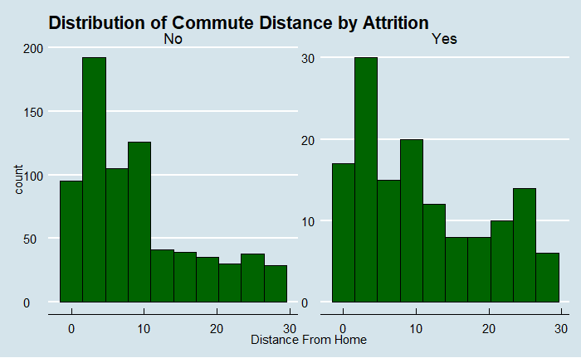
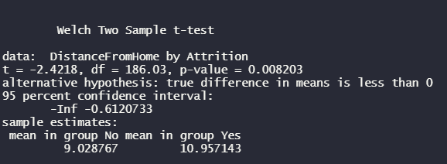
Does commute distance increase attrition?
Assumptions for test
Different standard deviations
Different sample sizes
CLT
Conclusion
We are 95% confident that the mean commute distance of employees who left is less than the mean commute distance of employees who remain, p-value = 0.008
Interpretation
Place new locations near employees

Slide 4
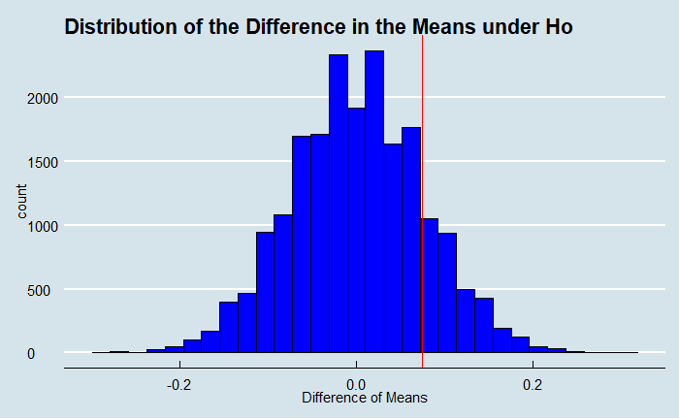
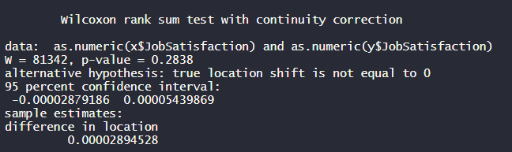
Do non-exempt employees have lower job satisfaction?
Permutation test shows observed difference is not significant
Randomly assigned ranks for both types of employees 20,000 times and observed a difference in means as extreme or more extreme about 6,500 times, p-value = 0.32875
Wilcoxon rank sum test also fails to reject the null that the difference in centers, median in this case, is different than 0

Slide 5
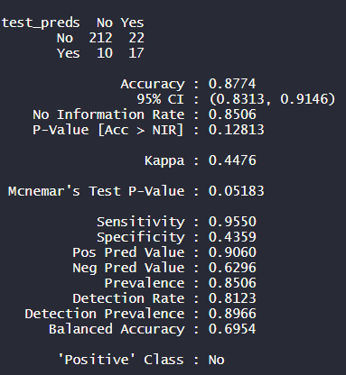
Classification : Logistic Regression w/ Stepwise Selection
Stepwise selection
Adds variables to the model one by one and if the variable reduces the AIC(good) keeps the variable
After each variable is added, test other variables still in the model to see if removing them reduces AIC and if it does, that variable is removed
Resulting model had very high specificity but moderate sensitivity

Slide 6
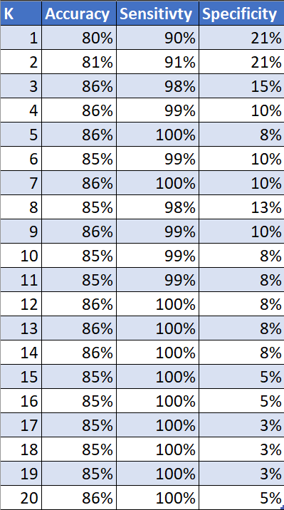
Classification : KNN
K represents the number of “neighbors” used to classify
Very low specificity signifying the model is very poor at identifying employees who leave
Could be due to the large number of categorical variables in dataset

Slide 7
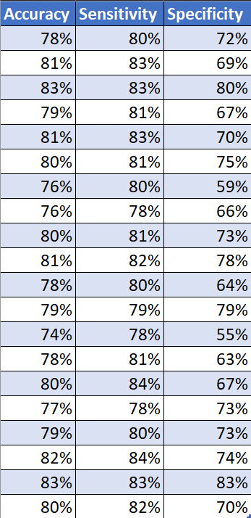
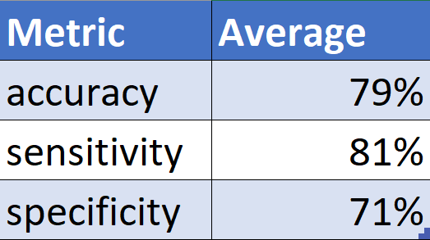
Classification : Naïve Bayes
Predicts classification based off probabilities, bayes thereom
Most robust model
Predicts positive and negative values more equally than the other models
Recommended model when predicting Monthly Income going forward

Slide 8
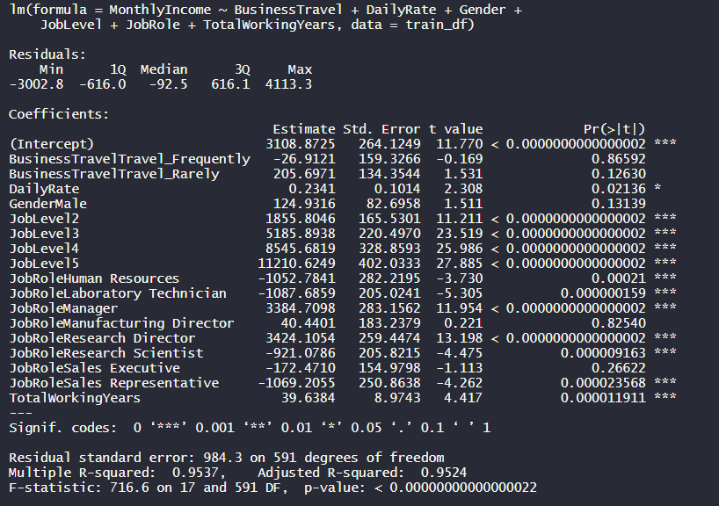
Linear Regression w/ Stepwise Selection
Reduces the sum of squared residuals
Adjusted R-squared of 95.24% would indicate model does a very good job
Verified on test set
Example interpretation
When all other variables are 0, the mean of the distribution of Monthly Income for an employee with a Job Level of 5 is expect to be $11,210.62 more than an employee with a Job Level of 1
About 66% lower than the target RMSE

