Slide 1
Health Insurance Options for the Uninsured in New York
Amarnadha Reddy A
Saikumar Reddy P
Naga Mounika T

Slide 2
Summary
We explored and implemented a solution for those in New York who do not have health insurance using data.
First, we'll go over how we described the problem and concern, taking into account both pre-pandemic and pandemic conditions.
We examined data sets, completed analysis, and created visualizations to explain the issue from a data perspective after identifying the problem.

Slide 3

Problem & Issue Identification: ● Who are the people or communities in need of help?:
The communities in need of help are those without health insurance during the COVID-19 pandemic.

Slide 4

When did the problem take place?
Although the lack of affordable health care has long been a concern in the United States, it became even more so during the COVID-19 pandemic, which struck the country in March of 2020 and continues to be an issue.

Slide 5

Where did this happen?:
The United States, but specifically the State of New York.

Slide 6
Why?:
Many people in the United States may not have health insurance. The COVID-19 pandemic has intensified this problem by causing many people to lose their jobs and, as a result, their health insurance. Many people are struggling to get access to appropriate medical services at a time when staying healthy is more important than ever.

Slide 7
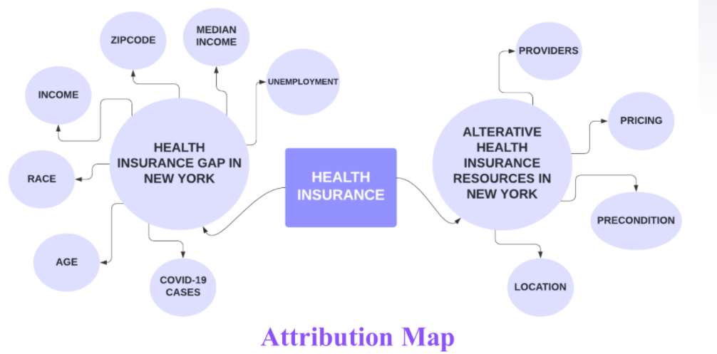
Data Searching, Analysis, and Visualization

Slide 8
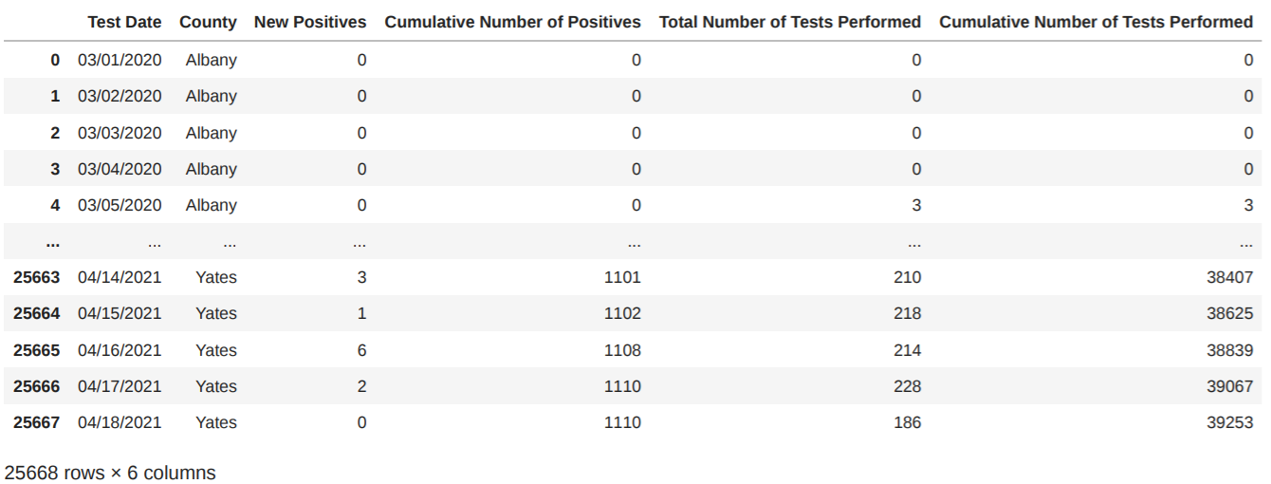
COVID-19 Cases New York Analysis:

Slide 9
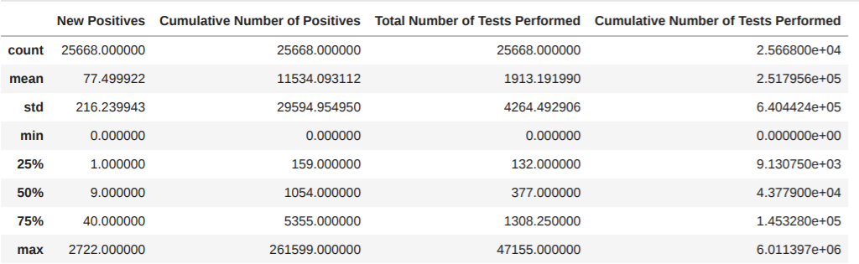
Data Analysis:

Slide 10
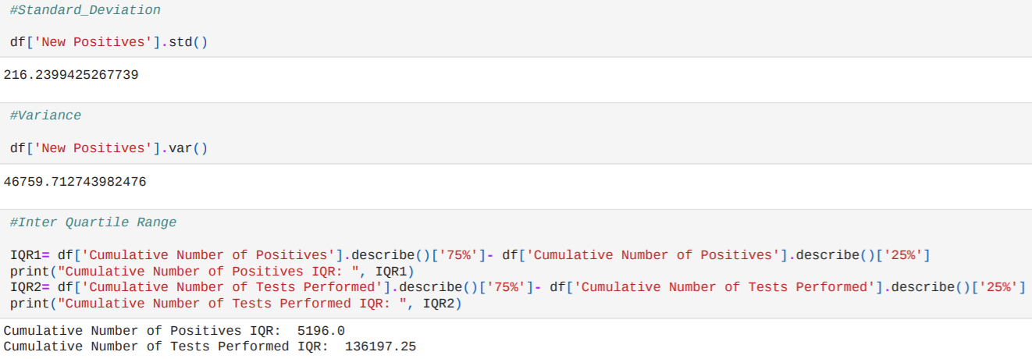
Standard deviation, Variance and Iqr:

Slide 11
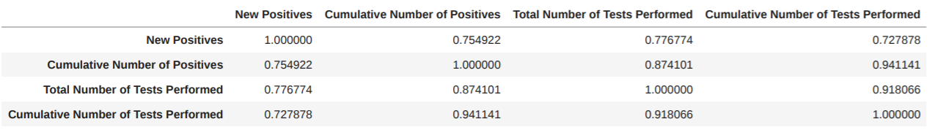
Correlation between each attribute:

Slide 12
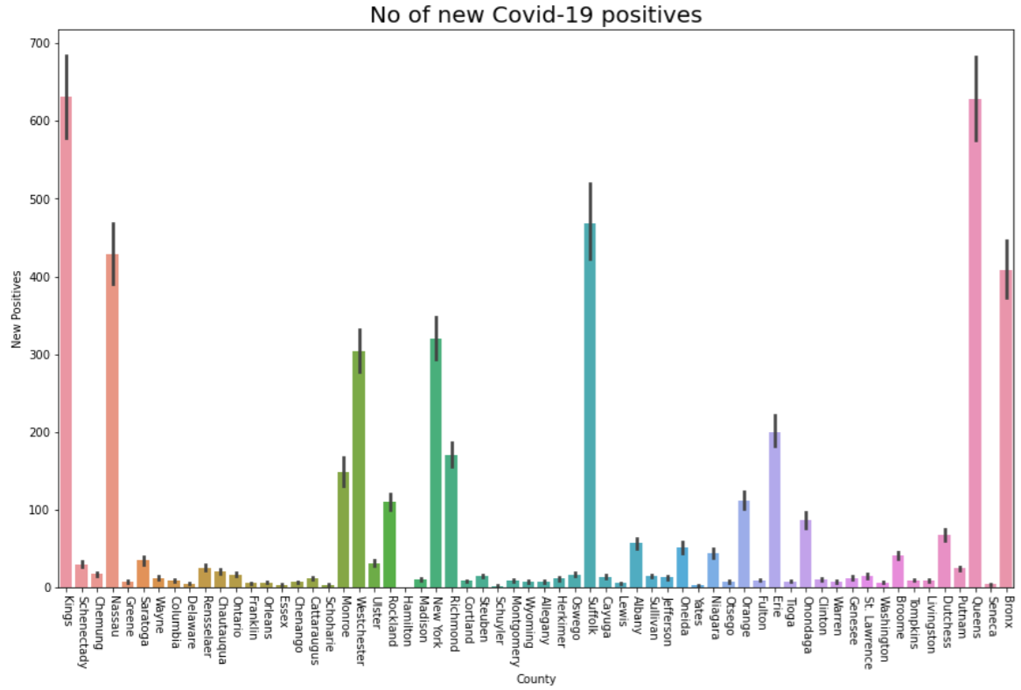
No of new covid-19 positive cases in each county:

Slide 13
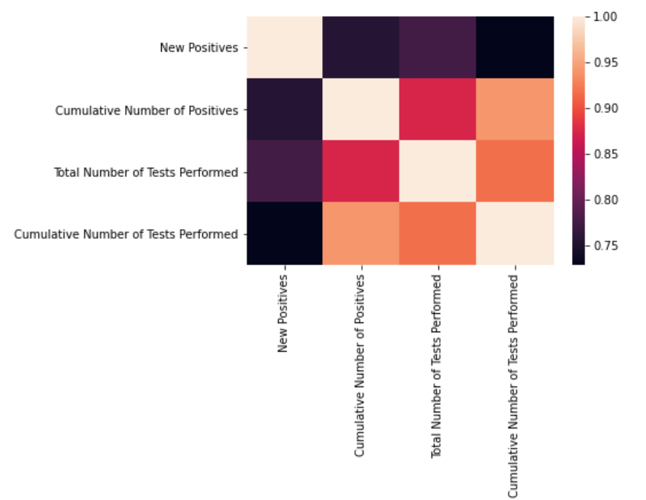
Correlation heat map:

Slide 14

Thank you

