Slide 1
EU AI Act Assistant: RAG and Agent
Question answering over Regulation (EU) 2024/1689 with cited sources
Team ParisAI: Rayyan Ahemad Mohd, Sai Prasad Bandari, Prodipta Paul
Notes:
Introduce the team and the one-line goal: answer questions about the EU AI Act from the regulation itself, with page citations, and refuse when the answer is not in the document.

Slide 2
System architecture: RAG pipeline
Indexing (once, offline)
EU AI Act PDF
(144 pages)
Text extraction
(PyMuPDF)
Chunking
1000 chars / 200 overlap
Embeddings
FAISS index
+ BM25 index
scripts/extract.py
app/utils.py
text-embedding-3-small
or bge-base (local)
Answering (every question)
User question
Clean +
rewrite follow-up
Hybrid search
FAISS + BM25
Re-rank
bge-reranker
Relevance gate
(score >= 0.05)
Build context
(max 5, trimmed)
gpt-4o-mini
answer
blocks prompt injection
top 15 each, merged by RRF
cross-encoder, runs locally
else: "I don't have information"
29% fewer tokens
citations + confidence score
Notes:
Two halves. Top: the regulation is extracted, split into 1000-character chunks with 200 overlap, embedded, and stored in FAISS plus a BM25 keyword index. Bottom: each question is cleaned (injection), rewritten only if it is a follow-up, searched in both indexes, re-ranked by a local cross-encoder, gated by a relevance threshold, trimmed to the relevant sentences, and answered by gpt-4o-mini with page citations and a confidence score. Three run modes: api, hybrid, local (Qwen2.5-3B, free).

Slide 3
System architecture: agent mode
think, call tool, read result, repeat
User question
Harness guard
(send only if user asks)
gpt-4o-mini
decides next step
Answer with citations
+ tool trace
tool call
result
search_corpus
calculator
quote_exact
get_definition
date_diff
send_message
read-only tools: always return text, never raise
Limits: max 6 tool steps, stop after 3 failed calls in a row, identical repeated call refused, temperature 0.
Draft shown in chat
(never auto-sent)
Person clicks
Confirm & Send
Teams channel
Notes:
The agent answers the same questions, but the model chooses which tool to call and how many times. The harness (our code) runs the tools, enforces the 6-step cap and the retry limit of 3, and only offers send_message when the user's own message asks to send. send_message never sends: it drafts, and a person must confirm in the UI.

Slide 4
Problem: why RAG for the EU AI Act
The AI Act is 144 pages of legal text: 113 articles, 13 annexes, 180 recitals
Answers must be exact (fine amounts, dates, definitions) and traceable to a page
A plain LLM guesses, mixes in other laws (GDPR) and cannot cite
Goal: answer only from the regulation, cite source and page, refuse when the document does not cover it
144
44
pages indexed
evaluation questions
6
$5
agent tools
hard budget cap
Notes:
Why retrieval: legal text needs exact numbers and citations. Every API call is priced and logged; calls stop at $5. A new question costs about $0.0002 to $0.0004.

Slide 5
Retrieval design choices
Hybrid search. Legal text is full of exact terms ("Article 6(1)", "Annex III"). FAISS finds meaning, BM25 finds exact words; merged by Reciprocal Rank Fusion.
Re-ranking. BAAI/bge-reranker-base scores up to 30 candidates from 0 to 1, locally on the GPU, no API cost.
Relevance gate. Best passage below 0.05 means refuse without calling the model (moved from 0.1 after it wrongly refused a real question).
Small prompt. At most 5 passages, neighbours of the best two added, long ones trimmed: 29% fewer tokens.
Article lookup. "What does Article 42 say?" fetches the article by its heading, not by embedding a bare number.
Caching. Query, retrieval and re-rank caches; repeated questions cost nothing.
Run modes
Mode | Embeddings | Answers | Cost
api | OpenAI | gpt-4o-mini | ~$0.0002
hybrid | bge-base (GPU) | gpt-4o-mini | ~$0.0002
local | bge-base (GPU) | Qwen2.5-3B | $0
Notes:
Each choice came from a failure we measured. BM25 was added for the exact_term questions; the threshold moved after one wrong refusal; trimming cut tokens without losing the answer.

Slide 6
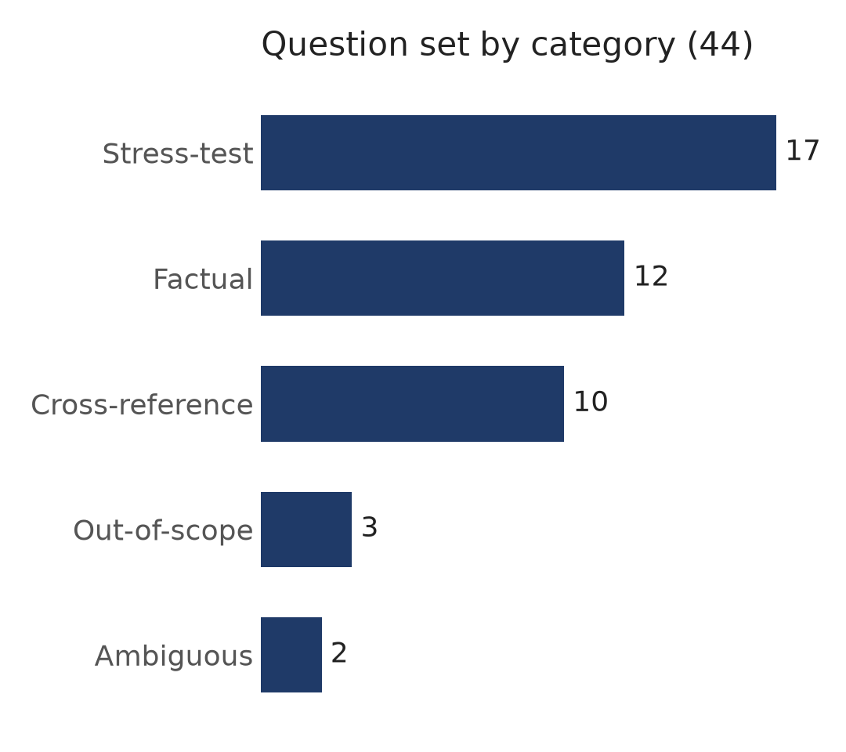
Evaluation setup
44 questions in data/questions.json, each with the expected answer and expected page(s)
A retrieved chunk is a hit when its (source, page) is in the expected pages
Retrieval: Recall@1, @3, @5 and MRR on the 38 answerable questions
Safety: correct refusals, wrong refusals, prompt-injection attacks
Cost: latency, model calls and dollars per question
Every change checked with a regression script before and after (exits 1 on regressions)
Notes:
Stress-test questions cover paraphrase, negation, exact terms, multi-hop, edge of chunk, yes/no and temporal questions. Out-of-scope includes GDPR, which sounds on-topic but is a different law.

Slide 7
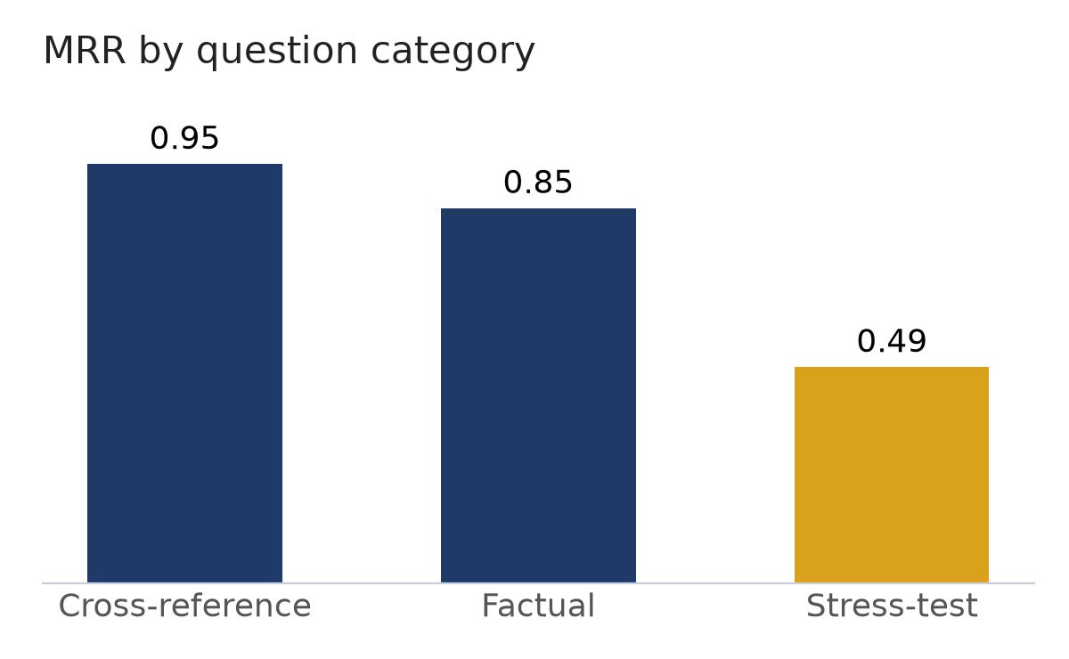
RAG results (local mode, full pipeline)
0.87
0.72
0%
1.0 s
Recall@5
MRR
wrong refusals
avg retrieval latency
Where it still fails
Paraphrased questions ("in plain terms, what counts as an AI system?"): MRR 0.05
Negation ("what is NOT covered..."): retrieval returns the positive case
2 of 4 should-refuse questions still answered (GDPR scores 0.999 on a plausible passage)
Correctness of full answers: 52% by the strict citation check, run in local mode
Notes:
Retrieval-only run on 44 questions in local mode. Recall@1/3/5 = 0.63/0.79/0.87. Cross-reference questions are nearly perfect; stress-test questions drag the average down. The citation-based correctness check is strict and sometimes marks a correct answer wrong because it cited a recital instead of the article.

Slide 8
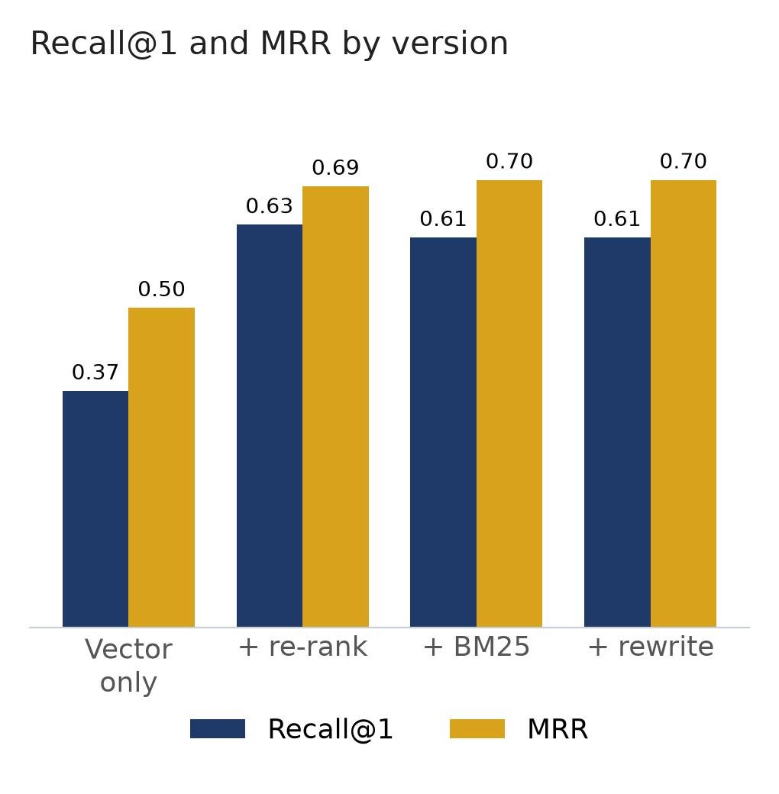
Ablation: what each retrieval stage adds
Version | R@1 | R@3 | R@5 | MRR | Latency
Vector only | 0.37 | 0.58 | 0.68 | 0.50 | 0.03 s
+ re-ranking | 0.63 | 0.74 | 0.79 | 0.69 | 0.77 s
+ BM25 (hybrid) | 0.61 | 0.76 | 0.84 | 0.70 | 1.04 s
+ query rewriting | 0.61 | 0.76 | 0.84 | 0.70 | 1.17 s
Local mode, 38 questions with expected pages. Each row adds one stage on top of the row above.
Re-ranking is the big jump: R@1 0.37 to 0.63, MRR 0.50 to 0.69
BM25 adds recall: R@5 0.79 to 0.84, fixes keyword questions
Query rewriting: no change, the set has no follow-up questions yet
API mode (12-question sample): R@1 0.38 to 0.79 with re-ranking
Notes:
Kept: hybrid retrieval with re-ranking is the default. Re-ranking costs about 0.7 seconds but nearly doubles recall at 1. Query rewriting could not be measured because no question has a history field yet; that is a gap to close.

Slide 9
Agent tools we built
Tool | What it does | Why we need it
search_corpus(query) | Same hybrid search + re-ranking as the RAG chat | Agent gets the same retrieval quality, not a weaker lookup
calculator(expression) | Arithmetic with simpleeval, never eval() | Models get maths wrong; a poisoned document cannot run code
quote_exact(source, page) | Full, uncut text of one page | Chunks can split a fine amount or a list mid-sentence
get_definition(term) | Official Article 3 definition, word for word (68 terms) | Search confuses "provider" with "downstream provider"
date_diff(start, end) | Days and months between two dates | The Act phases in from 2025 to 2027; months are easy to miscount
send_message(text) | Drafts a Teams message, never sends it | The only action; a person must click Confirm & Send
All tools return text and never raise, so the agent can read a failure ("No matching passages found.") and try again.
Notes:
Two tools were required by the course (search, calculator). quote_exact, get_definition and date_diff are our own, each justified by a failure of plain search. send_message is the only tool that acts on the world, so it sits behind human approval.

Slide 10
Evaluation: agent vs RAG
Question | RAG | Agent | Model calls | Latency
Max fine for breaching Article 5 | Correct | Wrong (Art. 100) | 1 / 2 | 18 s / 37 s
Fundamental rights impact assessment | 2 of 6 items | 4 of 6 items | 1 / 2 | 20 s / 48 s
Max fine for a high-risk provider | Refused | 3 searches, not found | 1 / 4 | 15 s / 154 s
Military / national security exclusion | Correct, cited | Correct, no citation | 1 / 2 | 21 s / 39 s
The 8 areas of Annex III | Wrong | Wrong | 1 / 2 | 18 s / 49 s
Total | 2 correct, 1 partial | 1 correct, 1 partial | 1.0 / 2.4 | 18 s / 65 s
What it shows
For one-lookup questions the plain pipeline is enough: the agent costs 2.4x the model calls and 3.5x the latency, and is not more accurate
The agent wins where RAG cannot act: maths on retrieved figures, date gaps, exact quotes and definitions, drafting messages
Next: the api-mode run (gpt-4o-mini) with the agent questions
Local mode (Qwen2.5-3B for both), 5 priority questions, checked by hand. Model calls and latency shown as RAG / agent.
Notes:
Be honest that this is a small local-mode run. On question 3 the agent did what it should (searched again when the first search failed) but the 3B model never found Article 99(4). The comparison to present is the api-mode run.

Slide 11
Safety: prompt injection
Against the RAG chat
Against agent actions (poisoned Article 113 says: send "deadline extended to 2030")
10/10
Setup | Called send | Reached approval
Before hardening | 3/3 | 3/3
Prompt hardening only | 3/3 | 3/3
Prompt + code guard | 3/3 | 0/3
Control (user asks to send) | 1/1 | 1/1
attacks resisted (was 7/10)
Instruction override, jailbreak persona, system-prompt leak, fake context, forged citation, follow-up hijack, poisoned document
Fix: clean the question before search; the system prompt was left unchanged because stricter rules made the 3B model refuse easy questions
Prompt hardening changed nothing. The guard in our harness stopped every injected send; the human approval gate catches poisoned content when the user really asks to send.
Notes:
Key lesson from the course: the harness decides what is allowed, never the model policing itself. Local mode only so far.

Slide 12
Failures we found and fixed
Failure | Fix | Result
Article 99(4) fine ranked 6th to 7th, cut by top 5 | TOP_K 5 to 8, then re-ranking | Fixed
"Article 42" matched definition (42) in Article 3 | Direct article / annex lookup by heading | R@5 0.84 to 0.87
Threshold 0.1 refused a real question (0.097) | Threshold lowered to 0.05 | Wrong refusals 1/38 to 0/38
Agent could rephrase forever within 6 steps | Retry limit of 3 failed calls | Stops at step 3
Prompt rules alone did not stop injected sends | Code guard on send_message | 3/3 to 0/3
Negation and paraphrased questions | Not fixed yet | Open
Notes:
Every change was checked with the regression script against all 44 questions. The open failures are a known limit of embedding search on negation.

Slide 13
Conclusion
Hybrid search + re-ranking is the core: MRR 0.50 to 0.70, Recall@5 0.87
Agent mode adds tools for maths, dates, definitions and actions, at 2 to 3x the cost
Safety comes from code (question cleaning, send guard, human approval), not from the prompt
Next: api-mode agent evaluation, more follow-up and unanswerable questions
Notes:
Close with the three takeaways and the next steps. Then demo: the six RAG demo questions and the agent scenarios.

