Slide 1
GitHub Copilot. Unleashing AI Power Responsibly.
Lukas Durovsky
Staff software engineer
Developer week ‘25

Slide 2
Me
Software Engineer
~10 years of experience, various projects, mostly life science
Conference speaker, Workshop developer
GitHub Copilot user

Slide 3
Workshop
Theory & Hands-on
Repository: https://github.com/xlukasd/WorkshopPlayground
Basics vs. latest features, Beginners vs. Advanced users
My setup
VS 2022, VS Code
GitHub Copilot Business / Free
C#/.NET
Don’t worry about C# / IDE

Slide 4
Workshop - Agenda
~30 minutes – Installation, Config
~60 minutes – ‘Everyday’ usage, Context, Prompts
BREAK
~60 minutes – Custom Extension, Custom MCP server, Agent mode
~15 minutes – Impact on Code quality
~15 minutes – Q&A

Slide 5
❗❗Very important info❗❗
Update regularly
IDE
(GitHub Copilot) extensions
Be aware of
IDE specific functionality
Settings (IDE + Web)
Be aware of Preview / Prerelease / (VS Code Insiders) …
Things change, do not hesitate to correct me

Slide 6
Basics Installation Configuration

Slide 7
What Copilot is? How would you define it?

Slide 8
What Copilot is? How would you define it?
AI Pair-Programmer

Slide 9
Capabilities
Code/script completion
Code/script generation
Refactoring
Explanation of problems (failing test, exception, performance analysis…)
Automatic agent

Slide 10
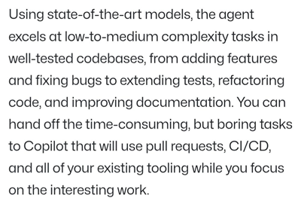
When to use it?
Experience, exploration

Slide 11
Licensing
Free
Pro
Pro+
Business
Enterprise

Slide 12
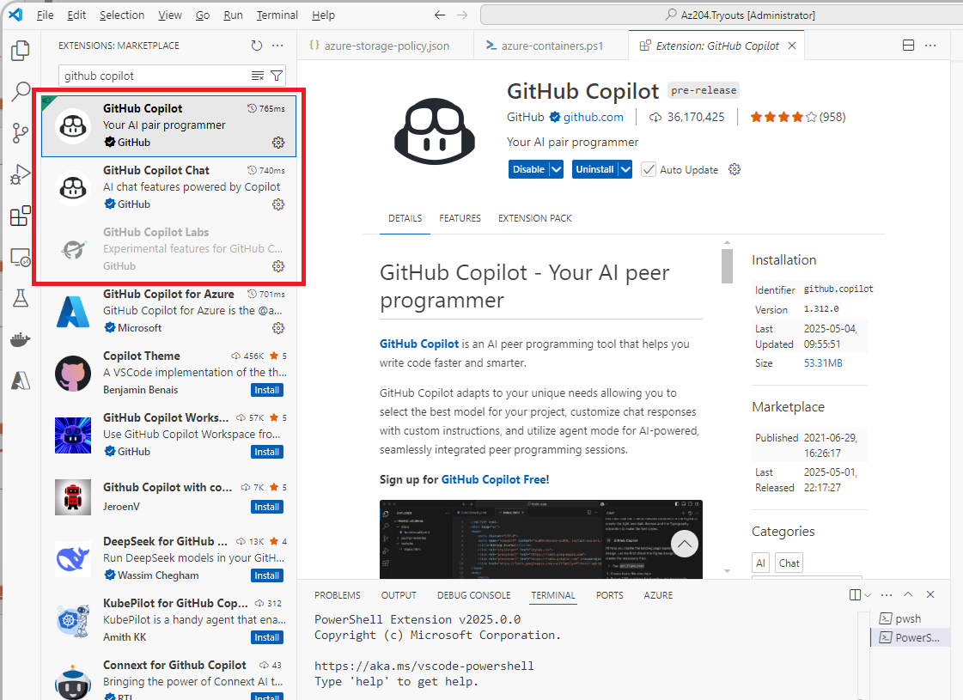
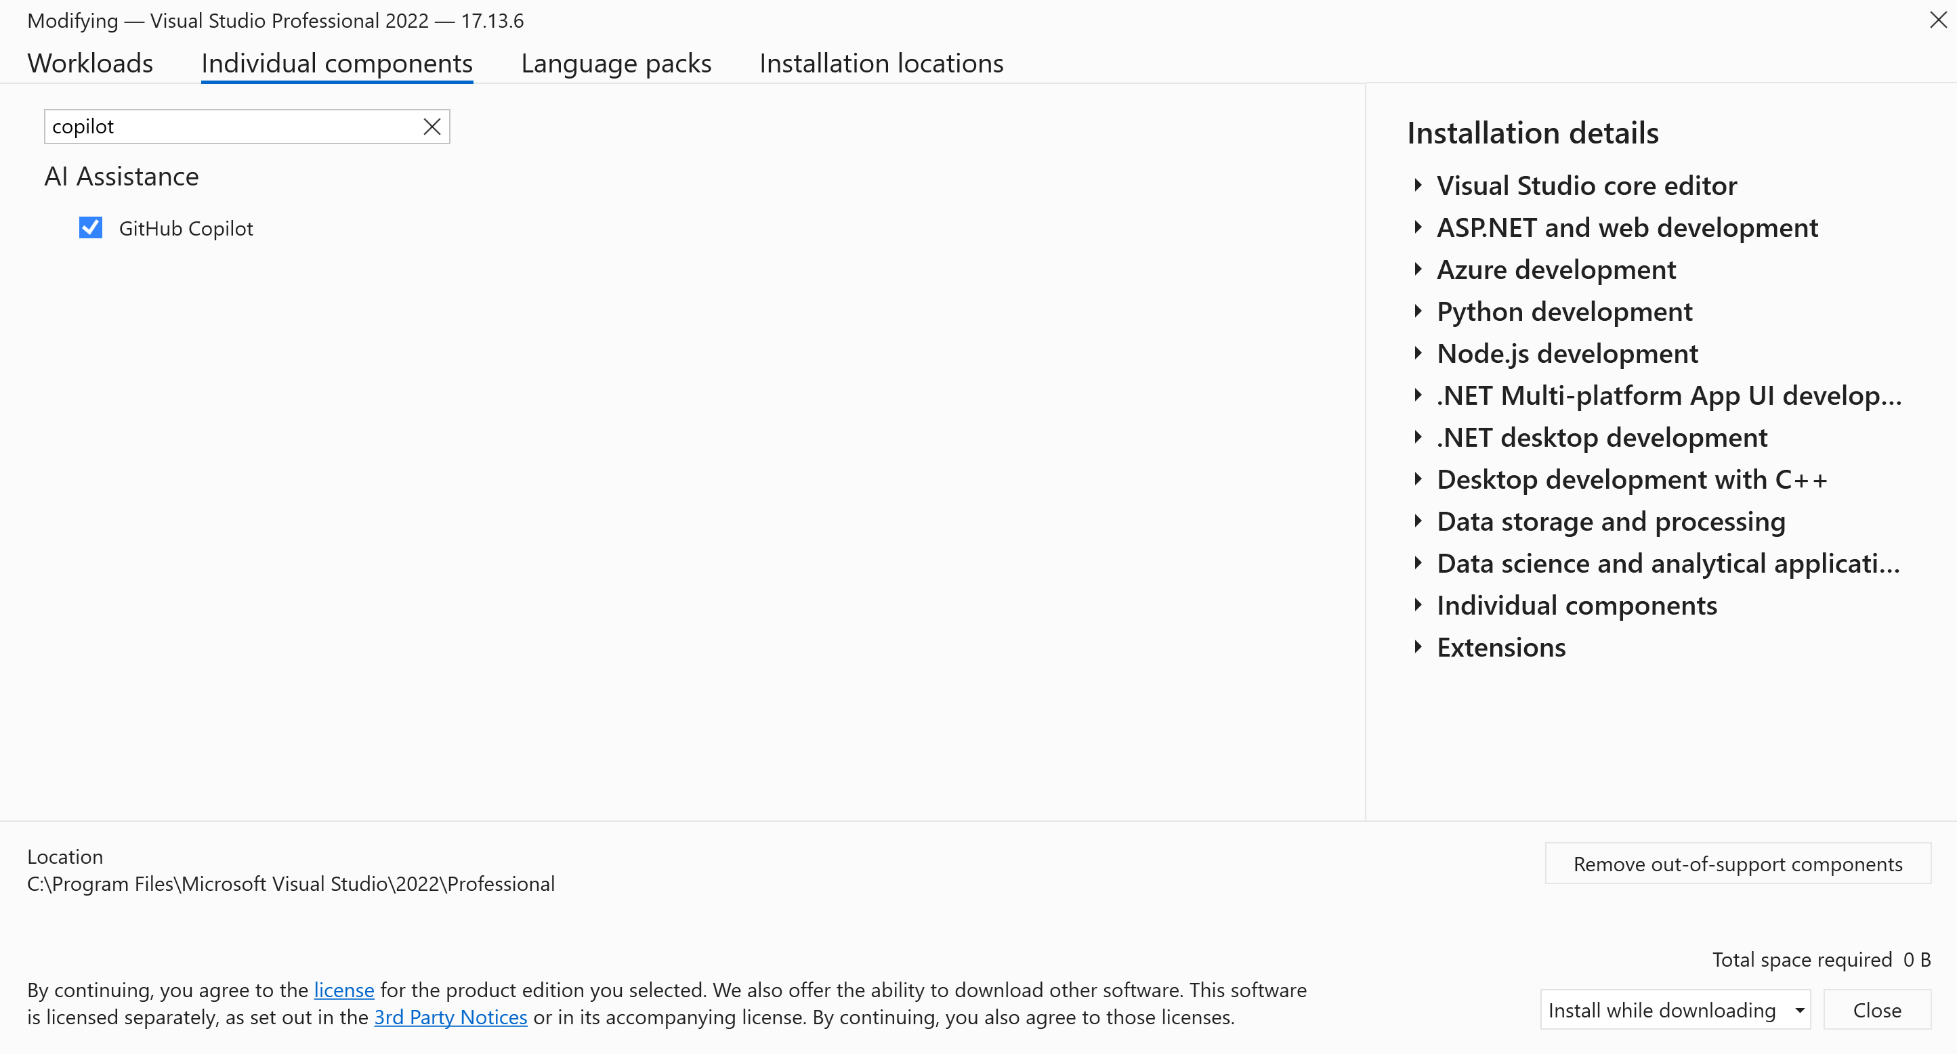
Installation – VS, VS Code

Slide 13
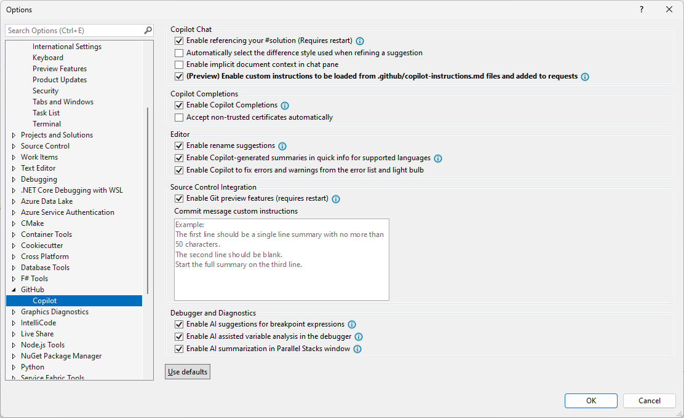
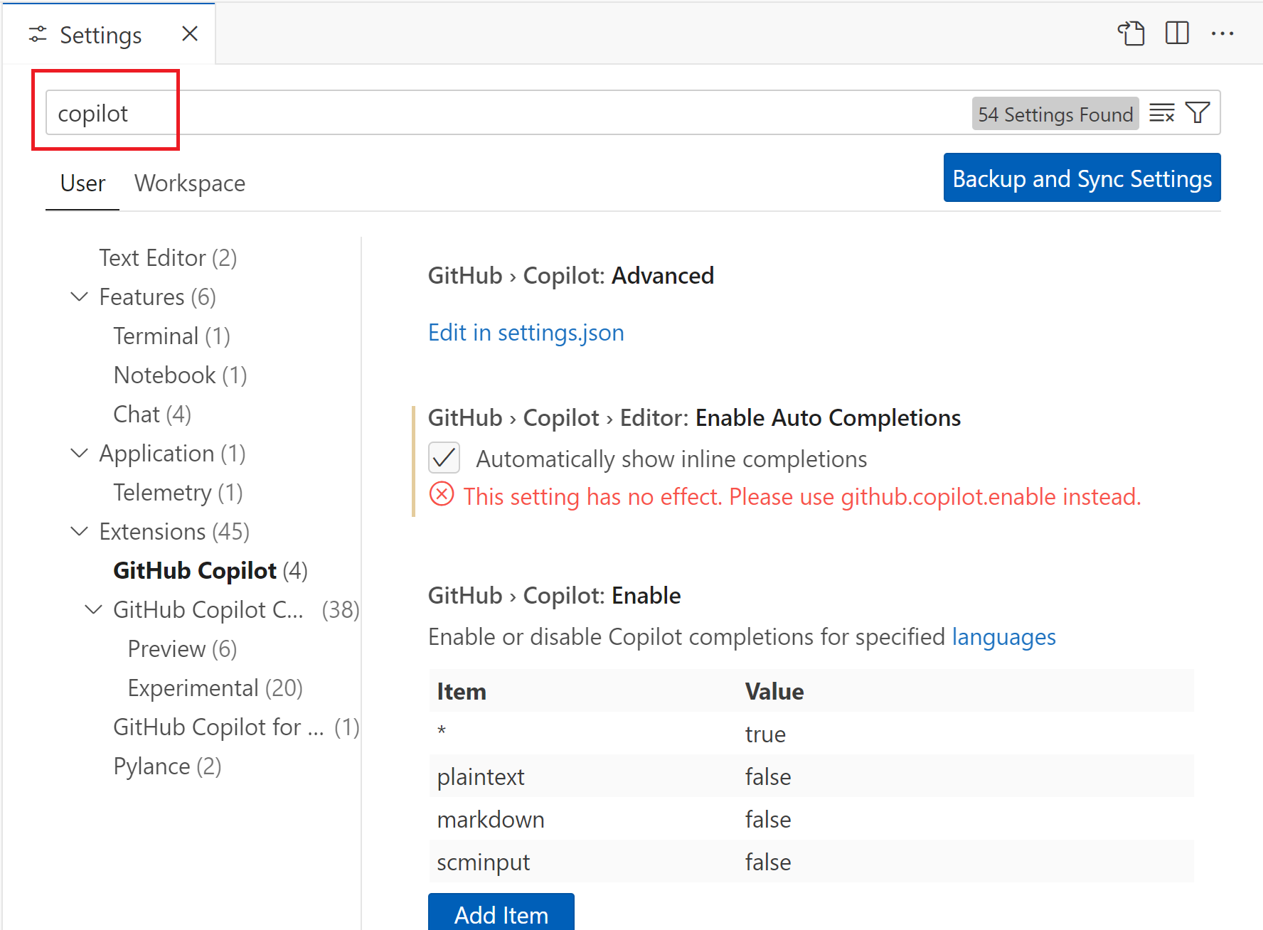
Configuration – VS 2022 / VS Code

Slide 14
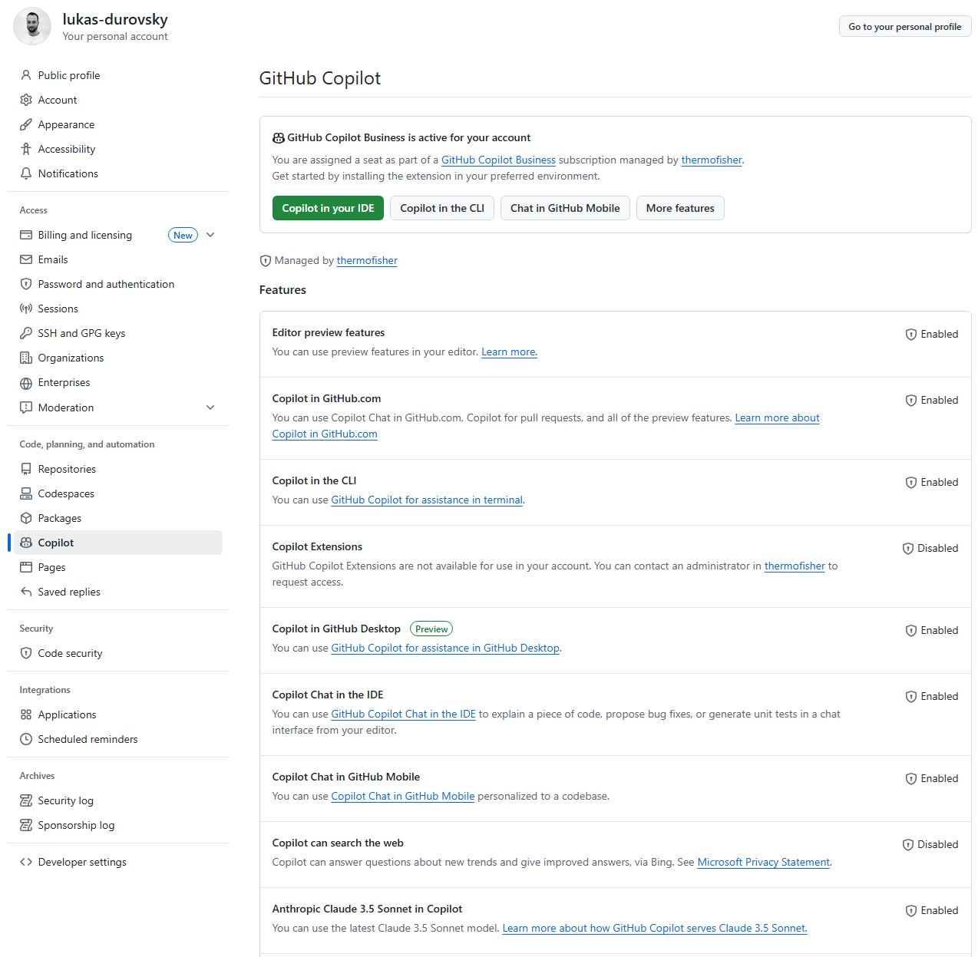
Configuration – GitHub Copilot website

Slide 15
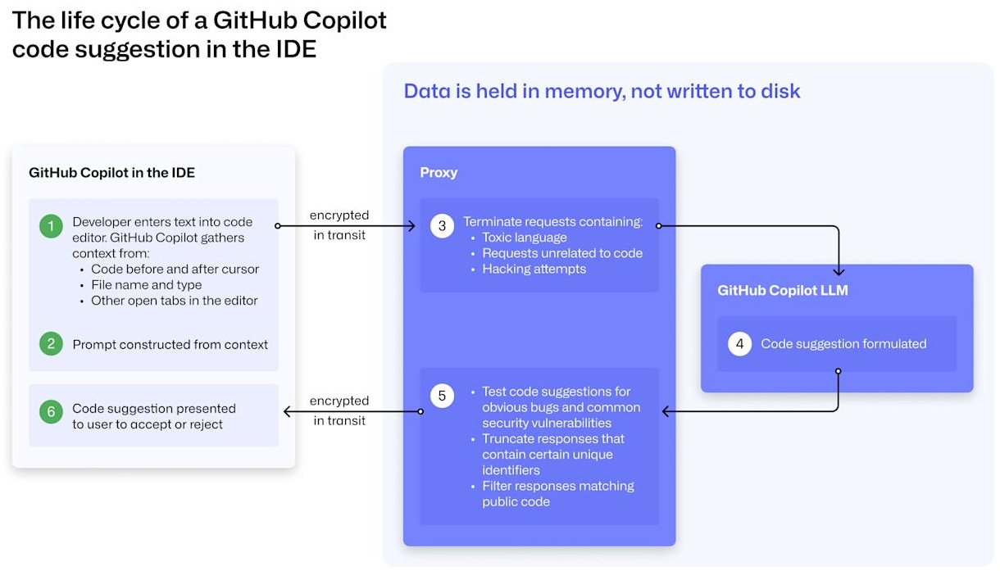
How it works
LLM – Open AI Codex
GitHub Public repos
Code synthesis, copy & paste

Slide 16
State of the tool
Very fast ongoing development
Started ~2 years ago
It’s like a different tool right now
People learnt to integrate it to their workflows

Slide 17
‘Everyday’ usage

Slide 18
Slash commands - depending on the IDE
/explain
/tests
/fix
/doc
/optimize
/clear

Slide 19
🏋️‍♂️Exercise – Slash commands
#slash_Explanation_SQL
#slash_Optimize_SQL

Slide 20
Variables - depending on the IDE
#solution
#{class_name}
#{method_name}
#{field_name}
#terminalLastCommand
#terminalSelection

Slide 21
🏋️‍♂️Exercise – Variables
#variables_McpTools

Slide 22
⏯️ Running FuzzAPI
#demo_agents_terminal_fuzzapi
https://github.com/Fuzzapi/fuzzapi

Slide 23
🏋️‍♂️ Creating API
#generation_api
You can use voice-input

Slide 24
🏋️‍♂️ Refactoring
#refactoring_CodeStyle
#refactoring_StopWatch
#refactoring_ApiInformation
https://github.com/xlukasd/WorkshopPlayground

Slide 25
🏋️‍♂️ Refactoring
#refactoring_finding_duplicate_code
#refactoring_solid_d
#refactoring_CQRS
#refactoring_code_language_change

Slide 26
🏋️‍♂️ Tests
#tests_generation_UnitTests
#tests_generation_TestCases
#tests_generation_StubGeneration
#tests_failingTest_explanation

Slide 27
Context Prompts Prompt Engineering

Slide 29
Context
What is sent to GHC API with your request?
What was used by GHC to generate a response?
Explicit / implicit
Opened tabs
Surrounding code
“random” files
Specified files
Real image
Context exclusion setting

Slide 30
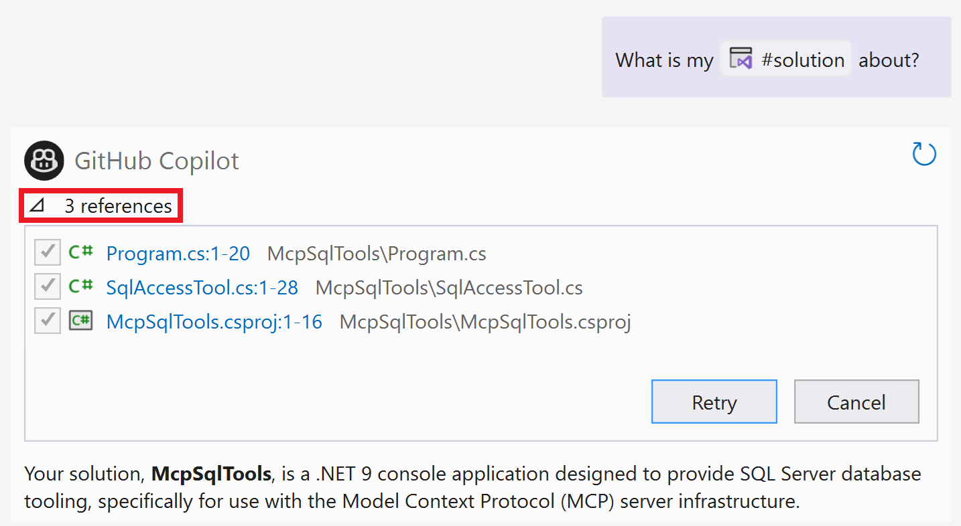

Slide 31
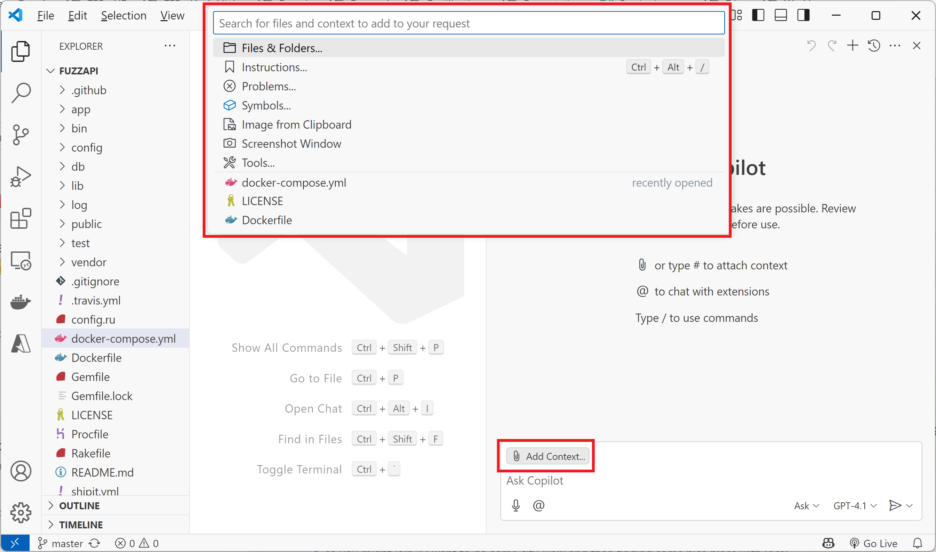

Slide 32
Prompts
Prompt
Input / instruction given to AI model to guide its output
Prompt engineering
Art and science of crafting and refining prompts
Understanding how AI models process information and iteratively adjusting prompts to optimize their responses

Slide 33
Prompts - Strategies
Q&A
“I want to create JavaScript frontend application, and I am not sure which framework to use. Ask me YES/NO questions to determine.”
Options-Pros-Cons
“I want to have my UI responsive. It must display differently on big screens than on smartphones. What options do I have? Give me pros and cons of each approach.”
Restriction
“/explain briefly, maximum 200 words.”

Slide 34
Prompts - Strategies
Chain of thought
Breaking up the potentially bigger prompt into smaller prompts (subtasks)
“Make an HttpClient GET request to the ‘https://favqs.com/api/qotd’”.
“Deserialize the Response into ‘Quote.cs’ class”
“Use the Retry policy for the request”
N-shots
Providing examples to LLM
“I want to make GET request to myapi.com/users and display JSON response in columns. The Json looks like the following: [ [{ name: 'John', age: 25 }, { name: 'Jane', age: 30 }], [{ name: 'Bob', age: 40 }] ];“

Slide 35
🏋️‍♂️ Context, Prompts
#context_Quote_GivenExample
#context_SearchAlgorithms

Slide 36
Context – Custom instructions
Additional context for Copilot
Included in every interaction via Chat
Included in Commit message generation
❌ Not included in code-completions

Slide 37
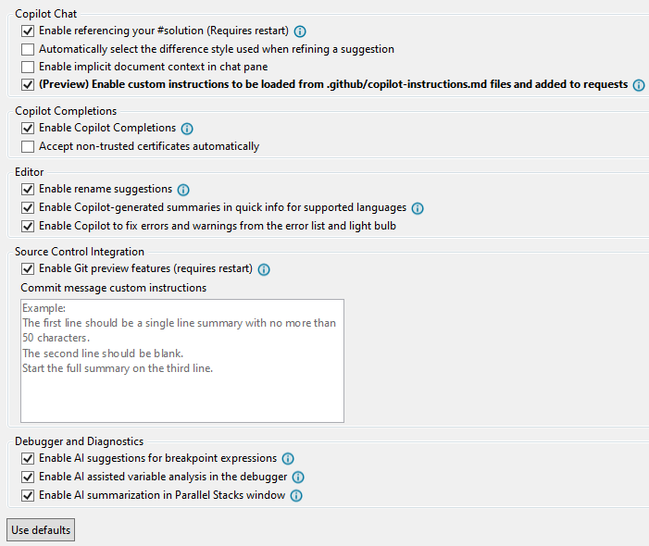
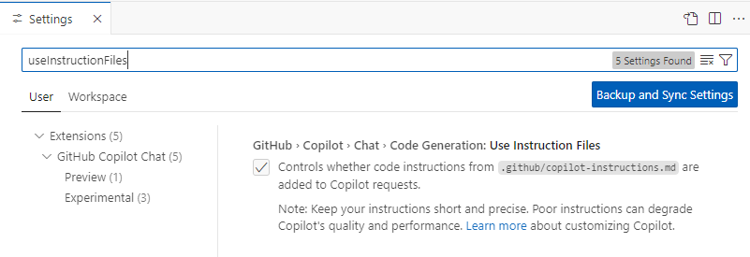
Context – Custom instructions - Settings
Tools – Options – GitHub - Copilot

Slide 38
🏋️ Exercises
#customInstructions_chat_testCreation
#customInstructions_chat_httpRequest

Slide 39
“Revolutionary” features

Slide 40
MCP – Model Context Protocol
“Connecting AI to everything”
“MCP frees AI from its isolation”
LLMs (e.g., Copilot) can call APIs
Additional reading: https://simplescraper.io/blog/how-to-mcp

Slide 41
MCP – How it works?
Creation of the MCP server with ‘tools’
Providing the description of the tool
Providing the description of the output & input parameters
“Registering” the server in the LLM
LLM decides to call the tool

Slide 42
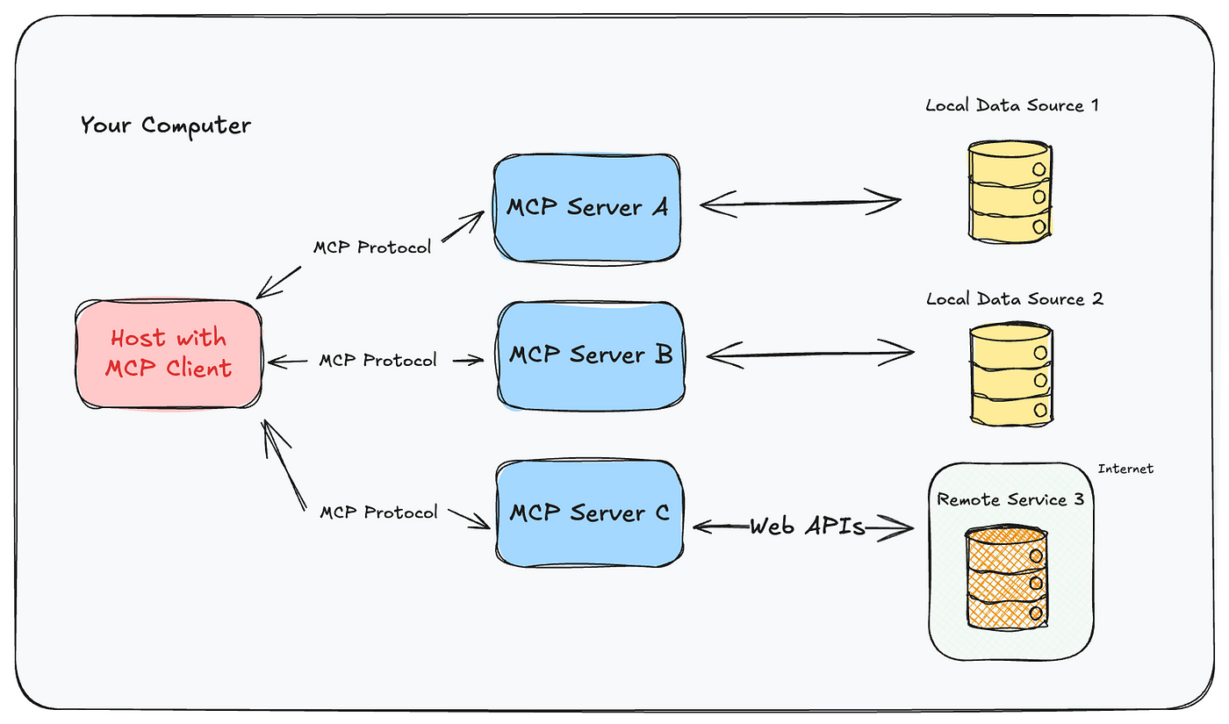

Slide 43
🏋️ Creating your own MCP server
Getting information from MS SQL server
Executing SQL script on particular Database in MS SQL server

Slide 44
Extensions
Integration of external tools into Copilot Chat
Those integrations expand capabilities of Copilot
https://github.com/marketplace?page=2&type=apps&copilot_app=true

Slide 45
🏋️ Creating your own extension
Creating an API
HTTP-GET ‘/info’
HTTP-GET ‘/callback’
HTTP-POST ‘/’
Creating GitHub App
https://github.com/settings/apps/new

Slide 46
Agent mode

Slide 47
Agent mode
Copilot acting as an autonomous peer programmer
User provides task, and Copilot
Analyze codebase
Considers relevant files as a context
Run terminal commands
Create new files
Edits existing files

Slide 48
🏋️ Exercise
#agentMode_RefactorMcpServer
#agentMode_CreatingWebsite
You can try print-screening the error and pasting it to Copilot

Slide 49
“Hidden” features

Slide 50
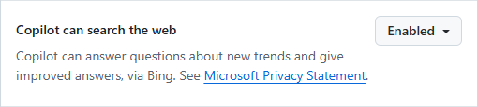
Web search
Must be enabled in GitHub Copilot web settings
Prompt must start with “@GitHub” agent

Slide 51
Web search
Must be enabled in GitHub Copilot web settings
Prompt must start with “@GitHub” agent

Slide 52
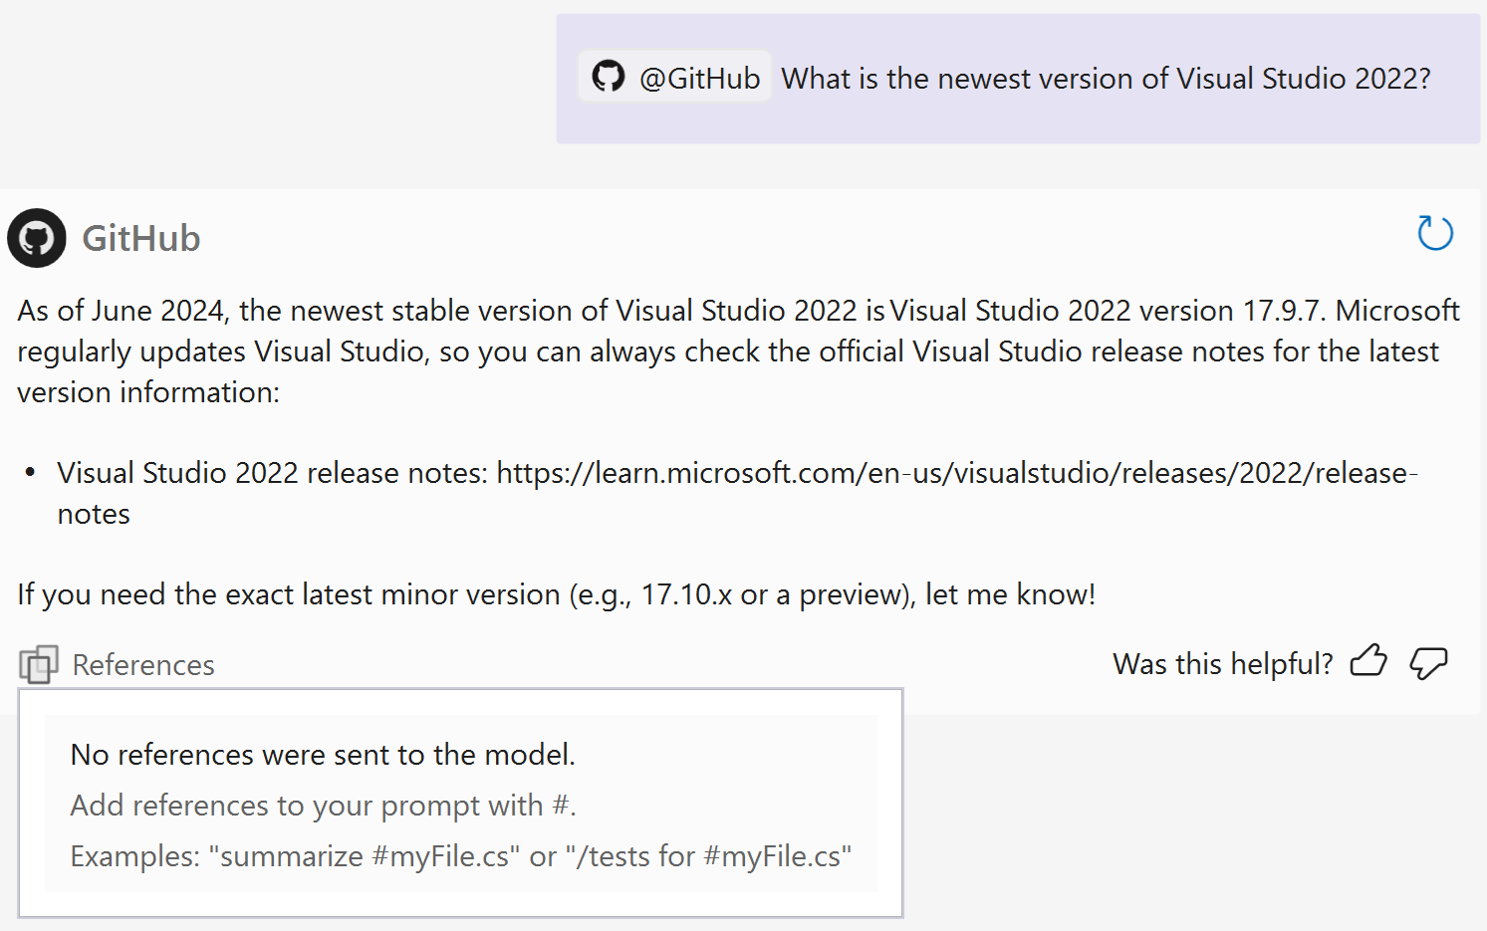
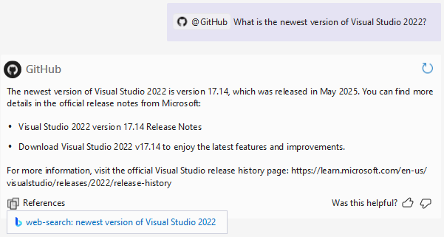

Slide 53
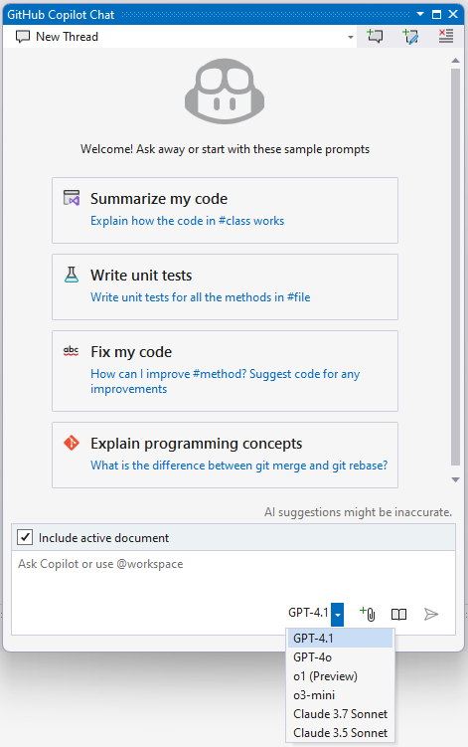
Changing the model
Various criteria
Speed
Accuracy
Separate model for Chat & Completions
https://github.blog/ai-and-ml/github-copilot/which-ai-model-should-i-use-with-github-copilot/
https://github.blog/ai-and-ml/github-copilot/a-guide-to-deciding-what-ai-model-to-use-in-github-copilot/

Slide 54
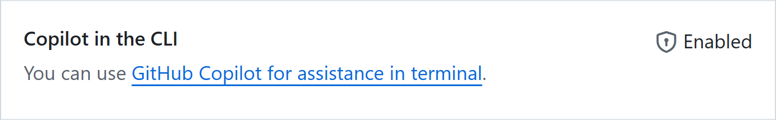
GH Copilot in CLI
Must be enabled in GitHub Copilot web settings
GitHub extension - https://github.com/cli/cli#installation
GitHub authentication – ‘gh auth login’
GitHub Copilot extension - https://docs.github.com/en/copilot/managing-copilot/configure-personal-settings/installing-github-copilot-in-the-cli

Slide 55
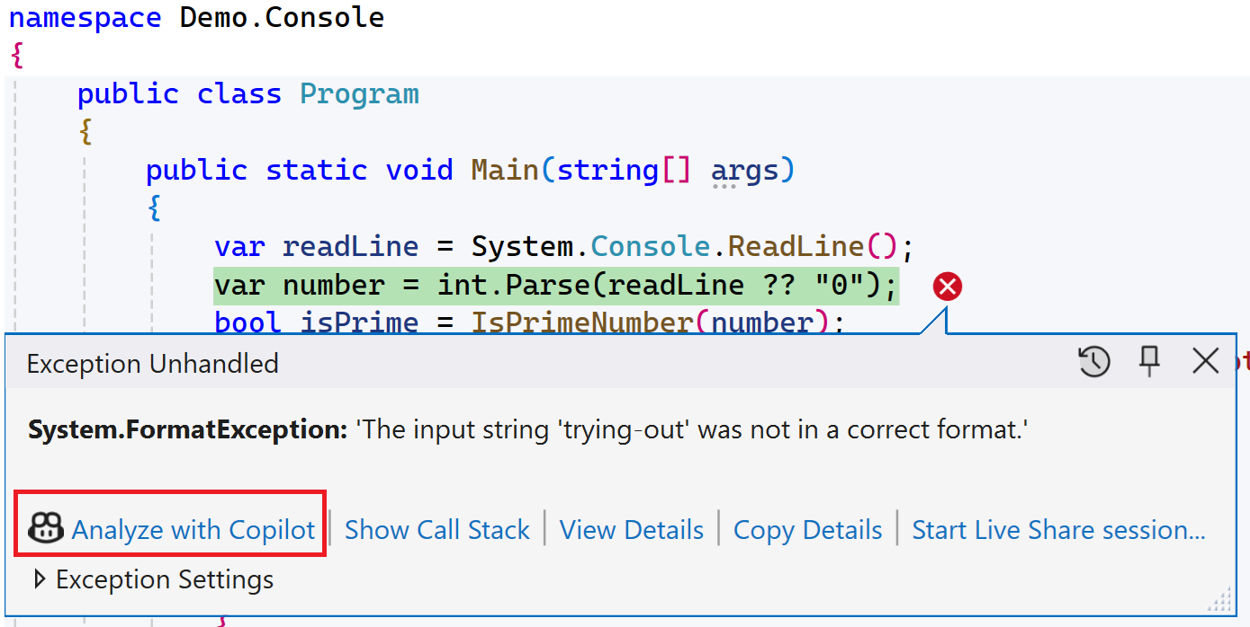
Thrown exception analysis
⏯️ #demo_debugging_ThrownExceptionAnalysis

Slide 56
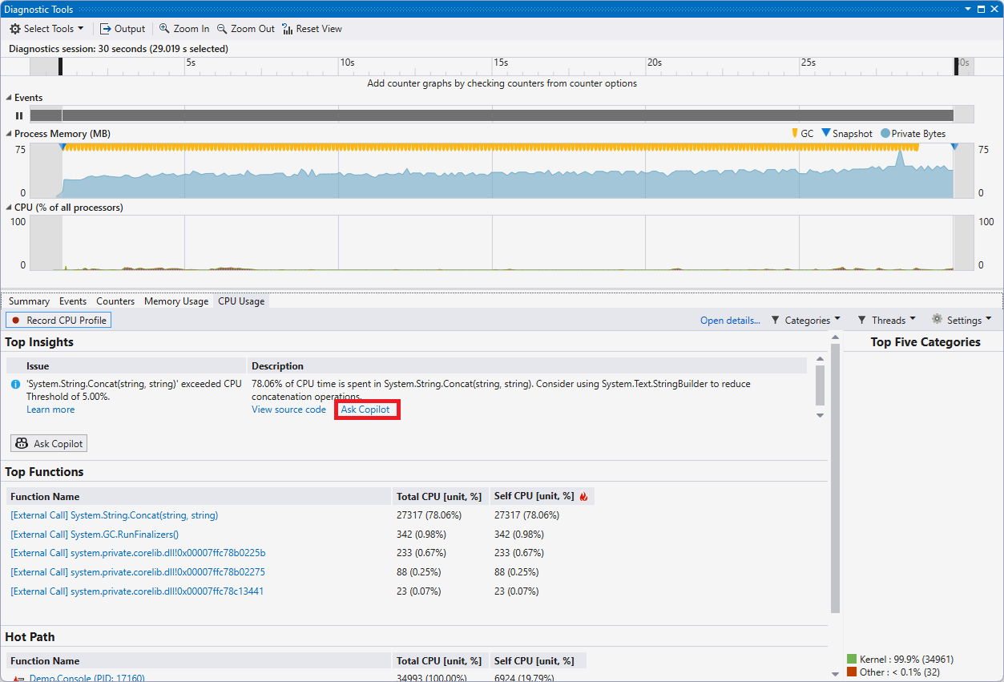
Performance analysis
⏯️ #demo_debugging_PerformanceAnalysis

Slide 57
Code review
🏋️‍♂️ #codeReview_ChangesInRepository

Slide 58
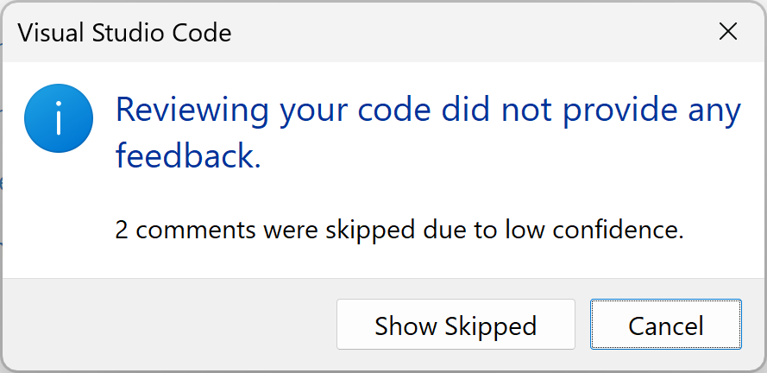
Code review

Slide 59
Other features for self-exploration
Next-edit suggestion
https://code.visualstudio.com/blogs/2025/02/12/next-edit-suggestions
Adaptive paste
https://devblogs.microsoft.com/visualstudio/effortless-adjustments-with-an-adaptive-paste/
.NET Upgrade assistant
https://devblogs.microsoft.com/dotnet/github-copilot-upgrade-dotnet/
Test debugging assistance
https://www.youtube.com/watch?v=eun8Mo4jpKk
Working on an real issue
https://docs.github.com/en/copilot/how-tos/agents/copilot-coding-agent/using-copilot-to-work-on-an-issue

Slide 60
Impact on Code quality

Slide 61
Aspects of SW quality
Functional correctness
Clean code
*-ability: Maintain-, Understand-, Read-, Test-, …
DRY, SOLID, YAGNI, styles
Security
Performance
Usage of recommended libraries

Slide 62
Real world example
Usage of recommended libraries
I had the Content Safety service (Azure AI Services) created in Azure
I wanted to call it from my .NET Core app
So, I asked Copilot (back in ~February 2024)

Slide 63
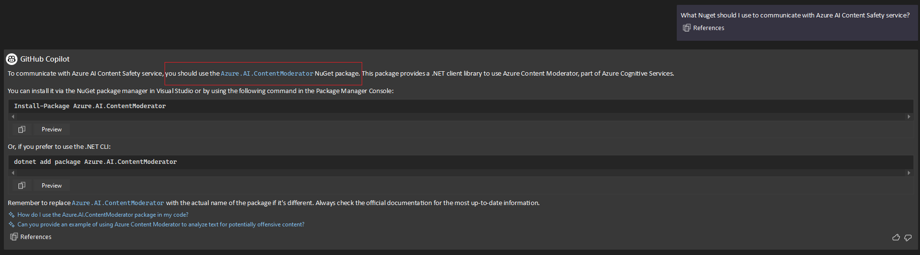

Slide 64
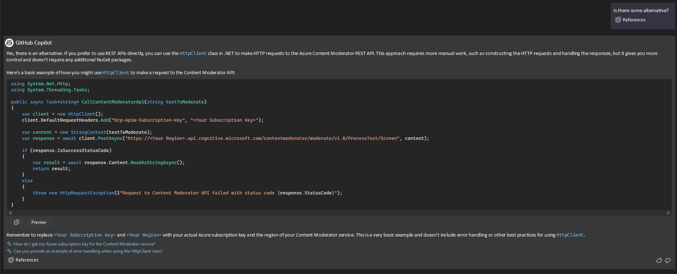

Slide 65
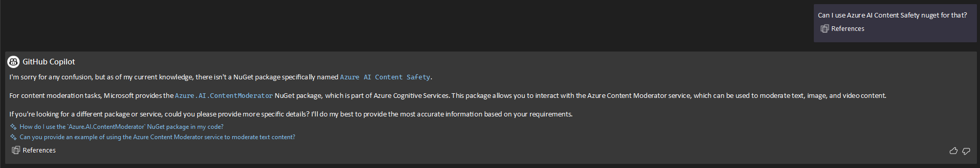

Slide 66
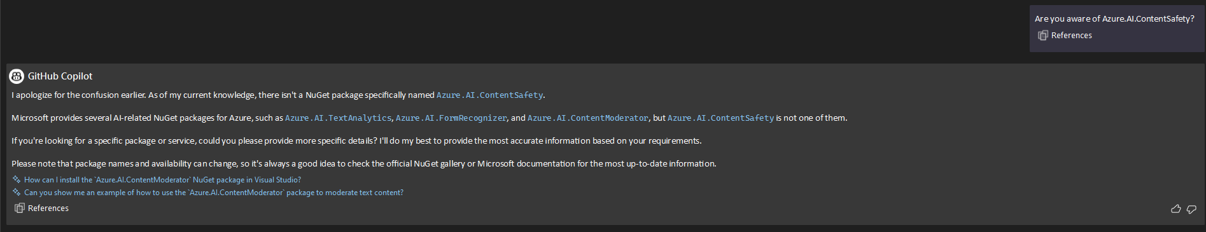

Slide 67
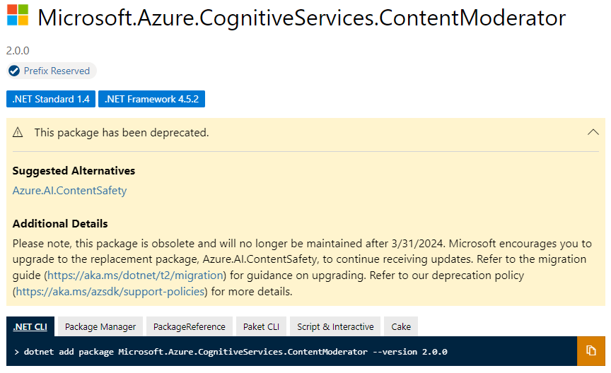
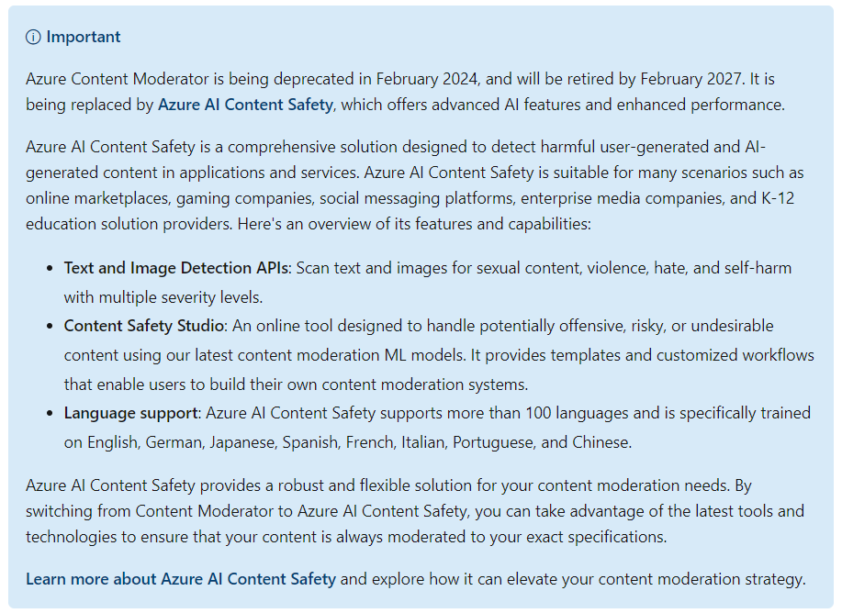

Slide 68
Study #1
“Coding on Copilot 2023 Data Shows Downward Pressure on Code Quality” [01/24, link]
Analysis of 153 000 000 changed lines of code between 01/2020 – 12/2023

Slide 70
Change in %
Operation | Change | + / -
Move | 17.3 | -
Copy/Paste | 11.3 | +
Churn | 39.2 | +

Slide 72
Study #2
“Assessing the Quality of GitHub Copilot’s Code Generation” [11/22, link]
What is the quality of the solution generated by the tool in comparison with “canonical” human-created solution
How valid are GitHub Copilot’s code suggestions?
How correct are GitHub Copilot’s code suggestions?
How efficient are GitHub Copilot’s code suggestions?
Effect of using appropriate function names
Effect of using documentation of the functions

Slide 74
Common user problems

Slide 75
List of problems
Incomplete / outdated installation
Not being aware of all Copilot features & integrations
Making Copilot the main pilot, overreliance
Settings
Not making use of Copilot in some scenarios

Slide 76
Thank you! Questions?
https://www.linkedin.com/in/ldurovsky/

Slide 77
Resources
https://medium.com/@elisowski/mcp-explained-the-new-standard-connecting-ai-to-everything-79c5a1c98288
https://diamantai.substack.com/p/model-context-protocol-mcp-explained

