Slide 1

About me
Slovakia
Software Engineer
~10 years of experience in Software Engineering
Mostly in chemical analysis area, some side projects
Currently in Thermo Fisher Scientific
What am I interested in?
Distributed systems, DDD, Clean Code, Security, AI
Skiing, tennis, hiking, travelling

Slide 2
Beyond the Basics: Advanced Exception Handling Techniques in C#/.NET
Swetugg
Göteborg 2024

Slide 3
The measure of a good software system is not how well it works when everything goes right, but how gracefully it degrades when things go wrong.

Slide 4
IMPORTANCE OF effective error HANDLING
Preventing application crashe
01
Improving code reliability, maintainability
02
Providing meaningful error messages to end-users
03
Providing meaningful error messages to developers
04

Slide 5


Let’s sow some seeds of doubt
Exceptions - good construct or not?
Discoverability, transparency
Basically, GOTO statement
What they mean in real world?
What is the alternative?
Union result type – either an actual result or an error
Do we use the alternatives?
e.g. APIs
Enforcement of catching from compiler
State consistency
Is some event really an exception?
You get the HttpStatusCode and Json object

Slide 6
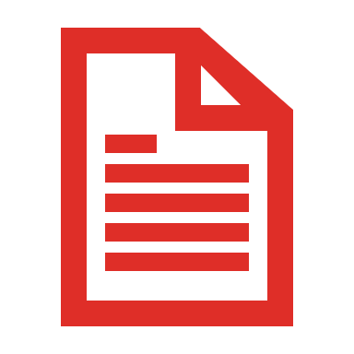
BASELINE

Slide 7
BASIC SYNTAX
Try-Catch-Finally
Try-Finally

Slide 8
EXCEPTION PROPERTIES
InnerException
CallStack
Source
The name of the application or the object that causes the error
If the Source property is not set explicitly, the runtime automatically sets it to the name of the assembly in which the exception originated
Message

Slide 9
‘least astonishment’ principle
“System should behave in a way that most users will expect it to behave, and therefore not astonish or surprise users.”
“If a necessary feature has a high astonishment factor, it may be necessary to redesign it”
When applied for exceptions:
Consistent exception types
Meaningful exception messages
Use expected exceptions, avoid unexpected ones
“Method signature honesty” – it should be somehow clear, that the method can throw an exception

Slide 10
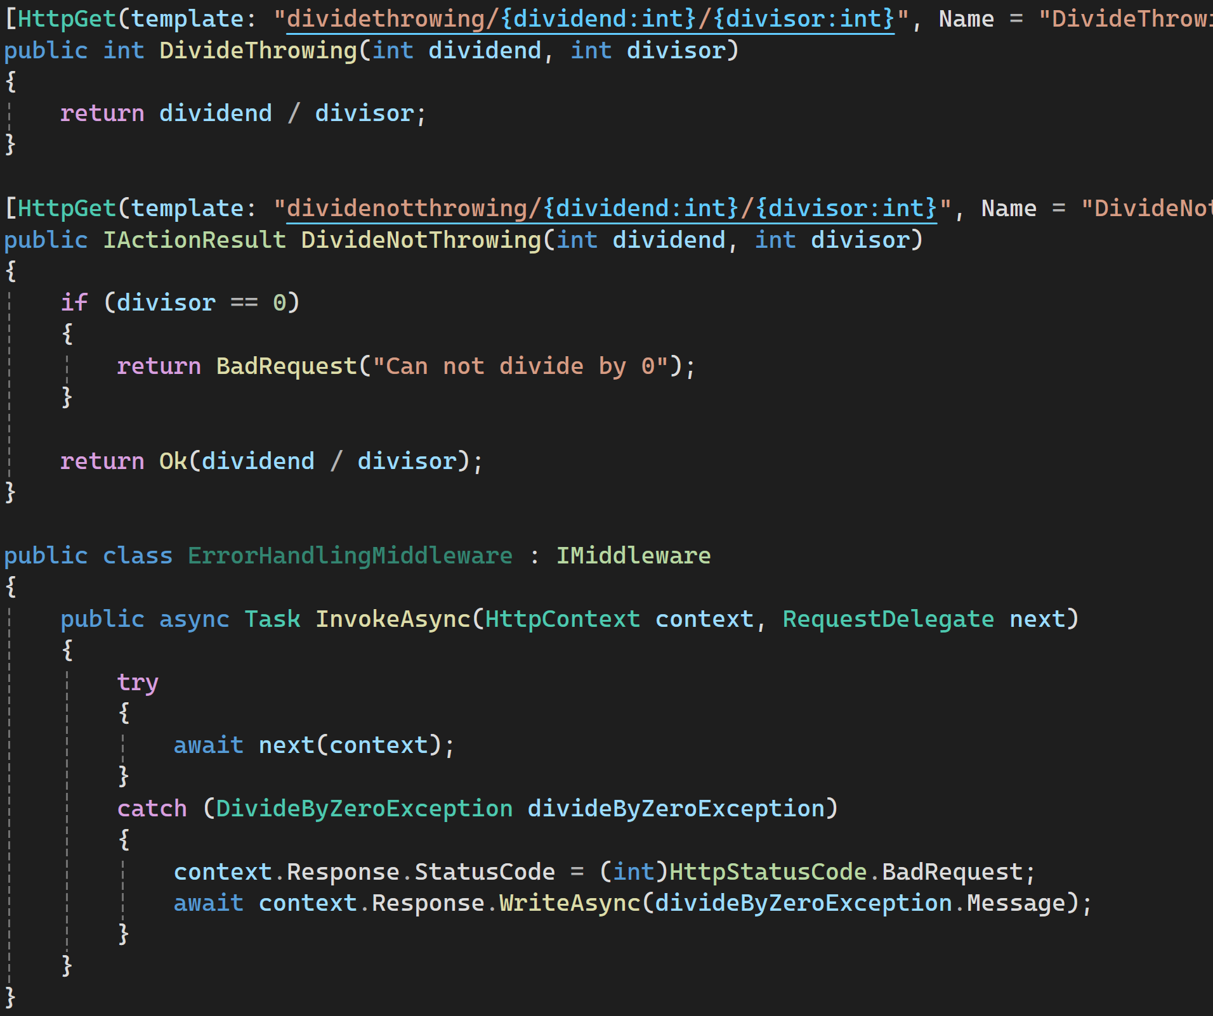
PERFORMANCE
Exception
1st endpoint: 275 ms
2nd endpoint: 1.25 ms
No exception
1st endpoint: ~1.3 ms
2nd endpoint: ~1.25 ms
Reasons:
Stack Unwinding – ‘catch’ lookup
Environment information capturing

Slide 11
Exception CLASSIFICATION
(according to Eric Lippert)

Slide 12
FATAL
OutOfMemoryException, ThreadAbortedException
Does not make sense to catch them
Consider using Environment.FailFast() in Finally

Slide 13
Boneheaded
a.k.a. “programmer” exceptions
Indicate a mess in the code leading to the bug
Examples
Wrong typecasting
NullReferenceException
ArgumentNullException
❌ Catch them
✅ Prevent them (better code quality, code reviews)

Slide 14
Vexing
a.k.a. “logical” exceptions
Result of poor design decisions
They are thrown in cases which might easily happen
Examples
Parsing of the input
Reading out of array bounds
Closing already closed connection

Slide 15
exogenous
Like vexing, however they are not the result of poor design decision
Something that your application can not really control
Examples
IOException when accessing some file
Timeout exception when calling some external stuff
They must be cached and application must react

Slide 16
CUSTOM EXCEPTIONS

Slide 17
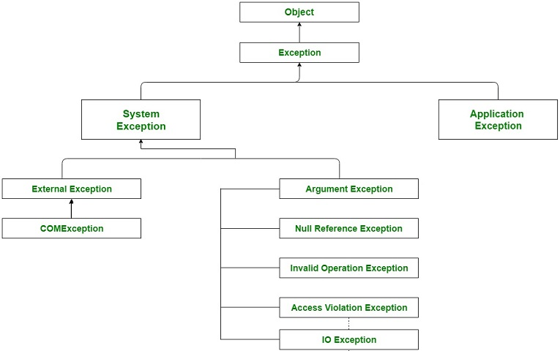
EXCEPTION HIERARCHY

Slide 18
Custom exceptions - pros
Improved error specificity
Clearer error messages
Enhanced debugging
Better error handling
Enhanced code structure
Logical grouping of errors
Improved code readability + maintainability
“Find usages” functionality
When you stop throwing exception, you can also remove try-catch
Enhanced information
Custom data
Richer error context

Slide 19
CUSTOM EXCEPTIONS
PaymentException
NotEnoughBallanceException
InstrumentControlLostException

Slide 20
COMMON ANTI-PATTERNS

Slide 21
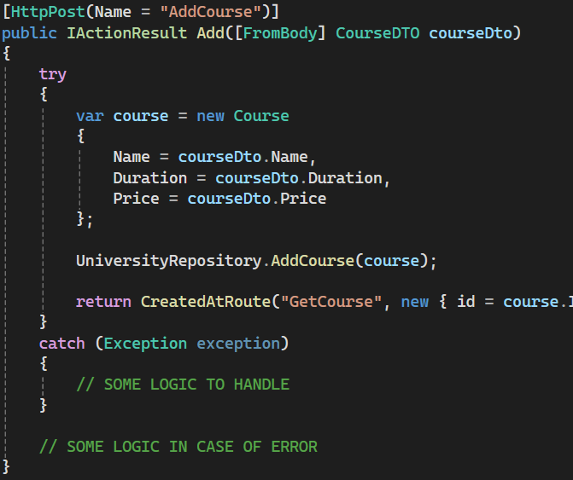
Catching base exception
Leads to hiding some unexpected errors, hiding bugs and making harder to investigate the root cause when something happens
When the concrete exception is deleted from code, you do not discover that

Slide 22
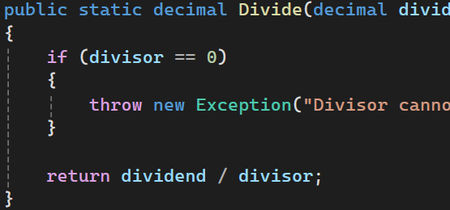
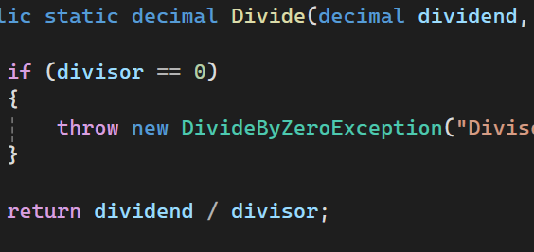
Throwing base exception
Enforces the caller to catch base exception
Caller must do some “IF” / “WHEN”

Slide 23
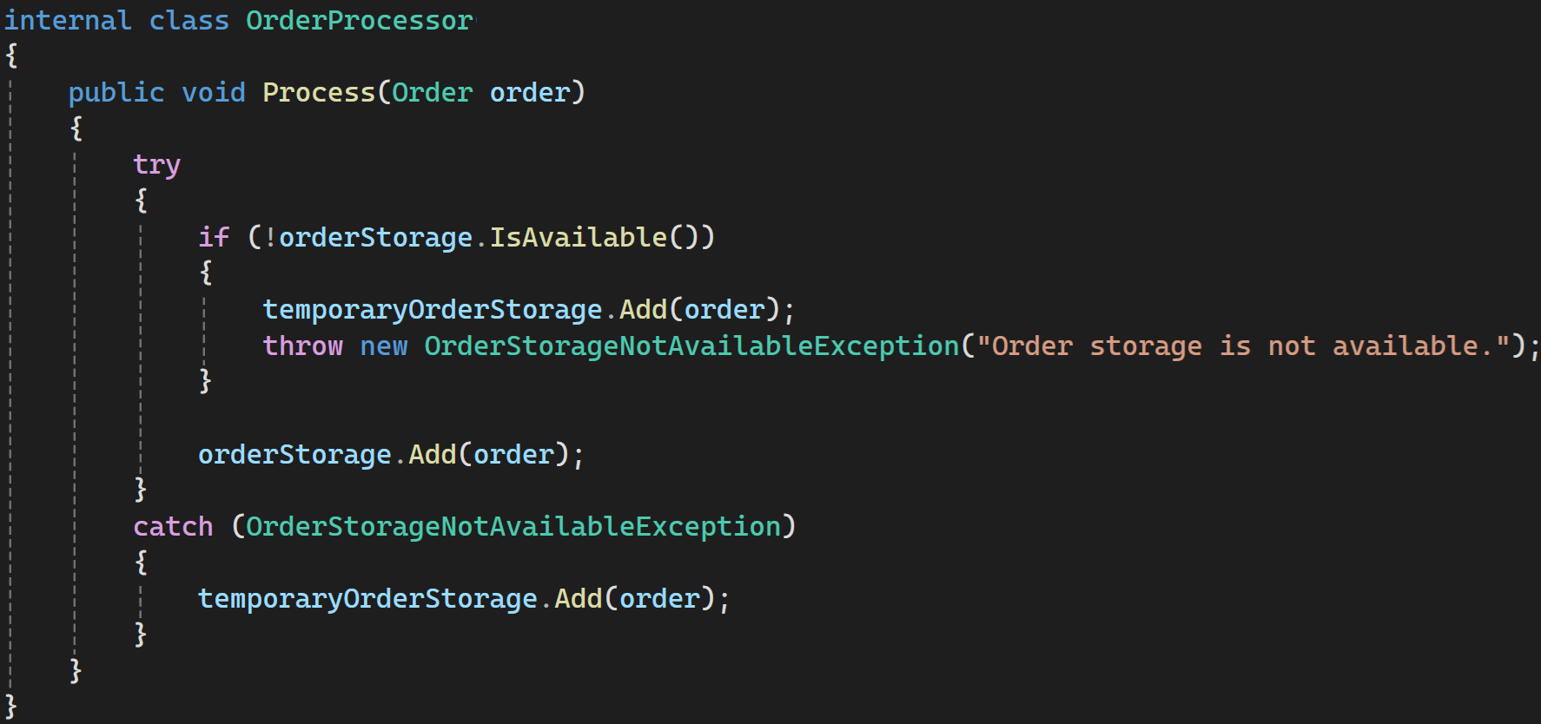
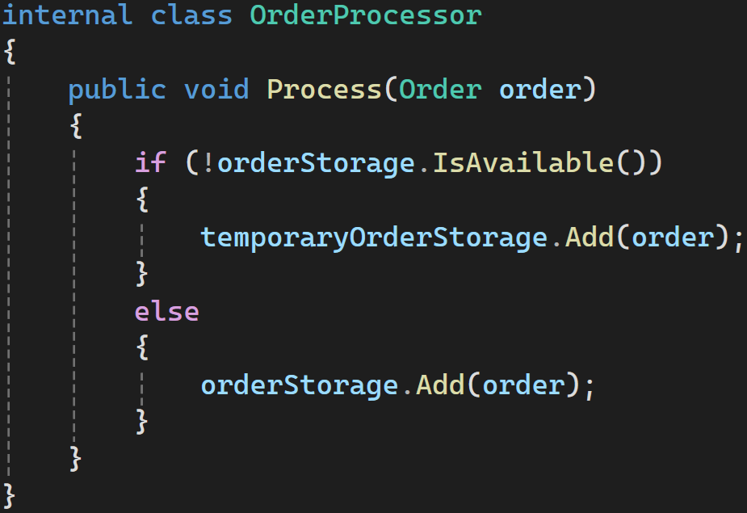
exceptions as control flow
Using exceptions in expected flows
Not good, because of
Performance
Maintainability
Readability

Slide 24
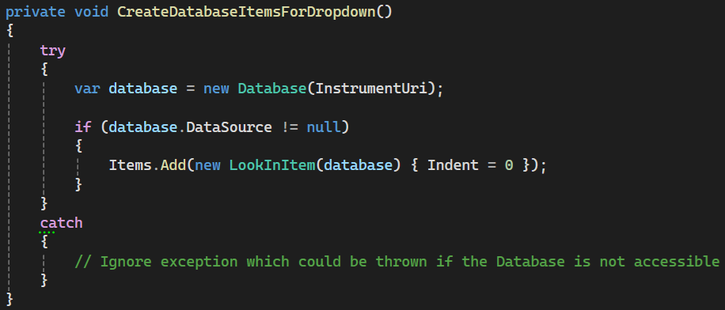
Swallowing exception
Might indicate poor design and dirty code
Debugging issues
Silent Failures
User is unaware of any problems

Slide 25
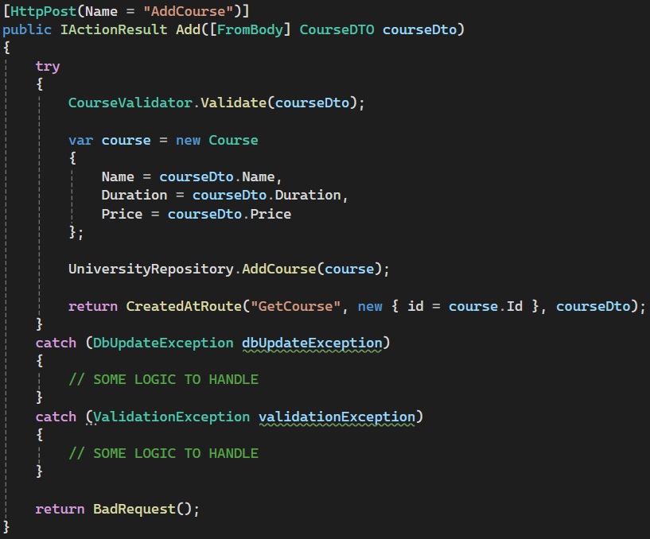
Putting all the code in TRY block
Readability
Maintainability

Slide 26
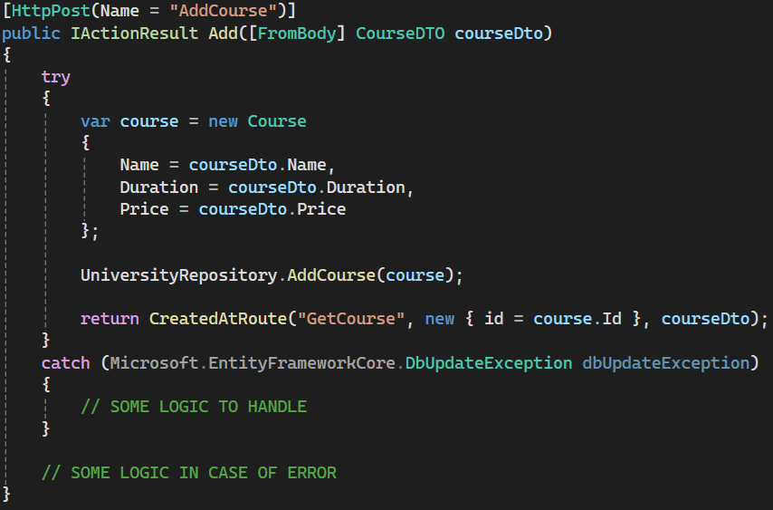
Leaky abstraction
There is some lower-level exception catched at some higher layer, leaking the implementation details of lower layers

Slide 27
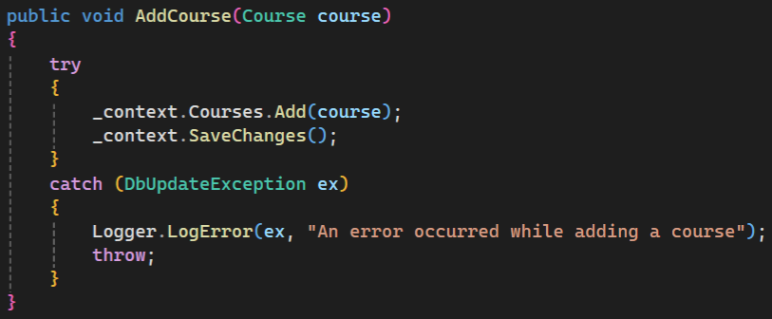
LOGGING and rethrowing
Logs pollution
Code duplication

Slide 28
BEST PRACTICES

Slide 29
Precondition checks
Validate input parameters before performing operations that might throw exceptions
Avoid “too defensive programming”
AOP
Aspect oriented programming
Extracting cross-cutting concerns

Slide 30
Use of ‘try’ methods
TryAdd
TryParse
TryGetValue

Slide 31
POINT OF THROW/CATCH
At some lower level?
At some higher level?
Or both?
Abstracting the exception
“Throw early & catch late principle”

Slide 32
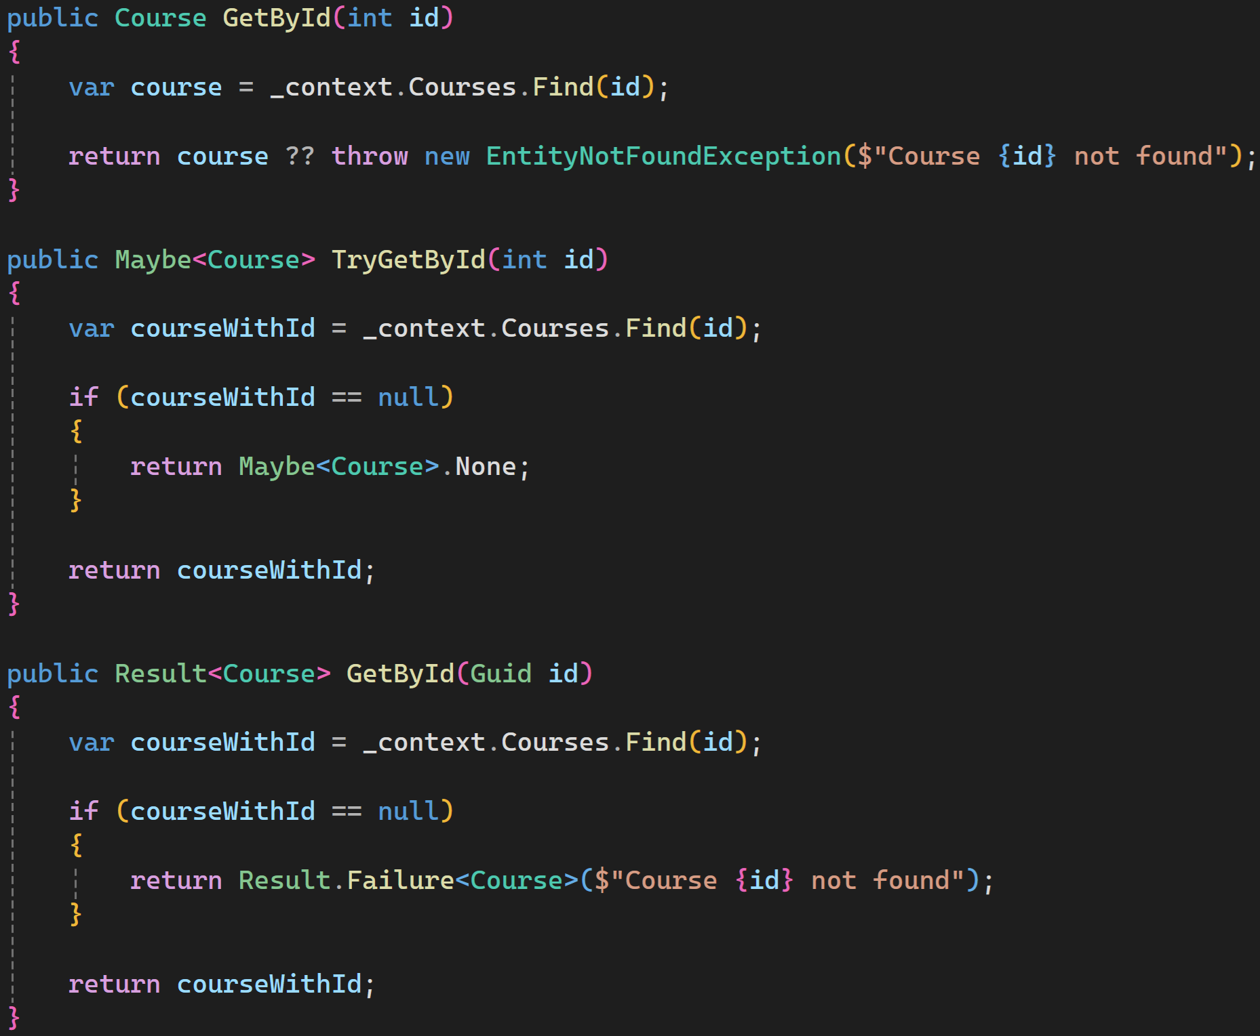
USING OF UNION TYPES or ERROR CODES
In case of very common problems:
Invalid email/phone/… value
Invalid username/password

Slide 33
Exception logging

Slide 34
THINGS TO CONSIDER
What should be logged
Sensitive information, GDPR
Log Level – FATAL / ERROR / WARN …
In Distributed system, is unavailability of some remote machine really in exception?
Retry pattern
Circuit breaker pattern

Slide 35
„MUST KNOW“

Slide 36
“Uncatchable” exceptions
Execution of catch-block: ❌
Execution of finally-block: ❌
▶️ EnvironmentFailFastExample()
▶️ StackOverFlowExceptionExample()

Slide 37
ASYNC+AWAIT - CONTINUEWITH
▶️ ContinueWithExample()

Slide 38
ASYNC+AWAIT - RETURN
▶️ AsyncAwaitReturnTaskExceptionDifference()

Slide 39
ASYNC+AWAIT - RESULT
Different exceptions
Async + Await: unwrapped exception
task.Result: AggregateException
▶️ AwaitResultDifferenceExample()

Slide 40
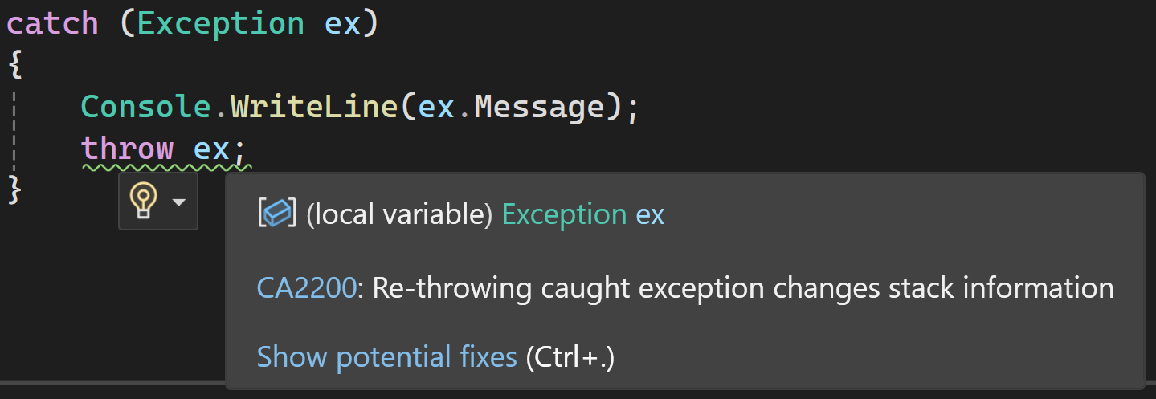
THROW – THROW EX
▶️ CallStackExample()

Slide 41
EXCEPTION FILTERS
Available from C# 6.0
catch (…) when (…)
Readability – avoiding IFs inside catch blocks
Flexibility – more granular control
Best practices
✅Clear and short filter conditions
❌Replacing proper design (when ex.Message ==)
▶️ Example_ExceptionFilter()

Slide 42
KEY TAKEAWAYS
Possible performance impact
Avoid vexing exceptions – use Try* methods
Always catch exogenous exceptions
Do not use exceptions for normal scenarios

Slide 43
THANK YOU!
lukasd1337@gmail.com
https://www.linkedin.com/in/ldurovsky/
Resources:
https://ericlippert.com/2008/09/10/vexing-exceptions/
https://dev.to/ziaulhasanhamim/exception-handling-is-an-antipattern-avoid-when-possible-1gjl
https://enterprisecraftsmanship.com/posts/exceptions-for-flow-control/
https://medium.com/@samanwayghatak/exception-as-control-flow-anti-pattern-e3b46b079cdd
https://en.wikipedia.org/wiki/Principle_of_least_astonishmentc

