Slide 1
Optimizing Trading Strategies with Reinforcement Learning
Amulya Saxena
Travis Desell

Slide 2
Agenda
Background
Domain and Architecture Models
Data Pipelines
Results
Demo
Conclusion and Future Work

Slide 3
Background

Slide 4
Reinforcement learning
Studies use innovative ensemble trading strategies leveraging deep reinforcement learning.
Models like Cascaded LSTM are used to effectively mine hidden insights from data. Tested on major global indices. Benchmarked against models like buy and hold, multilayer perceptron policy and other models.
RL agents are trained on features extracted from LSTM models.
Experimental results show model outperforms baseline models and accuracy improvement rates range from 5% to 15%. This also indicates a promising way to build an automated trading system.
Notes:
We introduce a DRL-based stock trading system utilizing a Cascaded Long Short-Term Memory (CLSTM-PPO Model) to effectively mine hidden insights from daily stock data, addressing the common challenge of low signal-to-noise ratios in financial datasets.
The system is tested across major global indices—DJI, SSE50, SENSEX, and FTSE100— and is benchmarked against traditional and contemporary models, including buy-and-hold, MLP, and LGBM strategies, demonstrating superior performance in key financial metrics.
Our findings reveal enhancements in cumulative returns, maximum earning rates, and average trade profitability, with improvements ranging from 5% to 52%, showcasing the potential of our approach in revolutionizing automated stock trading systems.

Slide 5
Proposed Project and Approach

Slide 6
Proposed Project
Develop an agent to learn trading strategies for the DJI stocks leveraging reinforcement learning.
Create a system that can adapt to market changes and optimize strategic decisions in real time aiming to maximize returns.
Evaluate trading strategy performances using metrics and choose which the model will use.
Notes:
A reinforcement learning (RL) trading agent learns stock trading strategies by analyzing historical market data, making buy/sell/hold decisions to maximize returns.
adapts to market changes using trial-and-error
Metrics such as profit factor, number of trades, net profit, average profit per trade.

Slide 7
Optimizing + Reinforcement Learning
What it is : Forecasting Algo + RL
Goals
Learning from the Stock Market
Trading Decisions
Increase Profitability
Notes:
learn from stock market to understanding market behavior
Over time, the RL agent would refine its trading strategy to maximize the cumulative reward
Based on its analysis the RL agent would make trading decisions, such as whether to buy, sell, or hold a stock at a particular time step, right now I am aiming to make the agent give a decision for the next day, the ideal goal is to reach an hourly decision
- Informed Trading Decisions: To enable investors to make more informed decisions by employing adaptive trading methods that respond to real-time market conditions.
- Increased Profitability: To aid investors and financial institutions in improving their profitability and portfolio management through optimized trading strategies.

Slide 8
Domain Model

Slide 9
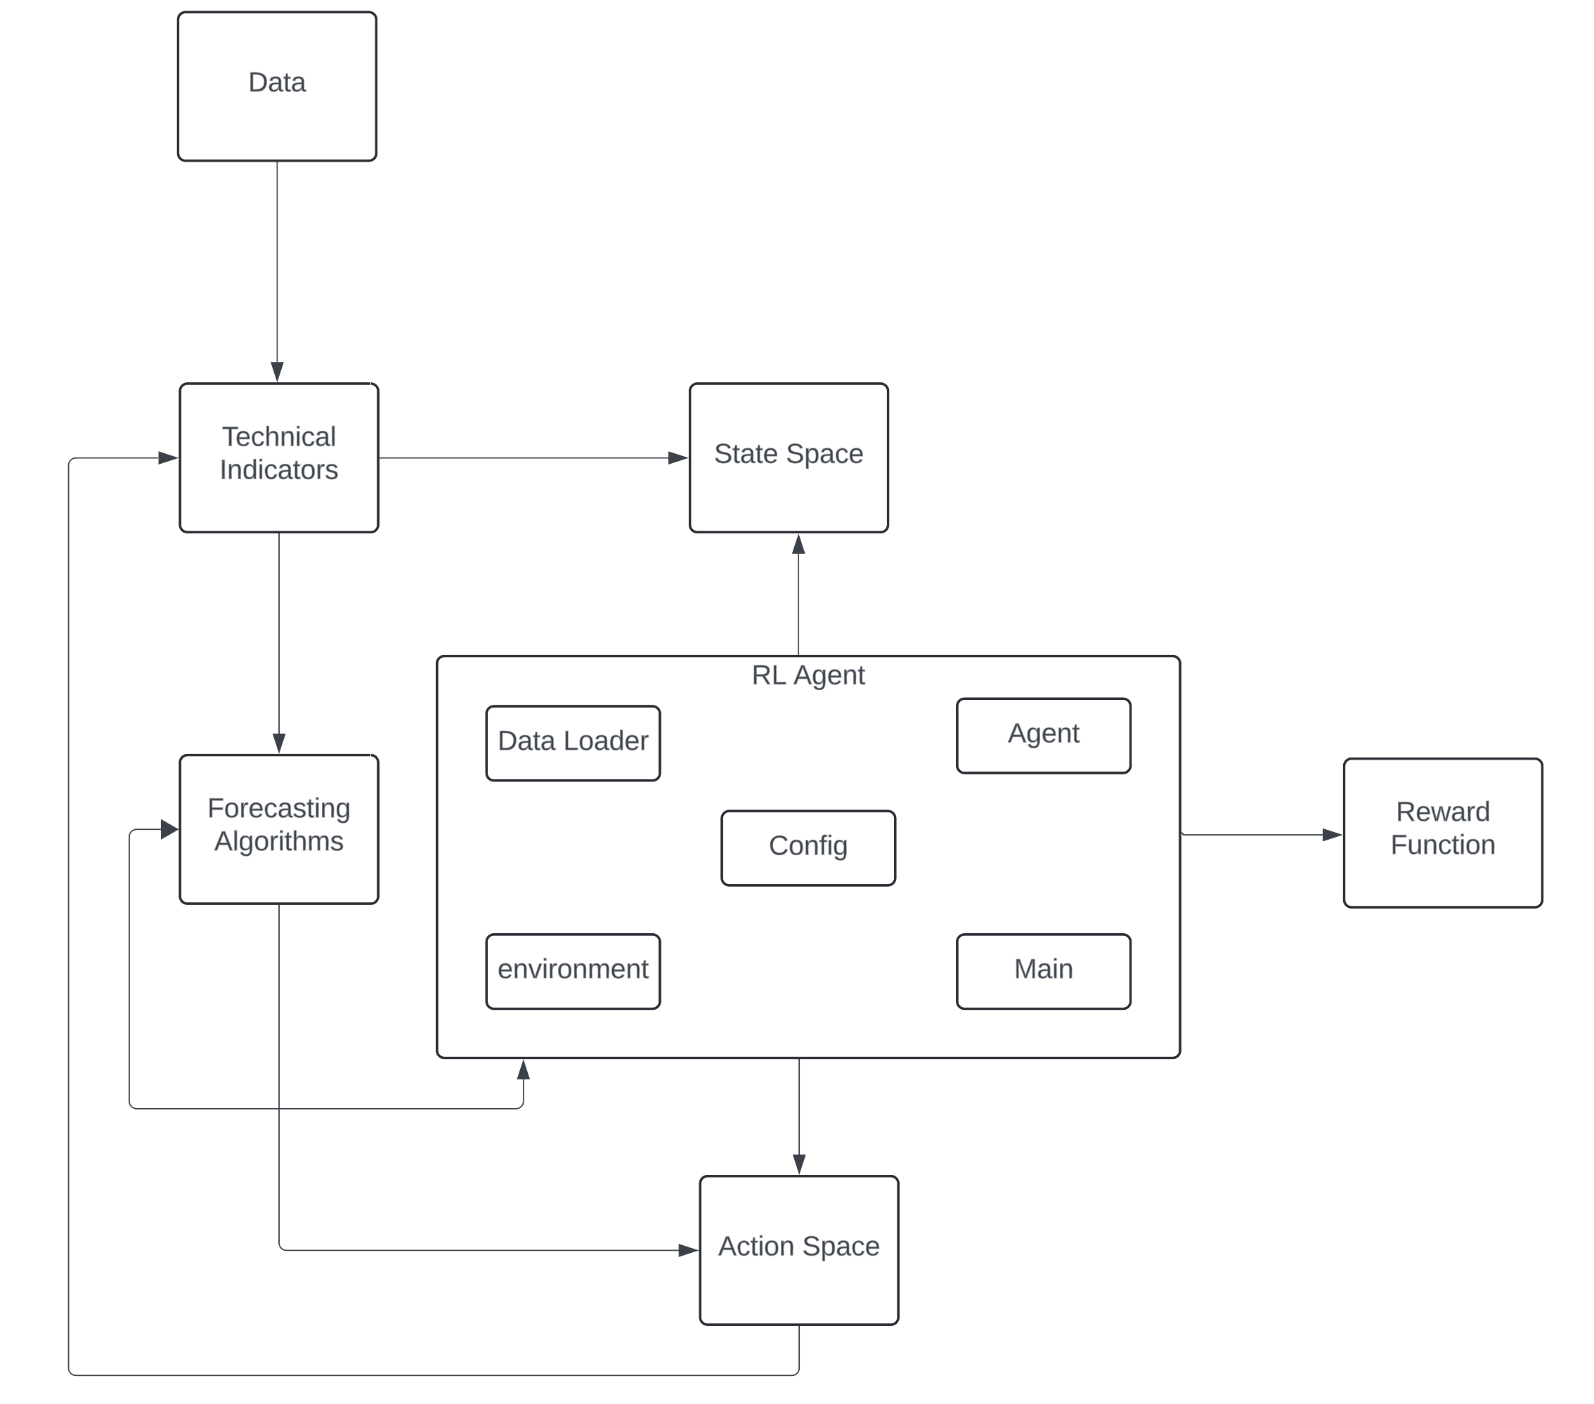
Notes:
Data is processed by data_loader.py.
data_loader.py computes Technical Indicators and may use Forecasting Algorithms
The processed data, along with technical indicators, is used to define the State Space
environment.py defines the Action Space and Reward Function, and uses configurations from config.py.
main.py initializes and coordinates the Agent, Environment, and configurations.
The Agent interacts with the Environment by taking actions from the Action Space based on the State Space and receives rewards calculated by the Reward Function.

Slide 10
Architecture Model

Slide 11
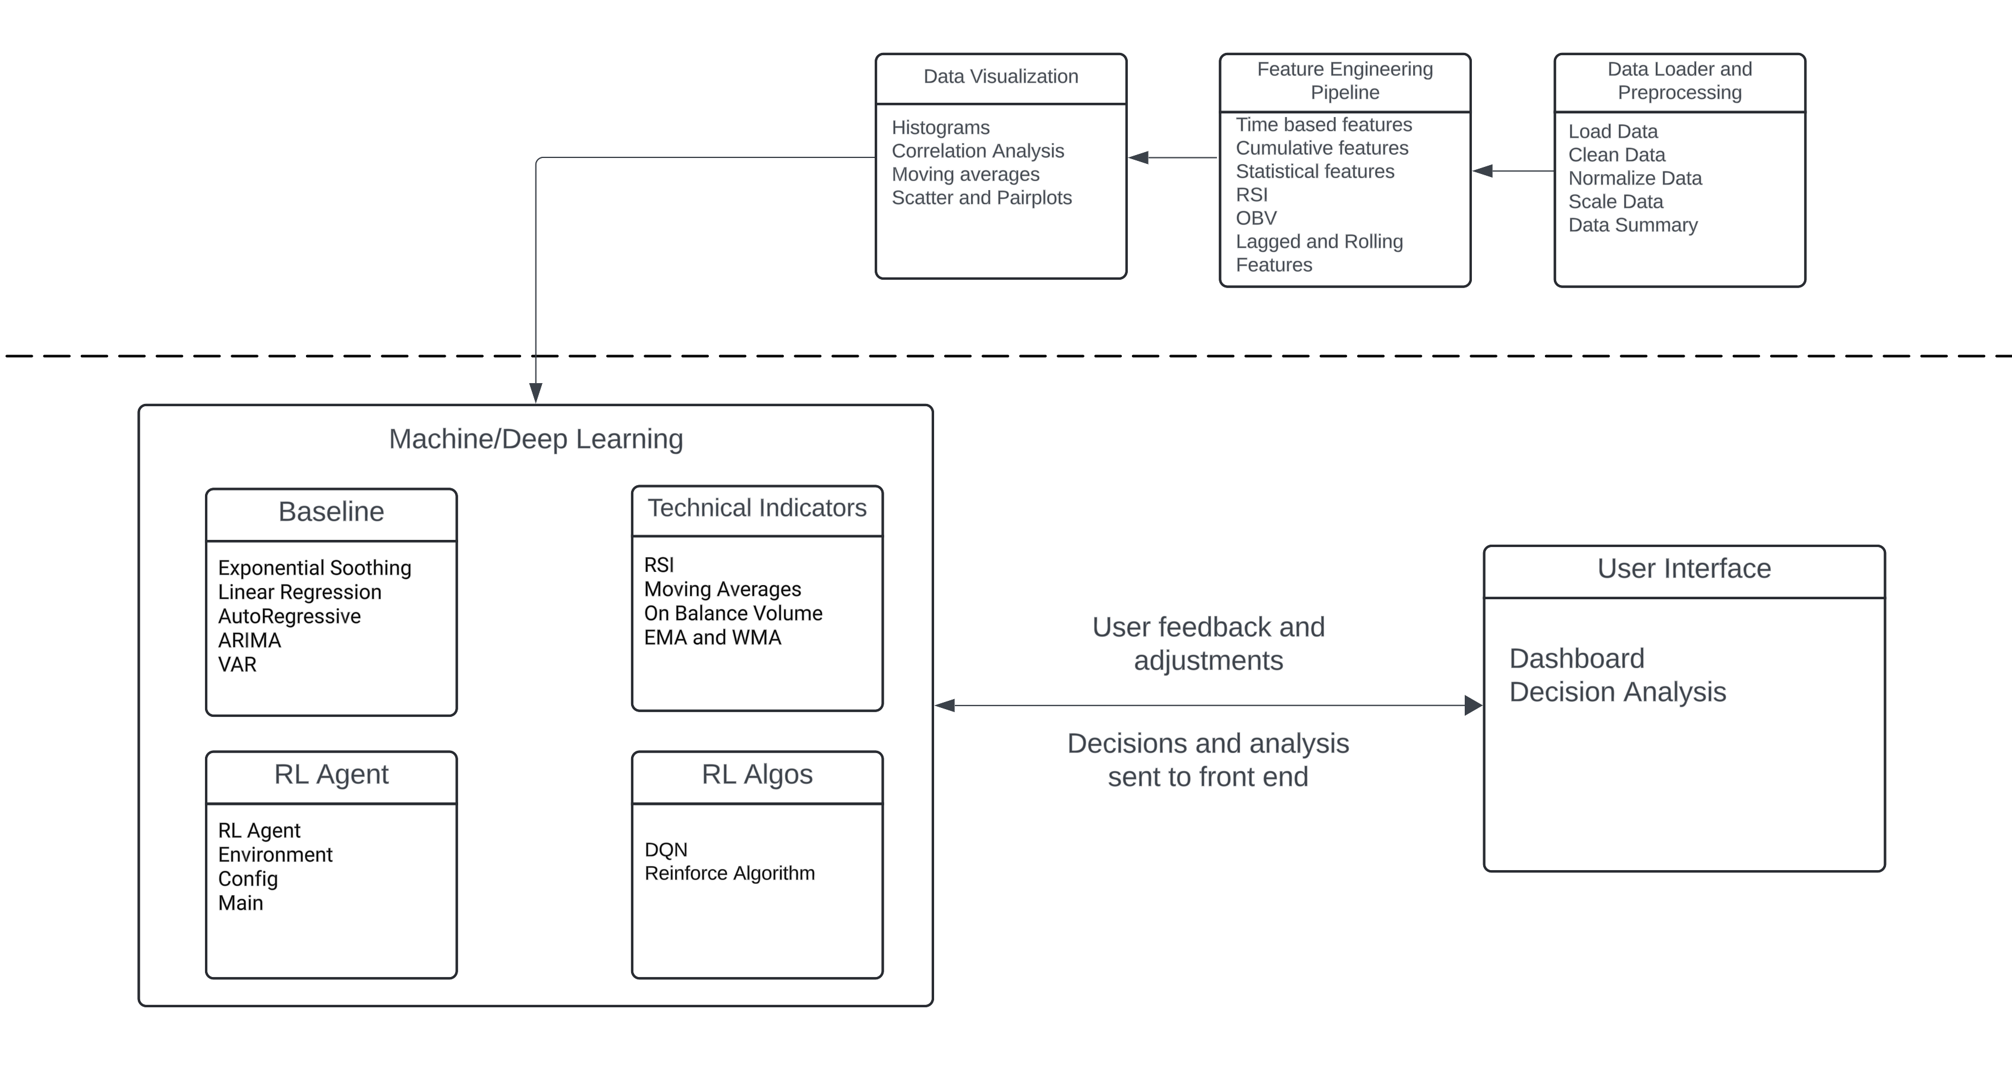
Notes:
2 major updates
Pipeline for the data ingestion and processing
In ml module, more clarity
Rl agent trained on specific strategies
The core learning mechanism, which could use algorithms like Q-learning or Actor-Critic to model the agent’s decision-making process.
Q-learning is a value-based RL method where the agent learns a Q-value for each state-action pair, representing the expected future reward of taking a particular action in a given state.States: The agent’s observations of the market (e.g., price trends, indicators).
Actions: Buy, sell, or hold a stock.
Reward: Profit or loss from each trading action.

Slide 12
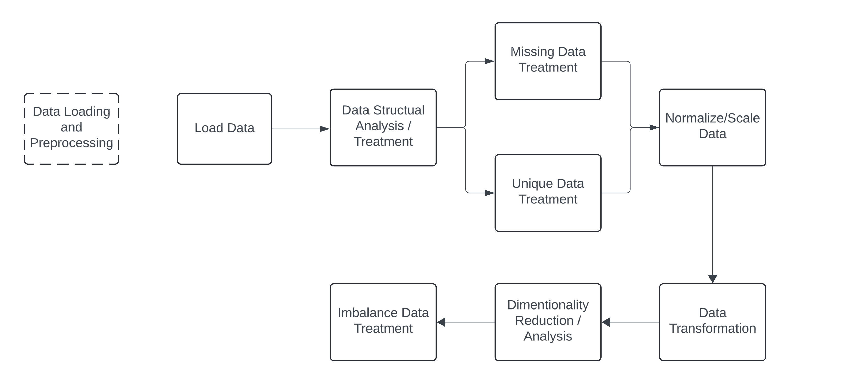
Data Loading and Preprocessing Pipeline

Slide 13
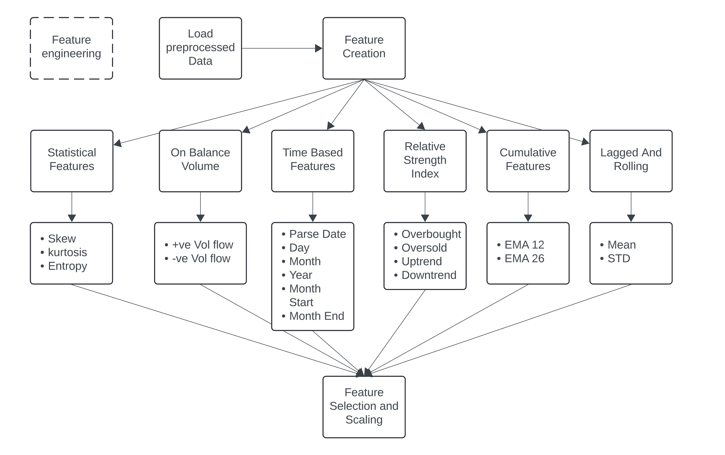
Feature Engineering Pipeline

Slide 14
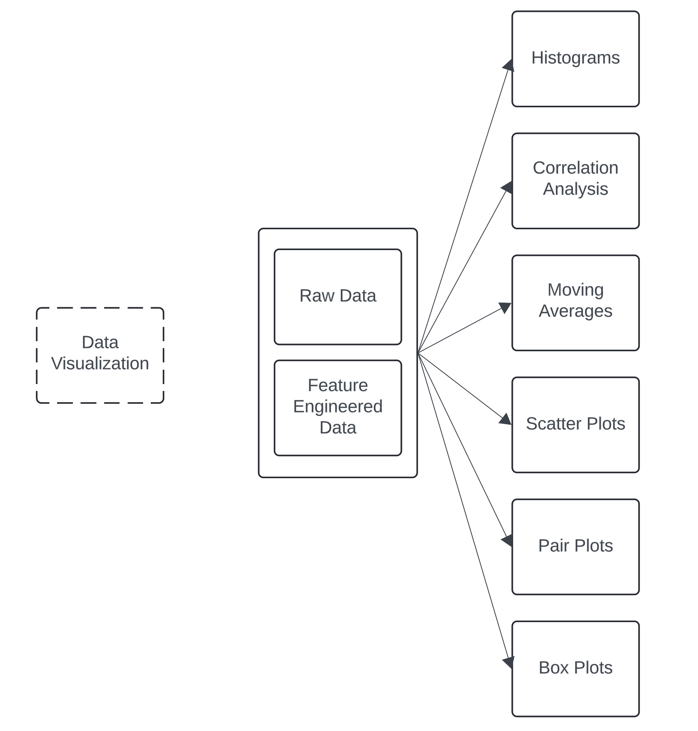
Data Visualization Pipeline

Slide 15
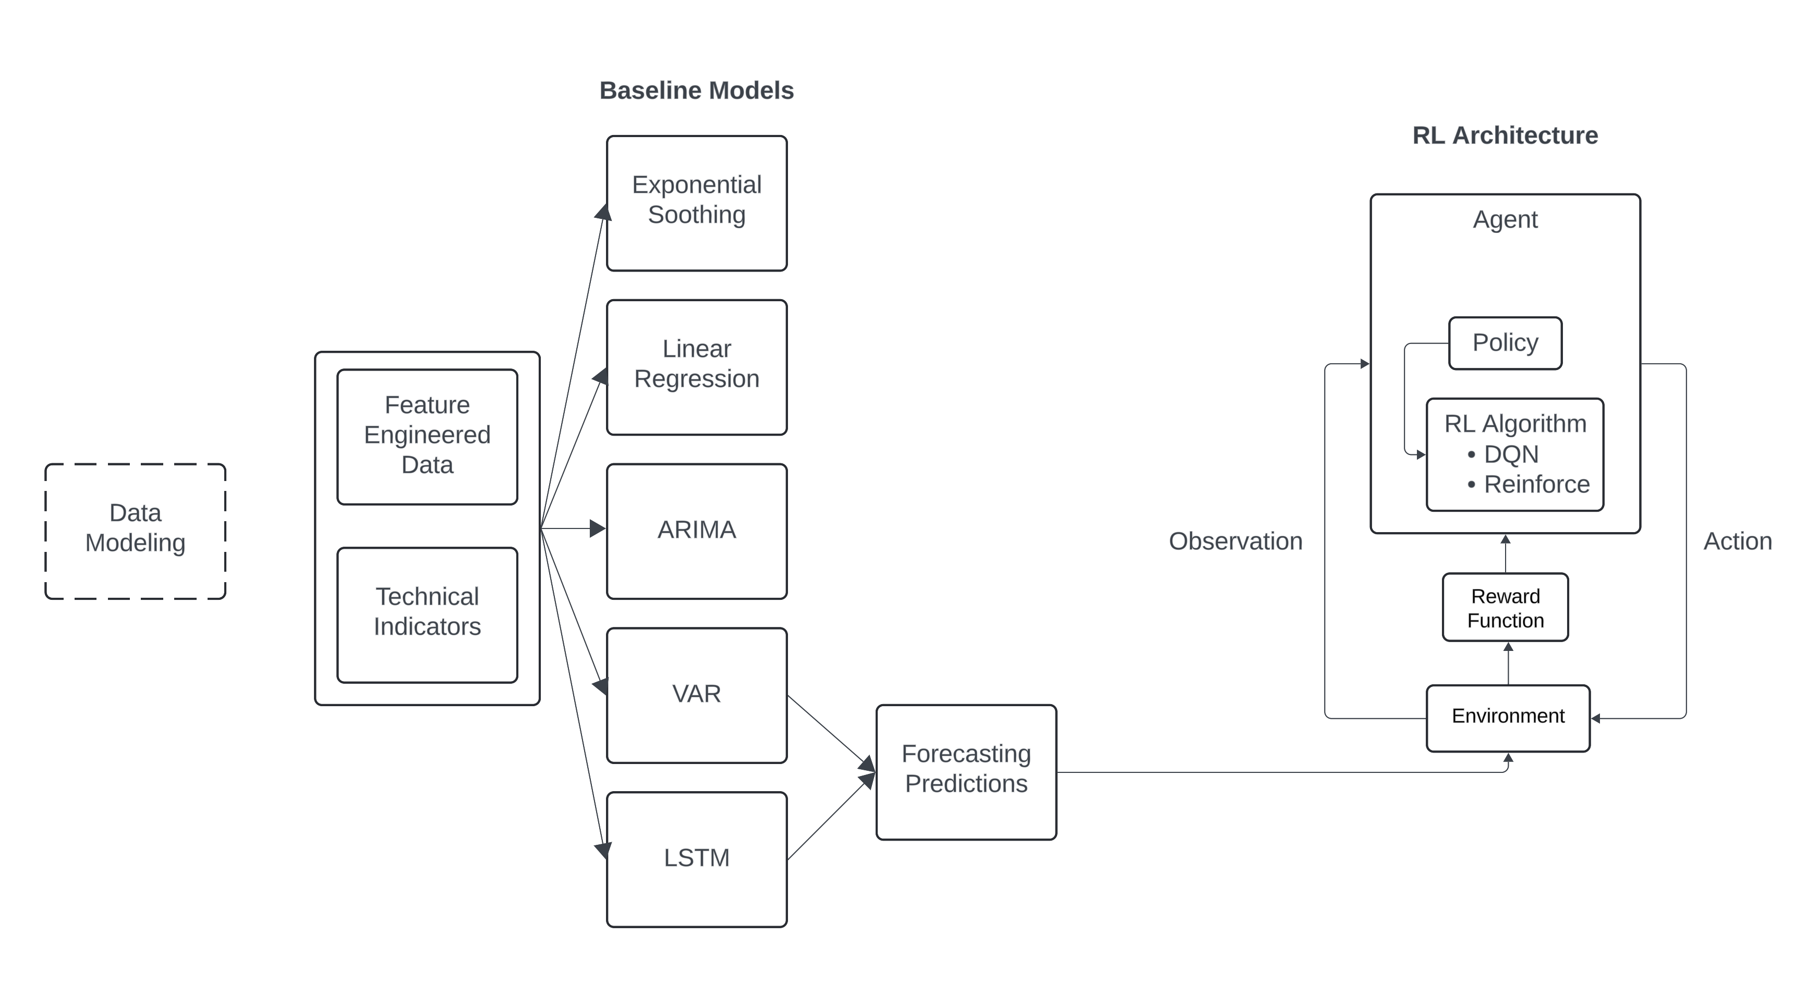
Data Modeling Pipeline

Slide 16
Results

Slide 17
Forecasting and RL Algorithm Results
Model | 50 Epoch R - Squared | 100 Epoch R - Squared | 500 Epoch R - Squared
LSTM | 0.4585 | 0.4759 | 0.5199
Model | 50 Episode Cumulative Return | 100 Episode Cumulative Return | 500 Episode Cumulative Return
Deep Q Network | - 5 % to – 3 % | - 3% to – 2 % | - 2% to – 0.9 %
Reinforce | - 2 % to – 0.29% | -1.5 % to 0.18 % | - 0.3 % to -0.07
Notes:
Cum ret = final portfolio value – (initial portfolio value/ initial portfolio)/ initial portfolio value x 100

Slide 18
Main Scripts
Environment.py
Framework for RL agent to interact with simulated environment.
Initialize
Reset
retrieves observation
Step(action, record that, update values, reward, move to next episode)
Render Output
Agent.py – DQN value based
Framework for RL agent.
Initialize agent and parameters
Builds model
Update models and remember
Selects actions
Replays – train network from past episodes
Notes:
Deep Q-Network (DQN) algorithm, the epsilon-greedy policy is used to balance exploration and exploitation:
Exploration: Trying out new actions to discover their effects, which may lead to better long-term results.
Exploitation: Selecting the best-known action to maximize immediate reward based on current knowledge.
Purpose of Epsilon Decay
Initial Exploration: At the beginning of training, the agent knows little about the environment, so a higher epsilon value encourages more exploration.
Gradual Exploitation: As training progresses, the agent should rely more on learned knowledge. Reducing epsilon over time shifts the balance towards exploitation.
To improve
Define a better reward function (right now any loss in the portfolio penalizes the agent – which might be too harsh)
Hyperparameter tuning – learning rate, batch size

Slide 19
Demo

Slide 20
Future Work
Additional Feature Engineering
Hybrid model Integration : LSTM + RL
A/B Testing of RL Algorithms (might not work for rl)
Enhanced UI with reporting features
Notes:
environment is designed for a reinforcement learning (RL) agent to interact wmight not work for rlith a simulated trading environment using OpenAI's Gym framework.
might not work for rl
Run 50, 100 times and compare for A/B
Models are randomized

Slide 21
Thank you

Slide 22
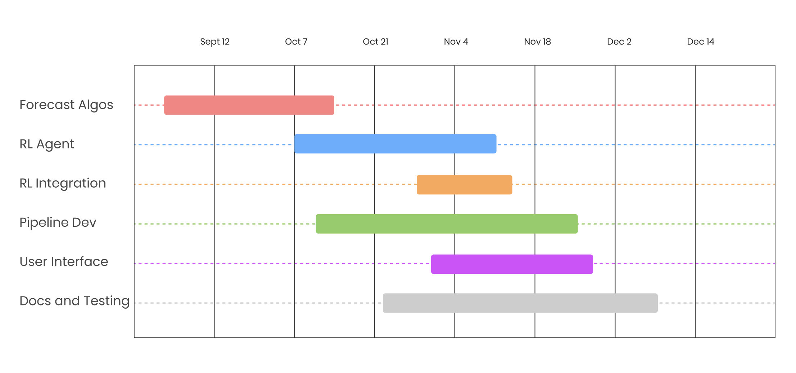
Gantt Chart

Slide 23
Deliverables By Stand up III
Finalize RL algorithm
Integration of TSA and RL
Basic UI for the project – frameworks and prototype

Slide 24
Deliverables
RL Agent and Integration [Started]
RL Environment Setup
Agent Selection and comparison
Training Agent and performance comparison
Basic Integration
Notes:
RL Environment Setup:
• Design the RL environment that simulates the trading process. Define states (technical indicators, market conditions), actions (buy, sell, hold), and rewards (profits, Sharpe ratio, etc.).
• RL Agent Selection:
• Choose and implement a basic RL algorithm (e.g., DQN, PPO, or A2C).
• Integrate the momentum and trend strategy rules as part of the environment.
• Training RL Agent:
• Train the RL agent on a dataset of historical prices to optimize decision-making based on rewards.
• Monitor convergence and adjust hyperparameters to improve the training process (e.g., learning rate, epsilon for exploration).
• Performance Comparison:
• Compare the performance of the RL agent to the baseline momentum and trend-following strategies.
• Evaluate key metrics like cumulative returns, Sharpe ratio, volatility, and drawdowns.
• Basic Integration:
• Ensure the RL agent can be deployed into the simulation pipeline alongside the traditional strategies for real-time testing.

