Slide 1
Patient readmission project – dsci 633
Amulya Saxena

Slide 2
AGENDA

Slide 3
Data analysis
This involves steps in data preprocessing – feature transforming and engineering, data cleaning, handling imbalance issue and rescaling the dataset.
Model building
Building a classifier to classify data with accuracy. Classic Models used are SVM, Logistic Regression and Ensemble models such as Xgboost.
Data evaluation
Different evaluation techniques for the models used such as Classification accuracy, confusion matrices, ROC and PR Curves.
conclusion
Concluding thoughts on the project.

Slide 4
introduction

Slide 5
Overview
For the course project, we will investigate the problem of predicting readmission of hospital patients.
The dataset includes over 50 attributes such as Race, Weight, and other representing patient and hospital outcomes.
The goal is to build a binary classifier that can predict early (<30 days) readmission given the patient’s features.

Slide 6
Data preprocessing and analysis

Slide 7

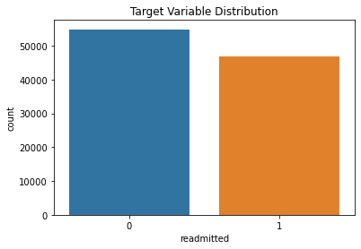
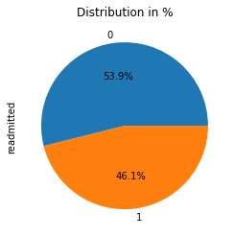
Dataset
Target variable = Readmitted

Slide 8
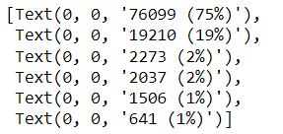
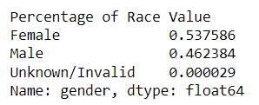

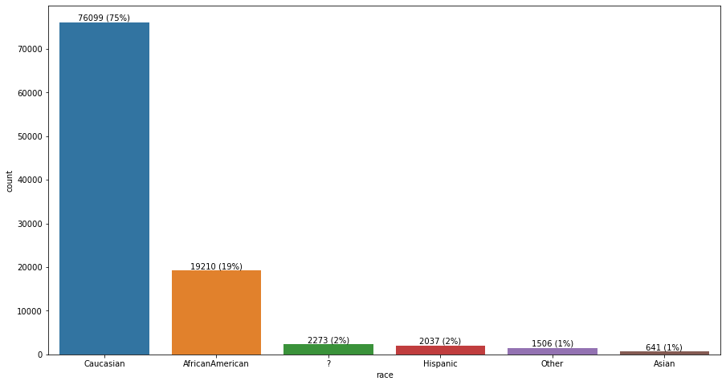
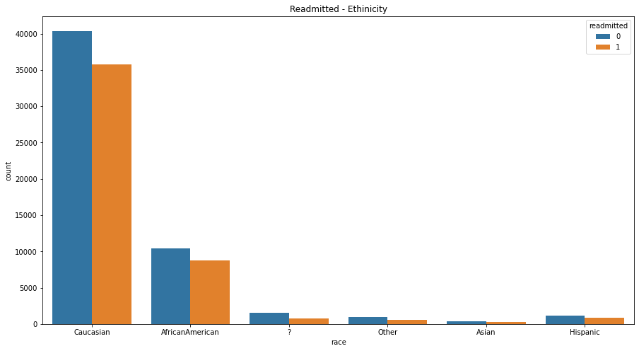
Dataset
Race Distribution
Male vs Female

Slide 9
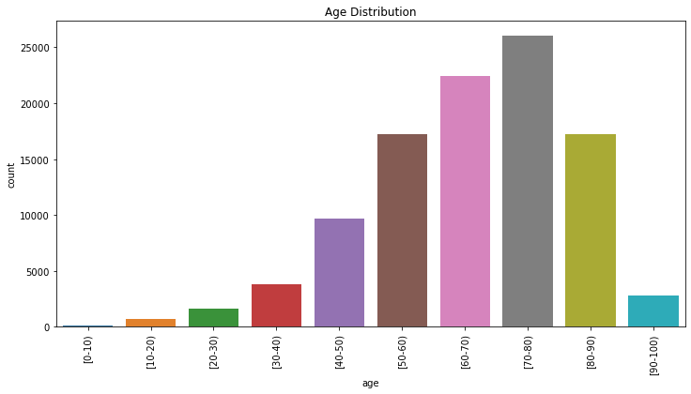
Dataset
Age Distribution

Slide 10
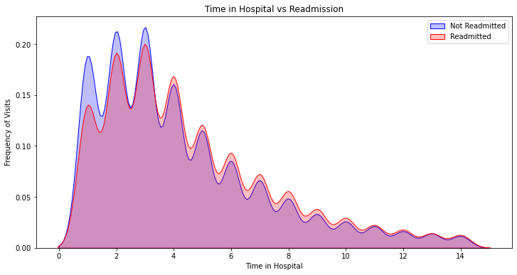
Dataset
Time in Hospital vs Readmission

Slide 11
Feature engineering 1st approach
STEPS
Handling missing values.
Finding ? Values.
Replacing ? Values with NaN.
Transformed String values into numerical values.
Converting values as some models don’t take string input.
Used label encoding.
Stratified Split the data into 70 30 ratio.
Dropped 14 features.

Slide 12

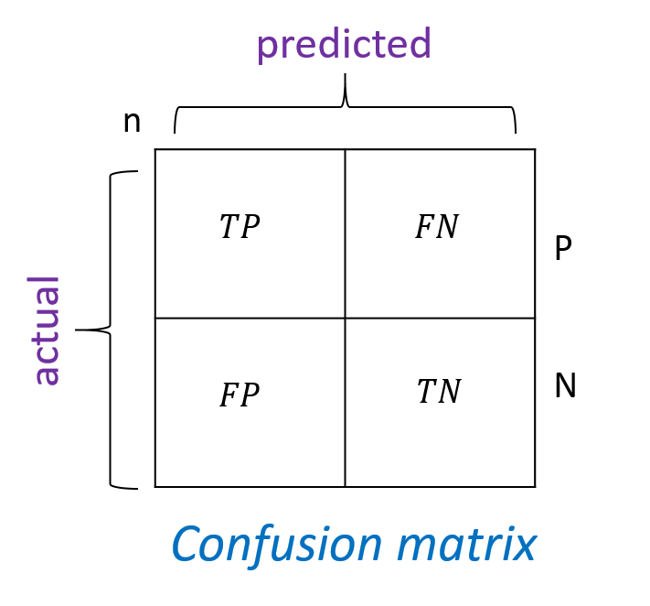
Data Evaluation techniques
Classification accuracy
Accuracy is one metric for evaluating classification models.
Informally, accuracy is the fraction of predictions our
model got right. Accuracy has the following definition:
Confusion matrix
A confusion matrix is a table that is often used to describe the performance
of a classification model (or "classifier") on a set of test data for
which the true values are known.

Slide 13
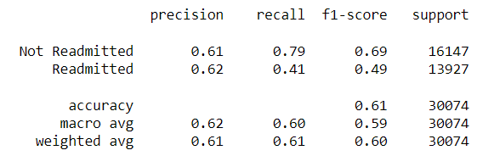
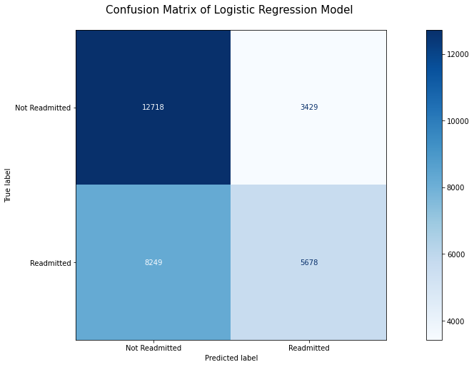
Building classifier
Logistic Regression

Slide 14
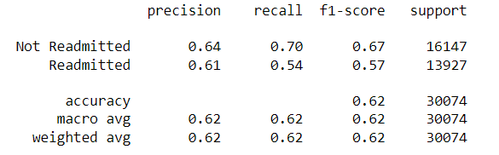
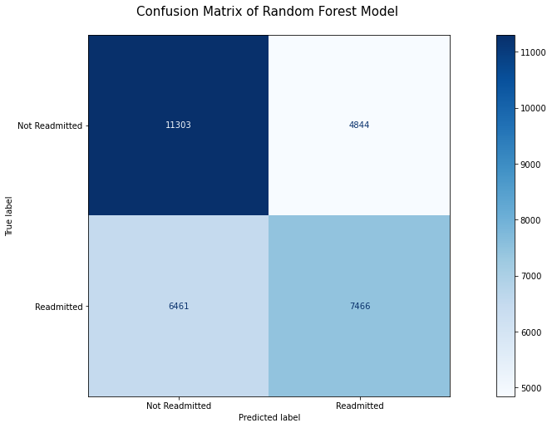
Building classifier
Random Forest Classifier

Slide 15
Feature engineering 2nd approach
STEPS
Adding new features.
Medicines
Sum of all reactions
Patient revisits and count of visits in a year.
Transforming variables.
Readmitted label to 1s and 0s
Transformed weight, discharge distribution, diagnosis attribute.
Dropping attributes that aren’t contributing to model training
Encounter ID
Patient NBR
Handling Data Imbalance and Splitting the Data

Slide 16
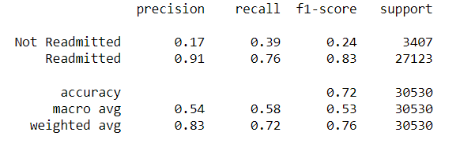
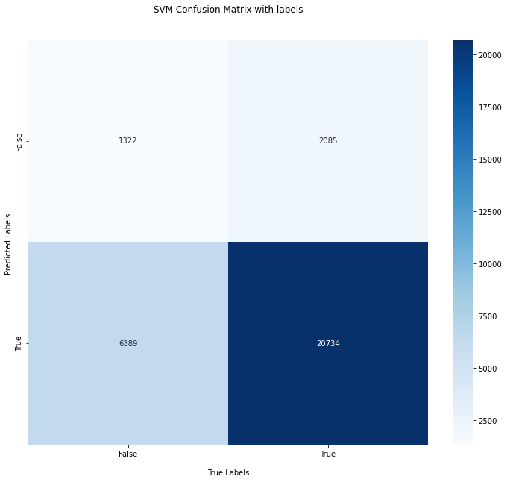
Building classifier
SVM

Slide 17
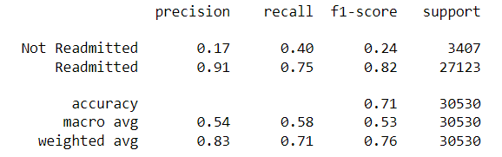
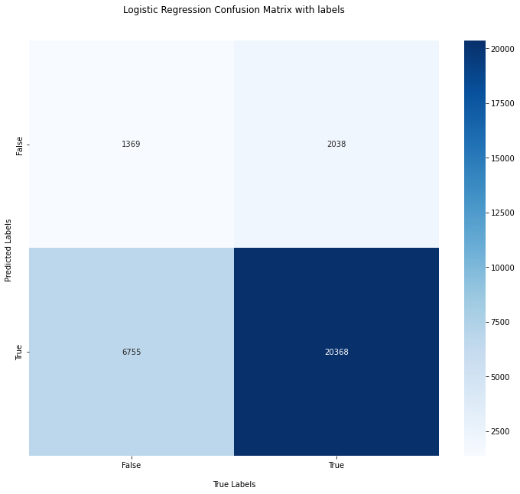
Building classifier
Logistic regression

Slide 18
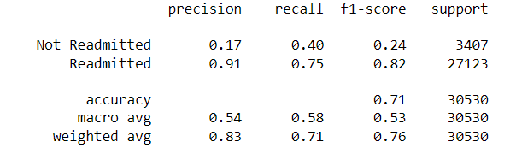
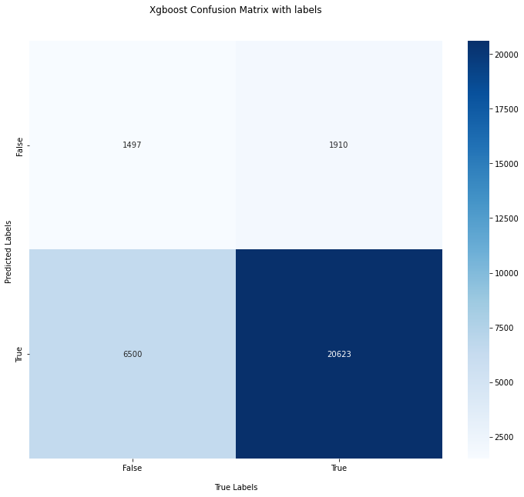
Building classifier
Xgboost

Slide 19
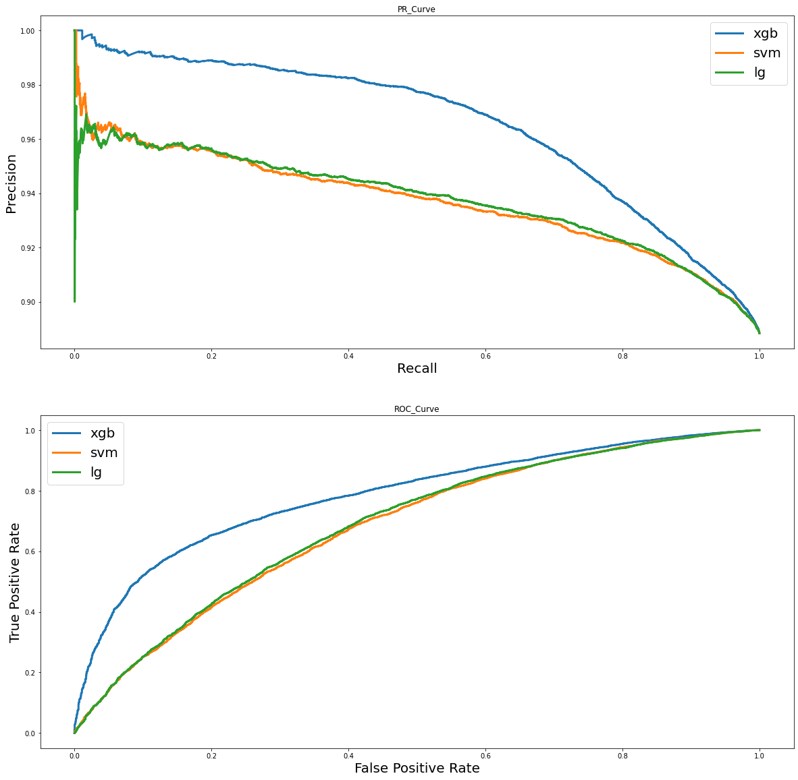
PR CURVE
ROC

Slide 20
Conclusion
- Data Transformation.
- Data Preprocessing and Feature engineering.
- Solving the imbalanced data issue.
- Implementing different classifiers.
- Xgboost – most efficient model.

Slide 21
THANK YOU
Amulya Saxena
as7108@rit.edu

