Slide 1


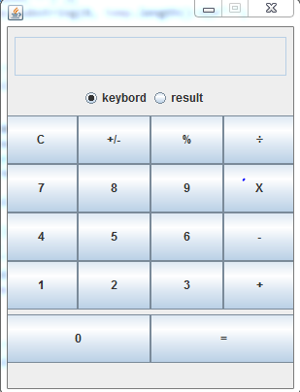

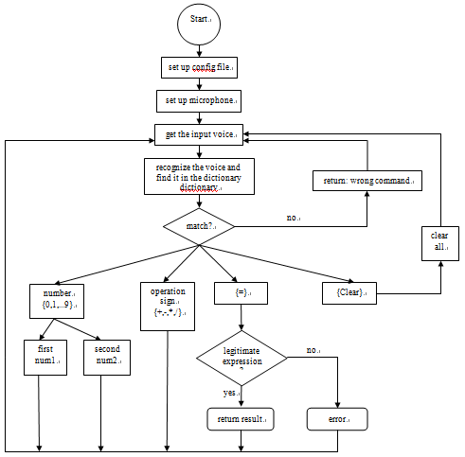
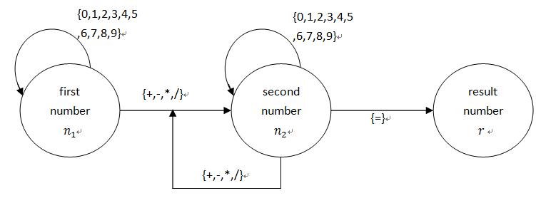

Voice-Controlled Calculator
Chenqi Zhang
Keywords CMU Sphinx; JAVA; Speech Recognition; Voice-Controlled Calculator Basic concept of speech Speech is a complex phenomenon: ☹A naive perception is that Speech is built with words consists of phones. ☺The reality is that Speech is a dynamic process without clearly distinguished parts. All modern descriptions of speech are to some degree probabilistic. That means no certain boundaries between units, or between words. Speech to text translation and other applications of speech are never 100% correct | Basic file for Sphinx4 To run a program using Sphinx4, three files are required: The Java file to compile and run. The grammar file. The configuration file Project Design Basically, this program has two main parts: one is in charge of interacting with the user and presents the result graphically; The other one handles all works behind GUI. For instance, set the configuration file, do the computing, and receive and execute the input voice command. Grammar For our program voice is use for command and control, so it is a good chose to use a finite state grammar. All the design should take user experience into consideration. | GUI Project Process
Goals in the project Go through the developer's tutorial. In particular, learn how to build applications with Sphinx4, which is the toolkit for developing in Java Write a Voice-Controlled calculator in Java, analysis the performance and propose some ideas about further improvement
Environment Configuration Java SE Development Kit(JDK)8 and Java SE Runtime Environment(JRE)8 Eclipse SDK. We can achieve great efficiency coding with Eclipse Sphinx4. Java speech recognition library. Java Speech API(JSAP). This allows Java application to incorporate speech technology into their user interfaces. | Summary This Voice-Controlled calculator works very well in quiet place. However, when there is noise in the environment, such as people's talking or sound of vehicle engine, the recognition accuracy is unacceptable. In further improvement, I can work on how to filter the noise. Another aspect that need to be improved is the reaction speed of the calculator.
Notes:
DESIGN NOTE: If you are creating a poster from resources other than individual PPT slides, please re-size all images to 100% of the desired placed size before inserting, to prevent raster image processing (RIP) problems. Image resolution should be no bigger than 300dpi; 150dpi is preferred.
CONVERTING POWERPOINT SLIDES TO A POSTER: Open the PowerPoint presentation you want to convert to a poster. ^ Go to an individual slide, Select All, and Copy ^ Go to the poster document and Edit, Paste Special, and select Paste As: Picture ^ Repeat step 7 until you have all your slides copied and pasted to your poster-size PowerPoint document ^ Name and Save.

