Slide 1


Bholabhai Patel College of Computer Studies- BCA (A constituent College of Kadi Sarva Vishwavidyalaya) Project - BCA 508 (Specialization- {Robotics} ) Smart Wristband to monitor Corona Patients
Under the Supervision of : Dr.Rebakah ma’am
Submitted by :
Name :- Upadhyay Aditya Yashaschandra, Patel Rachit, Prajapati Himil
Semester :- 5 - C

Slide 2
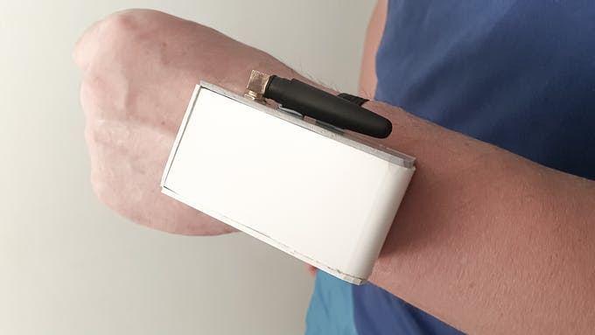
People with weak forms of virus, only show weak symptoms but the health of these patients can worsen in a matter of hours.
Their health must be monitored in detail.
Some countries have crowded their hospitals with such patients, whereas others have sent them to self-isolate but it is difficult to monitor their condition.
Some patients do not comply to quarantine norms and leave their homes these people can cause infections to other people.
Smart Wristband is a wristband held device that monitors the patient’s vitals and geolocation.

Slide 3
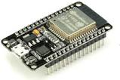
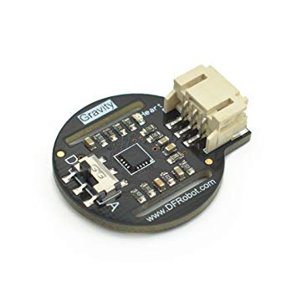
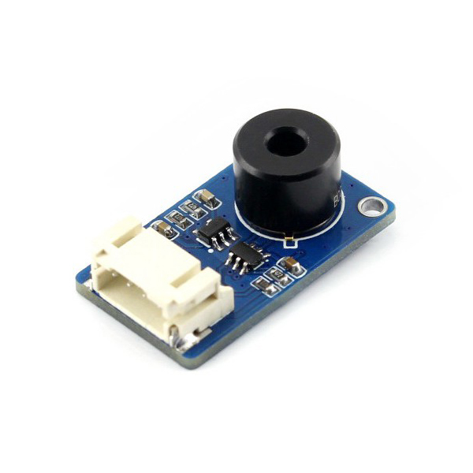
Hardware used:-
ESP32
IR temperature sensor(DS18B20)
heartrate sensor. (SKU SEN0203)

Slide 4
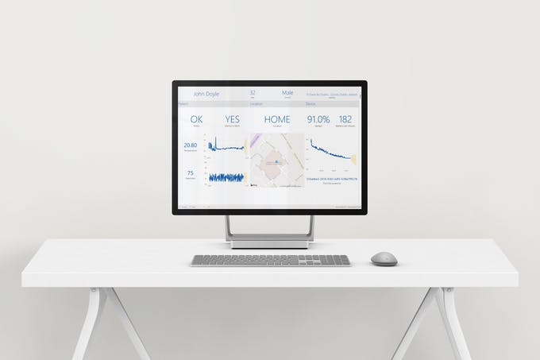
Elevated temperature and irregular heart rate are signs of the progression of virus.
The smart Wristband will stream this data securely to the hospital monitoring the patient.
The device will also track the location of the user ensuring that they are at home at all times.
All of this data is stored in scalable database allowing thousands of these devices to be deployed to various places.
The hospital will have access to a dashboard where they will be able to see the health of all patients being monitored at a glimpse.

Slide 5
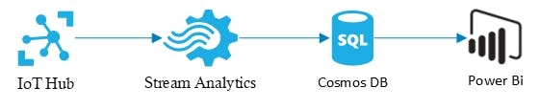
Functioning of the device: -
The frontend of the application
The diagram above shows the architecture of the application running on the device. These are the steps taken by the device every 5 minutes. The device collects all the data, checks if it is worn by the user and then packages them and sends them to the backend through GSM.
The device also keeps track of the time, it gets the time from a designated server and syncs its onboard RTC to this timestamp when it wakes up for the first time or after it was turned off.
The data sent by the device is received in the Azure IoT Hub where it was securely delivered. A stream analytics job then extracts this data from the hub and pushes it into a Cosmos DB database. The patient and doctor Power Bi reports then query this data at intervals of time from the database and then display the data.

Slide 6
Benefits of using Smart Wristband
Ensuring that patients sent to self-isolate are staying at home.
Monitoring the patients’ vitals without the need of them being in hospital.
Liberating space in hospitals for people with severe manifestations of the virus.
Alerting doctors to the state of all patients in self-isolation 24/7.
Providing a comfortable monitoring solution for the patient.
Providing the hospital with a forecast of the patient’s health.
Informing the patient about their health through a desktop dashboard.
Cost effective and scalable.

Slide 7
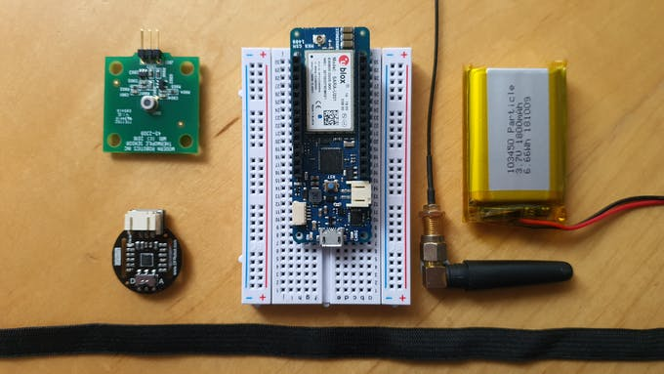
Project Conduct
Step 1: Getting everything together
Step 2: Working with the MKR GSM
Configure the MKR GSM to connect to Azure IoT. For this, we need to generate and store a certificate on the device to be able to verify the connection with the backend.

Slide 8
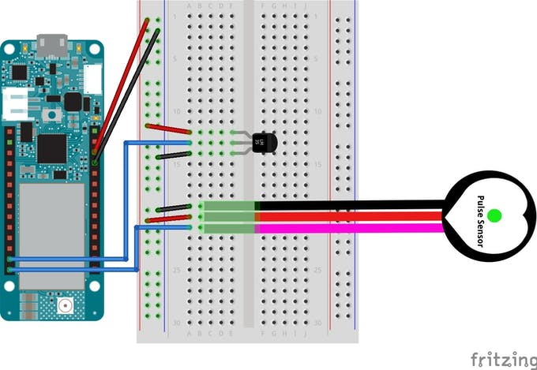
Step 3: Connecting everything together
Temperature sensor to A4 analog input on the device and the heartrate sensor to A5 analog input on the device.

Slide 9
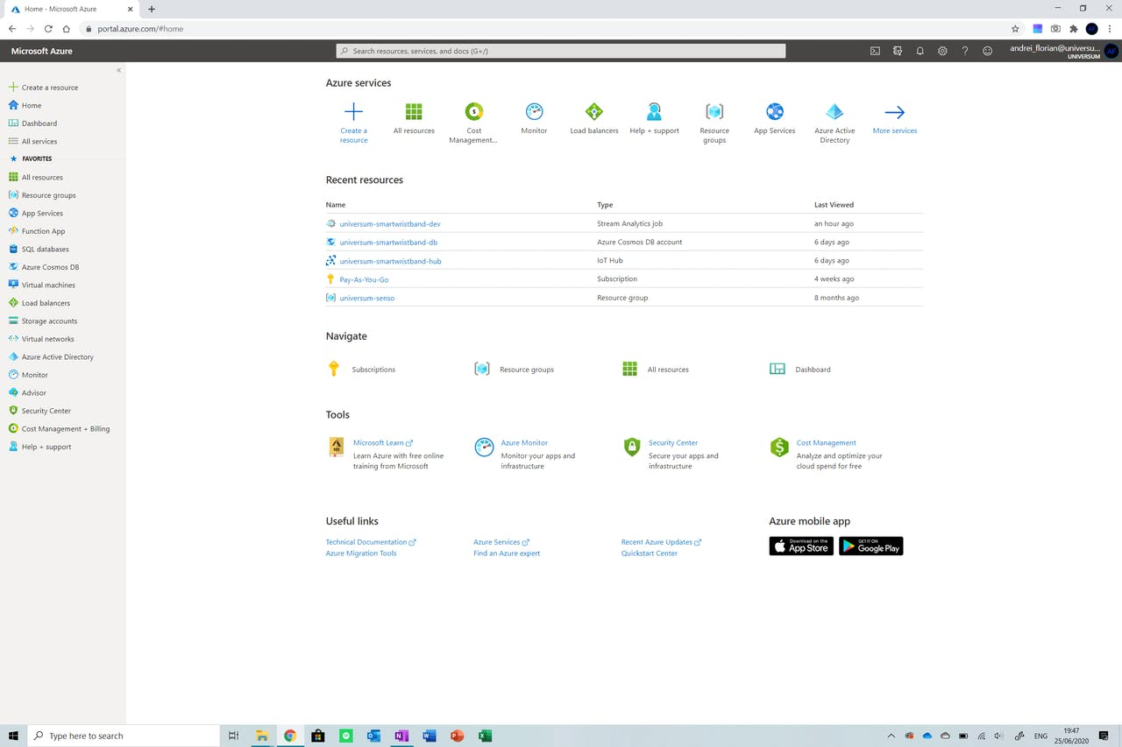
Step 4: Onto the IoT Hub
Navigate to your console(portal.azure.com) and click on the create a resource button at the top left of the screen. Now type IoT Hub and select the option from the drop down.

Slide 10
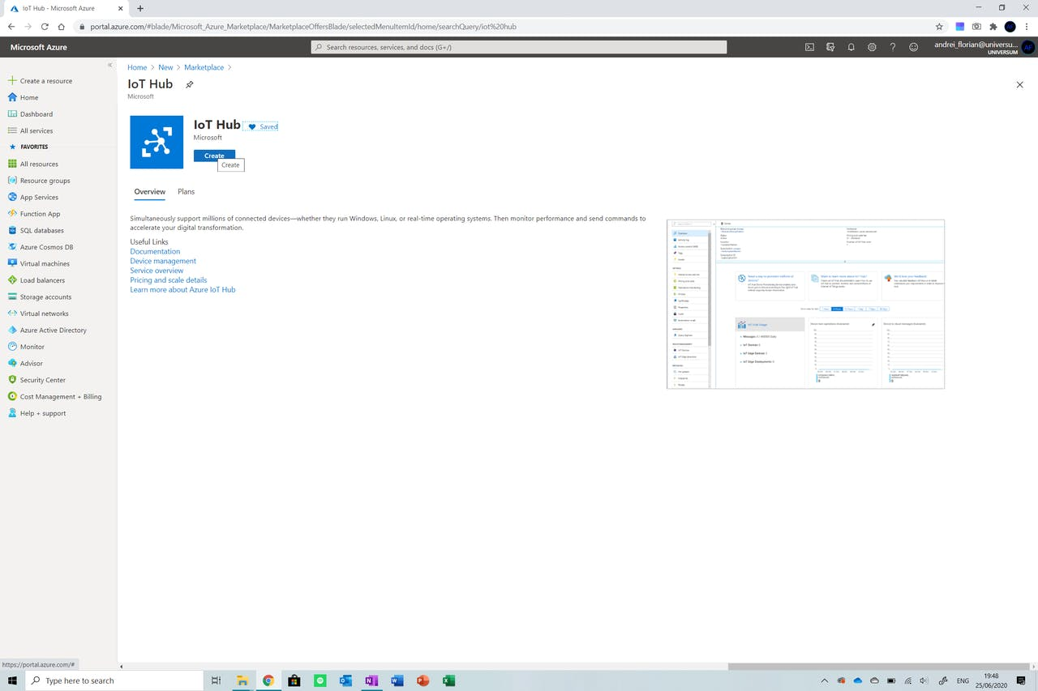
Click on create after the setup was completed. Select a free tier IoT hub.

Slide 11
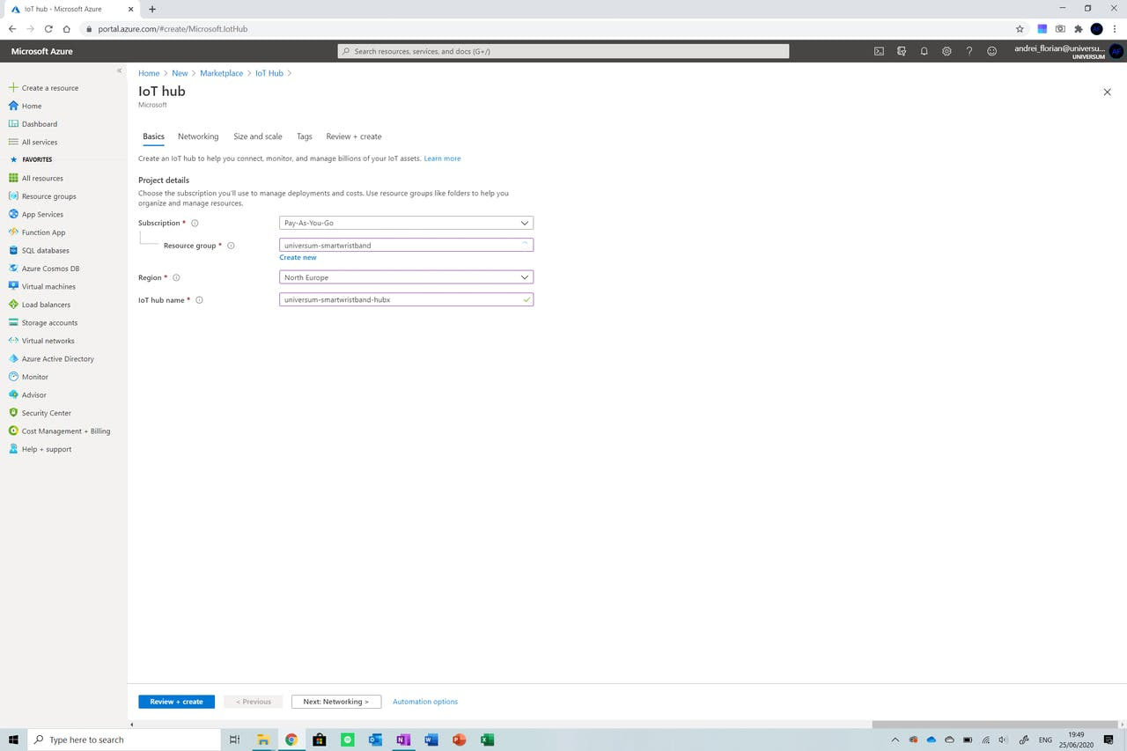
Create a new resource group and name your IoT hub. Now click on the Size and Scale option from the steps above.

Slide 12
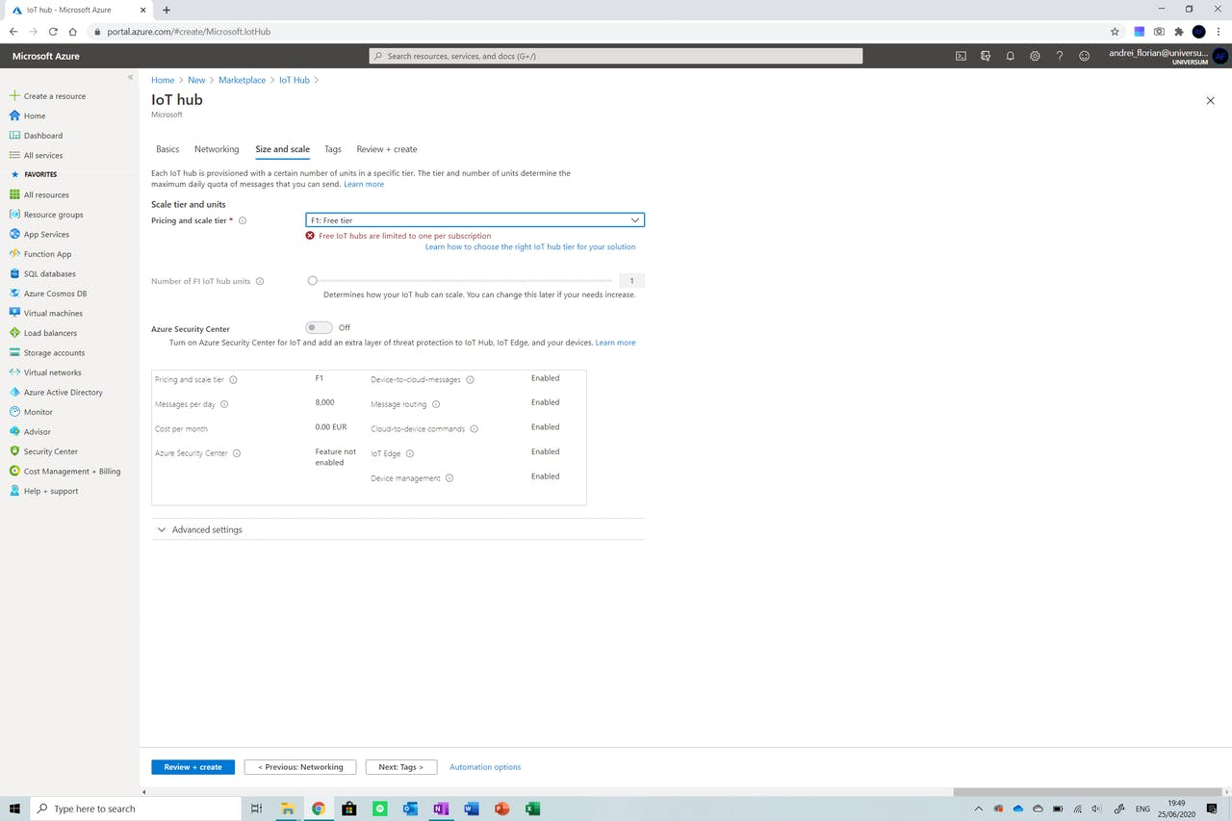
Now click Review and Create and deploy the resource. Wait for the IoT Hub to create and then open it by clicking onto All Resources from the menu on the right of the screen.

Slide 13
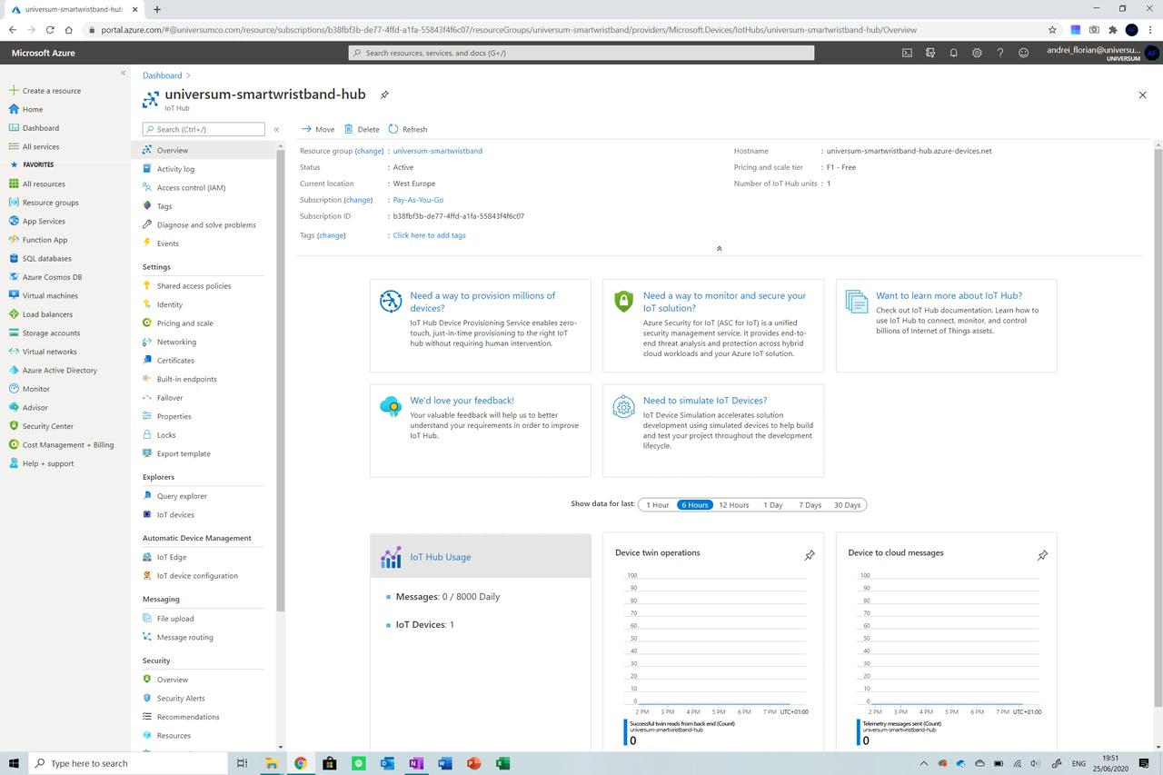
We now need to create a device and attach it to the IoT hub. Navigate to the IoT Devices option on the menu on the right of the screen and click on the option. Click on the New button to add a new device to the IoT hub. Input the following credentials:

Slide 14
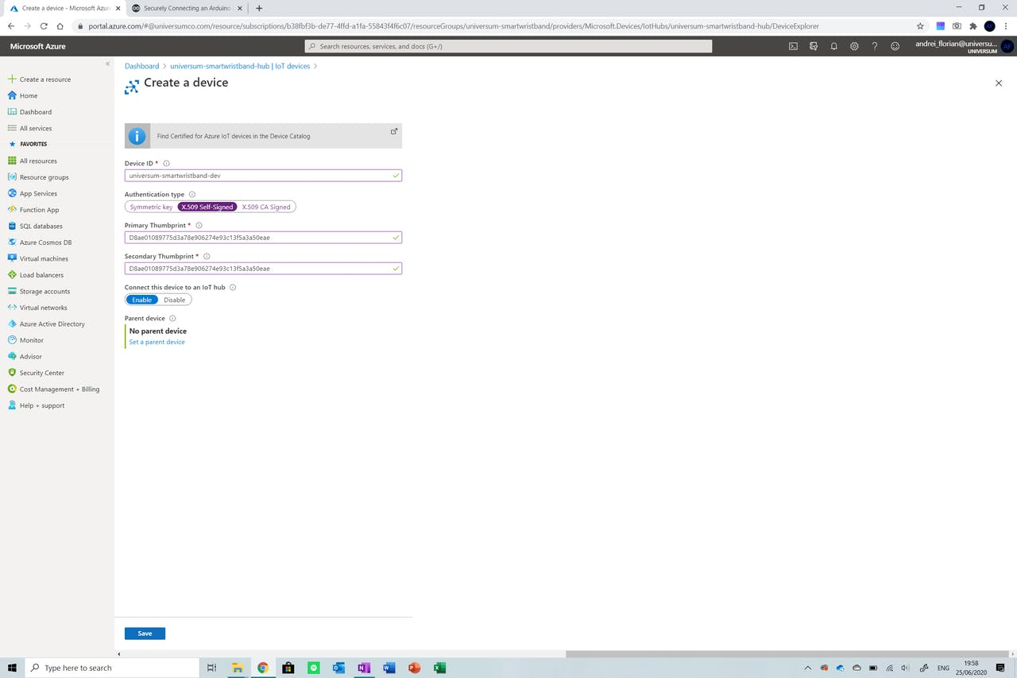
Make sure you replace the Primary Thumbprint and the Secondary Thumbprint with your SHA1 value extracted in the second step.

Slide 15
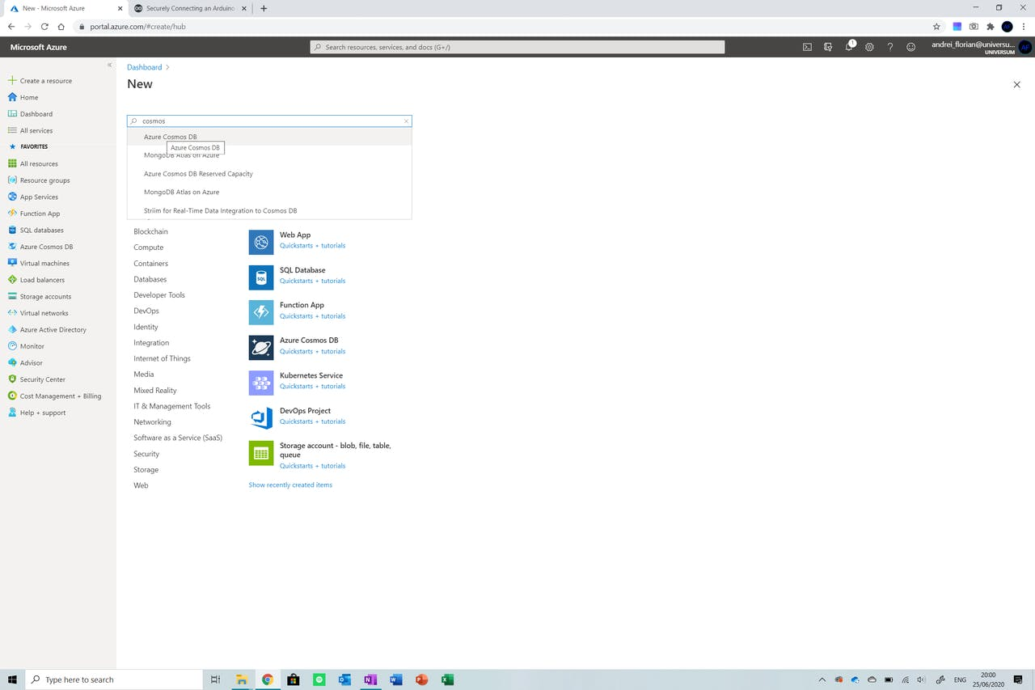
Step 5: Creating the Cosmos DB Database
Now we need to create the database where the data sent by our device will be stored. Azure’s Cosmos DB as it is accustomed to storing JSON files which is what we are sending from the device.

Slide 16
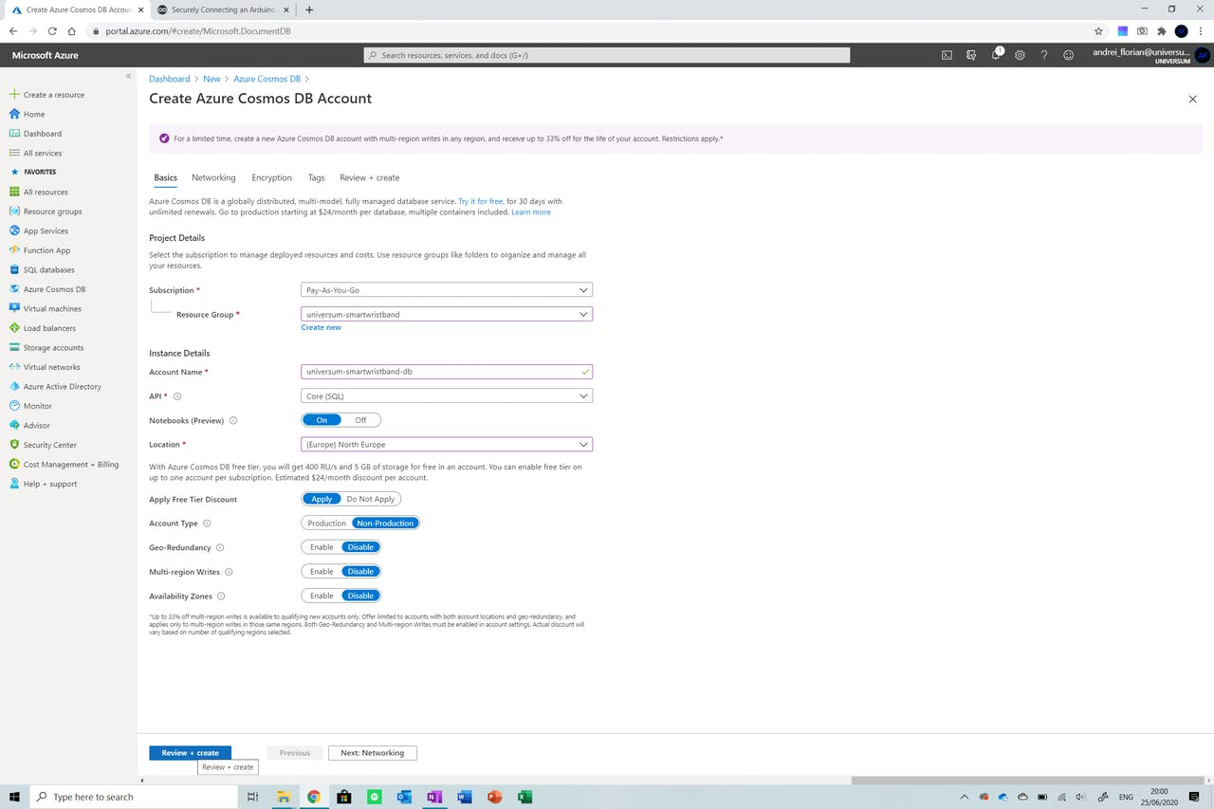
Firstly, navigate back to the Create a Resourcebutton from the menu on the right and click it. Search for Cosmos DB and then select the option.

Slide 17
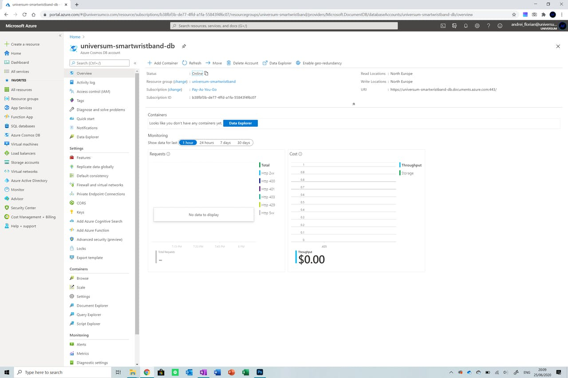
Select the resource group created with the IoT Hub and give it a name, keep the rest of the settings the same. Do ensure that the region is the same on both the IoT hub and the database to prevent region transfer costs.

Slide 18

Step 6: Creating the streaming analytics job
So now that we have our IoT hub and database set up, we need to connect the two together so that the data inputted into our IoT Hub is streamed into the database as it is received.

Slide 19
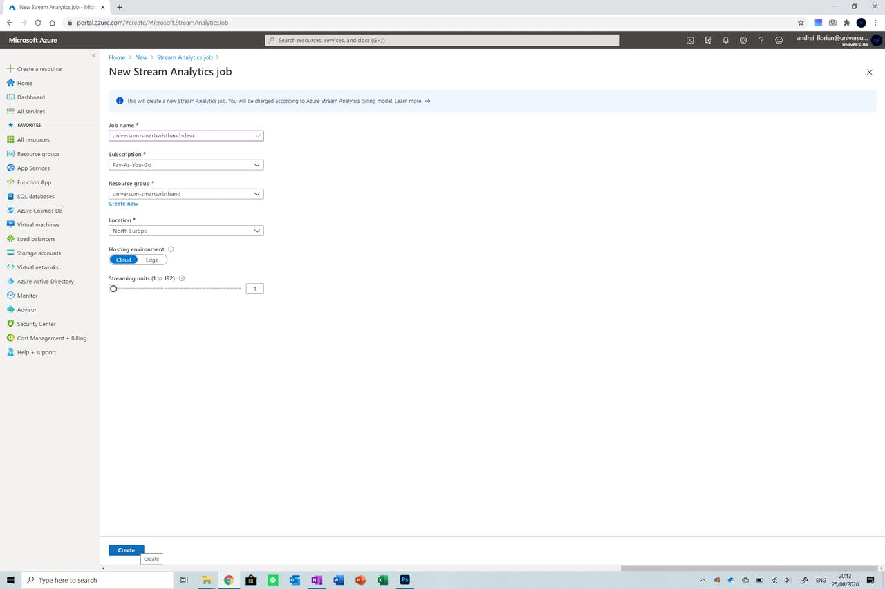
Start off by creating a new resource by typing Stream Analytics Job. Now select the resource group used up until now and ensure that the number of streaming units is set to 1. If delivering a high quantity of devices, you may want to consider creating more streaming units to handle the greater number of devices.

Slide 20
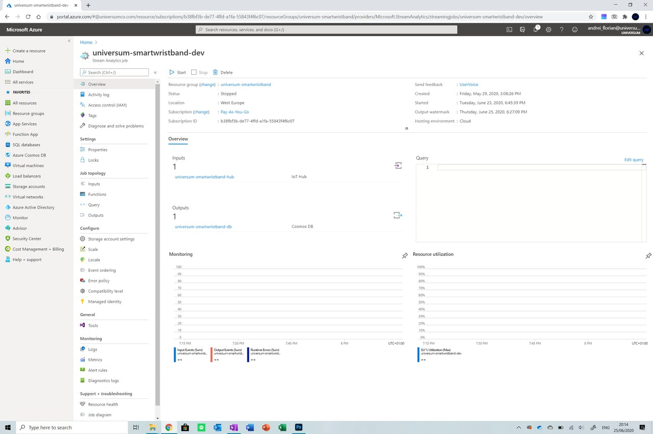
Wait for the resource to deploy and then select it from the All Resources button on the menu on the left.

Slide 21
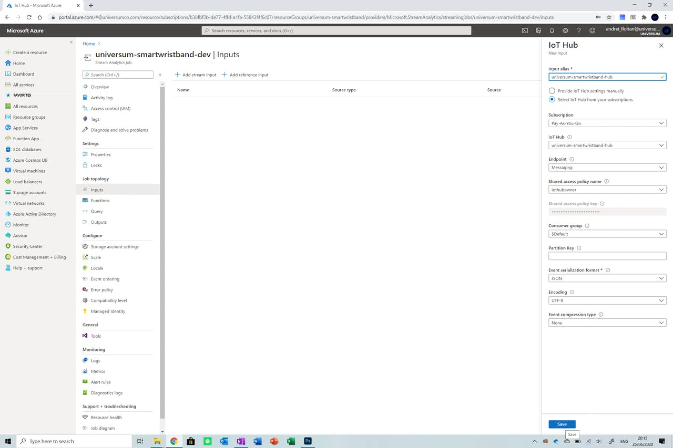
Now that we are in the resource, select the Inputsbutton from the menu on the left to select our input. Click on Add Stream Input and then select IoT Hub from the list of options.

Slide 22
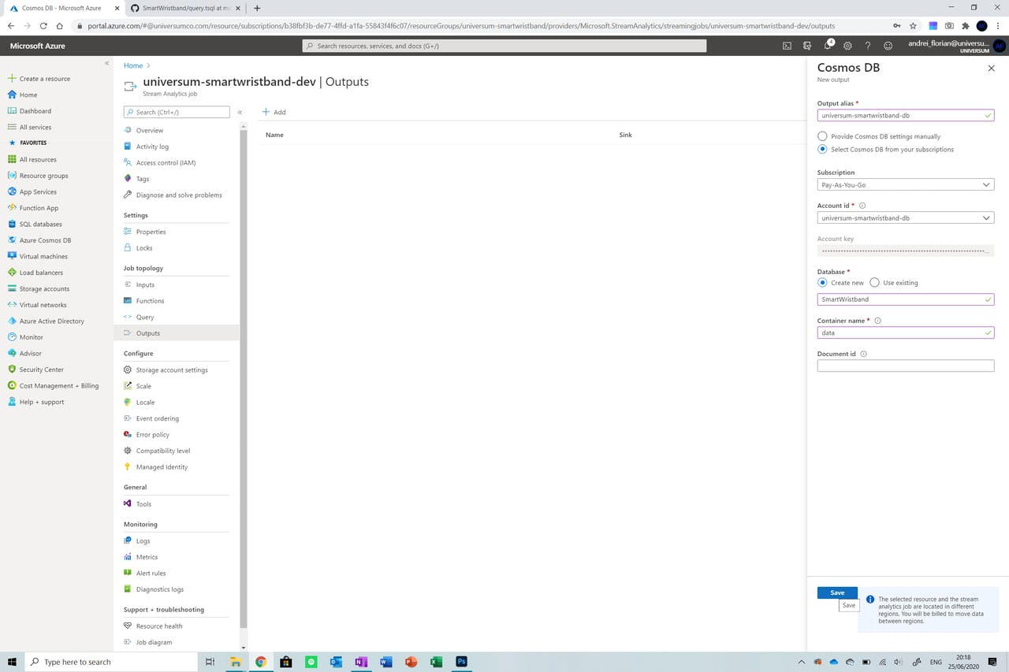
Enter the name of your IoT hub and then select it from the menu shown. Do not change any other settings. Click Save. Now click on the Outputs option from the menu on the left of the screen and select the Cosmos DB option from the list provided.

Slide 23
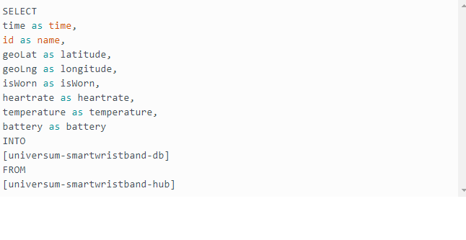
Name the output and then select the database from the options provided. Select Create New under Database and set the database name to SmartWristband and the container name to data. Leave the document ID empty. Now click Save.

Slide 24
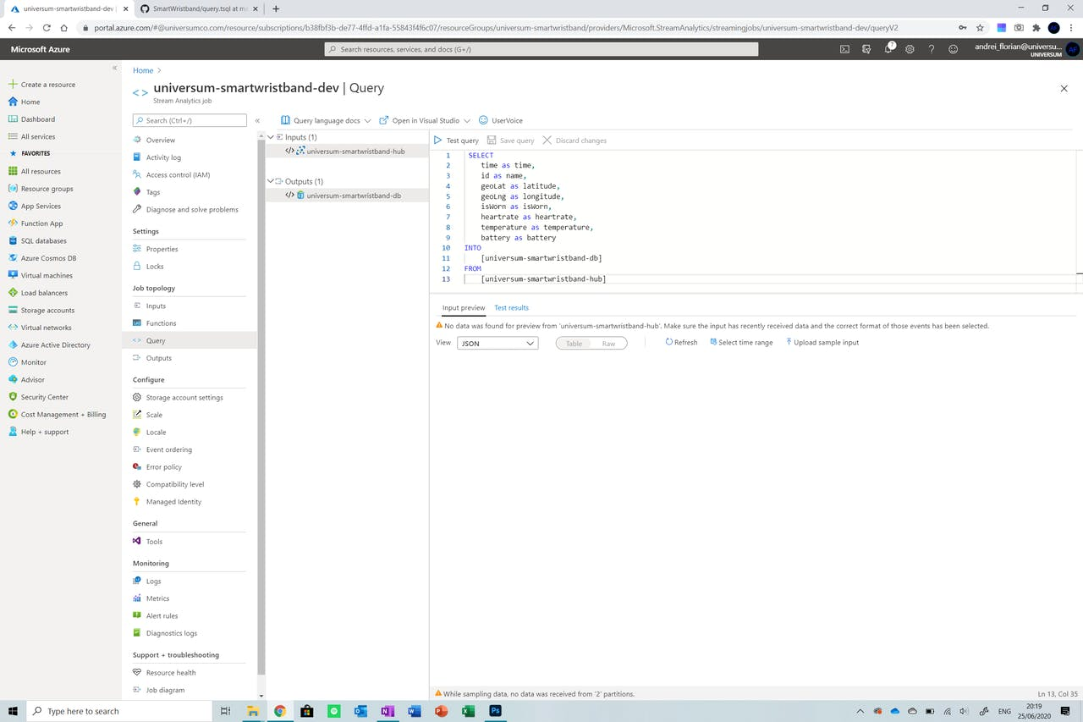
After that is done, click on the Save Query button from the menu at the top of the screen and we are ready to go. Now all we need to do is click back on Overview from the menu on the left and then start the streaming by pressing the Start button.

Slide 25
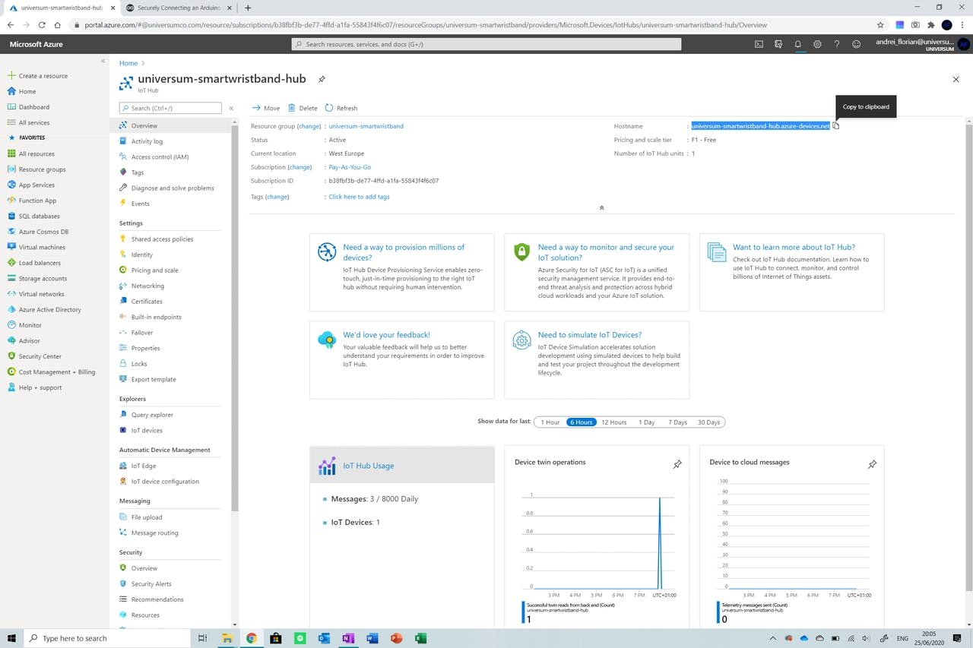
Step 7: Preparing the variables
Now we can focus on the frontend of the application. Open the code from the GitHub repo in the Arduino IDE or web IDE and follow along with the steps below to edit the variables in the document so that the MKR GSM will be able to connect to Azure IoT.

Slide 26
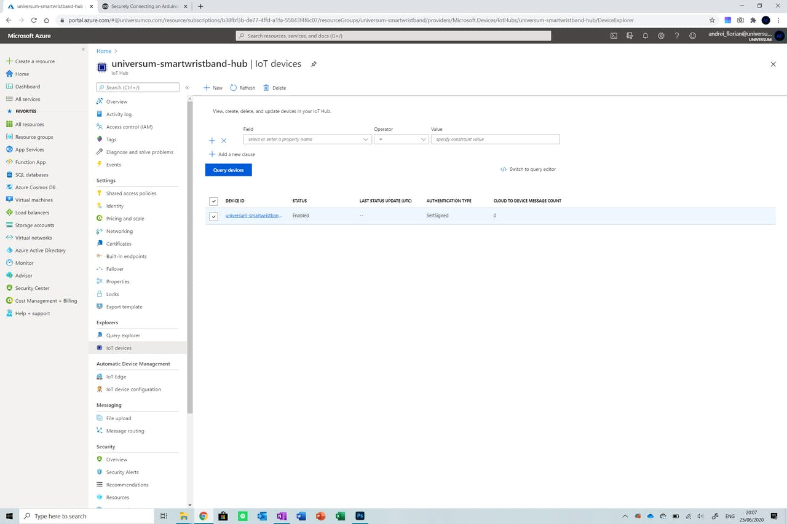
The first thing we will need to do is navigate to the IoT hub created and copy the hostname shown. Now open the secrets.h file from the project and input this string into the SECRET_BROKER field.

Slide 27
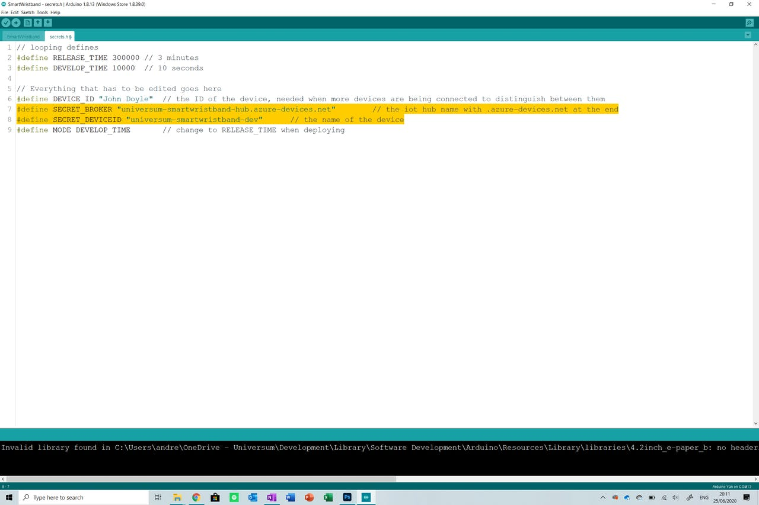
The next thing is getting the device name. This is simply the name given to the device in the IoT Hub. Copy the name displayed and then paste it in the SECRET_DEVICEID field in the secrets.h file. At the end, your file should look something like this.

Slide 28
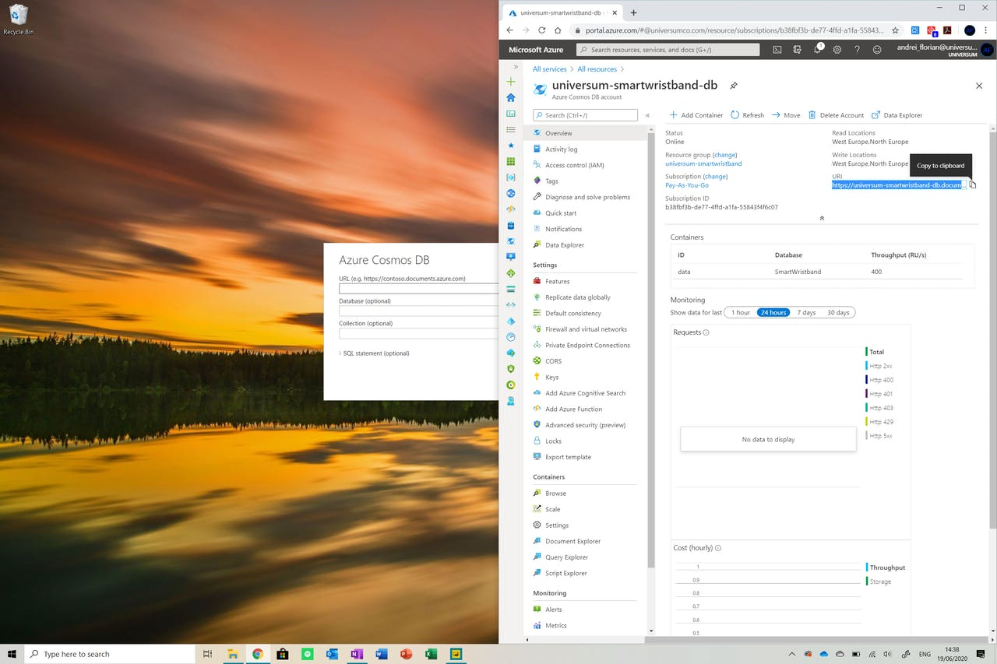
Step 8: Onto the Dashboard
Launch the application and click on the Get Databutton. Now navigate to the Azure option and select Cosmos DB from the options.

Slide 29
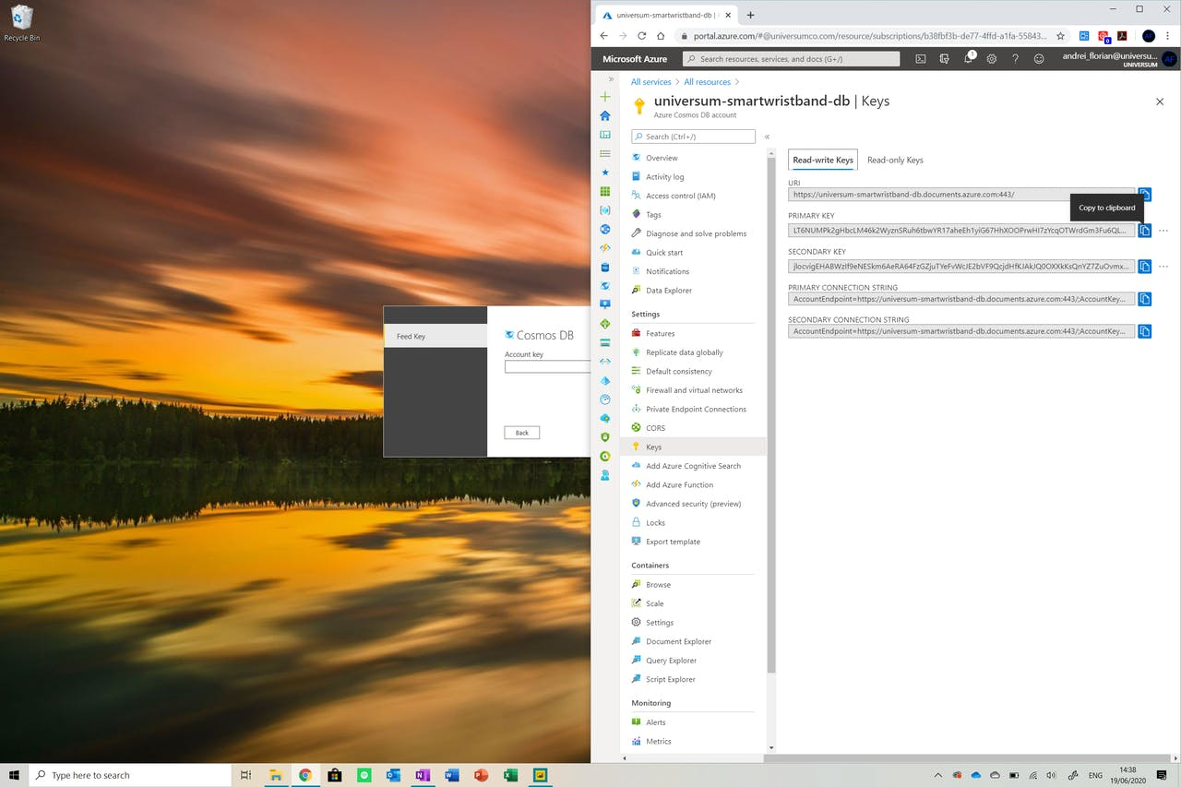
Now go to your Cosmos DB resource and copy the URI link and paste it in the field in Power Bi. Sign in if this is required.

Slide 30
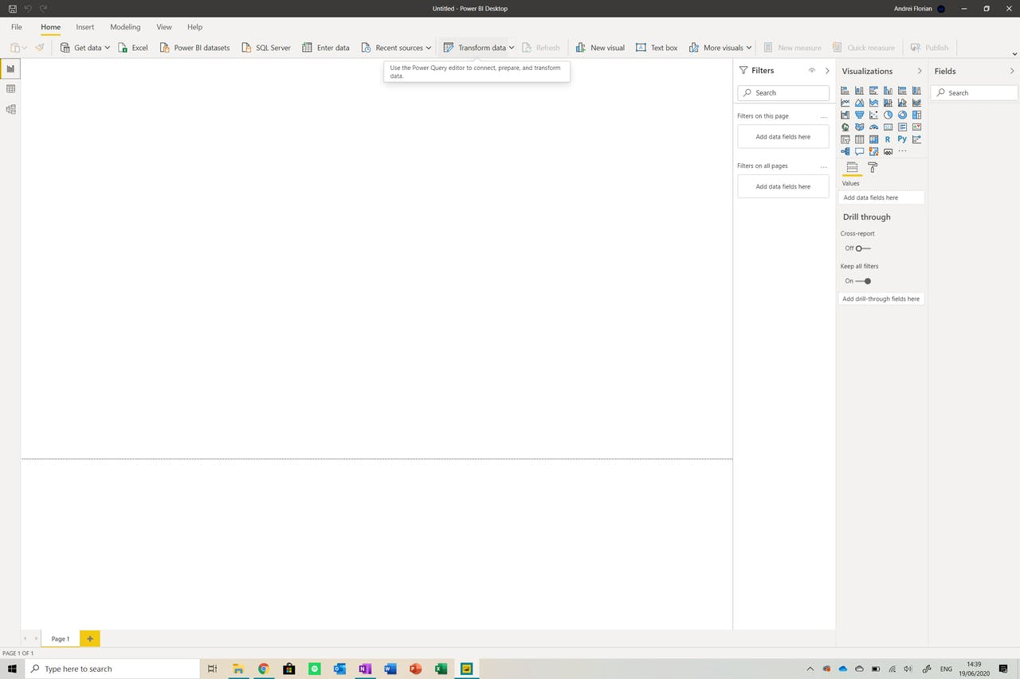
Now we need to go to the keys window in the Cosmos DB dashboard and copy the PRIMARY KEY and paste it into the Account Key field. Now navigate through the database and ensure that the datafile is checked. Click load and then we are ready to go!

Slide 31
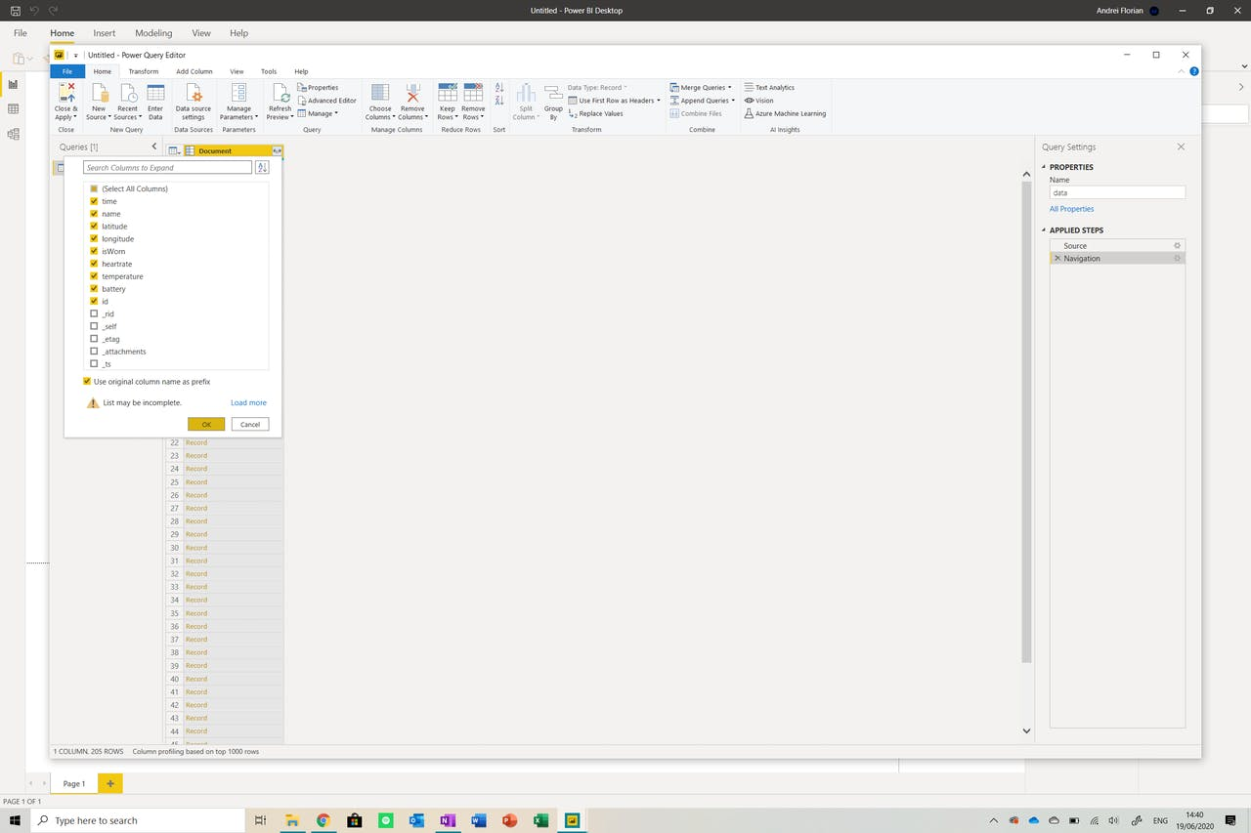
Now that you are in the report, find the Transform databutton from the menu at the top of the screen. Click it to get a table with data.

Slide 32
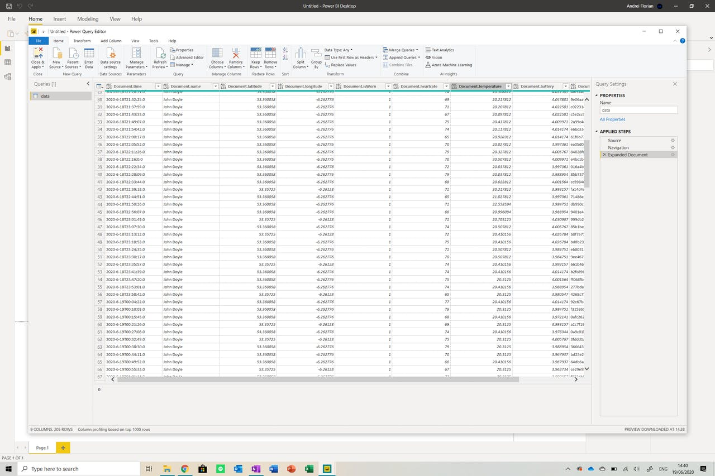
Click on the button next to the title of the table and select the fields shown above. You should see your table expand.

Slide 33
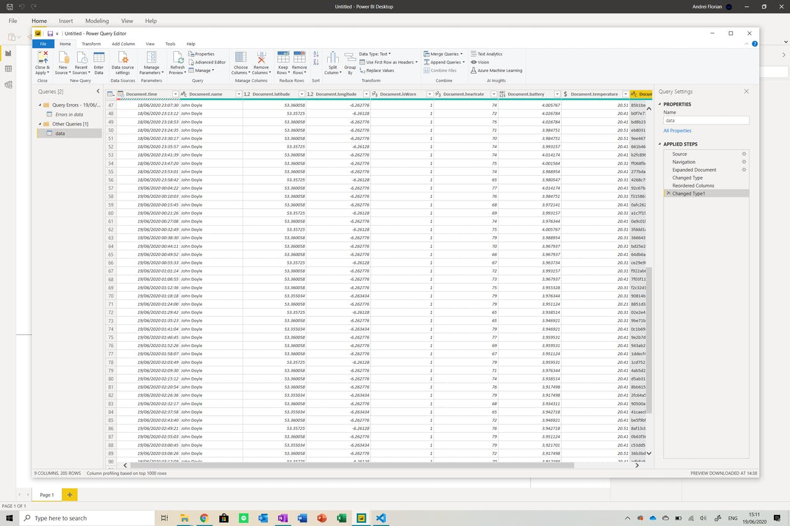
Now we need to change the data types of the rows. Identify the Data Type button from the menu at the top of the screen and change the values accordingly.

Slide 34
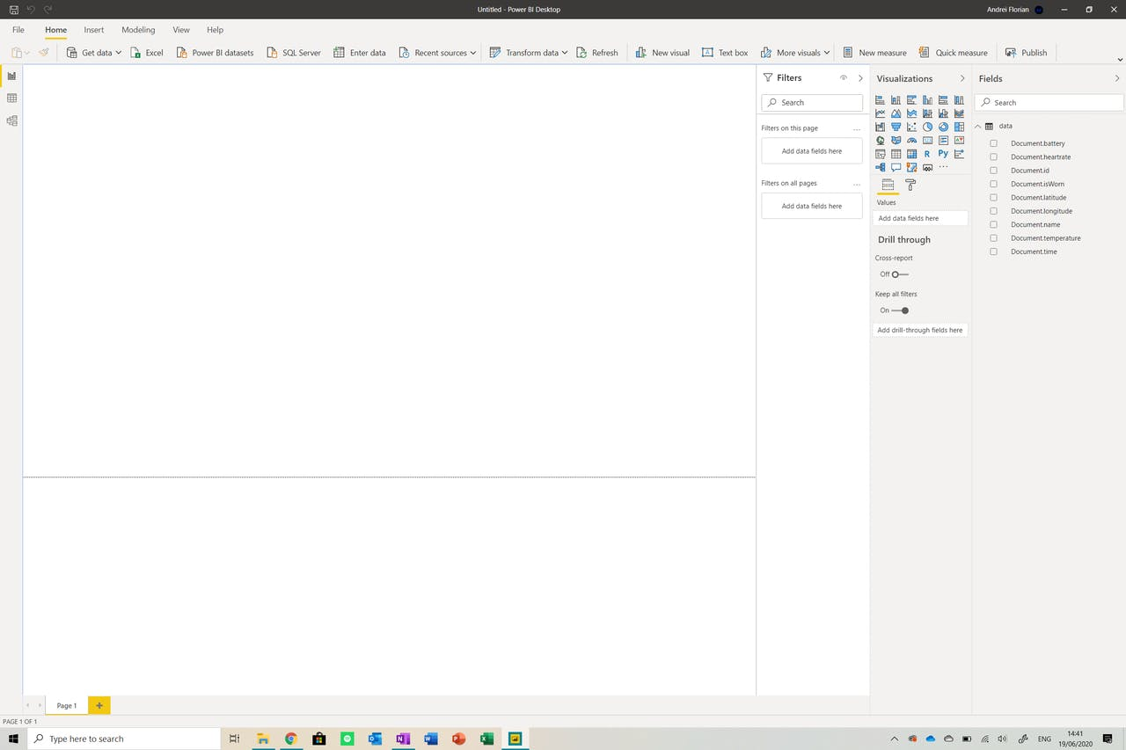
Now click on Close and Apply and you will be brought back to the dashboard. Your dashboard should look something like this.

Slide 35
