Slide 1


Bholabhai Patel College of Computer Studies- BCA (A constituent College of Kadi Sarva Vishwavidyalaya) Review Paper - BCA 508
(Specialization- {Robotics} ) Application of Arduino to monitor coronavirus patients
Under the Supervision of : Dr.Rebakah ma’am
Submitted by :
Name :- Upadhyay Aditya Yashaschandra, Patel Rachit, Prajapati Himil
Semester :- 5 - C

Slide 2
Abstract
Arduino is an programmable board, with a microcontroller and various I/O pins.
Arduino hardware and software is open source hence anyone can freely use it or make their own Arduino boards by themselves.
Here we use an Arduino board with a built in GSM module, a heart rate sensor, and a infrared temperature sensor to monitor someone who has had mild infection of coronavirus.
Many patients with mild symptoms of coronavirus are told to self-isolate themselves at home, and monitor their health, but some patients do not adhere to these guidelines causing further spread of the virus.
A simple device can be made to monitor these patients geolocation along with their health condition using the above stated hardware and following software.
Software : - Microsoft azure, Microsoft Power Bi reports.

Slide 3
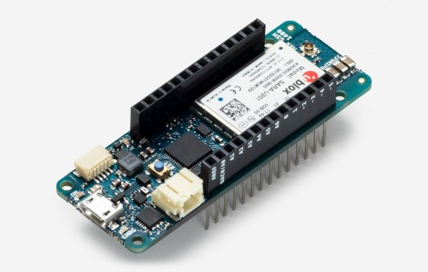
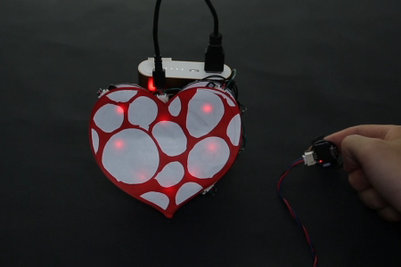
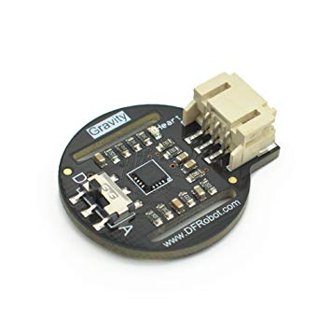
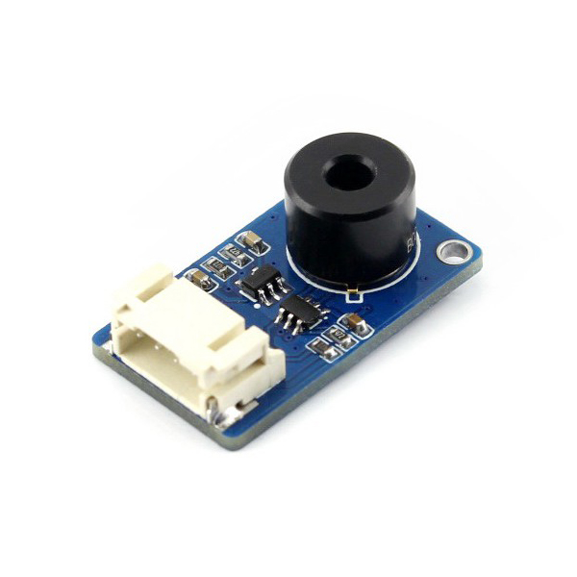
Hardware components
Arduino MKR GSM 1400
Arduino MKR GSM 1400 comes with
an inbuilt GSM (Global System for Mobile Communication Module).
Heart Rate Sensor
Uses an optical sensor to detect the presence
Of a large presence of blood during a pulse
From capillaries.
IR(infra red) temperature sensor
Uses a resistor that increases resistance on the presence of infrared
Radiation.

Slide 4
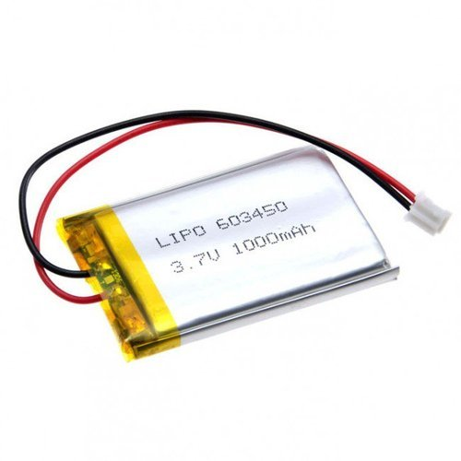

Hardware Components
3.7 Volt LiPo Battery
Rechargeable battery that provides large provides hours of battery life
For lower power consuming devices.
Antenna

Slide 5
Method of functioning
It is observed in patients with coronavirus infection that they have abnormal heart rate and high temperature.
By using the heartrate sensor and infrared temperature this pattern can be observed by doctors, also the geolocation of the patient can be found by sending location data through the SIM card to a server with a database.
The data stored in the database can be displayed in a proper report to end users.
This can also be used for people having heart problems, so that they can be geolocated in an emergency by family members.

Slide 6
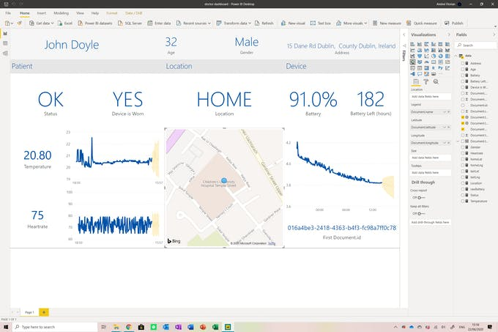

Slide 7
Summary
Cost effective and scalable
All the parts are perform very well for their price and can be used with even more components in the future
100% Open Source
Since the hardware is opensource various hardware manufactures can produce the same product without legal hassles.
Mass Production Capability
In case of greater demand for the product, it can be easily mass produced as it does not need complicated components.
Low Cost of Development
Total price below 10000 Rs.
Durable and Long battery life
Up to 8 days of battery life

Slide 8
