Slide 1

HAI Course Project Presentation
HAI Chat Avatar
An Emotion- and Gesture-Aware Virtual Chat Companion
Authors
July 26, 2026
AI Thrust
HKUST (GZ)

Slide 2
Table of Contents
1
Part 1. Base Layer: End-to-End Pipeline
2
Part 2. Personalization Layer
3
Part 3. Innovation Layer: Action Planner and Embodied Response
4
Part 4. Interface, Evaluation, and Storytelling
2/22

Slide 3
Roadmap
1
Part 1. Base Layer: End-to-End Pipeline
2
Part 2. Personalization Layer
3
Part 3. Innovation Layer: Action Planner and Embodied Response
4
Part 4. Interface, Evaluation, and Storytelling
3/22

Slide 4
Base Layer: What Problem Does It Solve?
Goal
Current Implementation
❒
Convert one user text input into a reliable multimodal response that the avatar can speak and perform.
LLM
Mock / OpenAI-compatible
TTS
Mock / Edge TTS
❒
Input: user text, recent dialogue history, and optional user profile.
Avatar
Mock / Prometheus
❒
Output: reply text, emotion, expression, gestures, voice style, and audio path.
UI
CLI / Gradio / Browser
❒
Engineering requirement: mockable locally, switchable to real API/TTS, and connectable to Live2D/Prometheus.
Tests
36 passed
[Implementation summary]
4/22

Slide 5
End-to-End Data Flow
User
Text
History
Builder
Profile
Prompt
LLM
Provider
JSON
Parser
Action
Planner
Post
Processor
TTS
Provider
Avatar
Controller
Pipeline
Result
Main code path: src/hai_avatar/services/pipeline_service.py::PipelineService.process
5/22

Slide 6
Pipeline Execution Steps
1
Validate user input: empty text and max length checks.
2
Load profile and build personalized system prompt if enabled.
3
Build short conversation history from previous turns.
4
Call the LLM provider with retry.
5
Parse structured LLM JSON; use neutral fallback if invalid.
6
Run Action Planner to normalize expression, gesture, and voice command.
7
Apply personalization post-processing when enabled.
8
Synthesize speech and prepare avatar expression / gesture.
9
Play audio, reset avatar, then save conversation and profile state.
One-Sentence Summary
The base layer is not just an API call. It is a stateful, fallback-aware, multi-provider asynchronous orchestration layer.
6/22

Slide 7
Base Layer Demo: What to Show Live
Example Input
Expected Output Fields
“I feel stressed about my project.”
reply_text
Natural-language response
emotion
supportive
What the Audience Should See
expression
concerned / soft_smile
❒
A natural text response.
gestures
nod, explain
❒
A generated speech audio file.
voice_style
gentle / calm
❒
Expression changes such as supportive or concerned.
audio_path
assets/audio/*.wav
❒
Gesture triggers such as nod, explain, or small bow.
7/22

Slide 8
Base Layer Reliability
Fallback Strategy
Test Coverage
❒
LLM provider error: retry, then neutral fallback.
❒
JSON parsing and fallback.
❒
Invalid JSON: parser repair or schema-safe fallback.
❒
Action normalization.
❒
TTS failure: fallback to mock audio.
❒
Mock providers.
❒
Avatar failure: warning recorded; pipeline still returns a result.
❒
Full pipeline integration.
❒
Personalization profile state.
Current status: 36 tests passed
8/22

Slide 9
Roadmap
1
Part 1. Base Layer: End-to-End Pipeline
2
Part 2. Personalization Layer
3
Part 3. Innovation Layer: Action Planner and Embodied Response
4
Part 4. Interface, Evaluation, and Storytelling
9/22

Slide 10
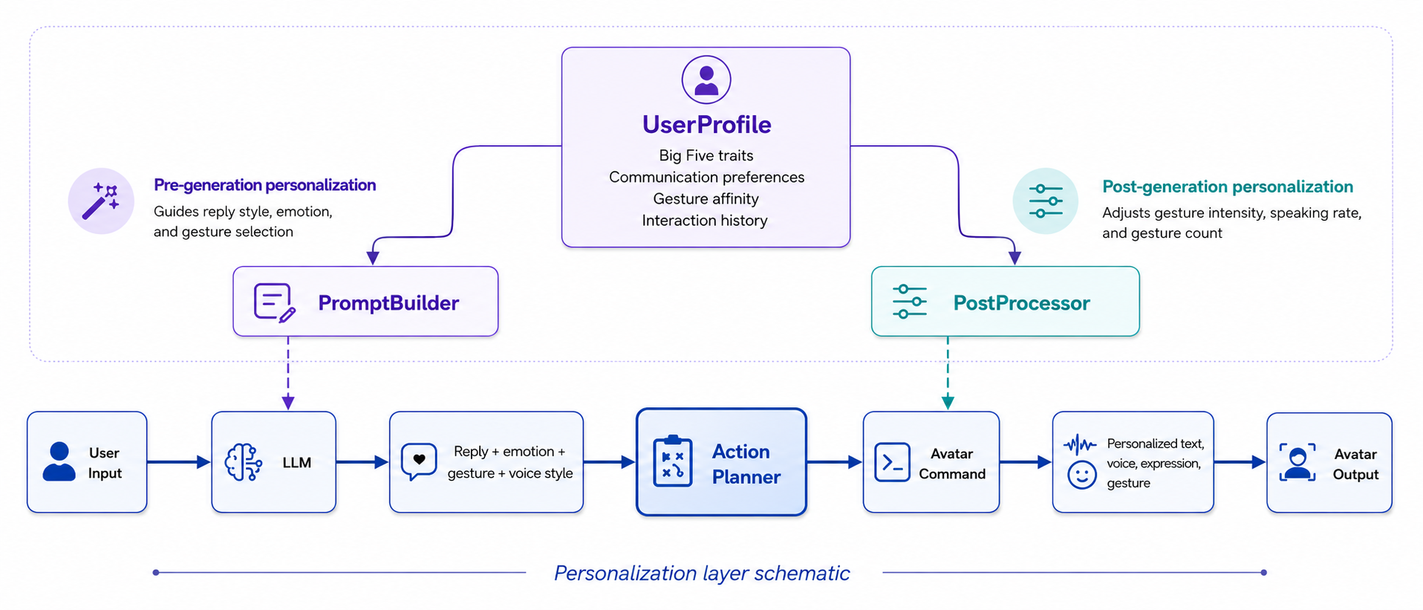
Personalization: Core Idea
Goal:
Make the avatar adapt not only what it says, but also how it speaks, feels, and moves.
UserProfile
Big Five traits
Communication preferences
Gesture affinity
Interaction history
Pre-generation personalization
Post-generation personalization
Guides reply style, emotion, and gesture selection
Adjusts gesture intensity, speaking rate, and gesture count
PromptBuilder
PostProcessor
Reply +
emotion +
gesture +
voice style
Personalized
text, voice,
expression,
gesture
User
Input
LLM
Action
Planner
Avatar
Command
Avatar
Output
[Personalization layer schematic]
Personalization is applied across text, emotion, voice, and avatar behavior, rather than only changing the prompt.
10/22

Slide 11
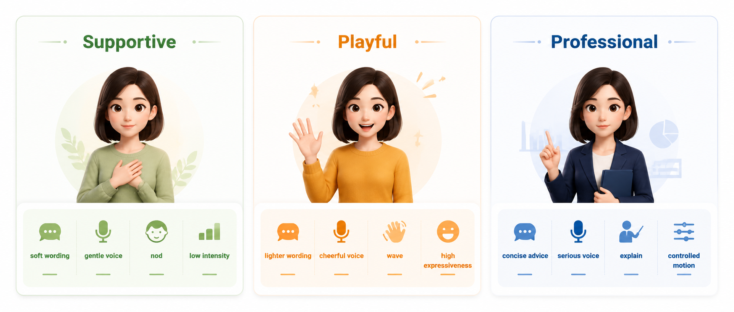
From User Profile to Avatar Behavior
Input: “I feel a little stressed about my project deadline.”
Supportive
Playful
Professional
soft wording
gentle voice
lighter wording
cheerful voice
concise advice
serious voice
nod
low intensity
wave
high expressiveness
explain
controlled motion
The same semantic reply can be embodied differently according to the active user profile.
11/22

Slide 12
Ablation: Personalization Matters
Result
❒
No persona: 1.4961
❒
Supportive_only: 0.5094
❒
Multi-persona: 0.5053
Takeaway
Persona conditioning reduces personality-target error by about 66%.
[Ablation on adapted InCharacter evaluation]
12/22

Slide 13
Roadmap
1
Part 1. Base Layer: End-to-End Pipeline
2
Part 2. Personalization Layer
3
Part 3. Innovation Layer: Action Planner and Embodied Response
4
Part 4. Interface, Evaluation, and Storytelling
13/22

Slide 14
Innovation Layer: Action Planner
Core Innovation
The system does not only generate text. It generates an embodied response that can be performed by a virtual avatar.
Semantic
Reply
Action
Planner
Avatar
Command
Live2D
Motion
Normalization + consistency rules + cooldown + executable command schema
14/22

Slide 15
Action Planner Demo Cases
Suggested Demo Cases
Media to Add
❒
Joy: wave + smile + cheerful voice.
❒
Live2D/Prometheus browser screenshot.
❒
Stress support: concerned expression + nod + gentle voice.
❒
A few key frames from the demo video.
Explanation: thinking expression + explain gesture + calm voice.
❒
Synchronized text, audio, expression, and gesture states.
❒
[Demo placeholders kept for real screenshots]
15/22

Slide 16
Roadmap
1
Part 1. Base Layer: End-to-End Pipeline
2
Part 2. Personalization Layer
3
Part 3. Innovation Layer: Action Planner and Embodied Response
4
Part 4. Interface, Evaluation, and Storytelling
16/22

Slide 17
Interface: Gradio + Prometheus Bridge
What to Show
HAI Avatar Demo UI
❒
Gradio chat UI.
❒
Prometheus Live2D browser bridge.
User: I feel stressed about my project.
❒
Synchronized text response, audio, and avatar motion state.
Avatar: Let’s break it into smaller steps...
emotion: supportive
expression: soft_smile
gesture: nod
voice: gentle
[Schematic reconstruction of UI behavior]
17/22

Slide 18
CharacterEval Result
Key Numbers
❒
Balanced adapted subset: 60 samples.
❒
Sampled CharacterRM: 36 scored records.
❒
Mean CharacterRM score: about 4.38 / 5.
❒
Strongest dimensions: Hallucination, Behavior, and Communication Skills.
[Adapted local evaluation, not official leaderboard]
18/22

Slide 19
InCharacter Multi-Persona Result
Key Numbers
❒
BFI: 3 personas × 44 items = 132 records.
❒
Macro MAE: 0.5053.
❒
Direction accuracy: 1.0 in the main run.
❒
Persona conditioning is controllable and stable.
[Adapted InCharacter BFI evaluation]
19/22

Slide 20
Follow-up Evaluation
BFI repeat stability: aggregate macro MAE mean 0.4913, std 0.0197. Empathy questionnaire: direction accuracy 1.0, with a visible helpful-assistant empathy bias.
20/22

Slide 21
Final Story
Claim
HAI is not simply a chatbot with a face. It is a structured pipeline that turns language into stable, personalized, embodied interaction.
❒
Base layer: the system runs end to end with replaceable real API, TTS, and avatar components.
❒
Personalization layer: explicit persona conditioning reduces personality-target error.
❒
Innovation layer: Action Planner turns semantic replies into executable avatar actions.
❒
Evaluation layer: CharacterEval and InCharacter adapted evaluations show stable system-level behavior.
21/22

Slide 22
Thank you!
Any questions?
22/22

