Slide 1

HAI Course Project Presentation
HAI Chat Avatar
An Emotion- and Gesture-Aware Virtual Chat Companion
Authors
July 26, 2026
AI Thrust
HKUST (GZ)

Slide 2
Table of Contents
1
Part 1. Base Layer: End-to-End Pipeline
2
Part 2. Personalization Layer
3
Part 3. Innovation Layer: Action Planner and Embodied Response
4
Part 4. Interface, Evaluation, and Storytelling
2/22

Slide 3
Roadmap
1
Part 1. Base Layer: End-to-End Pipeline
2
Part 2. Personalization Layer
3
Part 3. Innovation Layer: Action Planner and Embodied Response
4
Part 4. Interface, Evaluation, and Storytelling
3/22

Slide 4
Base Layer: What It Enables
A stable bridge from user language to avatar behavior
Current Implementation
LLM: Mock / OpenAI-compatible
TTS: Mock / Edge TTS
Avatar: Mock / Prometheus
UI: CLI / Gradio / Browser bridge
Tests: 36 passed
The base layer turns one text turn into a multimodal result: reply text, voice, expression, gesture, and executable avatar state.
Input
User text
Recent history
Optional profile
Pipeline
LLM -> Parser
Planner -> TTS
Avatar controller
Output
Reply text
AvatarCommand
Audio path
Base layer = runnable system boundary
4/22

Slide 5
End-to-End Data Flow
One pipeline turn is split into explicit, testable stages.
User Text
History
last 3 turns
Profile
optional
LLM
provider
JSON
parser
Action
planner
Post
processor
TTS
audio
Avatar
motion
Result
contract
base
innovation hook
personalization hook
Main code path: src/hai_avatar/services/pipeline_service.py::PipelineService.process
5/22

Slide 6
Pipeline Execution: From Turn to State Update
1. Guardrails
strip input
length check
empty input error
2. Context
profile load
personalized prompt
recent history
3. Generation
LLM call
retry policy
raw output kept
4. Validation
JSON parsing
schema repair
neutral fallback
5. Embodiment
action planning
TTS audio
avatar playback
Why this matters
The avatar can fail softly instead of crashing a live demo.
Every turn returns both behavior and diagnostics.
One-sentence summary
The base layer is a stateful, fallback-aware, multi-provider orchestration layer.
6/22

Slide 7
Base Layer Demo: Input, Output, and Observable Behavior
Example input
"I feel stressed about my project."
Natural reply
Break the problem down.
Offer supportive next steps.
Embodied output
soft_smile
nod + explain
gentle voice
Structured output fields
What to show live
Text response appears in the UI.
Speech audio is generated.
Avatar expression switches to supportive/concerned.
Gesture trigger is visible in Prometheus/Live2D.
reply_text
natural-language response
emotion
supportive
expression
concerned / soft_smile
gestures
nod, explain
voice_style
gentle / calm
audio_path
assets/audio/*.wav
7/22

Slide 8
Reliability: Fallbacks and Test Coverage
LLM error
retry -> neutral fallback
Invalid JSON
repair -> schema-safe output
TTS failure
mock audio fallback
Avatar failure
record warning, return result
Tested behavior
JSON parsing and fallback
Action normalization
Mock providers and full pipeline
Personalization profile state
Demo confidence
External services are replaceable.
Failures are visible in warnings.
Current verification: 36 tests passed.
No single external failure should break the full turn.
8/22

Slide 9
Roadmap
1
Part 1. Base Layer: End-to-End Pipeline
2
Part 2. Personalization Layer
3
Part 3. Innovation Layer: Action Planner and Embodied Response
4
Part 4. Interface, Evaluation, and Storytelling
9/22

Slide 10
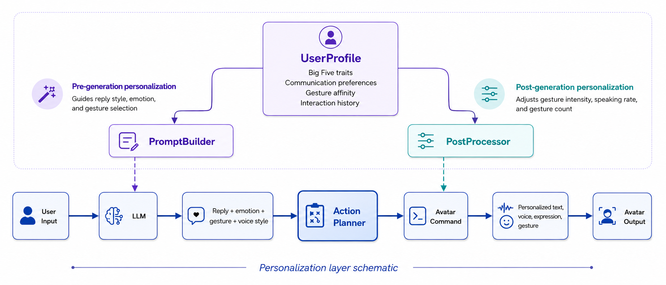
Personalization: Core Idea
Goal:
Make the avatar adapt not only what it says, but also how it speaks, feels, and moves.
UserProfile
Big Five traits
Communication preferences
Gesture affinity
Interaction history
Pre-generation personalization
Post-generation personalization
Guides reply style, emotion, and gesture selection
Adjusts gesture intensity, speaking rate, and gesture count
PromptBuilder
PostProcessor
Reply +
emotion +
gesture +
voice style
Personalized
text, voice,
expression,
gesture
User
Input
LLM
Action
Planner
Avatar
Command
Avatar
Output
[Personalization layer schematic]
Personalization is applied across text, emotion, voice, and avatar behavior, rather than only changing the prompt.
10/22

Slide 11
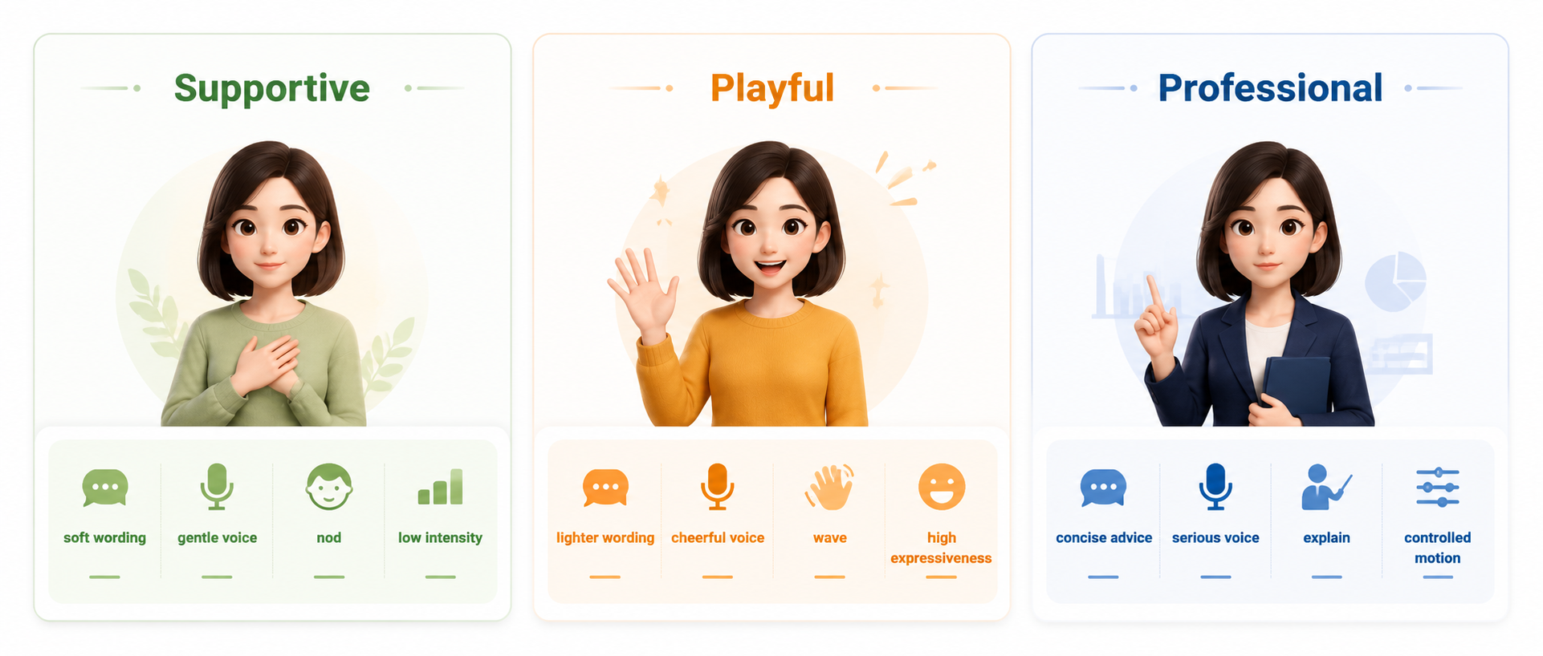
From User Profile to Avatar Behavior
Input: “I feel a little stressed about my project deadline.”
Supportive
Playful
Professional
soft wording
gentle voice
lighter wording
cheerful voice
concise advice
serious voice
nod
low intensity
wave
high expressiveness
explain
controlled motion
The same semantic reply can be embodied differently according to the active user profile.
11/22

Slide 12
Ablation: Personalization Matters
Result
❒
No persona: 1.4961
❒
Supportive_only: 0.5094
❒
Multi-persona: 0.5053
Takeaway
Persona conditioning reduces personality-target error by about 66%.
[Ablation on adapted InCharacter evaluation]
12/22

Slide 13
Roadmap
1
Part 1. Base Layer: End-to-End Pipeline
2
Part 2. Personalization Layer
3
Part 3. Innovation Layer: Action Planner and Embodied Response
4
Part 4. Interface, Evaluation, and Storytelling
13/22

Slide 14
Innovation Layer: Action Planner
Core Innovation
The system does not only generate text. It generates an embodied response that can be performed by a virtual avatar.
Semantic
Reply
Action
Planner
Avatar
Command
Live2D
Motion
Normalization + consistency rules + cooldown + executable command schema
14/22

Slide 15
Action Planner Demo Cases
Suggested Demo Cases
Media to Add
❒
Joy: wave + smile + cheerful voice.
❒
Live2D/Prometheus browser screenshot.
❒
Stress support: concerned expression + nod + gentle voice.
❒
A few key frames from the demo video.
Explanation: thinking expression + explain gesture + calm voice.
❒
Synchronized text, audio, expression, and gesture states.
❒
[Demo placeholders kept for real screenshots]
15/22

Slide 16
Roadmap
1
Part 1. Base Layer: End-to-End Pipeline
2
Part 2. Personalization Layer
3
Part 3. Innovation Layer: Action Planner and Embodied Response
4
Part 4. Interface, Evaluation, and Storytelling
16/22

Slide 17
Interface: Gradio + Prometheus Bridge
What to Show
HAI Avatar Demo UI
❒
Gradio chat UI.
❒
Prometheus Live2D browser bridge.
User: I feel stressed about my project.
❒
Synchronized text response, audio, and avatar motion state.
Avatar: Let’s break it into smaller steps...
emotion: supportive
expression: soft_smile
gesture: nod
voice: gentle
[Schematic reconstruction of UI behavior]
17/22

Slide 18
CharacterEval Result
Key Numbers
❒
Balanced adapted subset: 60 samples.
❒
Sampled CharacterRM: 36 scored records.
❒
Mean CharacterRM score: about 4.38 / 5.
❒
Strongest dimensions: Hallucination, Behavior, and Communication Skills.
[Adapted local evaluation, not official leaderboard]
18/22

Slide 19
InCharacter Multi-Persona Result
Key Numbers
❒
BFI: 3 personas × 44 items = 132 records.
❒
Macro MAE: 0.5053.
❒
Direction accuracy: 1.0 in the main run.
❒
Persona conditioning is controllable and stable.
[Adapted InCharacter BFI evaluation]
19/22

Slide 20
Follow-up Evaluation
BFI repeat stability: aggregate macro MAE mean 0.4913, std 0.0197. Empathy questionnaire: direction accuracy 1.0, with a visible helpful-assistant empathy bias.
20/22

Slide 21
Final Story
Claim
HAI is not simply a chatbot with a face. It is a structured pipeline that turns language into stable, personalized, embodied interaction.
❒
Base layer: the system runs end to end with replaceable real API, TTS, and avatar components.
❒
Personalization layer: explicit persona conditioning reduces personality-target error.
❒
Innovation layer: Action Planner turns semantic replies into executable avatar actions.
❒
Evaluation layer: CharacterEval and InCharacter adapted evaluations show stable system-level behavior.
21/22

Slide 22
Thank you!
Any questions?
22/22

