Slide 1
PyTorch
Deep Learning

Slide 2


Deep Learning Framework
TensorFlow (Google)
Torch → PyTorch (Facebook)
Theano (2007 OpenSource Python)
Keras (on top of Theano or Tensorflow)
Caffe (Berkerly 2013)
CNTK (Microsoft)
MxNet (OpenSource)
Neon (Intel Nervana's reference deep learning framework)

Slide 3
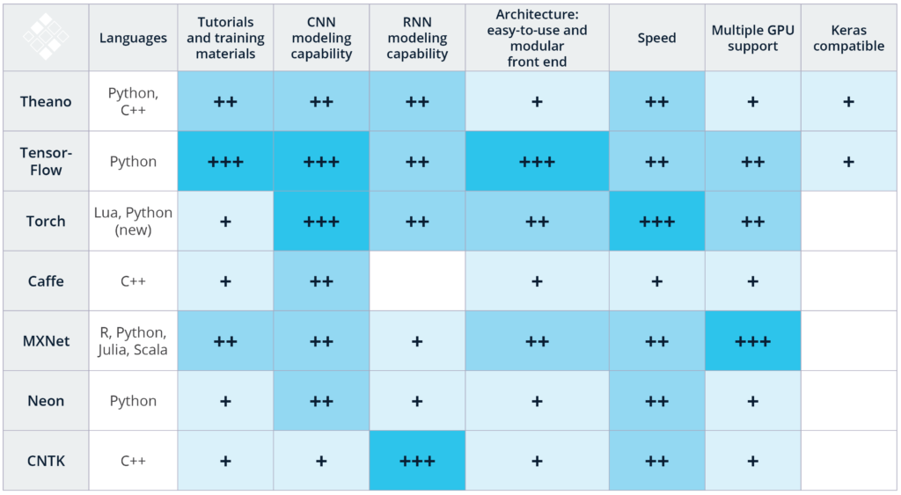
https://zhuanlan.zhihu.com/p/25285133

Slide 4
What is PyTorch?
Python based scientific computing package targeted at two sets of audiences:
A replacement for numpy to use the power of GPUs
a deep learning research platform that provides maximum flexibility and speed
PyTorch provides two main features:
An n-dimensional Tensor, similar to numpy but can run on GPUs
Automatic differentiation for building and training neural networks
Tensors
Autograd
nn module
PyTorch: nn
PyTorch: optim
PyTorch: Custom nn Modules
PyTorch: Control Flow + Weight Sharing

Slide 5
Tensors
Tensors are similar to numpy’s ndarrays:
Create Tensor
import torch
x = torch.Tensor(5, 3)
print(x)
Construct a randomly initialized matrix
x = torch.rand(5, 3)
Get its size
print(x.size())

Slide 6
Tensors
Operations
Addition
y = torch.rand(5, 3)
print(x + y)
print(torch.add(x, y))
torch.add(x, y, out=result) #giving an output tensor
y.add_(x) #adds x to y
Use standard numpy-like indexing
print(x[:, 1])
Get its size
print(x.size())
Converting a torch Tensor to a numpy array and vice versa
Tensor to numpy
a = torch.ones(5)
b = a.numpy()
Numpy to Tensor
a = np.ones(5)
b = torch.from_numpy(a)

Slide 7
Tensors
CUDA Tensors
Tensors can be moved onto GPU using the .cuda function
if torch.cuda.is_available():
x = x.cuda()
y = y.cuda()
x + y

Slide 8
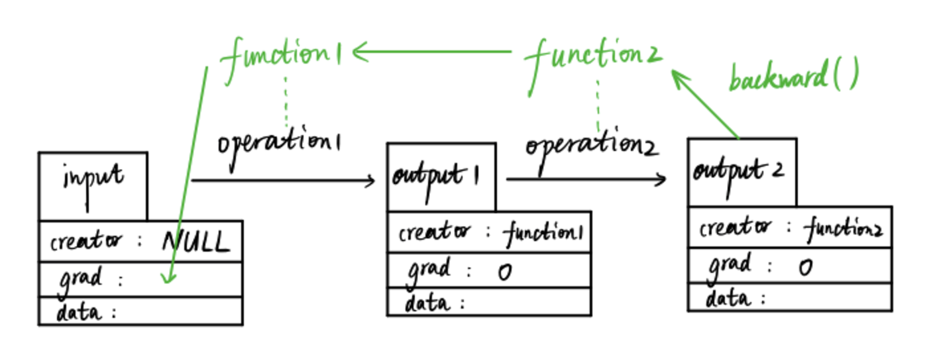
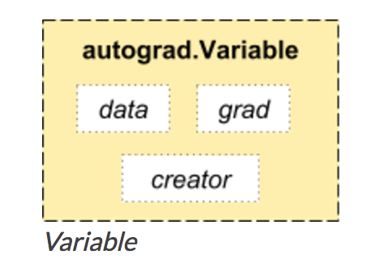
Autograd: automatic differentiation
The autograd package provides automatic differentiation for all operations on Tensors. It is a define-by-run framework, which means that your backprop is defined by how your code is run, and that every single iteration can be different.
autograd.Variable
autograd.Variable is the central class of the package.
You can access the raw tensor through the .data attribute, while the gradient w.r.t. this variable is accumulated into .grad. Each variable has a .creator attribute that references a Function that has created the Variable.

Slide 9
Autograd: automatic differentiation
#EXAMPLE
from torch import autograd
import variable
x = Variable(torch.ones(2, 2), requires_grad=True)
y = x + 2
print(y)
print(y.creator)
z = y * y * 3
out = z.mean()
print(z, out)

Slide 10
Autograd: Gradients
Gradients
out.backward() is equivalent to doing out.backward(torch.Tensor([1.0]))
out.backward()
print(x.grad)
torch.autograd.backward(variables, grad_variables=None, retain_graph=None, create_graph=None, retain_variables=None)
Computes the sum of gradients of given variables w.r.t. graph leaves.
The graph is differentiated using the chain rule.

Slide 11
Neural Network
Neural networks can be constructed using the torch.nn package.
An nn.Module contains layers, and a method forward(input)that returns the output.
A typical training procedure for a neural network is as follows:
Define the neural network that has some learnable parameters (or weights)
Iterate over a dataset of inputs
Process input through the network
Compute the loss (how far is the output from being correct)
Propagate gradients back into the network’s parameters
Update the weights of the network, typically using a simple update rule:weight = weight + learning_rate * gradient

Slide 12
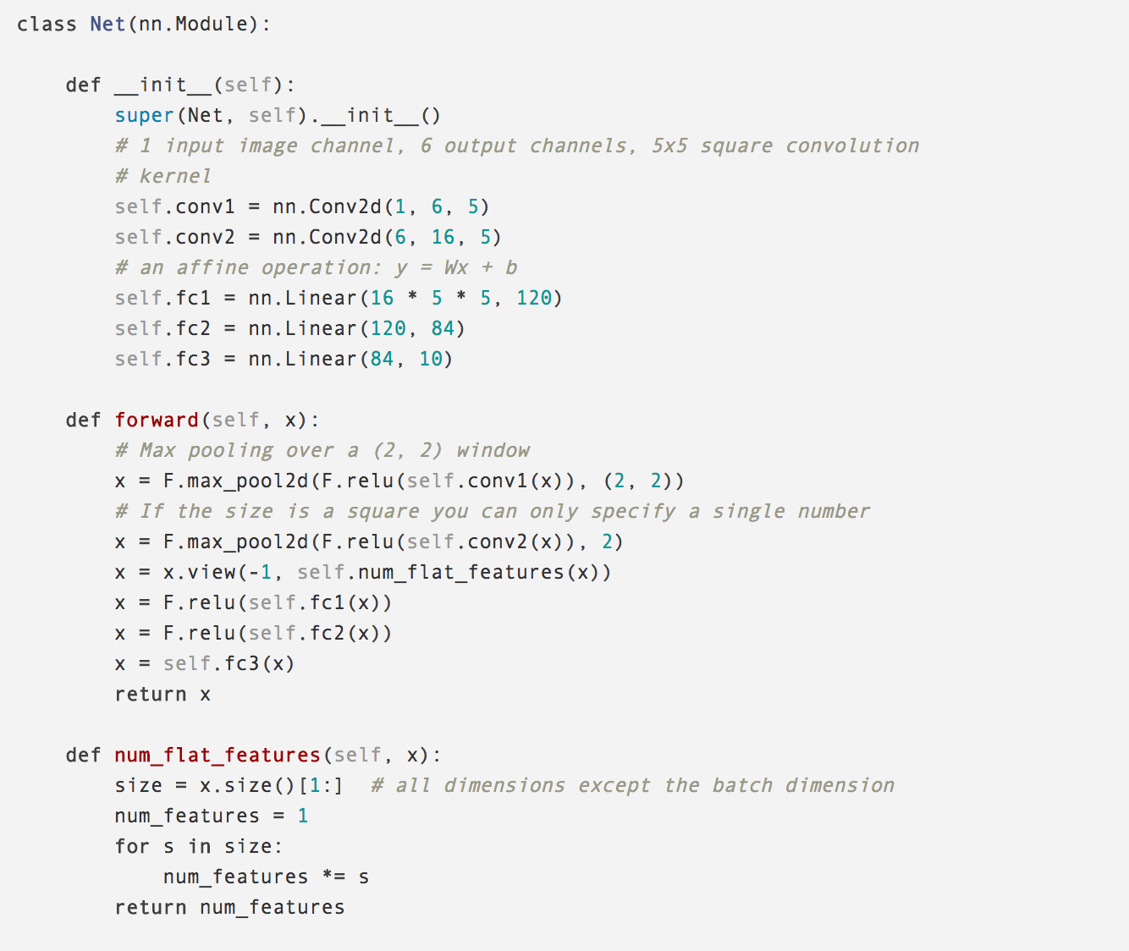
Neural Network
Define Network:
You just have to define the forward function, and the backward function (where gradients are computed) is automatically defined for you using autograd.
The input to the forward is an autograd.Variable.
input = Variable(torch.randn(1, 1, 32, 32))
out = net(input)
You can use any of the Tensor operations in the forward function.

Slide 13
forward and backward
The forward function computes output Tensors from input Tensors. The backward function receives the gradient of the output Tensors with respect to some scalar value, and computes the gradient of the input Tensors with respect to that same scalar value.

Slide 14
Recap
torch.Tensor - A multi-dimensional array.
autograd.Variable - Wraps a Tensor and records the history of operations applied to it. Has the same API as a Tensor, with some additions like backward(). Also holds the gradient w.r.t. the tensor.
nn.Module - Neural network module. Convenient way of encapsulating parameters, with helpers for moving them to GPU, exporting, loading, etc.
nn.Parameter - A kind of Variable, that is automatically registered as a parameter when assigned as an attribute to a Module.
autograd.Function - Implements forward and backward definitions of an autograd operation. Every Variable operation, creates at least a single Function node, that connects to functions that created a Variable and encodes its history*.

Slide 15
Loss Function
A loss function takes the (output, target) pair of inputs, and computes a value that estimates how far away the output is from the target.
There are several different loss functions under the nn package .
For example:
output = net(input)
target = Variable(torch.arange(1, 11))
criterion = nn.MSELoss()
loss = criterion(output, target)
print(loss)

Slide 16
Backprop
To backpropogate the error all we have to do is to loss.backward(). You need to clear the existing gradients though, else gradients will be accumulated to existing gradients
For example:
net.zero_grad() # zeroes the gradient buffers of all parameters
print('conv1.bias.grad before backward')
print(net.conv1.bias.grad)
loss.backward()
print('conv1.bias.grad after backward')
print(net.conv1.bias.grad)

Slide 17
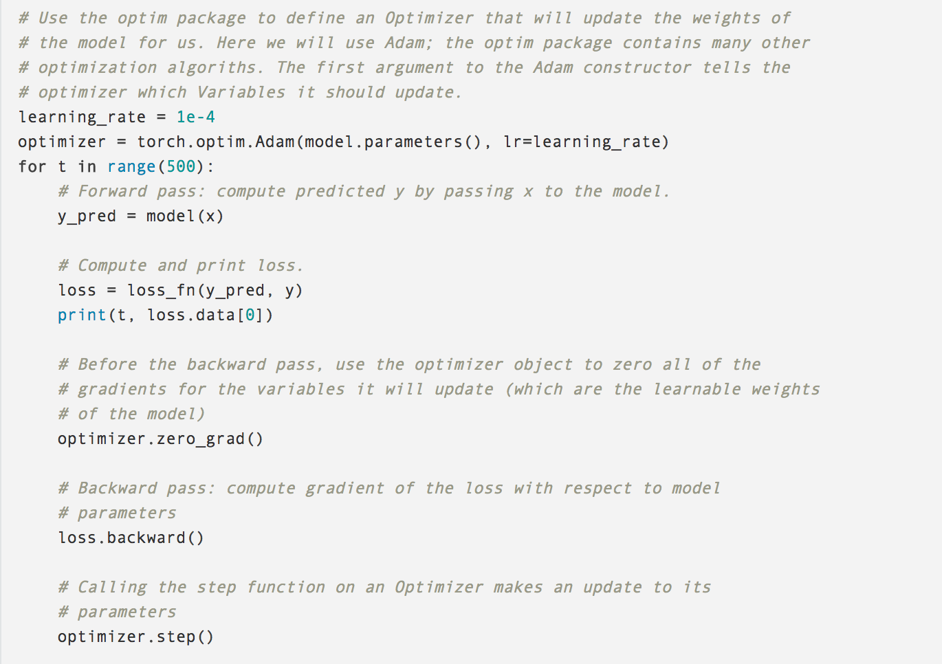
Update the weights
Use various different update rules such as SGD, Nesterov-SGD, Adam, RMSProp, etc. To enable this, we built a small package: torch.optim that implements all these methods.
The optim package in PyTorch abstracts the idea of an optimization algorithm and provides implementations of commonly used optimization algorithms.

Slide 18
Examples: Classification and Regression
Github: https://github.com/MorvanZhou/PyTorch-Tutorial

Slide 19
Example: CNN and GAN
Github: https://github.com/devnag/pytorch-generative-adversarial-networks
Introduction : https://medium.com/@devnag/generative-adversarial-networks-gans-in-50-lines-of-code-pytorch-e81b79659e3f

Slide 20
Reference
http://pytorch.org/tutorials/beginner/deep_learning_60min_blitz.html
https://github.com/devnag/pytorch-generative-adversarial-networks
https://medium.com/@devnag/generative-adversarial-networks-gans-in-50-lines-of-code-pytorch-e81b79659e3f
https://github.com/MorvanZhou/PyTorch-Tutorial

Slide 21
Thank you!
Questions?

