Slide 1

Sorting demonstration Group 15
Members
Hoàng Trần Nhật Minh – 20204883
Nguyễn Quang Minh – 20204884
Nguyễn Trần Xuân Mạnh – 20200385
Dương Vũ Tuấn Minh – 20209705

Slide 2
Problem statement
Array is the most basic structure of computer science. Most operations as well as other data structures are built and performed on an array. In this project, we will make an application to explain three sorting algorithms on an array: bubble sort, heap sort, and shell sort.

Slide 3
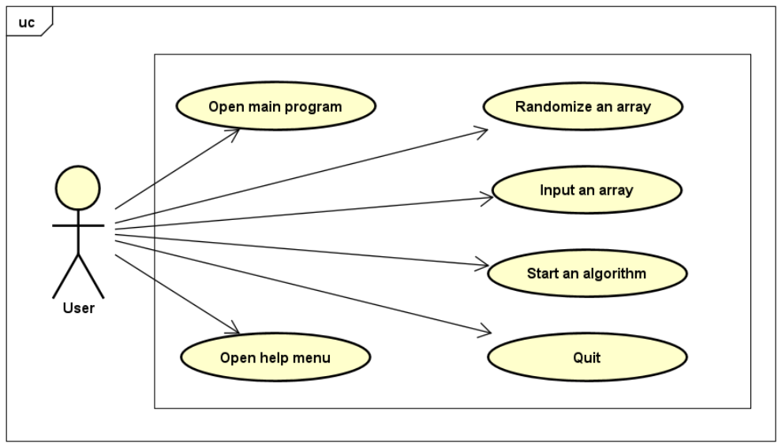
Usecase diagram

Slide 4
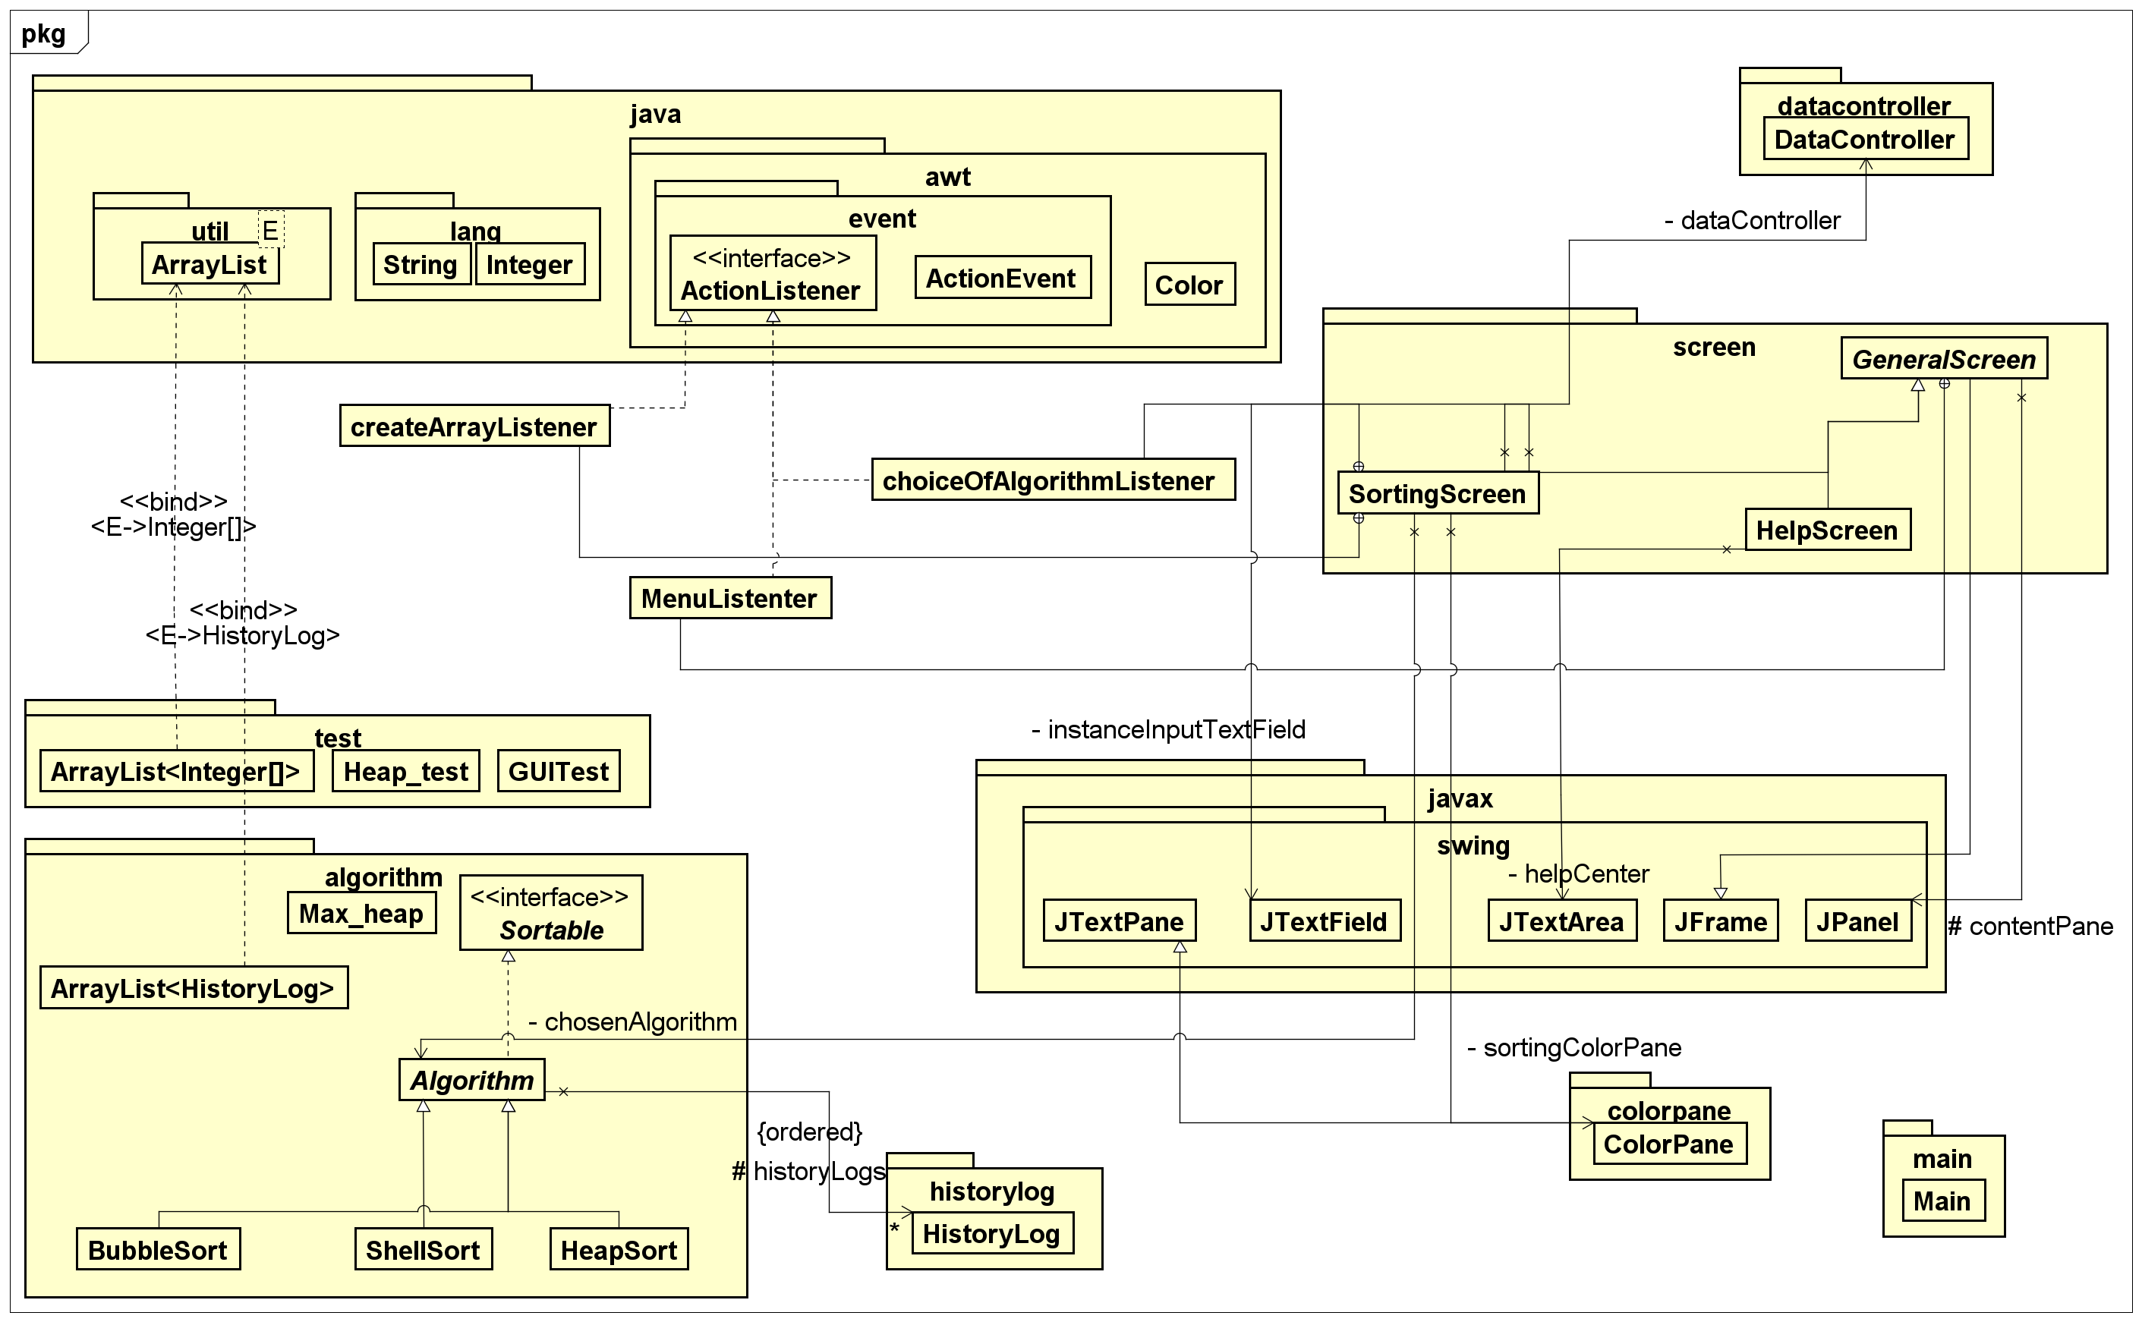
General Class diagram

Slide 5
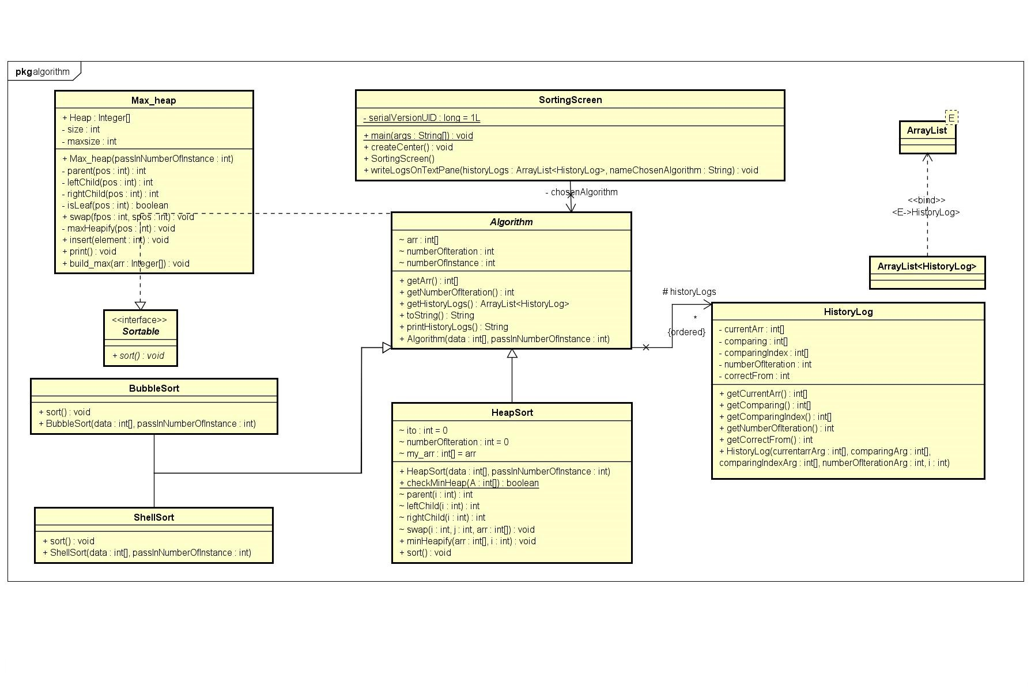
Diagrams for package algorithms

Slide 6
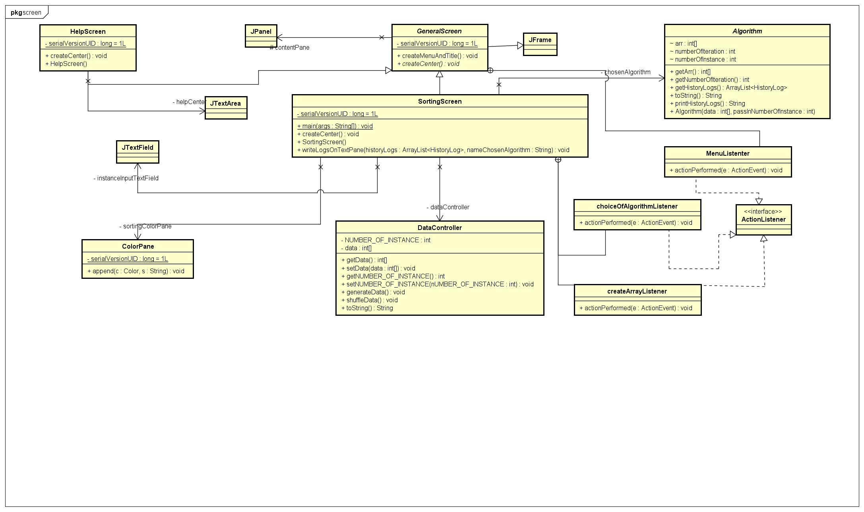
Diagrams for packages (2)
Diagrams for package screen

Slide 7

Explanation of each package
- algorithm: Include all the sorting algorithms for the system to use and for the users to demonstrate.
- colorpane: Include a JTextPane with a method to append colored text.
- datacontroller: Include a class that manipulate and control our array.
- historylog: Include a class that will record changes inside Algorithm.sort() method
- screen: Include all the screens in the application for the user to interact.
- test: test the GUI and heapsort
- main: Include the main() method for the program to run.

Slide 8

Each sort() method of all 3 algorithms has its own sorting process
An abstract method createCenter() (Abstraction) for the child classes to use and an inner class MenuListener that implements ActionListener interface.
HelpScreen and SortingScreen has its own process of createCenter() method.
Encapsulation
Attribute ‘arr’ and ‘numberOfIteration’ can be accessed through get method.
Attribute data and NUMBER_OF_INSTANCE can be accessed and modified through get and set method.
All attributes in HistoryLog are private attributes and can only be accessed through get method.
Polymorphism

Slide 9

Inheritance
BubbleSort, HeapSort, ShellSort inherit from class Algorithm (Inheritance) and implement Sortable interface.
HelpScreen and SortingScreen inherit GeneralScreen (Inheritance)
GeneralScreen is an abstract class (Abstraction) that inherits JFrame class from Java Swing (Inheritance).
ColorPane class inherits JTextPane class from Java Swing (Inheritance).

Slide 10


Demo video
https://husteduvn-my.sharepoint.com/:v:/g/personal/manh_ntx200385_sis_hust_edu_vn/EVvTJEAp5bZNumfG0cItZR8BNviyXSpxAc7h5_D6RQ0Okw?e=00b1iq

