Slide 1
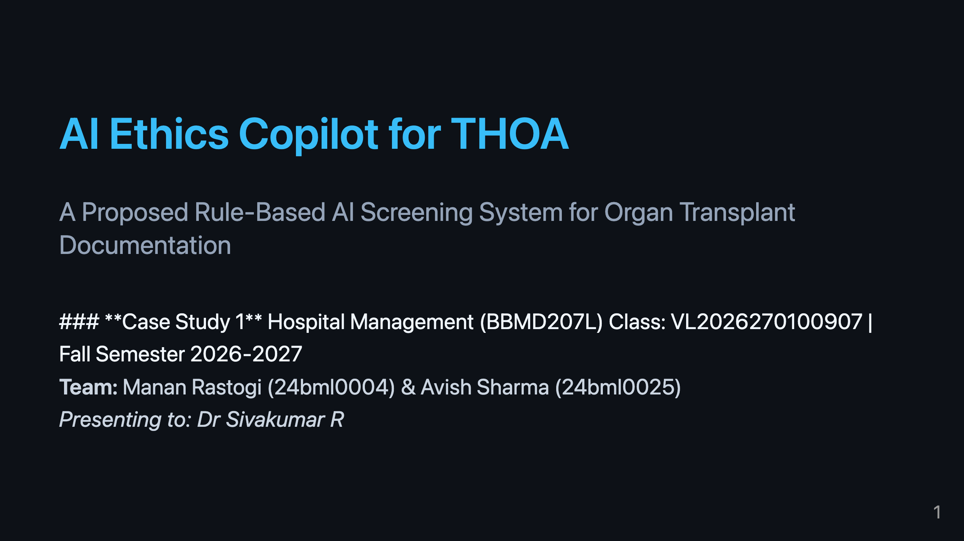
Notes:
Speaker Notes:
Good morning Dr. Sivakumar and class. Today we are presenting Case Study 1: an AI Ethics Copilot designed to assist with compliance for the Transplantation of Human Organs Act, or THOA.

Slide 2
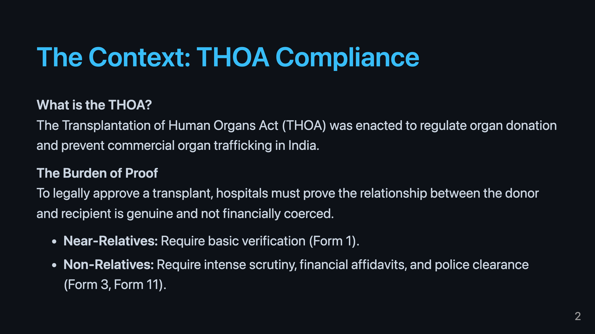
Notes:
The THOA is the legal bedrock of our project. It dictates that every transplant must undergo strict verification. The rules change dramatically depending on whether the donor and recipient are related, making the compliance process highly dynamic and complex.

Slide 3
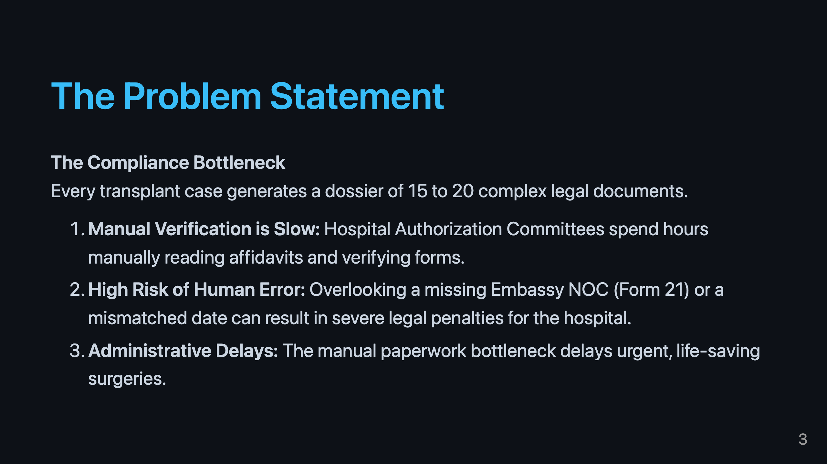
Notes:
The core problem we are solving is administrative bottleneck. When a committee spends all their time checking if a PDF has the right signature, they have less time to evaluate the actual ethics of the case. Furthermore, human error in this process carries massive legal risk.

Slide 4
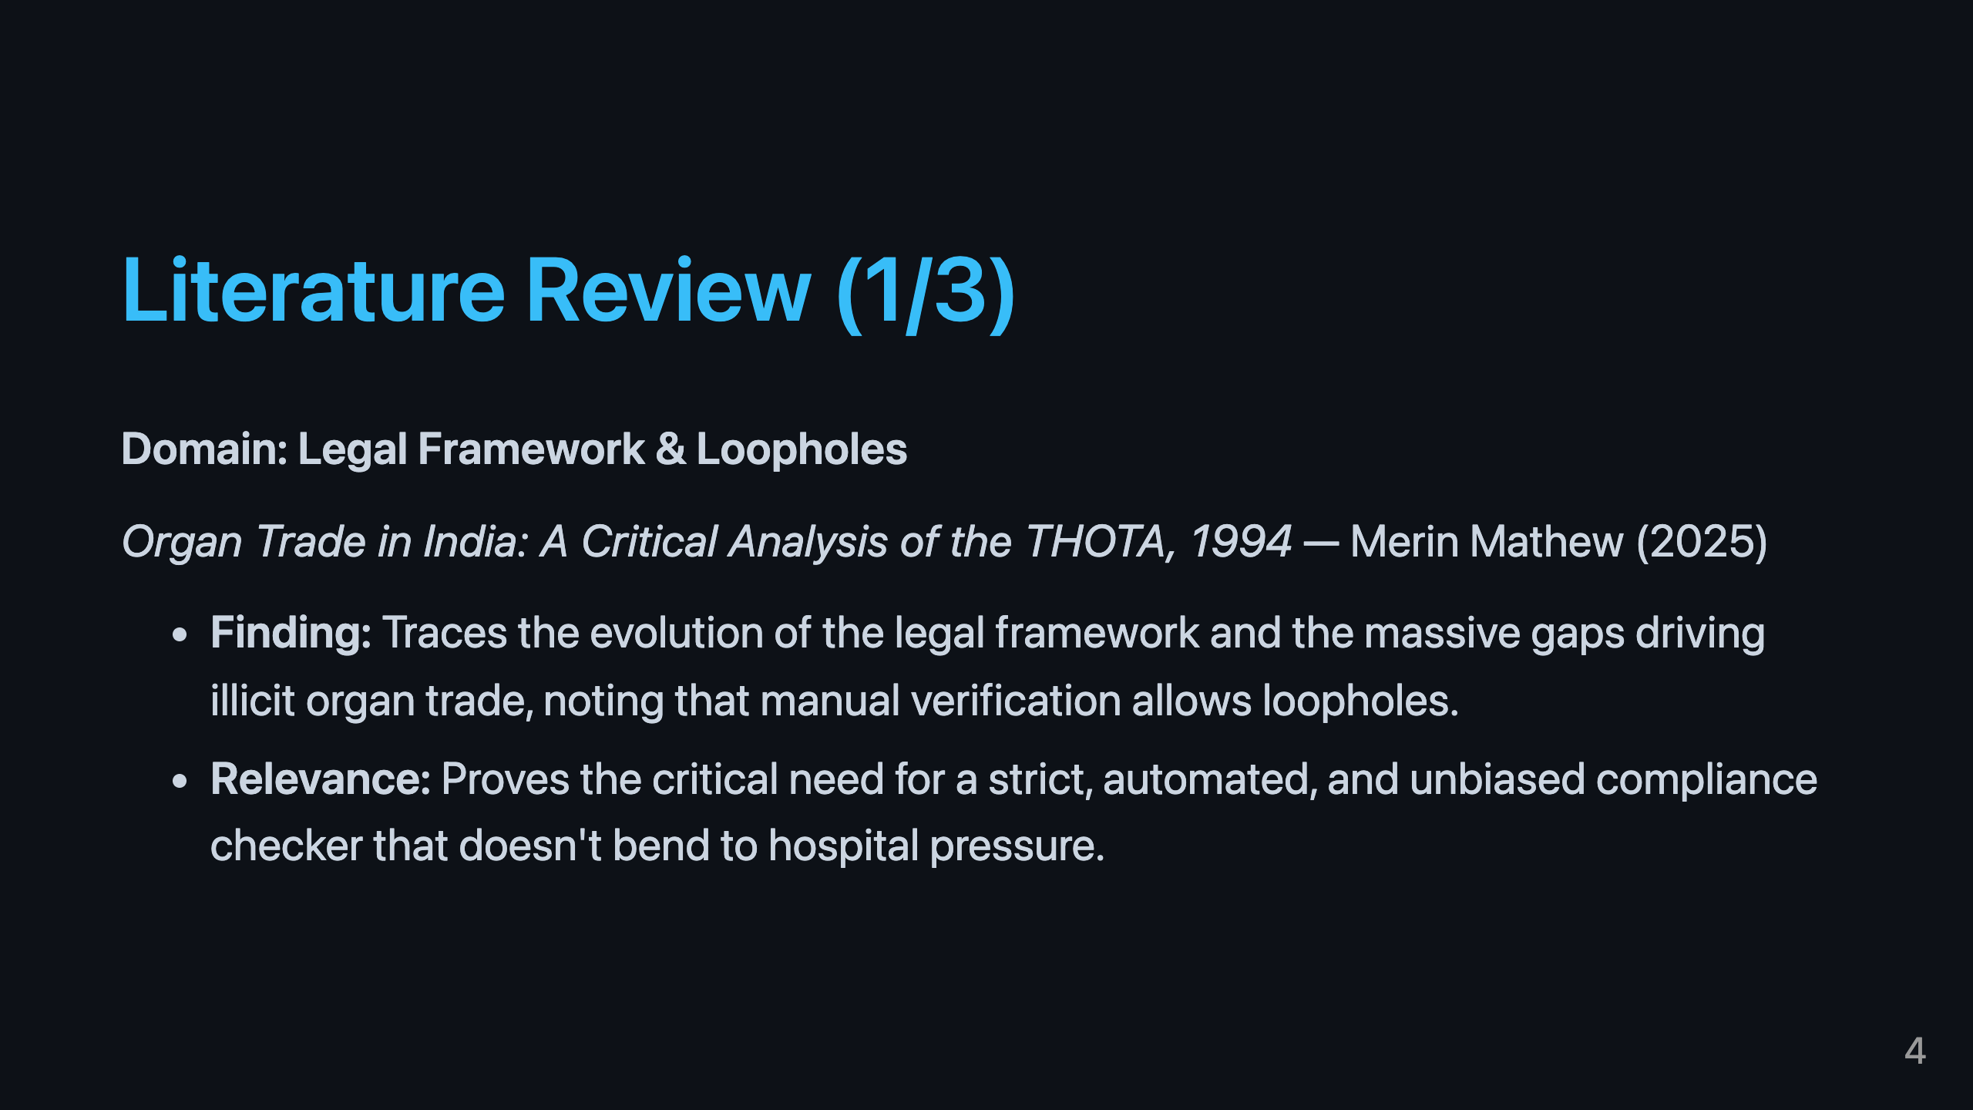
Notes:
To ground our proposal, we looked at existing literature. Dr. Sunil Shroff's 2009 paper clearly outlines the exact loopholes our system targets: how forged or incomplete documents slip past human committees. This justifies the need for an automated, objective filter.

Slide 5
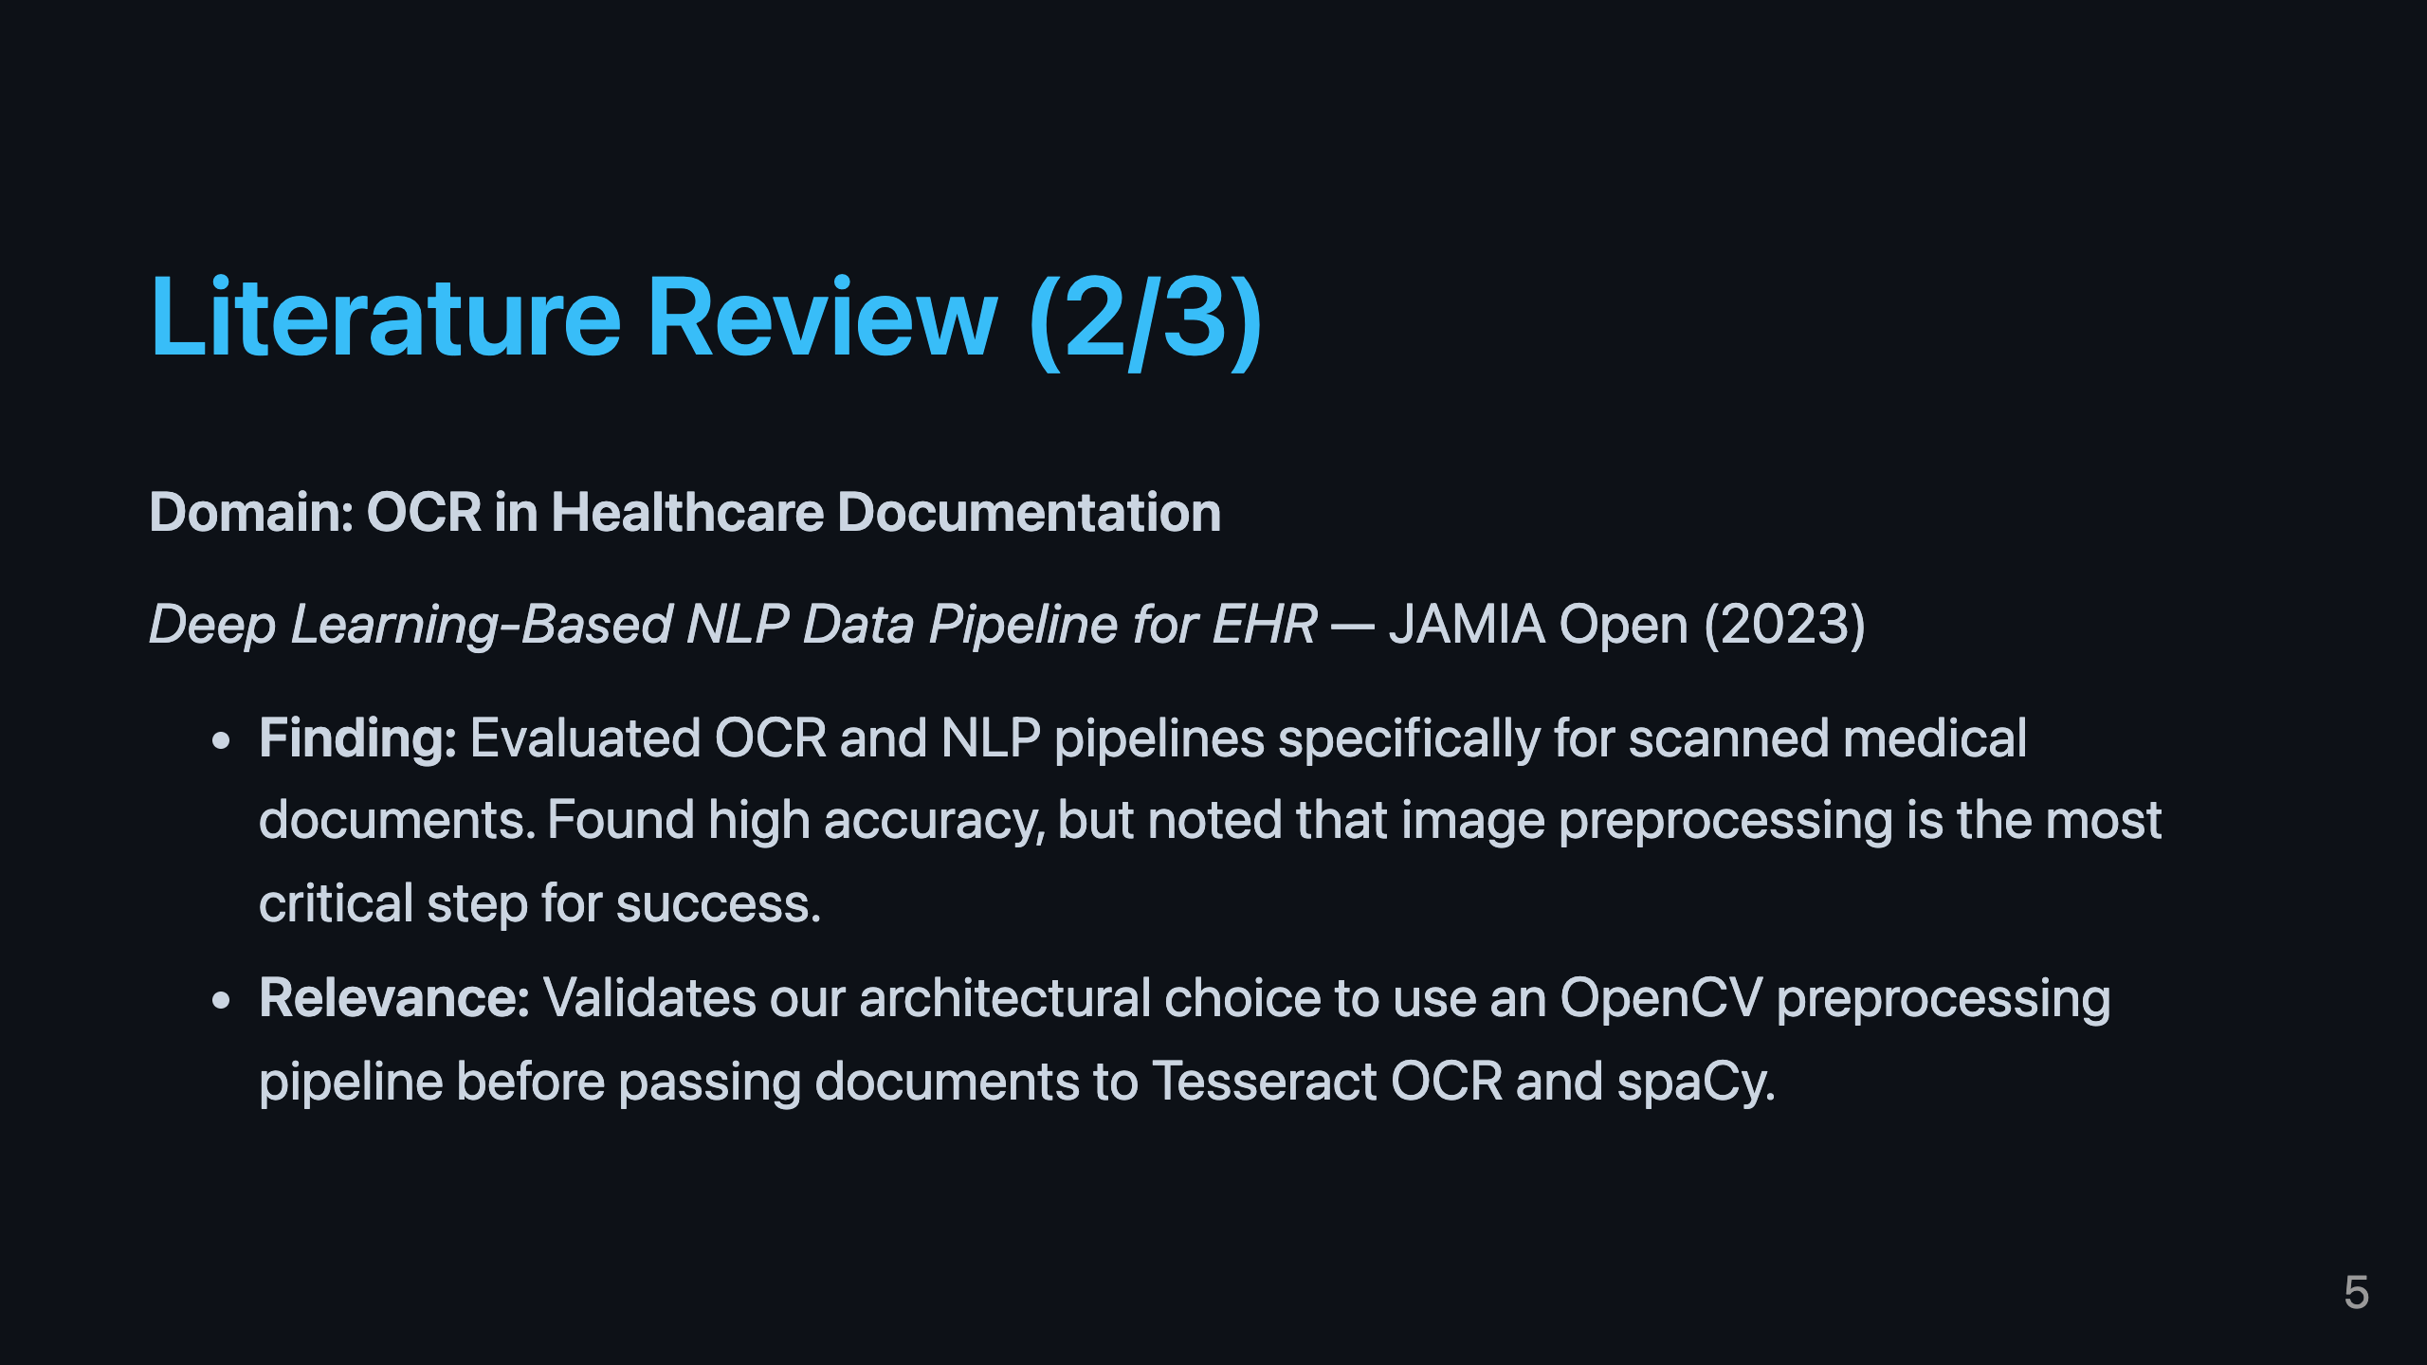
Notes:
On the technical side, the 2023 JAMIA Open paper confirms that applying OCR to medical documents is viable, but emphasizes that raw OCR will fail on noisy hospital scans without proper image preprocessing—which informed our pipeline design.

Slide 6
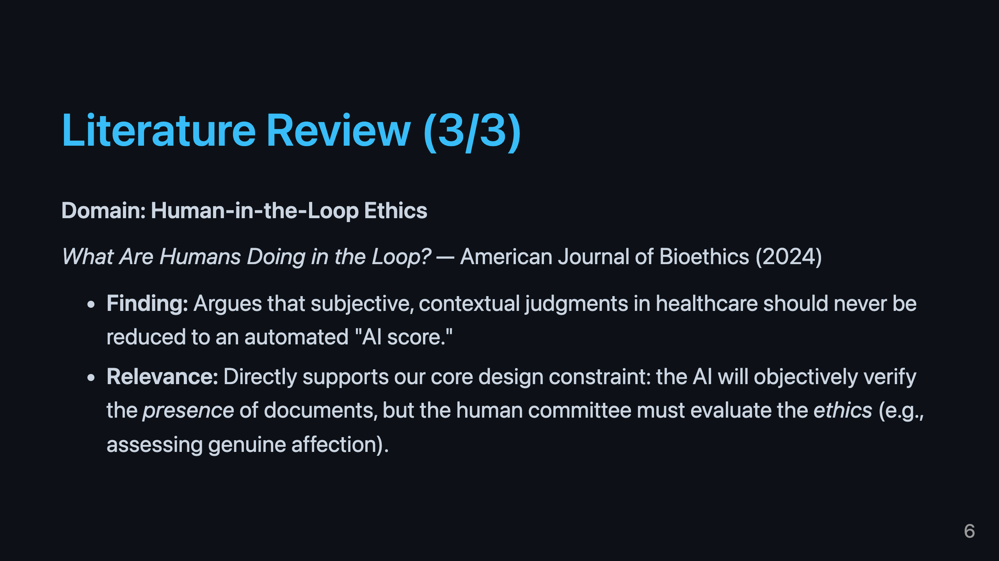
Notes:
Finally, the ethical literature strongly warns against replacing human judgment. The 2024 AJOB paper validates our decision to make this an "advisory" system that flags missing paperwork, rather than a system that makes the final approval decision.

Slide 7
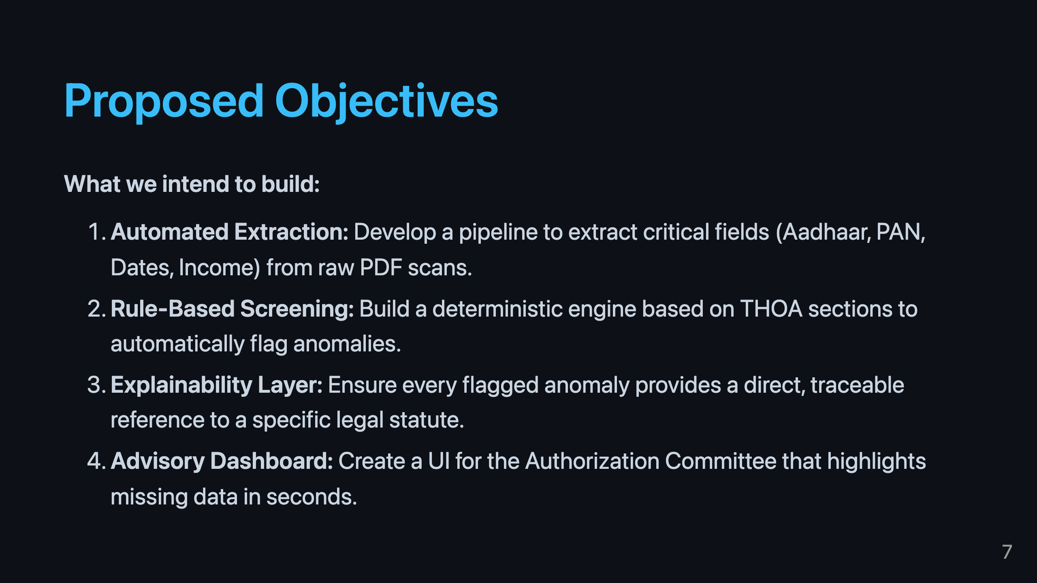
Notes:
Based on this research, our objectives are clear: extract the data, run it through deterministic rules, explain why a rule failed, and present it clearly to the committee.

Slide 8
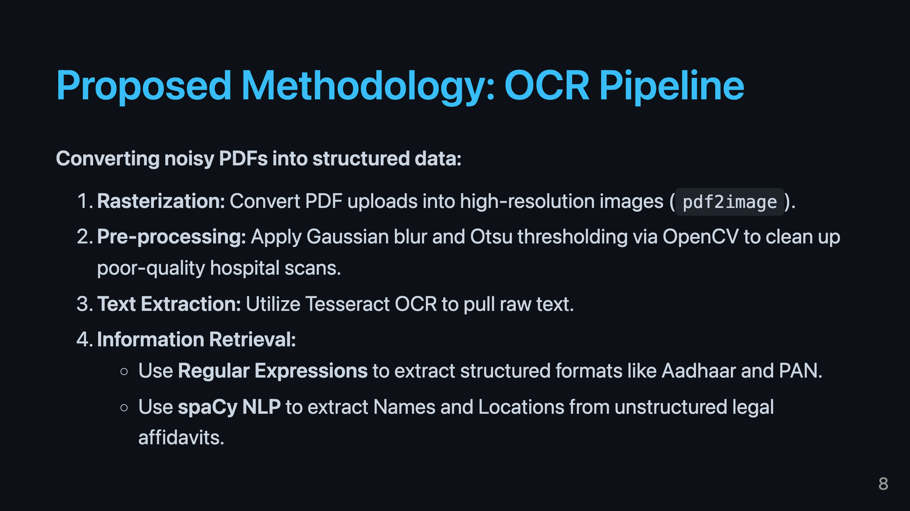
Notes:
Our methodology starts with data extraction. We don't just run basic OCR; we use a multi-step pipeline with OpenCV to clean the images first, ensuring we get high-quality text for our NLP models to analyze.

Slide 9
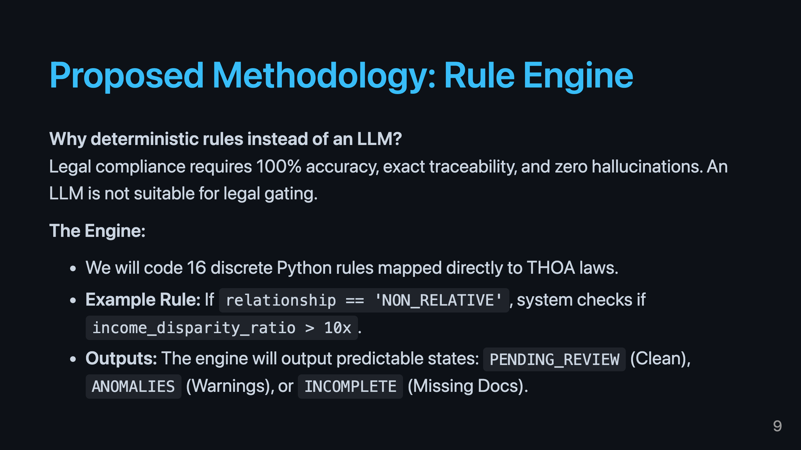
Notes:
For the actual decision making, we explicitly chose a deterministic rule engine over an LLM. In legal compliance, hallucinations are unacceptable. We need a system that predictably outputs the exact same flag for the exact same missing document every time.

Slide 10
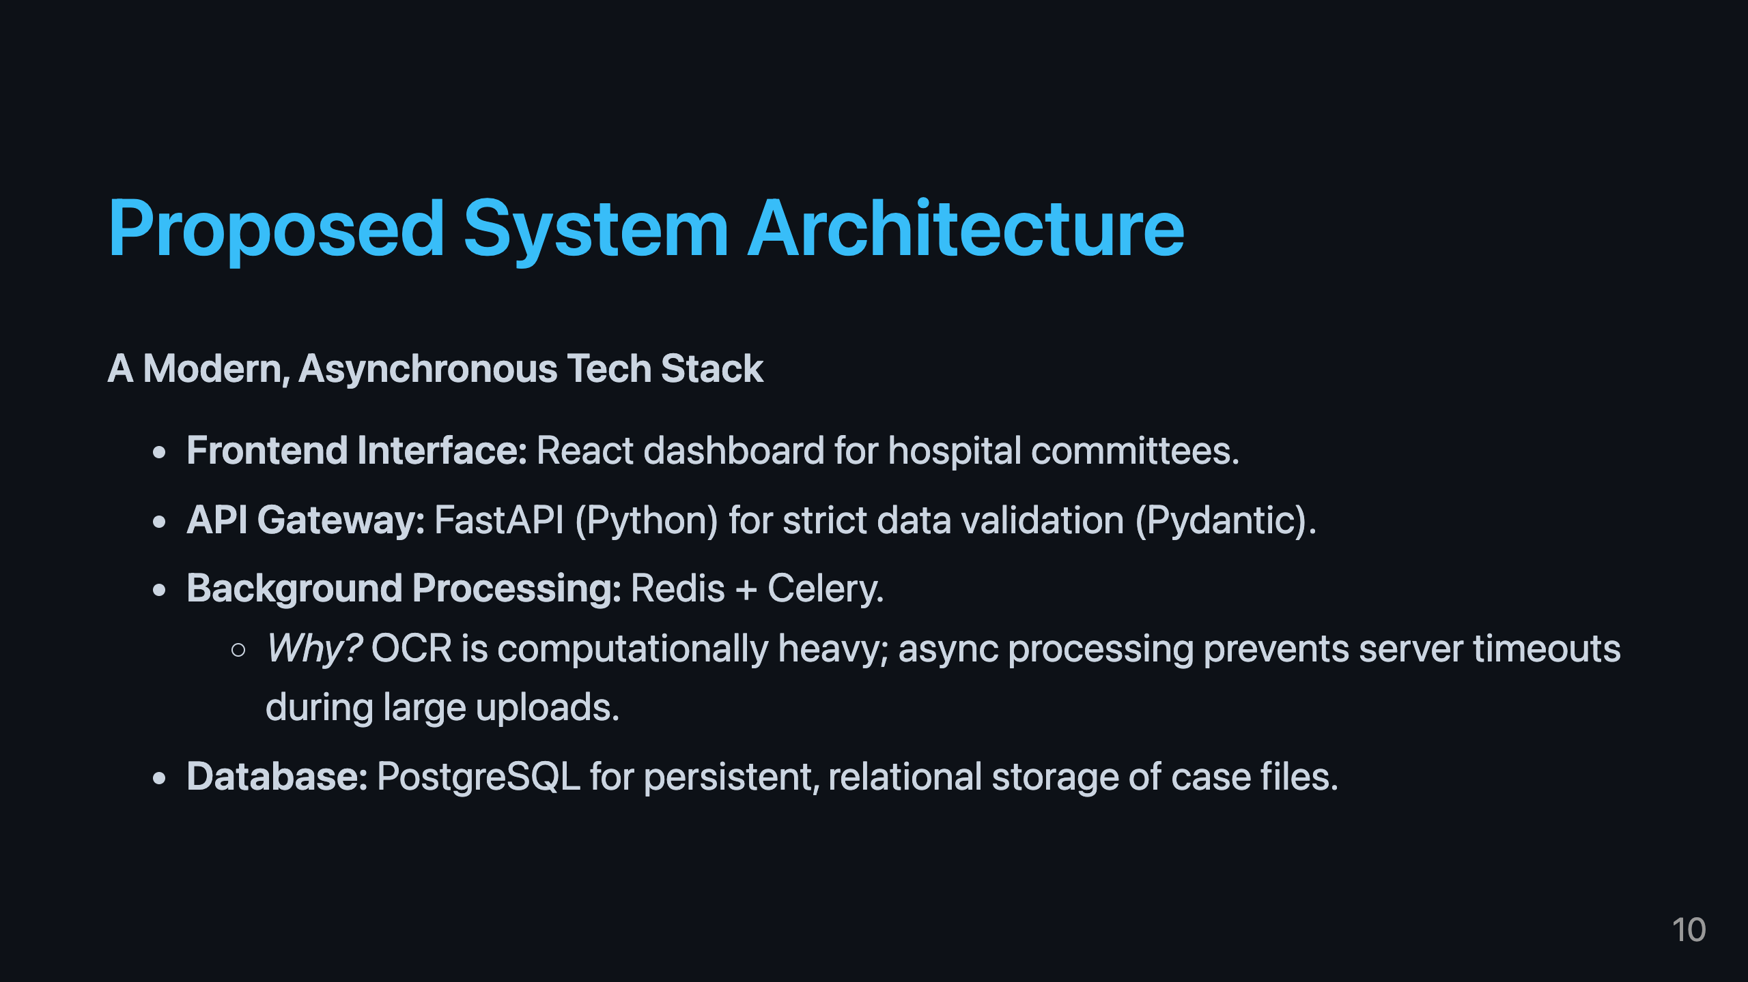
Notes:
Our proposed architecture uses a modern Python stack. The key feature here is the use of Celery and Redis to handle the OCR in the background, ensuring the web interface remains responsive even when uploading a 40-page dossier.

Slide 11
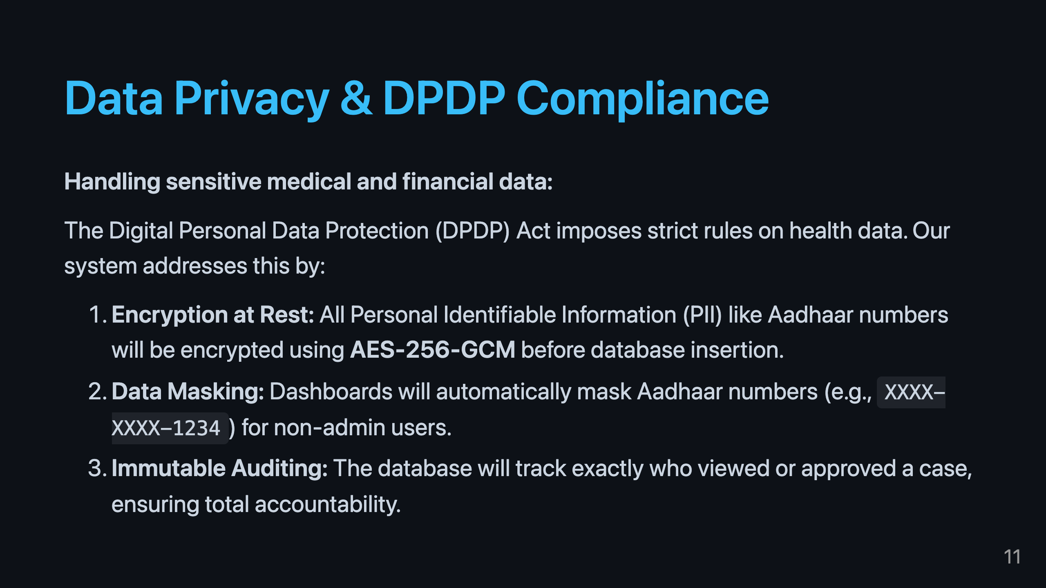
Notes:
Because we are handling medical and financial data, privacy is paramount. We are designing the system with DPDP Act compliance from day one, utilizing AES-256 encryption and data masking to protect donor identities.

Slide 12
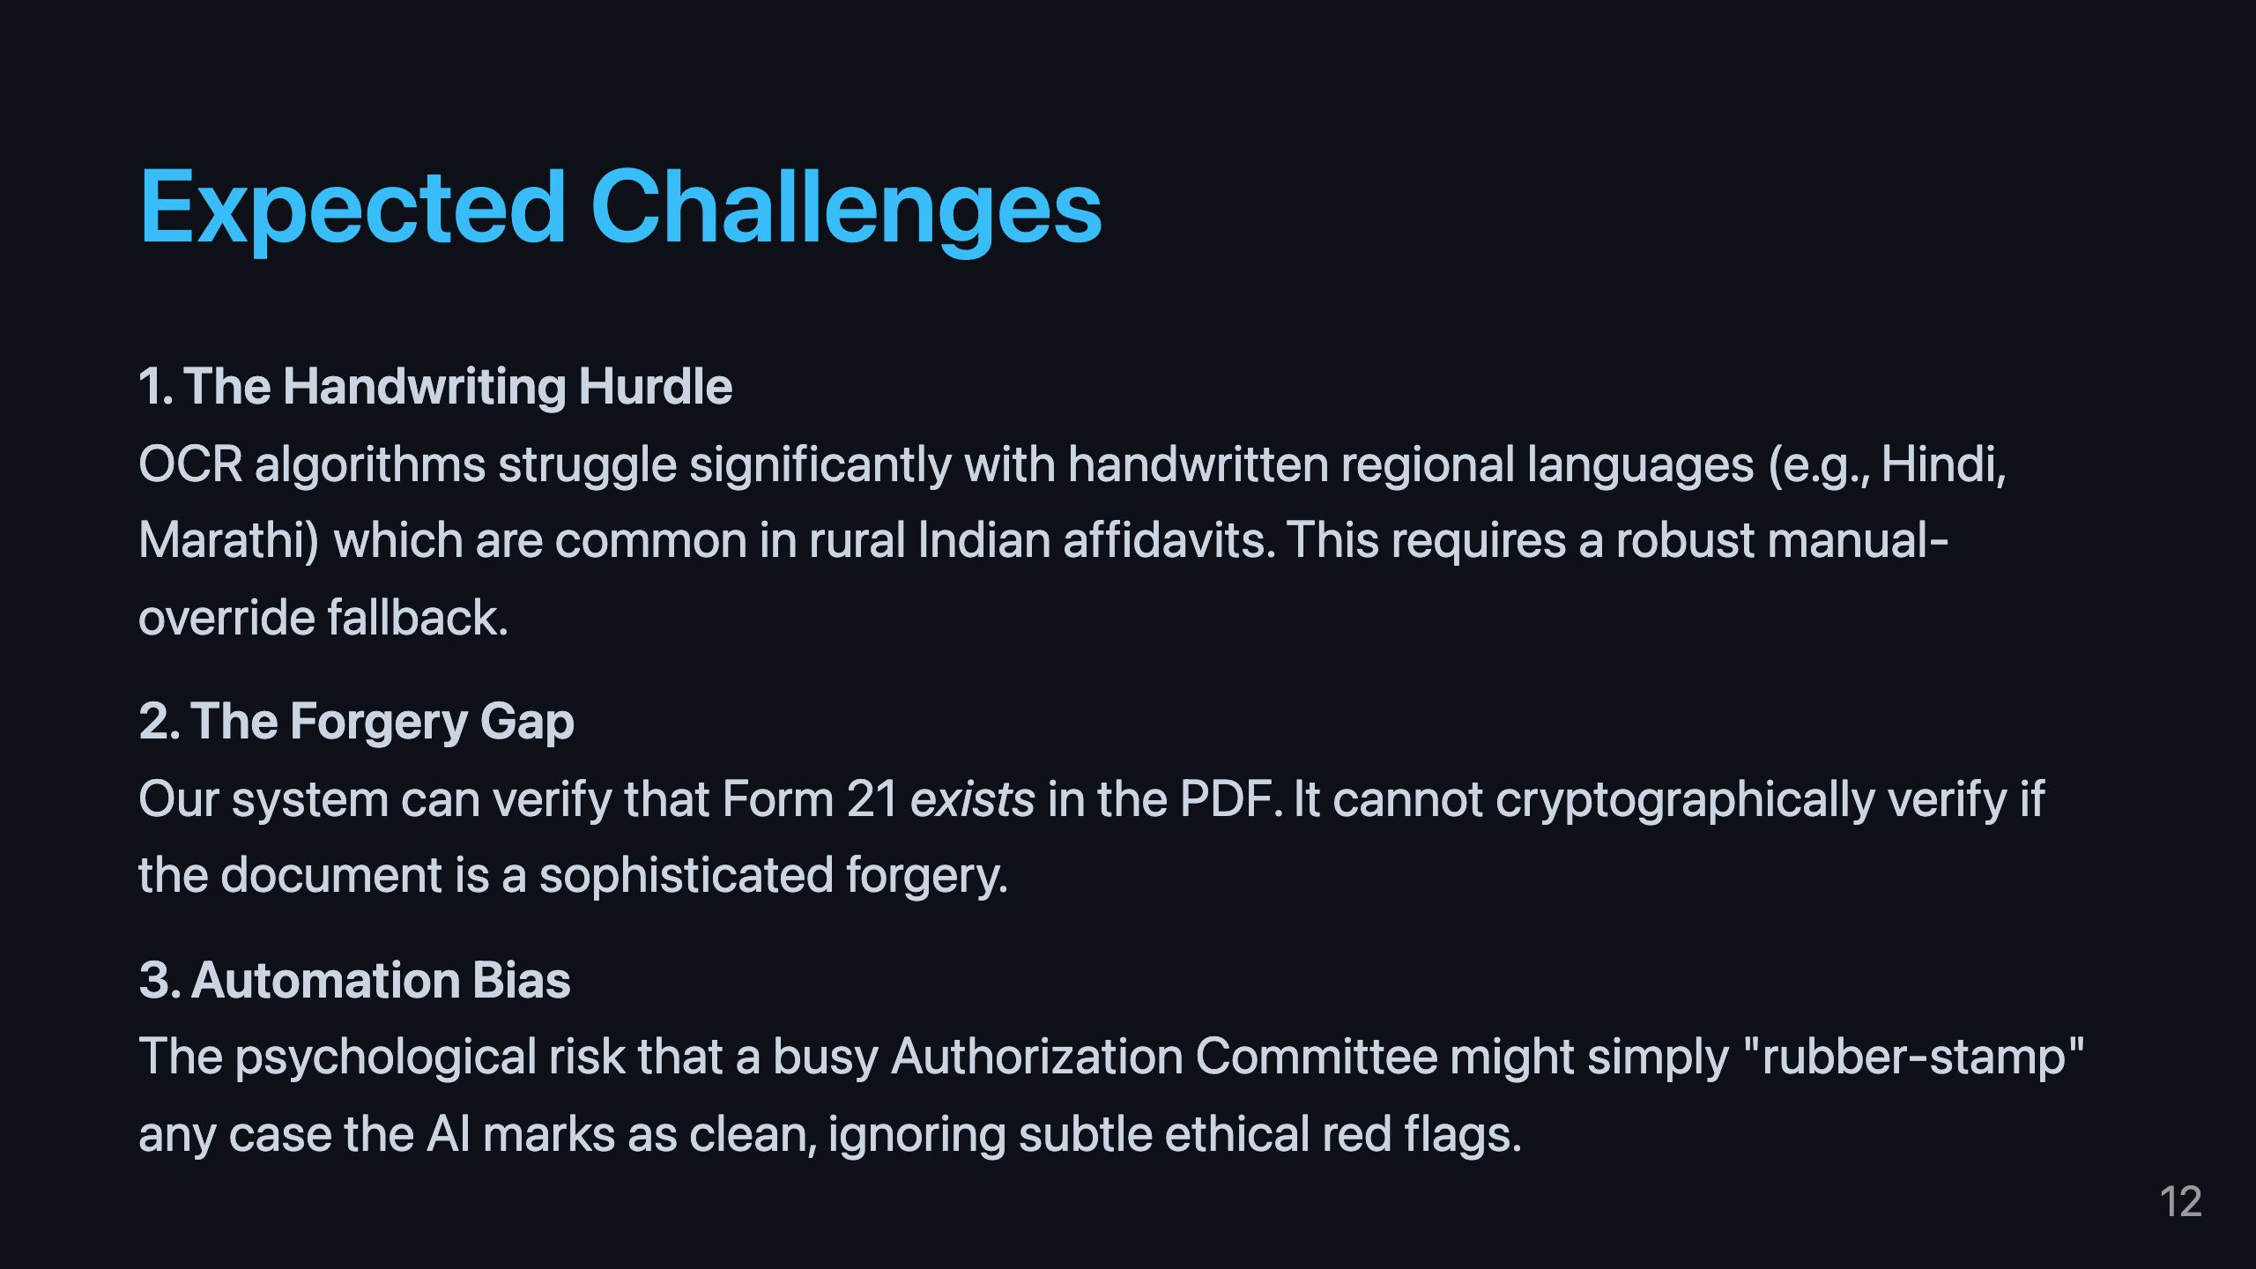
Notes:
We anticipate three main challenges: OCR failing on bad handwriting, the inability of software to detect physical forgery, and the ethical risk of automation bias, where humans become overly reliant on the machine's verdict.

Slide 13
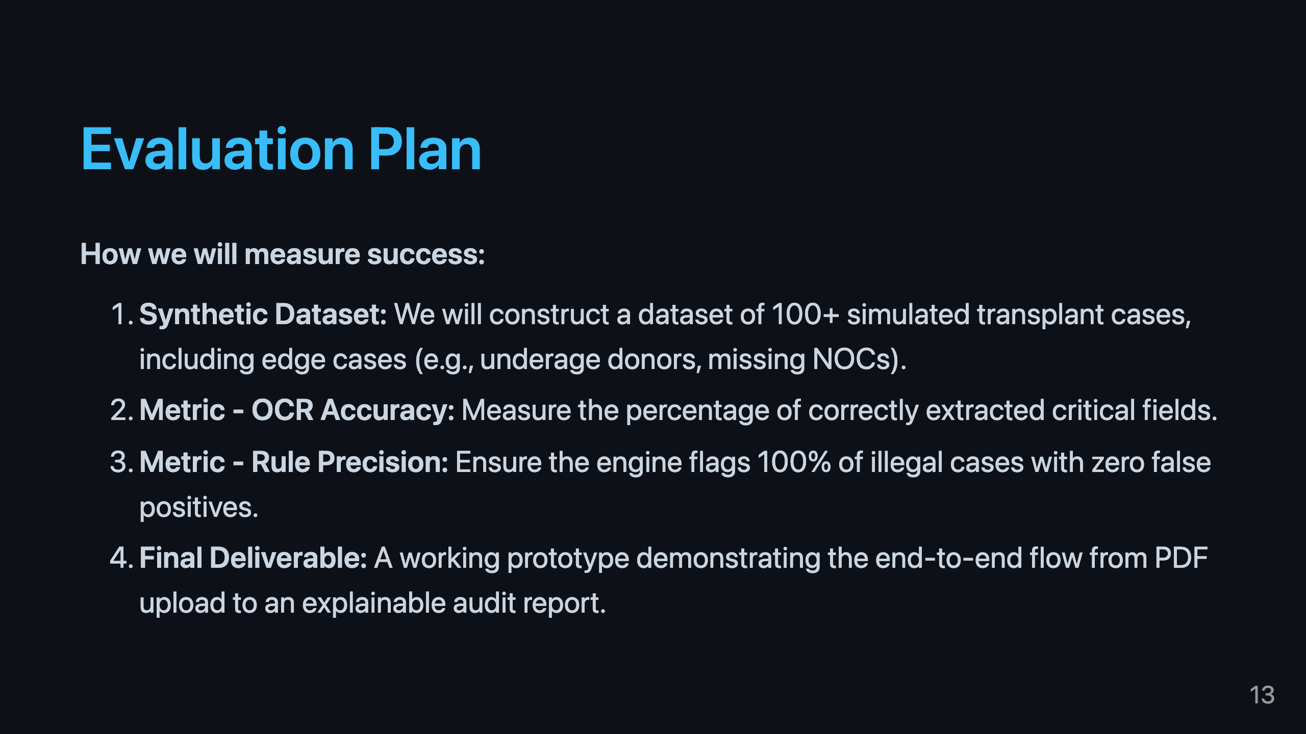
Notes:
To evaluate our system, we will build a comprehensive synthetic dataset of over 100 cases. Success will be defined by achieving zero false positives in our rule engine and delivering a fully working prototype.

Slide 14
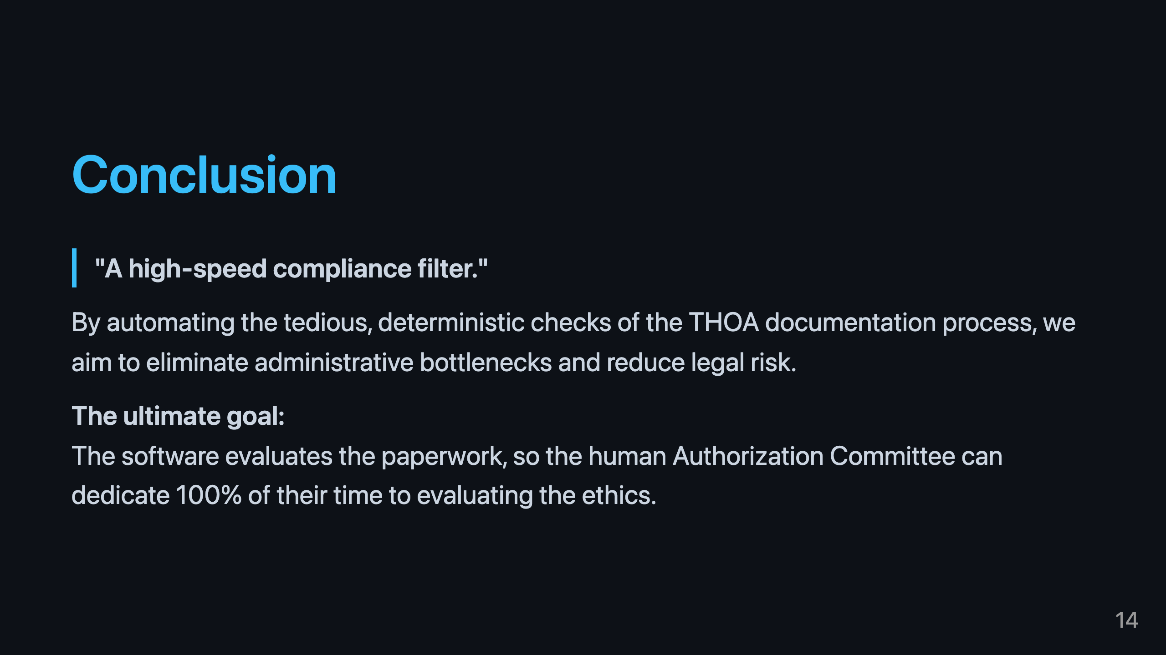
Notes:
In conclusion, this Copilot is a high-speed compliance filter. It takes the burden of paperwork off the humans, so they can focus on what they do best: ethical evaluation.

Slide 15
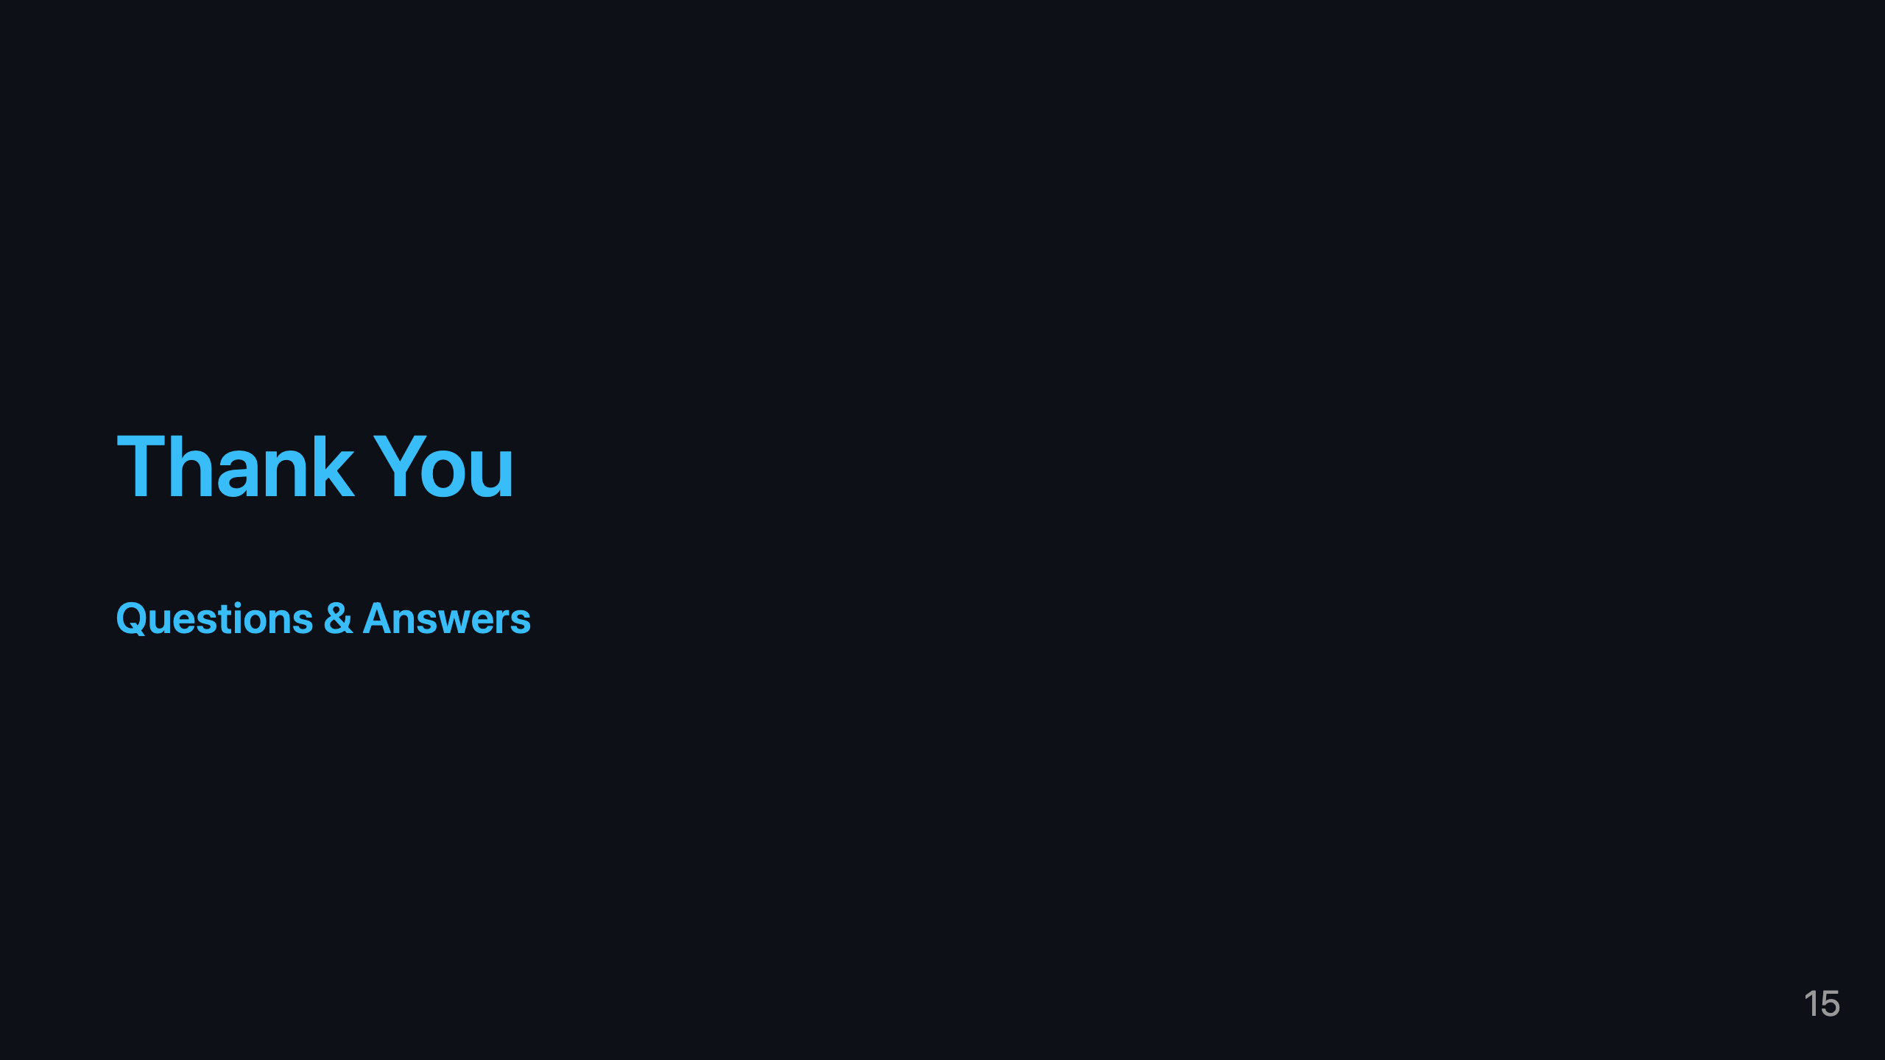
Notes:
Thank you for your time. We are happy to take any questions regarding the methodology, the architecture, or the ethical considerations.

Slide 16
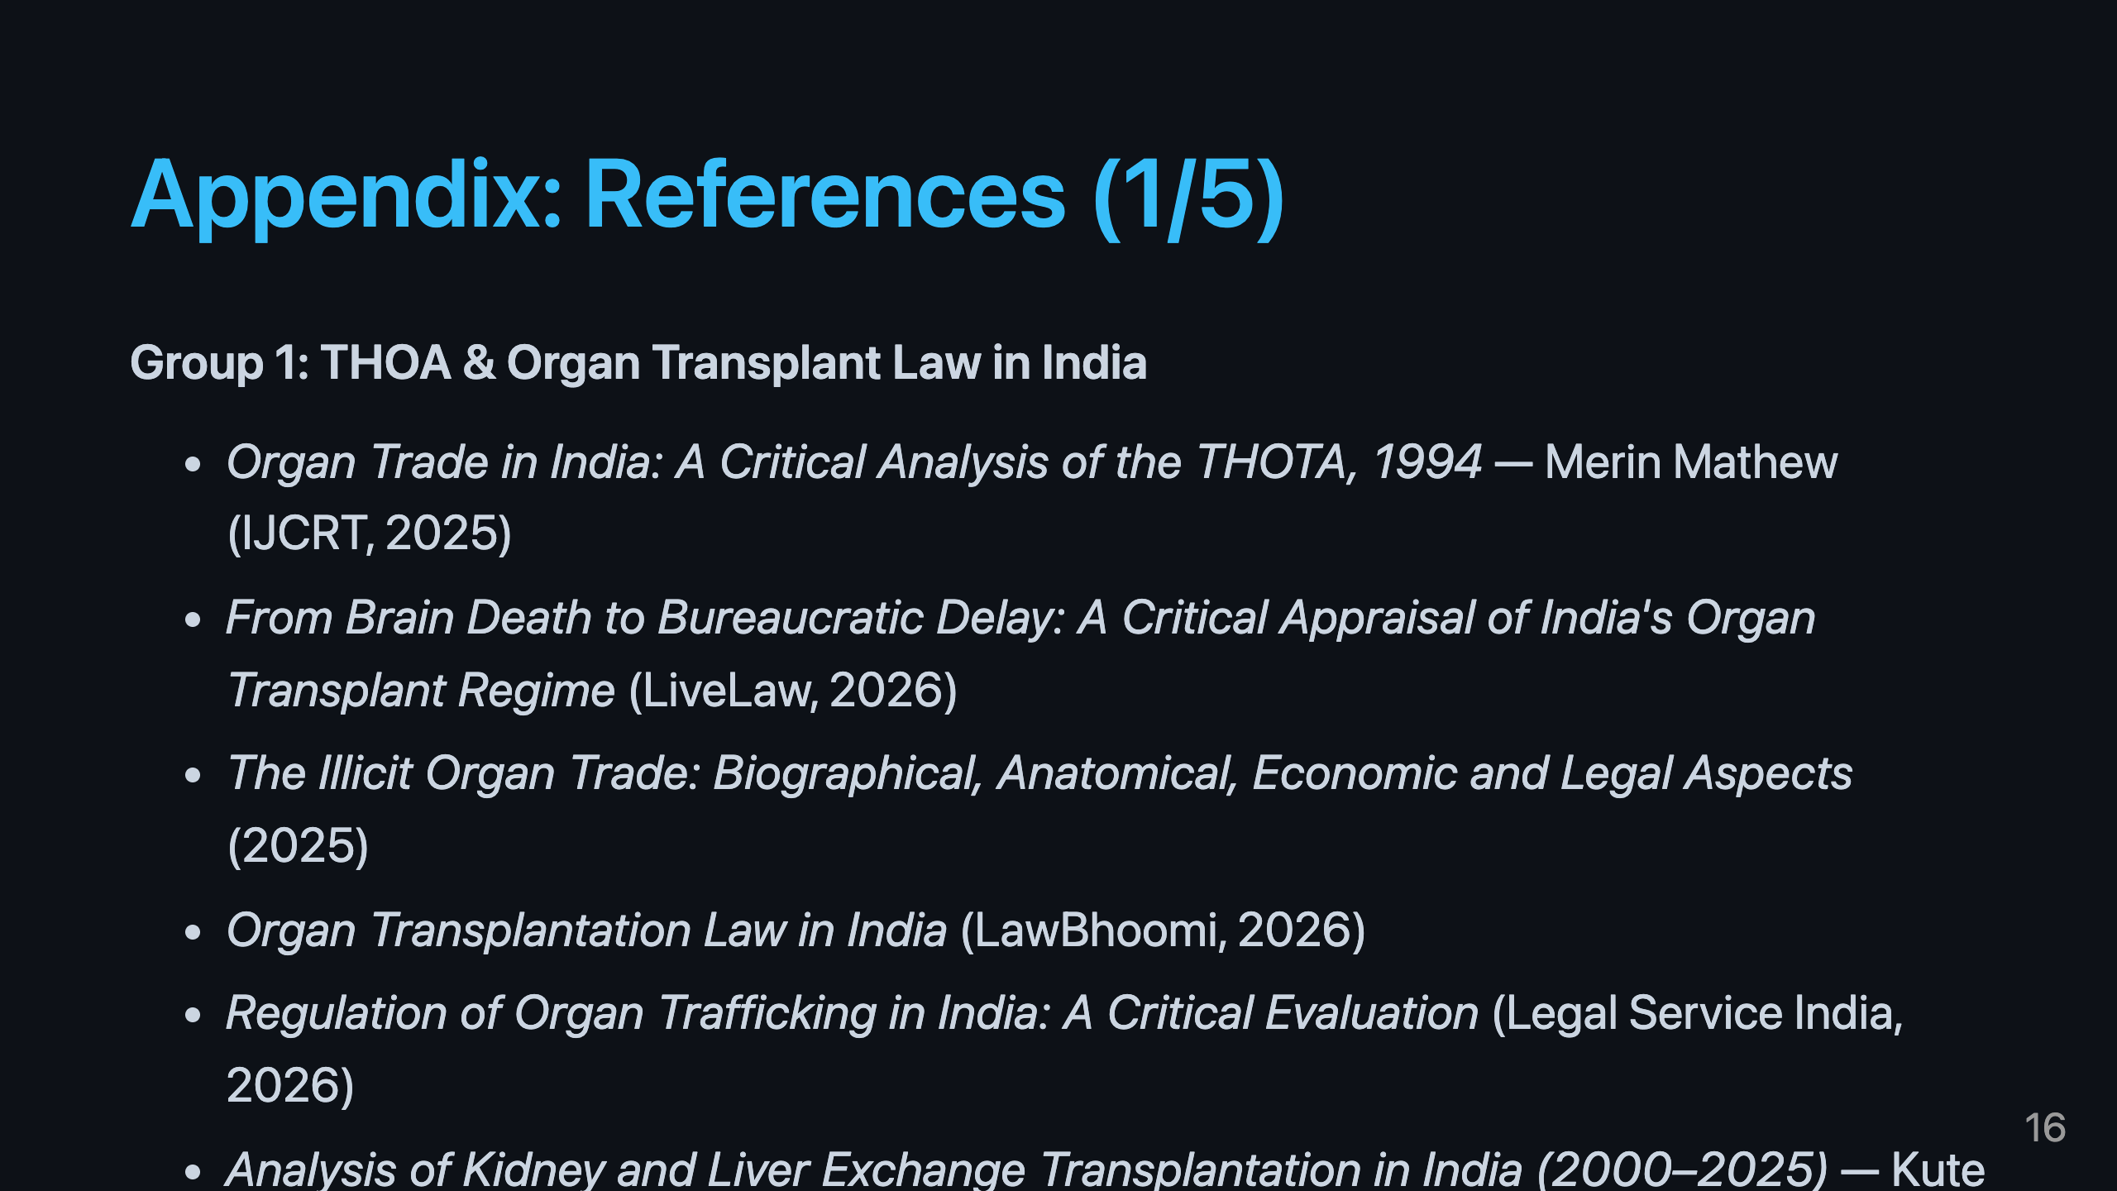

Slide 17
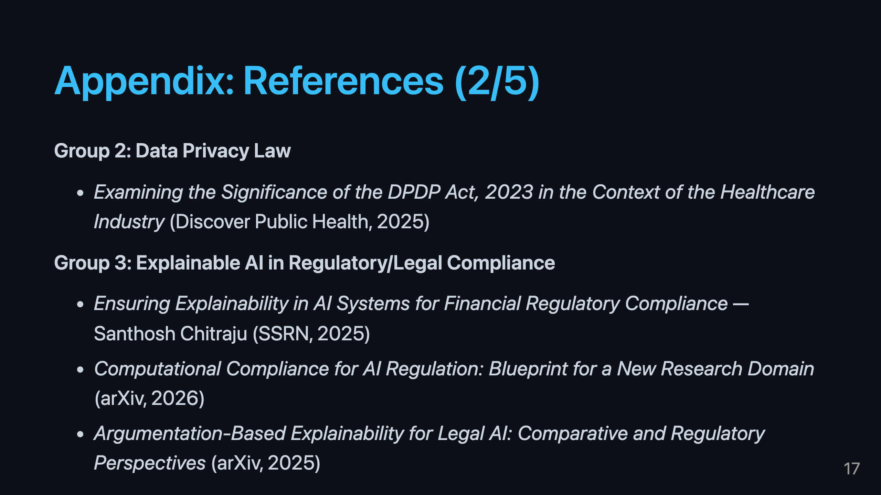

Slide 18
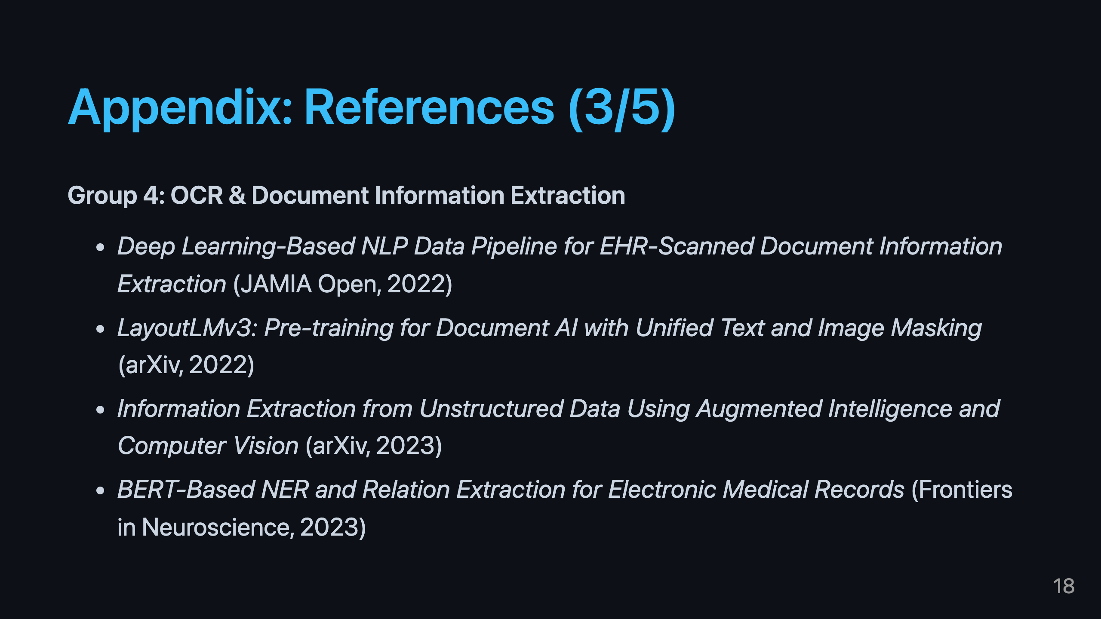

Slide 19
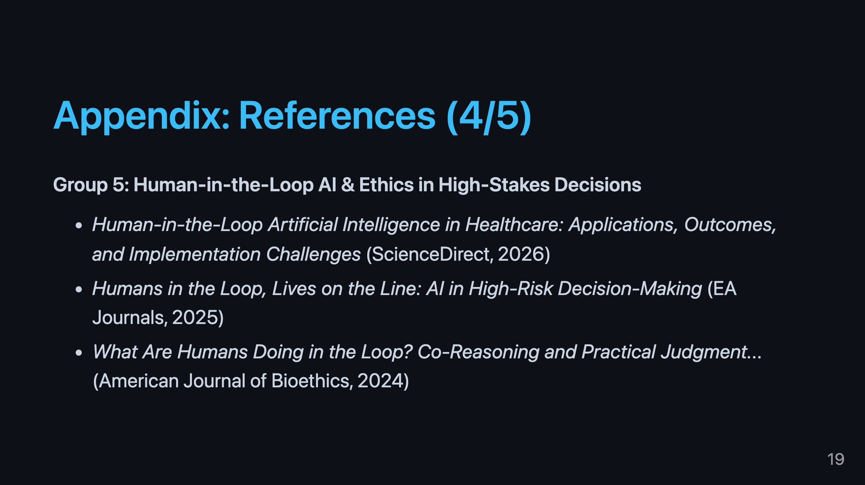

Slide 20
