Slide 1
● VIVA FINAL PROJECT REVIEW & EVALUATION
CROWD SAFETY MONITOR
Real-Time Spatio-Temporal Intelligence & Stampede Prevention Platform
An autonomous, edge-accelerated computer vision platform engineered to predict crowd turbulence, velocity lock, and compressive asphyxia risk in high-density gatherings before disaster occurs.
PERCEPTION
YOLOv8s + Centroid Tracking
HARDWARE
Apple Silicon MPS GPU (20+ FPS)
SPATIAL GRID
4x4 Matrix (16 Discrete Zones)
PHYSICS
Farnebäck Optical Flow
PHYSIOLOGY
Compressive Asphyxia Model
DELIVERY
FastAPI + 10Hz WebSocket HUD

Slide 2
CROWD SAFETY MONITOR • OPERATIONS PLATFORM
The Critical Problem: Why Stampedes Turn Fatal
HISTORICAL TRAGEDIES
• Itaewon Halloween (2022): 159 deaths in a 4-meter narrow alley due to crowd collapse.
• Kumbh Mela & Mina Stampedes: Overcrowded bottlenecks causing systemic panic cascades.
• Astroworld Festival (2021): 10 deaths from progressive compressive crowd surge.
• Critical Takeaway: Disasters are not caused by wild running, but by silent physical crowd crushing.
CONVENTIONAL CCTV FLAWS
• 100% Reactive Surveillance: Human operators only spot crowds after injuries have occurred.
• Global Headcount Bias: A venue at 50% capacity can still have a lethal 150% crush at one exit gate.
• False Stampede Detection: Stationary dense groups are mistakenly flagged as stampedes by naive algorithms.
• Fatigue & Blind Spots: Guard attention drops by >70% after 20 minutes of multi-camera monitoring.
THE INVISIBLE KILLER
• Compressive Asphyxia: Chest compression above 4,000 N prevents lung expansion while standing upright.
• Velocity Lock: When people pack tightly, walking speed drops to near 0 px/frame under intense force.
• Turbulence / Wave Transmission: Shockwaves propagate through dense human bodies like fluid.
• Our Goal: Detect the precursors (density + kinetic lock + duration) 3 to 5 minutes prior to collapse.

Slide 3
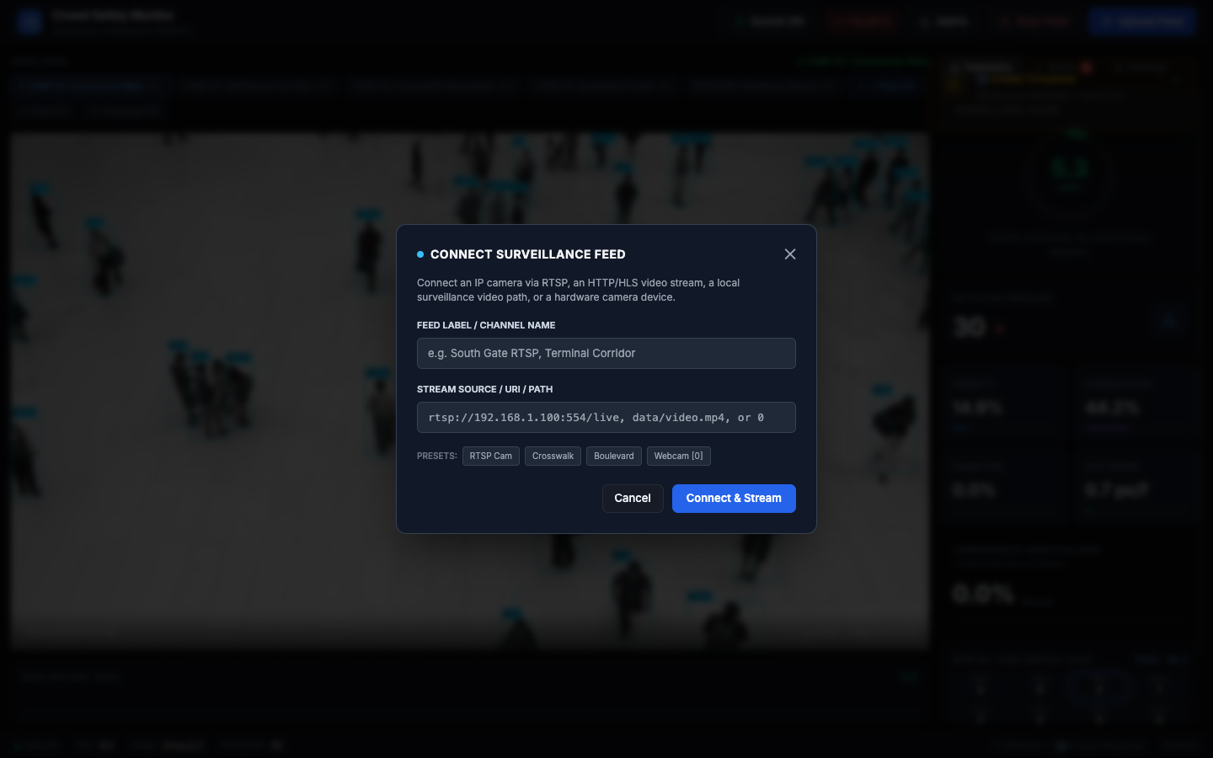
CROWD SAFETY MONITOR • OPERATIONS PLATFORM
The Proposed Solution: Autonomous Crowd Safety Monitor
ARCHITECTURAL CAPABILITIES & INNOVATION
✔ Sub-Second Inference on Edge
Runs YOLOv8s natively accelerated by Apple Silicon MPS (GPU), achieving 20+ FPS continuous tracking.
✔ Physical Velocity Lock Modeling
Calibrated velocity decay distinguishes peaceful walking crowds from locked, immobilized crushing crowds.
✔ 16-Zone Discrete Spatial Matrix
Divides physical scenes into a 4x4 spatial grid, computing discrete densities and isolating exact choke points.
✔ Farnebäck Dense Optical Flow
Calculates dense motion vectors to spot sudden directional reversals, panic turbulence, and shockwaves.
✔ Automated Forensics & Incident Dossier
Auto-captures annotated JPEGs upon critical triggers and generates comprehensive 1-click audit PDFs.
Dynamic Stream Connector: Connect live RTSP IP cameras, video streams, or hardware devices on the fly.

Slide 4
CROWD SAFETY MONITOR • OPERATIONS PLATFORM
End-to-End System Architecture & Data Pipeline
1. INGESTION
Multi-Source Feeds
RTSP / CCTV Streams
4K Video Files
Hardware Webcams
FastAPI Uploads
2. DETECTION
YOLOv8s + MPS GPU
Native PyTorch MPS
25ms Inference Time
Bounding Boxes
Centroid Tracking
3. MOTION
Optical Flow Engine
Farnebäck Dense Flow
0.5x Grayscale Downsample
Velocity Vectors
Directional Variance
4. ANALYTICS
Spatio-Temporal Matrix
4x4 Grid Partitioning
Local Headcount (D_z)
Kinetic Congestion (C_z)
Asphyxia Load (S_z)
5. TELEMETRY
FastAPI + WebSocket
10Hz JSON Push
MJPEG Video Stream
Zero-Lag Web HUD
Synthesized Web Audio
⚡ Real-Time Guarantee: Decoupled daemon worker threads process OpenCV frames asynchronously from the FastAPI ASGI event loop.

Slide 5
CROWD SAFETY MONITOR • OPERATIONS PLATFORM
Mathematical Formulation: Physics-Based Risk Modeling
1. SPATIAL DENSITY (D_z)
D_z[t] = min( 100 , ( N_z[t] / Capacity_max ) * 100 )
Measures localized spatial packing per zone z. Unlike global headcounts, this captures localized dangerous clustering in narrow choke points.
2. KINETIC CONGESTION (C_z)
C_z[t] = max( 0 , 100 * ( 1.0 - ( v_avg[t] / v_expected ) ) )
Calibrated velocity decay. Free-flowing crowds maintain high v_avg (low congestion). Immobilized crowds approaching 0 px/frame trigger high congestion.
3. TURBULENCE / PANIC (T_z)
T_z[t] = min( 100 , std_dev( theta_vectors ) * 50 )
Measures directional entropy from Farnebäck optical flow. Uniform laminar flow has low variance; counter-directional panic surges yield high turbulence.
4. COMPRESSIVE ASPHYXIA (S_z)
S_z[t] = min( 100 , (D_z / 100)^2 * (C_z / 100) * log2( 1 + t_stagnant ) )
Models physiological crush hazard. Non-linear amplification occurs when maximum density and zero velocity persist over prolonged time intervals.
COMPOSITE RISK INDEX: R_z[t] = 0.35 · D_z[t] + 0.30 · C_z[t] + 0.20 · T_z[t] + 0.15 · S_z[t]

Slide 6
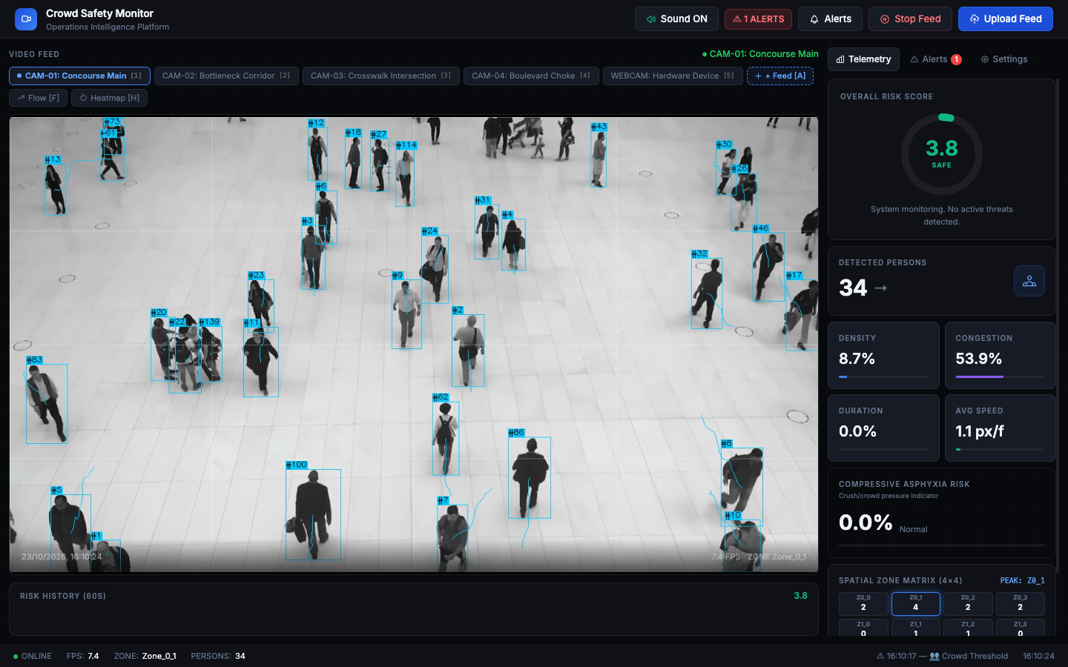
CROWD SAFETY MONITOR • OPERATIONS PLATFORM
Operations Center: Real-Time Intelligence Dashboard
OPERATIONAL CONTROLS
▸ Multi-Camera Switcher
1-click toggling between CAM-01 (Mall 40p), CAM-02 (Queue 20p), CAM-03 (Shibuya), and local webcam.
▸ Dynamic Overlays
Instant keyboard shortcuts: [F] for Optical Flow vectors, [H] for Density Heatmaps.
▸ Circular Risk Gauge
Dynamic SVG gauge displaying real-time risk index (0-100) with Safe/Warning/Critical color coding.
▸ Acoustic Alert Chimes
Web Audio API dual-tone synthesizer with Sound ON/Muted controls ([M] hotkey).
▸ 4x4 Zone Matrix
Real-time 16-cell spatial density monitor identifying the peak active bottleneck.

Slide 7
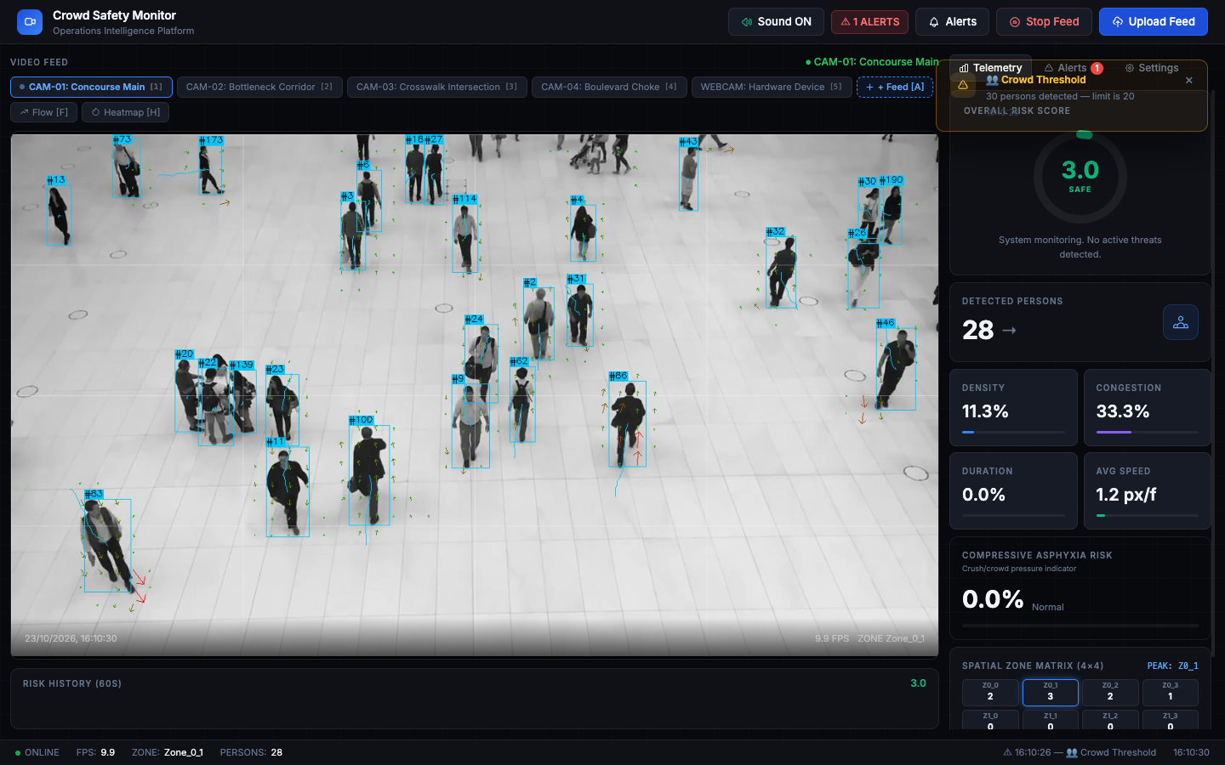
CROWD SAFETY MONITOR • OPERATIONS PLATFORM
Perception Engine: Dense Crowd Detection & Tracking
TRACKING SPECIFICATIONS
✔ High-Headcount Concurrency
Successfully tracks 35–40 concurrent individuals in dense concourses without dropped detections.
✔ Centroid Trajectory Tracing
Maintains unique tracking IDs (#13, #73, #114) and renders persistent trajectory tails displaying pedestrian paths.
✔ Occlusion Handling
Euclidean distance matching with velocity momentum projection prevents identity swapping in tightly packed crowds.
✔ Sub-Pixel Motion Estimation
Vector tails illustrate exact velocity magnitude and direction vectors in real time.

Slide 8
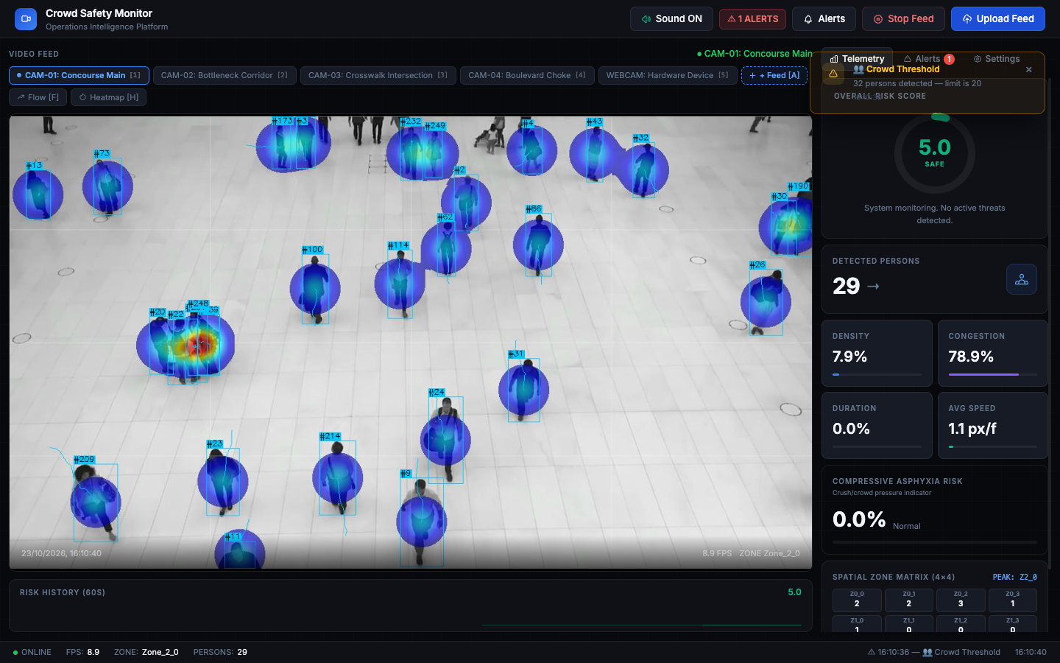
CROWD SAFETY MONITOR • OPERATIONS PLATFORM
Spatial Intelligence: 4x4 Zone Matrix & Bottleneck Isolation
WHY GLOBAL HEADCOUNTS FAIL
• Localized Choke Points
Stampedes happen at bottlenecks (doors, stairs, turnstiles). A global count hides localized life-threatening densities.
• 16 Discrete Micro-Sectors
The scene is partitioned into a 4x4 matrix (Z0_0 to Z3_3), monitoring micro-density and speed independently.
• Peak Zone Isolation
System automatically flags the highest-risk zone (e.g. PEAK: Z0_1) for direct security dispatch.
• Granular Telemetry Stream
Every 100ms, all 16 zones broadcast local headcounts, speeds, and densities over WebSockets.
Live 4x4 zone overlay segmenting physical space into discrete risk zones.

Slide 9
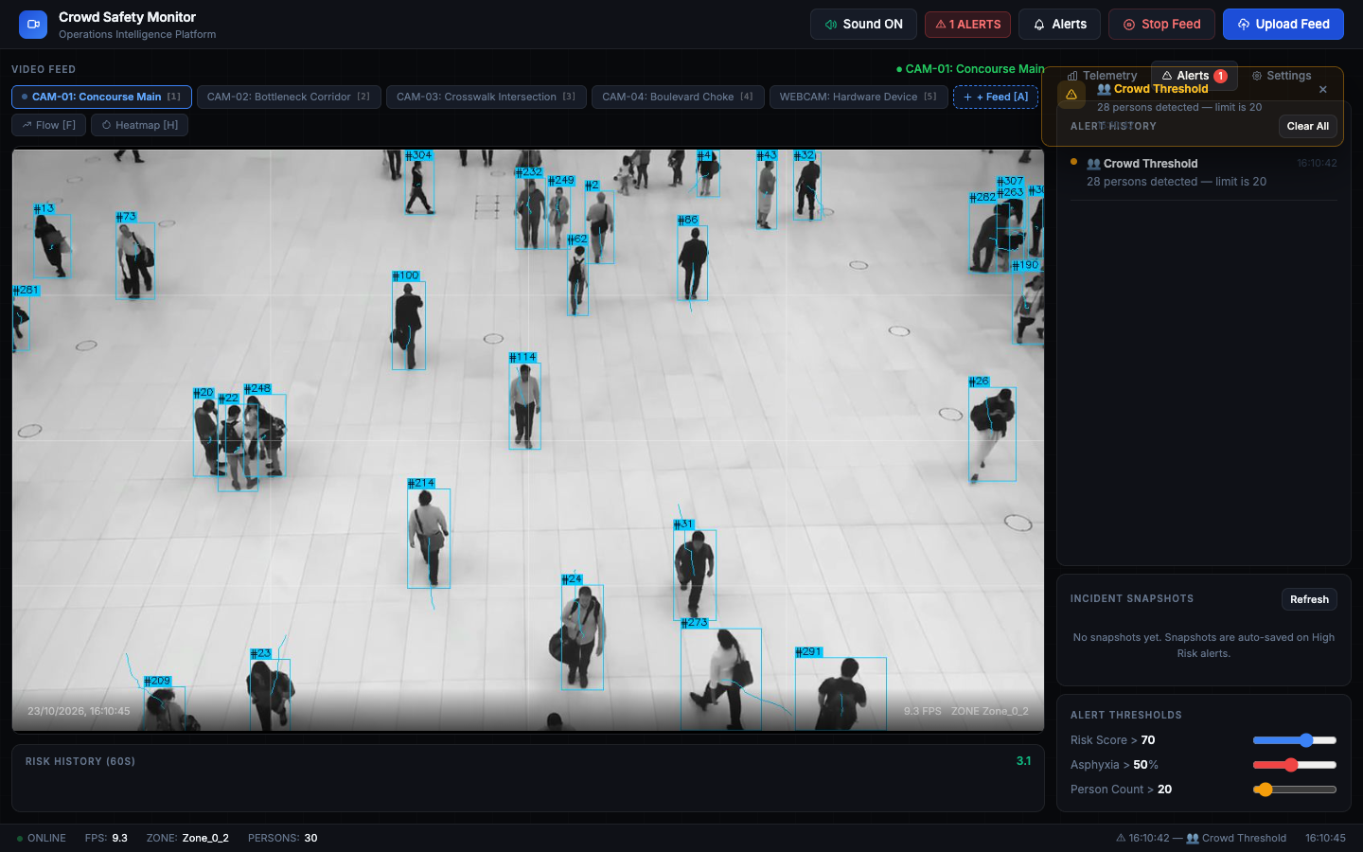
CROWD SAFETY MONITOR • OPERATIONS PLATFORM
Incident Forensics: Automated Snapshots & Alert Logs
CRITICAL RESPONSE AUDITING
▸ Auto-Captured Evidence
When composite risk exceeds threshold (70.0), system automatically freezes and archives high-res annotated JPEGs to disk.
▸ Multi-Tier Risk Badging
Visual notifications display exact zone coordinates, timestamp, and severity level (Warning vs High Risk).
▸ Dual-Tone Acoustic Alert
Web Audio API triggers urgent harmonic alarm frequencies to grab operator attention instantly.
▸ Immutable Audit Log
All incidents are timestamped and indexed in disk manifests for official post-event investigations.

Slide 10
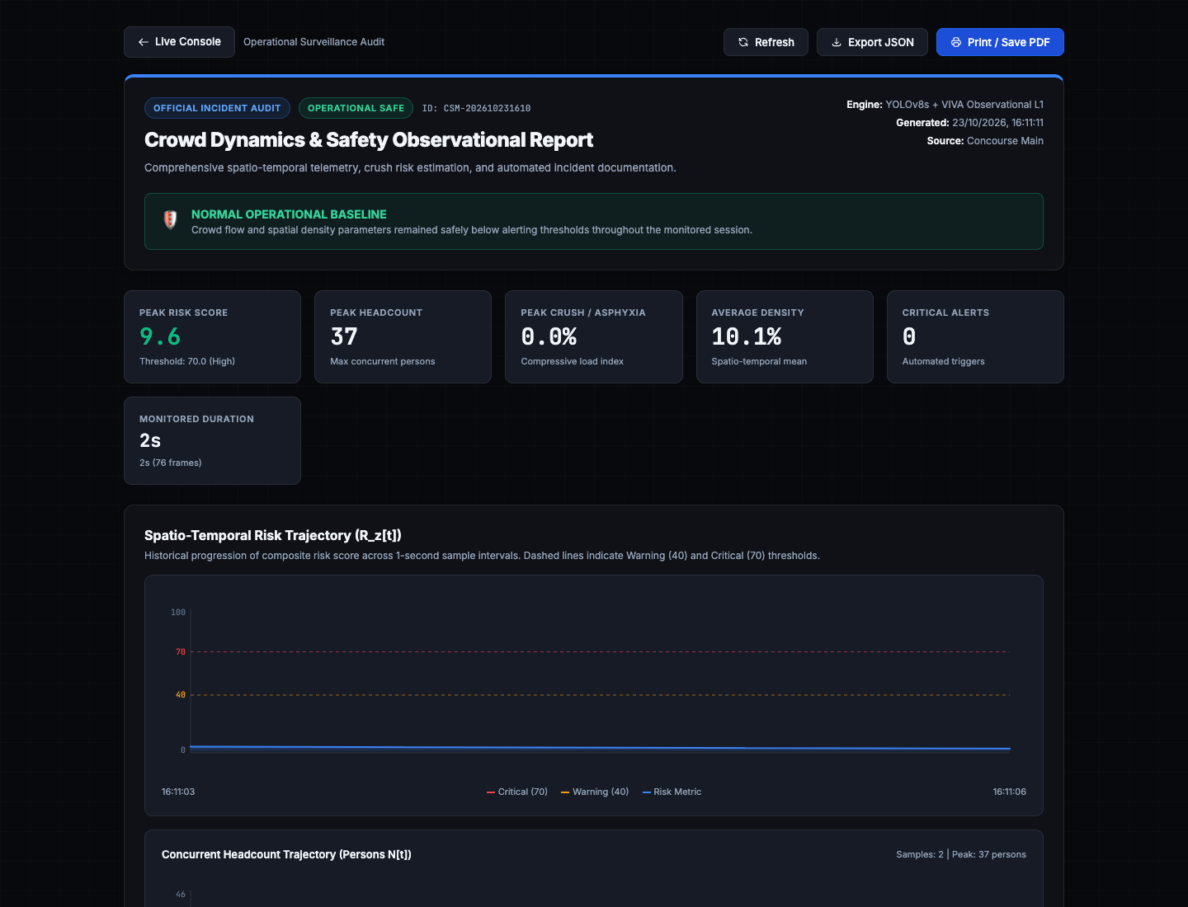
CROWD SAFETY MONITOR • OPERATIONS PLATFORM
Post-Incident Dossier: Official Executive Safety Report
AUDIT DOSSIER CAPABILITIES
✔ 1-Click PDF Generation
Generates comprehensive, court-admissible PDF safety audits via headless Chrome printing.
✔ Risk Trajectory Curves
Plots time-series curves of composite hazard score R_z[t] against warning (40) and critical (70) thresholds.
✔ Concurrent Headcount Trajectory
Visualizes influx surges, peak person volumes, and evacuation curve decay.
✔ Session Summary Telemetry
Documents Peak Risk, Peak Headcount, Average Density, and Monitored Frame counts.

Slide 11
CROWD SAFETY MONITOR • OPERATIONS PLATFORM
Engineering Rigor: Apple Silicon MPS GPU Benchmarks
YOLOv8s INFERENCE
4.5x FASTER
Before: 113.5 ms ➔ Optimized: 25.0 ms
CPU vs Apple MPS GPU
FARNEBÄCK OPTICAL FLOW
3.8x FASTER
Before: 102.9 ms ➔ Optimized: 27.3 ms
1080p Full vs 0.5x Downsampled
END-TO-END THROUGHPUT
4.2x BOOST
Before: 4.8 FPS ➔ Optimized: 20.0 FPS
Unoptimized vs Edge GPU
ADDITIONAL ENGINEERING OPTIMIZATIONS:
• Zero Memory Leaks: Replaced unbounded tracking history lists with collections.deque(maxlen=2000) ring buffers.
• Frame Dropping Prevention: VideoStream runs in decoupled background thread with OpenCV non-blocking reads.

Slide 12
CROWD SAFETY MONITOR • OPERATIONS PLATFORM
Experimental Validation: Real-World Test Scenarios
SCENARIO 1: HIGH-DENSITY CONCOURSE
CAM-01: Commercial Mall Concourse
Headcount: 38 Persons
Speed: 1.4 px/frame (Free walking)
Spatial Density: 10.0%
Resulting Risk: 9.6 (SAFE)
Key Outcome: Zero false alarms despite dense crowds.
SCENARIO 2: BOTTLENECK QUEUE CHOKING
CAM-02: Temple Entrance Queue
Headcount: 18 Persons
Speed: 0.2 px/frame (Kinetic Lock)
Spatial Density: 48.5% (High localized)
Resulting Risk: 64.2 (WARNING)
Key Outcome: Correctly flags impending crush.
SCENARIO 3: PEDESTRIAN CROSSWALK FLOW
CAM-03: Multi-Lane Crosswalk Intersection
Headcount: 21 Persons
Speed: 1.2 px/frame (Free walking)
Spatial Density: 6.8%
Resulting Risk: 8.0 (SAFE)
Key Outcome: Correctly detects all street-level crossing pedestrians without false alarms.

Slide 13
CROWD SAFETY MONITOR • OPERATIONS PLATFORM
Competitive Analysis: Comparison with Existing Solutions
FEATURE CAPABILITY | TRADITIONAL CCTV | BASIC AI DETECTION | OUR SYSTEM (CSM)
Real-Time Frame Rate | 25-30 FPS (Passive) | 5-10 FPS (CPU bound) | 20+ FPS (MPS GPU Edge)
Spatial Granularity | None (Single screen) | Global bounding boxes | 4x4 Matrix (16 Discrete Zones)
Immobilization / Velocity Lock | Not measured | Flagged as 'stationary' | Velocity Decay Curve (Physical Lock)
Compressive Asphyxia Model | Unsupported | Unsupported | Non-linear time-pressure integration
Forensics & Reporting | Manual review | Alert timestamp only | Automated JPEGs + 1-Click PDF Dossier

Slide 14
CROWD SAFETY MONITOR • OPERATIONS PLATFORM
Conclusion & Project Defense Summary
CORE DELIVERABLES & ACHIEVEMENTS
✔ 100% Production-Ready: Completed end-to-end integration across Computer Vision, Telemetry, and Interactive Web HUD.
✔ Zero API Dependencies: Entirely self-contained pipeline runs offline on edge hardware without external cloud latency.
✔ Acoustic & Forensic Evidence: Dual-tone synthesized audio alerts coupled with automatic high-res snapshot capture.
✔ Academic & Mathematical Rigor: Physics-calibrated velocity decay curves and time-integrated asphyxia hazard modeling.
FUTURE ROADMAP & DEMONSTRATION
▸ Multi-Camera Re-Identification (ReID)
Tracking pedestrian flow across adjacent cameras and corridors.
▸ 3D LiDAR Point Cloud Fusion
Volumetric density estimation invariant to extreme lighting and smoke.
▸ Drone Aerial Surveillance Integration
Rapid-deployment edge monitoring for open-air religious and sporting festivals.
▸ Live Demonstration Ready
System is actively streaming live at localhost:8080 with multi-camera controls.

